Slide 1
SENTIMENT ANALYSIS OF CUSTOMER TWEETS FOR GOOGLE AND APPLE PRODUCTS
NiaTech Inc.

Slide 2

OUTLINE
Business Understanding
Modelling
Evaluation
Conclusion
Recommendations
Data preparation

Slide 3
OVERVIEW
Customer sentiments are a key concern in the Tech Retail Industry.
By accurately identifying customer sentiments, NiaTech can tailor its marketing efforts, optimize product offering and reduce the risk of costly missteps in customer engagements.
The insights derived from sentiment analysis will empower NiaTech to refine its marketing strategy. By leveraging customer feedback, NiaTech can foster brand loyalty, drive sales and position itself for long-term success in a competitive market.

Slide 4
DEVELOP A MACHINE LEARNING MODEL TO CORRECTLY CLASSIFY SENTIMENTS IN TWEETS AS POSITIVE, NEGATIVE, OR NEUTRAL REGARDING APPLE AND GOOGLE PRODUCTS.
IDENTIFY AND ANALYZE WHICH PRODUCT HAS THE HIGHEST AND LOWEST SENTIMENT SCORES, HIGHLIGHTING AREAS FOR POTENTIAL IMPROVEMENT.
ASSESS THE OVERALL SENTIMENT TRENDS TOWARDS APPLE AND GOOGLE TO INFORM NIATECH’S STRATEGIC DECISION ON CONTINUING PARTNERSHIPS WITH THESE COMPANIES.
OBJECTIVES

Slide 5
DATA UNDERSTANDING & PREPARATION
The dataset for this project, sourced from https://data.world/crowdflower/brands-and-product-emotions consists of 3 columns and 9093 rows.
The dataset underwent cleaning, including checking for duplicated rows and missing values and renaming columns.
Text pre-processing was undertaken to remove URLs and punctuations, fix contracted words, remove stop words and apply stemming and lemmatization.

Slide 6
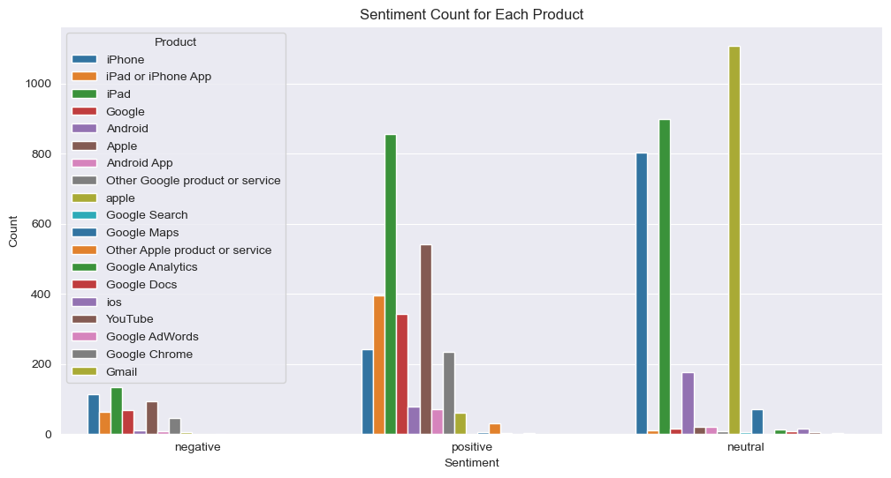
SENTIMENT COUNT FOR EACH PRODUCT
The product column is divided into several classes that can be primarily categorized into two groups: Apple and Google. From our observations, Apple products are dominant in all the sentiment classes possibly pointing to the fact that majority of the consumers interact with Apple products.

Slide 7
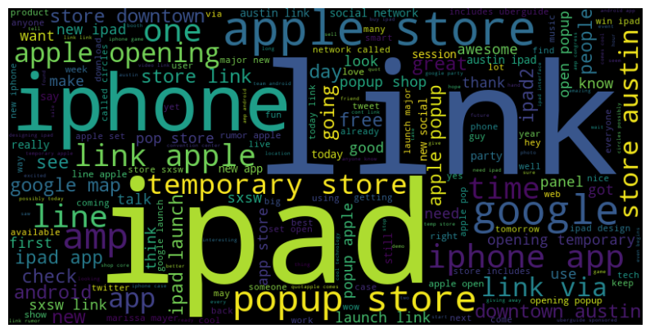
WORD FREQUENCY
The word cloud below shows word frequency in our tweet dataset, with larger fonts indicating more common words. This visually highlights key themes and trends, making it easier to analyze and interpret the data at a glance.

Slide 8
MODELLING
Classification modeling algorithms used:
Support Vector Machine (SVM)
Naive Bayes
Random Forest
Logistic Regression
NLP-SVC Model

Slide 9
Winning Model: NLP Model with Grid Search CV
Surpassed other models with a high overall accuracy score of 88% making it more reliable for sentiment analysis tasks.
1
Strong across all classes, especially in the negative class (F1: 0.96), with improvements in neutral and positive sentiment detection.
2
These strengths highlight the model's potential for delivering valuable insights into customer sentiment and guiding effective marketing strategies.
4
The overall balance in performance across categories reflects a well-rounded model suitable for nuanced sentiment analysis.
3

Slide 10
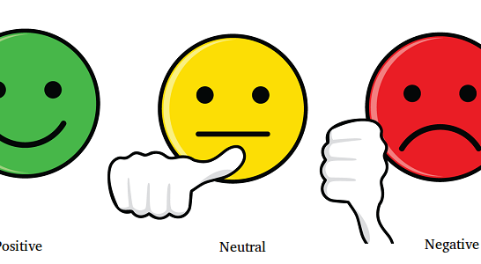
CONCLUSION
The larger share of sentiments were directed to the Apple Products, pointing to the fact that the brand was more dominant compared to google products
Neutral sentiments towards the products was higher compared to the positive and negative sentiments
By investigating recurring topics associated with positive and negative sentiments using a word cloud for each sentiment, we gained valuable insights into the prevailing themes that influence public perception of Google and Apple.

Slide 11
RECOMMENDATIONS
Enhanced customer engagement is recommended to deduce the exact feeling towards the brand or product where the sentiment is majorly neutral
Increased Marketing and Advertising spend for Google brand to balance market dominance with Apple.
Allocate budget towards a tuned NLP model for sentiment classification. This will reduce human bias and improve accuracy.
Tailored Marketing Campaigns; develop targeted marketing strategies for different sentiment groups.
Proactive/Continuous sentiment monitoring. This will allow NiaTech to identify and address potential issues before they escalate into negative trends

Slide 12
NEXT STEPS
Incorporate more advanced natural language processing techniques and machine learning algorithms to enhance the accuracy of sentiment classification
Extend the analysis over a longer time period to observe trends and changes in sentiment over time
Analyze sentiment based on user demographics such as age, gender and location.
Develop predictive models to anticipate shifts in sentiment

Slide 13

APPRECIATION

