Slide 1
FIT3143 Week 8 Lab 2
Open MPI and Hybrid OpenMP Prime Search
Savin Vindiv De Alwis (35221631)
Willwara Arachchilage Shamle Imal Thilaksiri (35512075)
7-minute presentation

Slide 2
Experimental environment and correctness
Single-node local Open MPI environment
Independent output validation
• WSL2 Ubuntu, Open MPI 4.1.6
• Intel Core i7-13700H: 14 physical cores, 20 logical CPUs
• n = 60,000,000; 4 MPI ranks × 2 OpenMP threads
• Median of three end-to-end runs for scaling results
• End-to-end time includes communication, root merge, and file writing
Both Task 1 and Task 2 produced 3,562,115 primes.
A separate sieve compared every output value against all expected primes below n.
Result: sorted, unique, complete, and prime-only output.

Slide 3
Task 1 workload distribution
Odd candidates only. Rank r owns indices r, r+p, r+2p, …
Cyclic ownership balances candidate magnitude as well as count. Each rank receives a mix of cheap composites and expensive large prime candidates. Rank 0 merges sorted rank lists in O(m log p) while writing the output.
Measured 4-rank balance at n = 60M
Rank 0: 6.418 s Rank 1: 6.393 s
Rank 2: 6.385 s Rank 3: 6.497 s
Candidate-count range: 7,499,999–7,500,000
Max/min computation-time ratio: 1.017
Conclusion: cyclic partitioning is balanced for the non-uniform trial-division kernel.

Slide 4
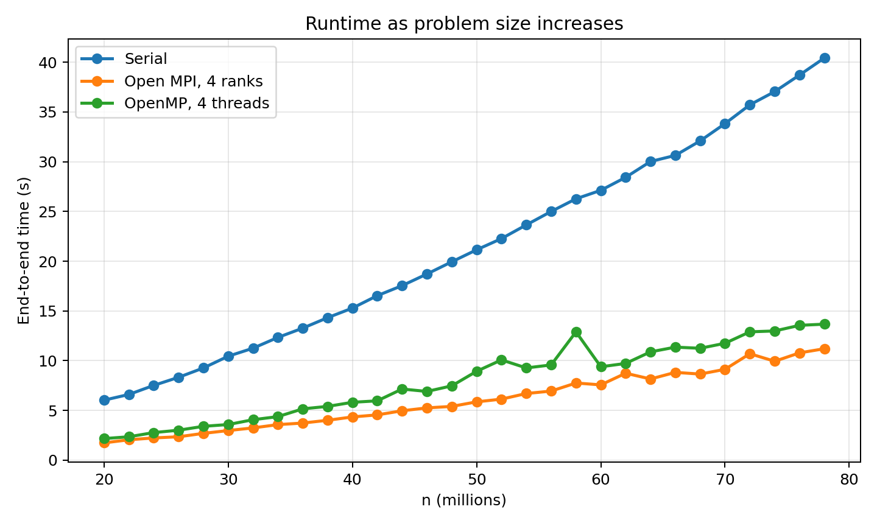
Task 1 runtime as n increases
Notes:
Source: results/n_scaling.csv and results/openmp_n_scaling.csv.

Slide 5
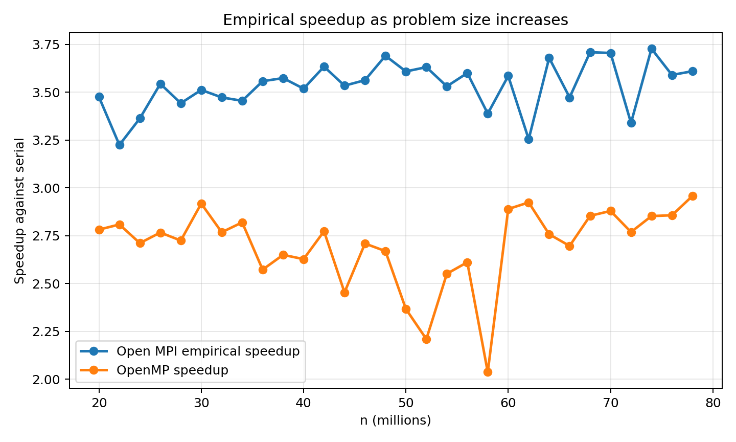
Task 1 empirical speedup as n increases
Notes:
Source: results/n_scaling.csv and results/openmp_n_scaling.csv.

Slide 6
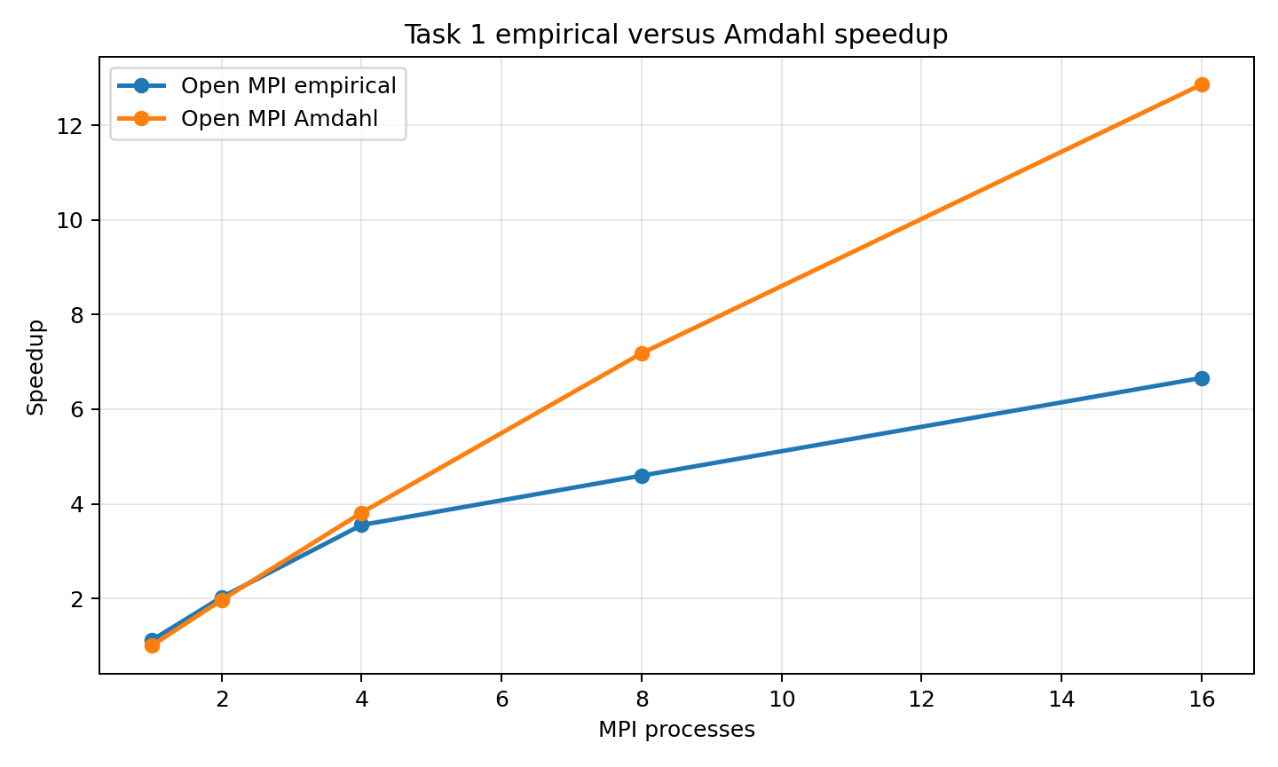
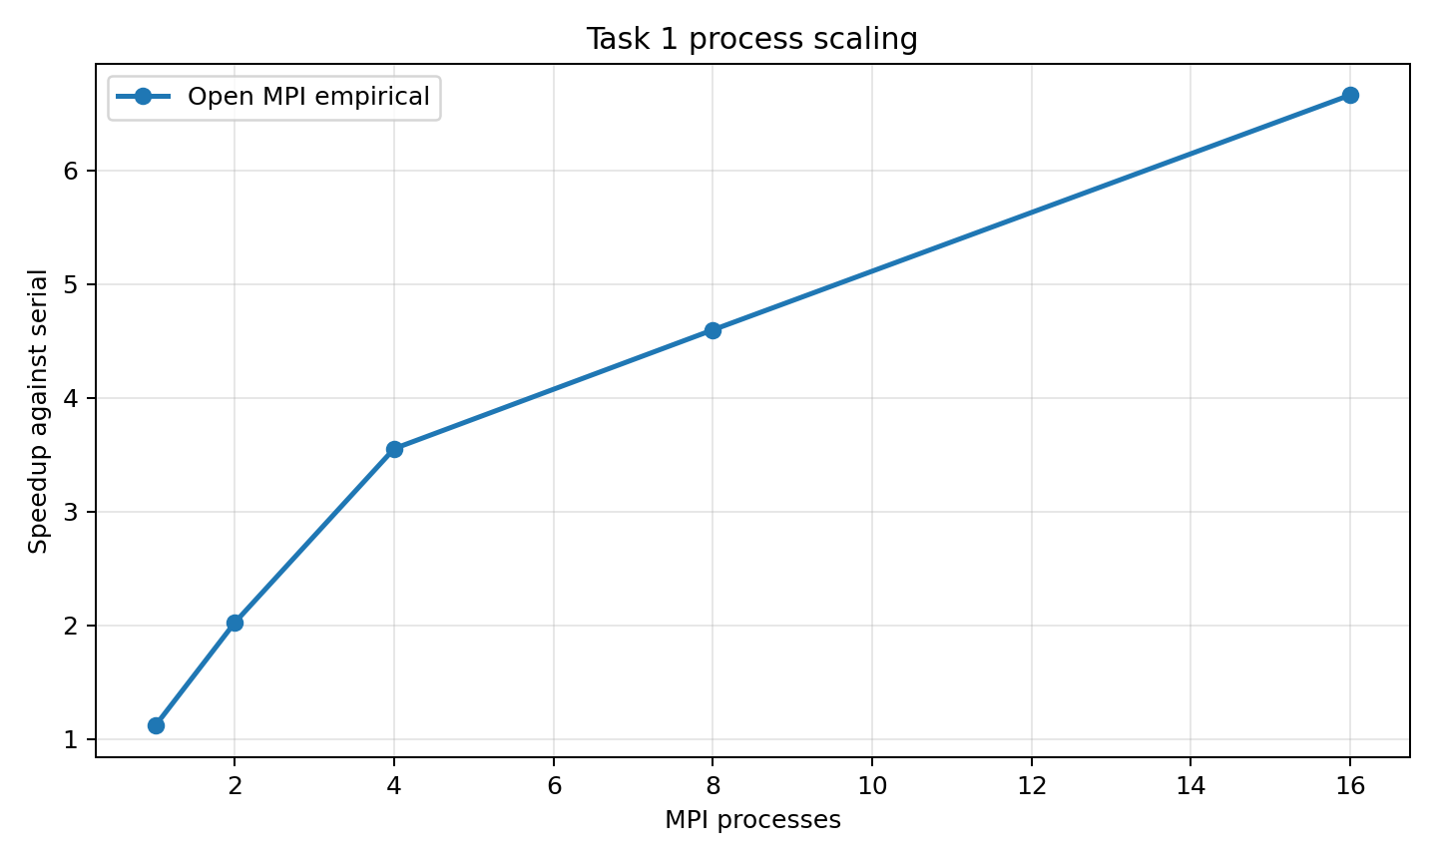
Task 1 process scaling and Amdahl analysis
At 16 MPI ranks, empirical speedup is 6.66×. The Amdahl curve is higher because it does not model increasing collective latency or root-only file output.
Notes:
Source: results/task1_process_scaling.csv.

Slide 7
Task 2 hybrid decomposition
MPI distributes cyclic candidate sets across processes. Each process applies OpenMP dynamic scheduling to its local candidates.
Measured 4-rank × 2-thread balance at n = 60M
Task 2 result
Rank 0: 4.264 s Rank 1: 4.434 s
Rank 2: 4.493 s Rank 3: 4.431 s
Candidate-count range: 7,499,999–7,500,000
Max/min computation-time ratio: 1.054
4 ranks × 2 threads
5.054 s representative run
6.97 s Task 1 representative run
Hybrid reduces elapsed time while retaining globally ordered output.
Dynamic OpenMP scheduling smooths residual cost variation after MPI’s cyclic partitioning.

Slide 8
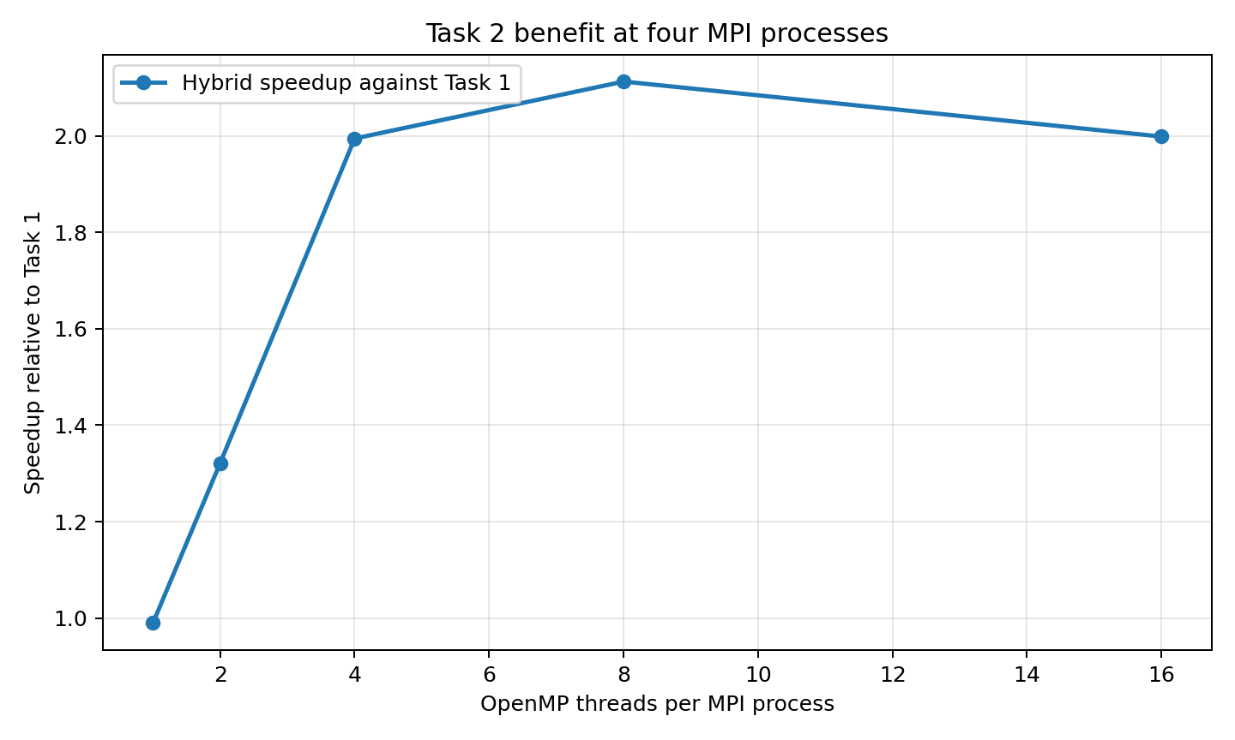
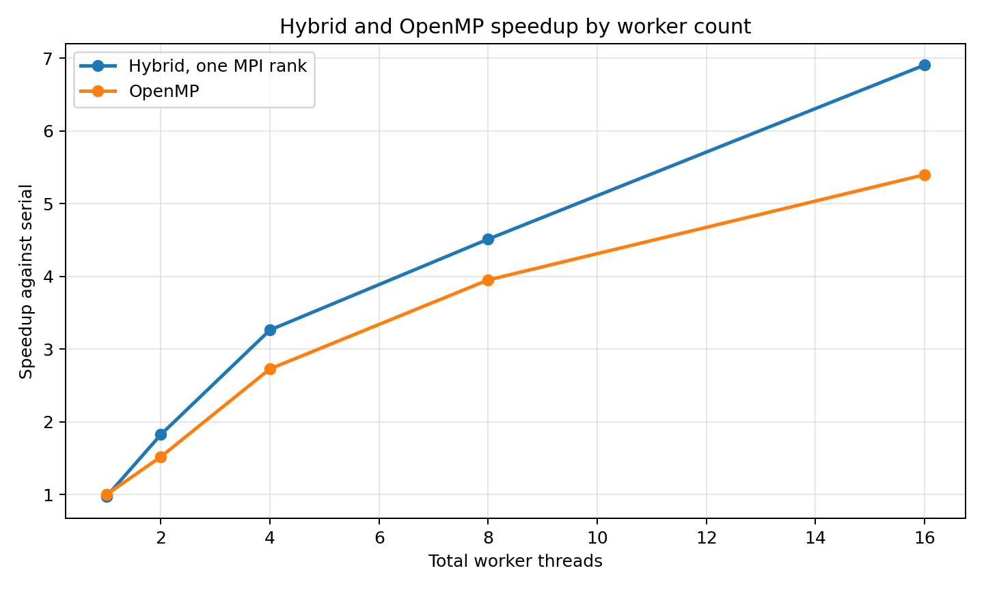
Hybrid scalability
Four ranks × four threads reached 6.63× speedup. Larger thread counts oversubscribe the available cores and lower efficiency.

Slide 9
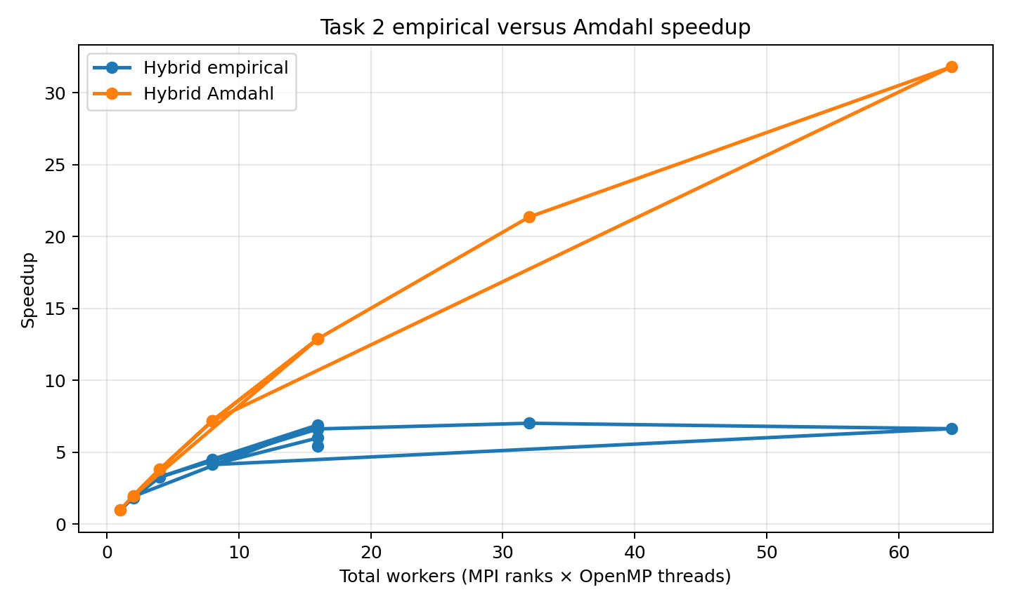
Hybrid Amdahl analysis, limitations, and Q&A
Why empirical speedup is lower
• MPI collective latency rises with rank count
• Rank 0 still merges and writes the result
• Memory bandwidth and scheduling contend at high worker counts
• Amdahl assumes an ideal fixed serial fraction
Q&A
Open MPI enables distributed-memory execution across nodes, but this fine-grained kernel pays communication and root-aggregation overhead. Hybrid OpenMP improves local compute throughput; oversubscription reduces efficiency.
Notes:
Source: results/hybrid_scaling.csv.

