Slide 1
FIT3143 • PARALLEL COMPUTING
Prime Search at Scale
Open MPI and hybrid MPI + OpenMP
Correctness • workload balance • measured scalability
Savin Vindiv De Alwis (35221631)
Willwara Arachchilage Shamle Imal Thilaksiri (35512075)
Main presentation: 6 min 25 s

Slide 2
FIT3143 • LAB 2
Experimental setup and correctness
PLATFORM
PRIMARY WORKLOAD
COVERAGE
1 node • 14C / 20T
n = 60,000,000
30 n values
WSL2 Ubuntu • Open MPI 4.1.6
Intel Core i7-13700H
3,562,115 primes below n
all output written by rank 0
20M–78M • MPI ranks 1–16
OpenMP threads 1–16 • up to 64 workers
Measurement discipline
Independent exact validation
Process and hybrid scaling
Both programs were compared value-for-value with a separate sieve across MPI ranks 1–5 and thread counts 1–3, including n = 0, 1, 2, 3, 4, 10 and 1000.
Median of 3 end-to-end runs; computation, gather and root post-processing recorded separately.
n sweep
One run at every required n; every runtime exceeds one second. Oversubscription is included explicitly.
PASS: sorted • unique • complete • prime-only • < n
2 / 9
Notes:
Sources: results/local_cluster_execution.txt; scripts/verify_correctness.sh; results/n_scaling.csv; results/task1_process_scaling.csv; results/hybrid_scaling.csv.

Slide 3
FIT3143 • LAB 2
Task 1: robust block-cyclic MPI partition
Measured computation-time imbalance (max / min)
Odd-candidate index space
Chunks of 64 odd candidates are assigned round-robin.
Strategy | p = 3 | p = 4 | p = 5
Block-cyclic | 1.05 | 1.06 | 1.06
Pure cyclic | 627.76 | 1.03 | 491.08
Contiguous block | 2.20 | 2.61 | 2.78
rank 0
C0
C3
C6
C9
rank 1
C1
C4
C7
C10
rank 2
C2
C5
C8
C11
Equal-sized chunks preserve locality while mixing cheap composites and expensive large candidates across ranks.
Why this is the selected partition
Rank 0 performs an O(m log p) k-way merge and buffered output.
It had the lowest worst-case imbalance among the three measured strategies: ≤ 1.06 for p = 3–5. Pure cyclic collapses at odd p because divisibility patterns align with rank strides.
3 / 9
Notes:
Source: results/partition_balance.csv. Each value is the median of three runs at n=20,000,000. The strategy comparison uses identical primality testing, merge and output code.

Slide 4
FIT3143 • LAB 2
Graph 1 — runtime across 30 problem sizes
All 30 values are shown; no run is below one second.
4 / 9
Notes:
Sources: results/n_scaling.csv (current serial and MPI sweep) and results/openmp_n_scaling.csv (prior Week 4 OpenMP sweep). Both use the same machine, n values and 4 workers, but were measured in separate sessions; absolute runtime may include session noise.

Slide 5
FIT3143 • LAB 2
Graph 2 — speedup across 30 problem sizes
MPI stays near 3.3–3.6× at four processes; the OpenMP series is noisier but uses its own matched serial session.
5 / 9
Notes:
Sources: MPI speedup from results/n_scaling.csv. OpenMP speedup = results/task3_n_scaling.csv serial_total divided by results/openmp_n_scaling.csv openmp_time for the same n. This avoids mixing serial baselines across sessions.

Slide 6
FIT3143 • LAB 2
Graphs 3 and 6 — Task 1 scaling and Amdahl comparison
At p = 16: 6.02× empirical versus 12.67× Amdahl — collectives, contention and root-only output are not in the ideal model.
6 / 9
Notes:
Graph 3 sources: results/task1_process_scaling.csv and results/openmp_thread_scaling.csv. Graph 6 source: results/task1_process_scaling.csv. Process-scaling points are medians of three runs at n=60,000,000.

Slide 7
FIT3143 • LAB 2
Task 2: hybrid decomposition and measured balance
Two-level parallelism
Representative local execution at n = 60M
Program | Configuration | min compute | max compute | max/min
Task 1 | 4 ranks | 6.446 s | 6.507 s | 1.009
Task 2 | 4 × 2 | 4.567 s | 4.685 s | 1.026
MPI
OpenMP
Rank 0
block-cyclic chunks
across processes
→
dynamic schedule(64)
inside each process
→
k-way merge +
buffered output
Why dynamic scheduling remains useful
TASK 1
TASK 2
Trial division has irregular per-candidate cost. MPI chunks balance rank-level work; OpenMP dynamic scheduling smooths the remaining variation between threads without changing output order.
6.97 s
5.16 s
4 MPI processes
exact output validation: PASS
4 MPI × 2 OpenMP
exact output validation: PASS
Hybrid speedup over the same 4-rank Task 1 run: 1.35×
7 / 9
Notes:
Source: results/local_cluster_execution.txt. This representative run records per-rank compute times, candidate-count range, total runtime, commands and exact sorted-output validation.

Slide 8
FIT3143 • LAB 2
Graphs 4 and 5 — hybrid scaling
Best measured hybrid point: 8.46× at 1 × 16; 32- and 64-worker configurations (4×8 and 4×16) reduce efficiency.
8 / 9
Notes:
Sources: results/hybrid_scaling.csv and results/openmp_thread_scaling.csv. Hybrid points are medians of three runs at n=60,000,000. Graph 5 compares equal total worker counts.

Slide 9
FIT3143 • LAB 2
Graph 7 — hybrid scaling limits
Why the curves diverge
MPI collectives and rank-0 aggregation
Memory and scheduler contention
Oversubscription beyond 20 logical CPUs
Amdahl assumes a fixed, ideal serial fraction
Limitations and future work
Single-node benchmark results do not quantify network cost. A two-node CAAS Task 1 functional test completed successfully; full multi-node performance measurements remain future work.
Q&A
9 / 9
Notes:
Sources: results/hybrid_scaling.csv. The benchmark series is local single-node data. CAAS evidence in Appendices 5–6 verifies a two-node Task 1 functional test at n = 10,000 and is not graph or balance data.

Slide 10
APPENDIX
Measured partition and Amdahl evidence
Partition strategy comparison • n = 20M • median of 3 runs
p | Block-cyclic ratio | Pure cyclic ratio | Block ratio | Block-cyclic total
3 | 1.047 | 627.764 | 2.204 | 1.931 s
4 | 1.058 | 1.032 | 2.615 | 1.581 s
5 | 1.057 | 491.084 | 2.780 | 1.300 s
Amdahl inputs are measured, not assumed
Formula
Program | Ts | Tp | fs = Ts / (Ts+Tp)
Task 1 MPI | 0.427566 s | 23.948293 s | 0.017541
Task 2 hybrid | 0.411327 s | 23.749574 s | 0.017024
S(W) = (Ts + Tp) / (Ts + Tp / W)
Empirical speedup uses the Week 4 serial end-to-end baseline. Theoretical speedup uses each parallel program's measured one-worker decomposition; this difference is stated explicitly.
Appendix 1
Notes:
Sources: results/partition_balance.csv, results/task1_process_scaling.csv and results/hybrid_scaling.csv.

Slide 11
APPENDIX
Evidence and Moodle submission readiness
Verified artifacts
Requirement | Artifact | Status
Task 1 source | task1.c | Ready
Task 2 source | task2.c | Ready
Presentation | output/FIT3143_Week8_Lab2_Presentation_HD_Submission_With_Evidence_And_AI_Declaration.pptx | Ready
Representative scripts | scripts/run_benchmarks.sh + capture_local_execution_evidence.sh | Ready
Execution + sorted output proof | results/local_cluster_execution.txt + prime output | Text evidence ready
AI use declaration | output/AI_Use_Declaration.pdf and Appendix 7 | Ready
Execution screenshots | App. 3–6: local and CAAS Task 1 | Ready
Appendix 2
Notes:
This checklist distinguishes verified files from evidence that must be created by the students. Appendix 3 and Appendix 4 contain authentic local WSL2 terminal captures. The prompt-record PDF must still be exported from the actual AI conversation.

Slide 12
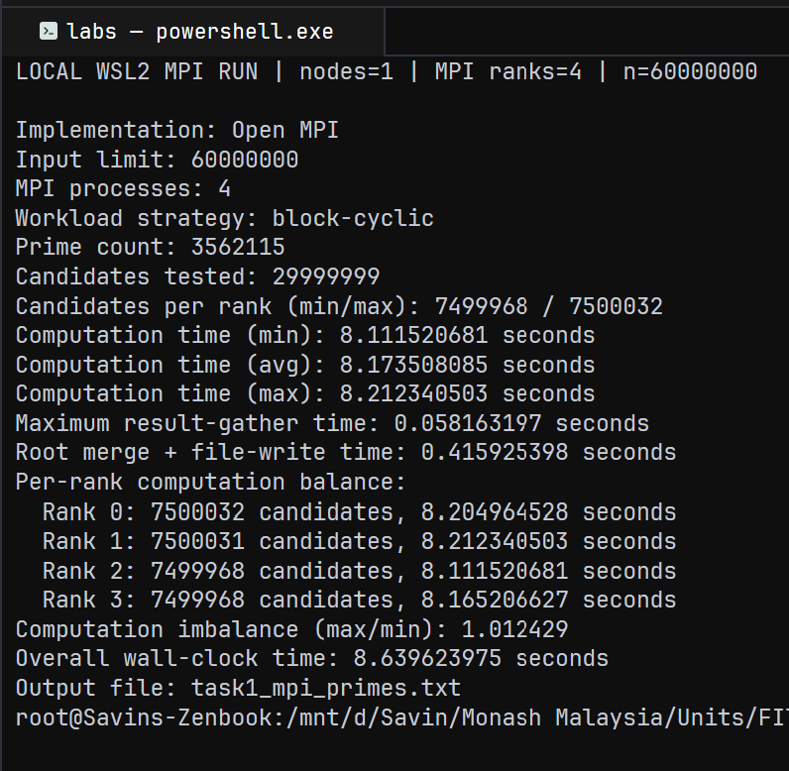
APPENDIX
Execution evidence — Task 1 Open MPI
Representative local WSL2 terminal capture
What this proves
• Local WSL2, one node, 4 MPI ranks
• n = 60,000,000; block-cyclic partitioning
• Prime count = 3,562,115
• Per-rank candidate counts and computation times
• Imbalance ratio = 1.012429
• Output file produced: task1_mpi_primes.txt
Authentic execution evidence only; the benchmark charts use the documented CSV measurements, not this single run.
Appendix 3
Notes:
Source: evidence/screenshots/task1_local_mpi_execution.png. Authentic local WSL2 single-node MPI run, n=60M, 4 ranks; representative execution evidence only, not graph data.

Slide 13
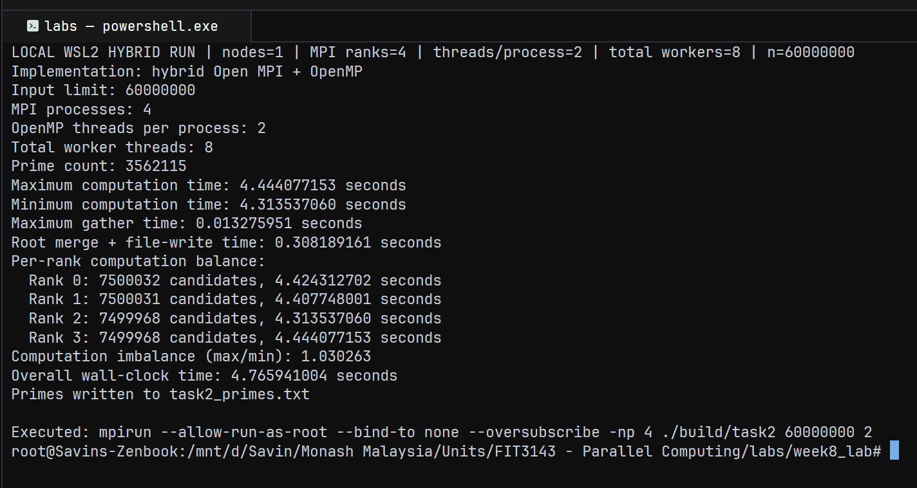
APPENDIX
Execution evidence — Task 2 MPI + OpenMP
Representative local WSL2 terminal capture
Authentic local run: 1 node, 4 MPI ranks × 2 OpenMP threads = 8 workers; graph data remains in the documented CSV files.
Appendix 4
Notes:
Source: evidence/screenshots/task2_local_hybrid_execution.png. Authentic local WSL2 single-node hybrid run, n=60M, 4 MPI ranks, 2 OpenMP threads per process; representative execution evidence only, not graph data.

Slide 14
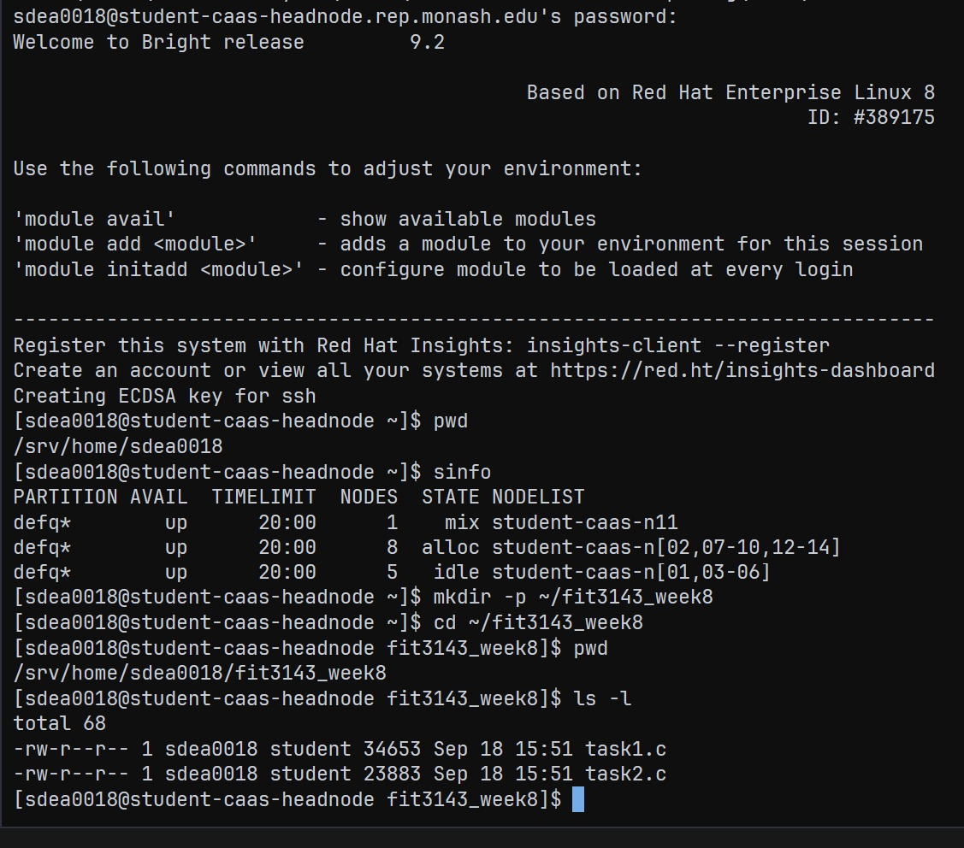
APPENDIX
CAAS evidence — access and job setup
CAAS head-node access and source upload
What this proves
• Authenticated CAAS head-node access
• SLURM defq reported idle compute nodes
• Task 1 and Task 2 sources uploaded
• Setup evidence only; no performance claim
This capture establishes the CAAS environment before the submitted two-node Task 1 job shown in Appendix 6.
Appendix 5
Notes:
Source: evidence/screenshots/caas_login_and_setup.jpg. Authentic CAAS setup screenshot. It documents head-node access, scheduler visibility, and uploaded source files.

Slide 15
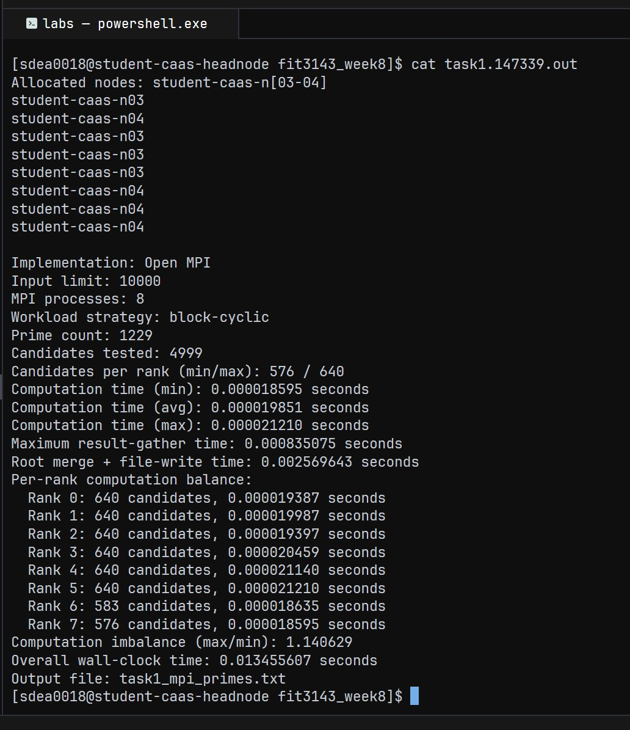
APPENDIX
CAAS evidence — two-node Task 1 run
Two-node CAAS Task 1 functional execution
What this proves
• Allocated nodes: student-caas-n03 and n04
• 8 MPI ranks, 4 ranks on each node
• Task 1 at n = 10,000 returned 1,229 primes
• Functional proof only; not performance or balance data
CAAS functional evidence. The existing graphs and balance findings remain based on the documented local measurement files.
Appendix 6
Notes:
Source: evidence/screenshots/caas_task1_two_node_execution.jpg. Authentic two-node CAAS Task 1 functional run at n = 10,000. The screenshot does not support performance or workload-balance conclusions.

Slide 16
APPENDIX
Generative AI use declaration
Summary of the separate declaration PDF
Scope of assistance
Team responsibility
Generative AI assisted with interpreting the specification and rubric, reviewing the MPI and hybrid implementation, planning experiments, drafting charts and slides, and preparing documentation.
The team reviewed the material against the supplied requirements, compiled and executed the programs locally, validated prime output independently, and accepts responsibility for every submitted claim and result.
Appendix 7
Notes:
Source: output/AI_Use_Declaration.pdf. This appendix reproduces a concise summary of the team's AI-use declaration. The PDF and authentic prompt/conversation record remain separate Moodle submission items.

