Slide 1
FIT3143 • PARALLEL COMPUTING
Prime Search at Scale
Open MPI and hybrid MPI + OpenMP
Correctness • workload balance • measured scalability
Savin Vindiv De Alwis (35221631)
Willwara Arachchilage Shamle Imal Thilaksiri (35512075)
Main presentation: 6 min 25 s

Slide 2
FIT3143 • LAB 2
Experimental setup and correctness
PLATFORM
PRIMARY WORKLOAD
COVERAGE
1 node • 14C / 20T
n = 60,000,000
30 n values
WSL2 Ubuntu • Open MPI 4.1.6
Intel Core i7-13700H
3,562,115 primes below n
all output written by rank 0
20M–78M • MPI ranks 1–16
OpenMP threads 1–16 • up to 64 workers
Measurement discipline
Independent exact validation
Process and hybrid scaling
Both programs were compared value-for-value with a separate sieve across MPI ranks 1–5 and thread counts 1–3, including n = 0, 1, 2, 3, 4, 10 and 1000.
Median of 3 end-to-end runs; computation, gather and root post-processing recorded separately.
n sweep
One run at every required n; every runtime exceeds one second. Oversubscription is included explicitly.
PASS: sorted • unique • complete • prime-only • < n
2 / 9
Notes:
Sources: results/local_cluster_execution.txt; scripts/verify_correctness.sh; results/n_scaling.csv; results/task1_process_scaling.csv; results/hybrid_scaling.csv.

Slide 3
FIT3143 • LAB 2
Task 1: robust block-cyclic MPI partition
Measured computation-time imbalance (max / min)
Odd-candidate index space
Chunks of 64 odd candidates are assigned round-robin.
Strategy | p = 3 | p = 4 | p = 5
Block-cyclic | 1.05 | 1.06 | 1.06
Pure cyclic | 627.76 | 1.03 | 491.08
Contiguous block | 2.20 | 2.61 | 2.78
rank 0
C0
C3
C6
C9
rank 1
C1
C4
C7
C10
rank 2
C2
C5
C8
C11
Equal-sized chunks preserve locality while mixing cheap composites and expensive large candidates across ranks.
Why this is the selected partition
Rank 0 performs an O(m log p) k-way merge and buffered output.
It had the lowest worst-case imbalance among the three measured strategies: ≤ 1.06 for p = 3–5. Pure cyclic collapses at odd p because divisibility patterns align with rank strides.
3 / 9
Notes:
Source: results/partition_balance.csv. Each value is the median of three runs at n=20,000,000. The strategy comparison uses identical primality testing, merge and output code.

Slide 4
FIT3143 • LAB 2
Graph 1 — runtime across 30 problem sizes
All 30 values are shown; no run is below one second.
4 / 9
Notes:
Sources: results/n_scaling.csv (current serial and MPI sweep) and results/openmp_n_scaling.csv (prior Week 4 OpenMP sweep). Both use the same machine, n values and 4 workers, but were measured in separate sessions; absolute runtime may include session noise.

Slide 5
FIT3143 • LAB 2
Graph 2 — speedup across 30 problem sizes
MPI stays near 3.3–3.6× at four processes; the OpenMP series is noisier but uses its own matched serial session.
5 / 9
Notes:
Sources: MPI speedup from results/n_scaling.csv. OpenMP speedup = results/task3_n_scaling.csv serial_total divided by results/openmp_n_scaling.csv openmp_time for the same n. This avoids mixing serial baselines across sessions.

Slide 6
FIT3143 • LAB 2
Graphs 3 and 6 — Task 1 scaling and Amdahl comparison
At p = 16: 6.02× empirical versus 12.67× Amdahl — collectives, contention and root-only output are not in the ideal model.
6 / 9
Notes:
Graph 3 sources: results/task1_process_scaling.csv and results/openmp_thread_scaling.csv. Graph 6 source: results/task1_process_scaling.csv. Process-scaling points are medians of three runs at n=60,000,000.

Slide 7
FIT3143 • LAB 2
Task 2: hybrid decomposition and measured balance
Two-level parallelism
Representative local execution at n = 60M
Program | Configuration | min compute | max compute | max/min
Task 1 | 4 ranks | 6.446 s | 6.507 s | 1.009
Task 2 | 4 × 2 | 4.567 s | 4.685 s | 1.026
MPI
OpenMP
Rank 0
block-cyclic chunks
across processes
→
dynamic schedule(64)
inside each process
→
k-way merge +
buffered output
Why dynamic scheduling remains useful
TASK 1
TASK 2
Trial division has irregular per-candidate cost. MPI chunks balance rank-level work; OpenMP dynamic scheduling smooths the remaining variation between threads without changing output order.
6.97 s
5.16 s
4 MPI processes
exact output validation: PASS
4 MPI × 2 OpenMP
exact output validation: PASS
Hybrid speedup over the same 4-rank Task 1 run: 1.35×
7 / 9
Notes:
Source: results/local_cluster_execution.txt. This representative run records per-rank compute times, candidate-count range, total runtime, commands and exact sorted-output validation.

Slide 8
FIT3143 • LAB 2
Graphs 4 and 5 — hybrid scaling
Best measured hybrid point: 8.46× at 1 × 16; 32- and 64-worker configurations (4×8 and 4×16) reduce efficiency.
8 / 9
Notes:
Sources: results/hybrid_scaling.csv and results/openmp_thread_scaling.csv. Hybrid points are medians of three runs at n=60,000,000. Graph 5 compares equal total worker counts.

Slide 9
FIT3143 • LAB 2
Graph 7 — hybrid scaling limits
Why the curves diverge
MPI collectives and rank-0 aggregation
Memory and scheduler contention
Oversubscription beyond 20 logical CPUs
Amdahl assumes a fixed, ideal serial fraction
Limitations and future work
Single-node local results do not quantify network cost. Next: multi-node CAAS runs, segmented-sieve work units, and distributed or parallel output to remove the rank-0 bottleneck.
Q&A
9 / 9
Notes:
Source: results/hybrid_scaling.csv. Amdahl serial fraction is measured from the one-worker hybrid run: Ts=0.411327 s, Tp=23.749574 s, fs=0.017024. Main presentation ends here; appendix slides are for Q&A only.

Slide 10
APPENDIX
Measured partition and Amdahl evidence
Partition strategy comparison • n = 20M • median of 3 runs
p | Block-cyclic ratio | Pure cyclic ratio | Block ratio | Block-cyclic total
3 | 1.047 | 627.764 | 2.204 | 1.931 s
4 | 1.058 | 1.032 | 2.615 | 1.581 s
5 | 1.057 | 491.084 | 2.780 | 1.300 s
Amdahl inputs are measured, not assumed
Formula
Program | Ts | Tp | fs = Ts / (Ts+Tp)
Task 1 MPI | 0.427566 s | 23.948293 s | 0.017541
Task 2 hybrid | 0.411327 s | 23.749574 s | 0.017024
S(W) = (Ts + Tp) / (Ts + Tp / W)
Empirical speedup uses the Week 4 serial end-to-end baseline. Theoretical speedup uses each parallel program's measured one-worker decomposition; this difference is stated explicitly.
Appendix 1
Notes:
Sources: results/partition_balance.csv, results/task1_process_scaling.csv and results/hybrid_scaling.csv.

Slide 11
APPENDIX
Evidence and Moodle submission readiness
Verified artifacts
Requirement | Artifact | Status
Task 1 source | task1.c | Ready
Task 2 source | task2.c | Ready
Presentation | output/FIT3143_Week8_Lab2_Presentation_HD_Submission_With_Evidence.pptx | Ready
Representative scripts | scripts/run_benchmarks.sh + capture_local_execution_evidence.sh | Ready
Execution + sorted output proof | results/local_cluster_execution.txt + prime output | Text evidence ready
AI use declaration | output/AI_Use_Declaration.pdf | Ready
AI prompt record PDF | Export from the actual AI conversation | ADD BEFORE MOODLE
Local terminal screenshots | Appendices 3–4: Task 1 MPI and Task 2 hybrid runs | Ready
Do not submit until the red item is authentic, legible and included. This review cannot fabricate it.
Appendix 2
Notes:
This checklist distinguishes verified files from evidence that must be created by the students. Appendix 3 and Appendix 4 contain authentic local WSL2 terminal captures. The prompt-record PDF must still be exported from the actual AI conversation.

Slide 12
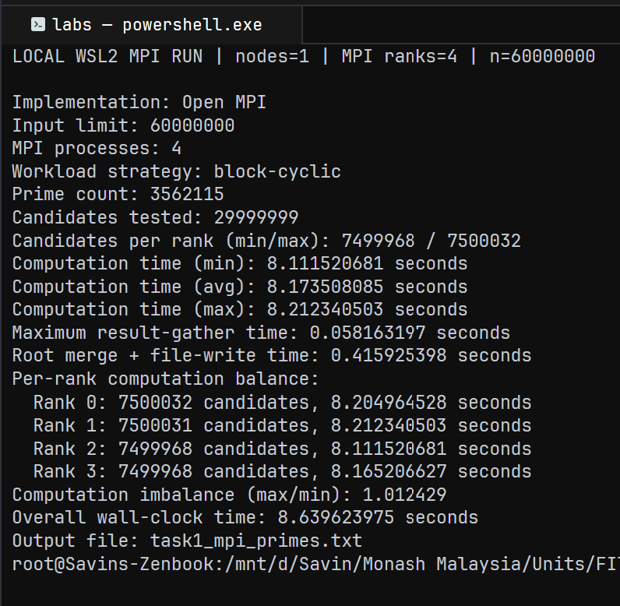
APPENDIX
Execution evidence — Task 1 Open MPI
Representative local WSL2 terminal capture
What this proves
• Local WSL2, one node, 4 MPI ranks
• n = 60,000,000; block-cyclic partitioning
• Prime count = 3,562,115
• Per-rank candidate counts and computation times
• Imbalance ratio = 1.012429
• Output file produced: task1_mpi_primes.txt
Authentic execution evidence only; the benchmark charts use the documented CSV measurements, not this single run.
Appendix 3
Notes:
Source: evidence/screenshots/task1_local_mpi_execution.png. Authentic local WSL2 single-node MPI run, n=60M, 4 ranks; representative execution evidence only, not graph data.

Slide 13
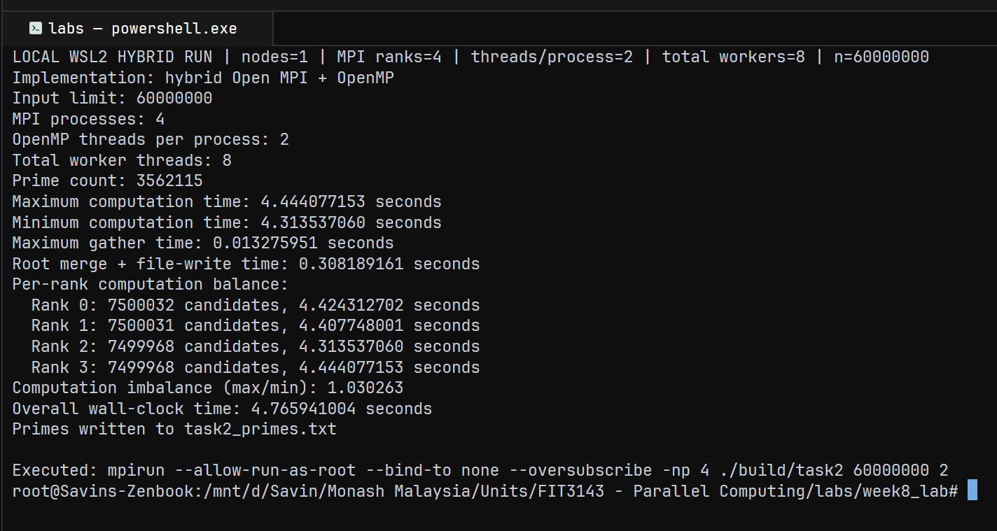
APPENDIX
Execution evidence — Task 2 MPI + OpenMP
Representative local WSL2 terminal capture
Authentic local run: 1 node, 4 MPI ranks × 2 OpenMP threads = 8 workers; graph data remains in the documented CSV files.
Appendix 4
Notes:
Source: evidence/screenshots/task2_local_hybrid_execution.png. Authentic local WSL2 single-node hybrid run, n=60M, 4 MPI ranks, 2 OpenMP threads per process; representative execution evidence only, not graph data.

