Slide 1
FIT3143 • PARALLEL COMPUTING
Prime Search at Scale
Open MPI and hybrid MPI + OpenMP
Correctness • workload balance • measured scalability
Savin Vindiv De Alwis (35221631)
Willwara Arachchilage Shamle Imal Thilaksiri (35512075)

Slide 2
FIT3143 • LAB 2
Experimental setup and correctness
PLATFORM
PRIMARY WORKLOAD
COVERAGE
1 node • 14C / 20T
n = 60,000,000
30 n values
WSL2 Ubuntu • Open MPI 4.1.6
Intel Core i7-13700H
3,562,115 primes below n
all output written by rank 0
20M–78M • MPI ranks 1–16
OpenMP threads 1–16 • up to 64 workers
Measurement discipline
Independent exact validation
Process and hybrid scaling
Both programs were compared value-for-value with a separate sieve across MPI ranks 1–5 and thread counts 1–3, including n = 0, 1, 2, 3, 4, 10 and 1000.
Median of 3 end-to-end runs; computation, gather and root post-processing recorded separately.
n sweep
One run at every required n; every runtime exceeds one second. Oversubscription is included explicitly.
PASS: sorted • unique • complete • prime-only • < n
2 / 9
Notes:
Sources: results/local_cluster_execution.txt; scripts/verify_correctness.sh; results/n_scaling.csv; results/task1_process_scaling.csv; results/hybrid_scaling.csv.

Slide 3
FIT3143 • LAB 2
Task 1: robust block-cyclic MPI partition
Measured computation-time imbalance (max / min)
Odd-candidate index space
Chunks of 64 odd candidates are assigned round-robin.
Strategy | p = 3 | p = 4 | p = 5
Block-cyclic | 1.05 | 1.06 | 1.06
Pure cyclic | 627.76 | 1.03 | 491.08
Contiguous block | 2.20 | 2.61 | 2.78
rank 0
C0
C3
C6
C9
rank 1
C1
C4
C7
C10
rank 2
C2
C5
C8
C11
Equal-sized chunks preserve locality while mixing cheap composites and expensive large candidates across ranks.
Why this is the selected partition
Rank 0 performs an O(m log p) k-way merge and buffered output.
It had the lowest worst-case imbalance among the three measured strategies: ≤ 1.06 for p = 3–5. Pure cyclic collapses at odd p because divisibility patterns align with rank strides.
3 / 9
Notes:
Source: results/partition_balance.csv. Each value is the median of three runs at n=20,000,000. The strategy comparison uses identical primality testing, merge and output code.

Slide 4
FIT3143 • LAB 2
Graph 1 — runtime across 30 problem sizes
All 30 values are shown; no run is below one second.
4 / 9
Notes:
Sources: results/n_scaling.csv (current serial and MPI sweep) and results/openmp_n_scaling.csv (prior Week 4 OpenMP sweep). Both use the same machine, n values and 4 workers, but were measured in separate sessions; absolute runtime may include session noise.

Slide 5
FIT3143 • LAB 2
Graph 2 — speedup across 30 problem sizes
MPI stays near 3.3–3.6× at four processes; the OpenMP series is noisier but uses its own matched serial session.
5 / 9
Notes:
Sources: MPI speedup from results/n_scaling.csv. OpenMP speedup = results/task3_n_scaling.csv serial_total divided by results/openmp_n_scaling.csv openmp_time for the same n. This avoids mixing serial baselines across sessions.

Slide 6
FIT3143 • LAB 2
Graphs 3 and 6 — Task 1 scaling and Amdahl comparison
At p = 16: 6.02× empirical versus 12.67× Amdahl — collectives, contention and root-only output are not in the ideal model.
6 / 9
Notes:
Graph 3 sources: results/task1_process_scaling.csv and results/openmp_thread_scaling.csv. Graph 6 source: results/task1_process_scaling.csv. Process-scaling points are medians of three runs at n=60,000,000.

Slide 7
FIT3143 • LAB 2
Task 2: hybrid decomposition and measured balance
Two-level parallelism
Representative local execution at n = 60M
Program | Configuration | min compute | max compute | max/min
Task 1 | 4 ranks | 6.446 s | 6.507 s | 1.009
Task 2 | 4 × 2 | 4.567 s | 4.685 s | 1.026
MPI
OpenMP
Rank 0
block-cyclic chunks
across processes
→
dynamic schedule(64)
inside each process
→
k-way merge +
buffered output
Why dynamic scheduling remains useful
TASK 1
TASK 2
Trial division has irregular per-candidate cost. MPI chunks balance rank-level work; OpenMP dynamic scheduling smooths the remaining variation between threads without changing output order.
6.97 s
5.16 s
4 MPI processes
exact output validation: PASS
4 MPI × 2 OpenMP
exact output validation: PASS
Hybrid speedup over the same 4-rank Task 1 run: 1.35×
7 / 9
Notes:
Source: results/local_cluster_execution.txt. This representative run records per-rank compute times, candidate-count range, total runtime, commands and exact sorted-output validation.

Slide 8
FIT3143 • LAB 2
Graphs 4 and 5 — hybrid scaling
Best measured hybrid point: 8.46× at 1 × 16; 32- and 64-worker configurations (4×8 and 4×16) reduce efficiency.
8 / 9
Notes:
Sources: results/hybrid_scaling.csv and results/openmp_thread_scaling.csv. Hybrid points are medians of three runs at n=60,000,000. Graph 5 compares equal total worker counts.

Slide 9
FIT3143 • LAB 2
Graph 7 — hybrid scaling limits
Why the curves diverge
MPI collectives and rank-0 aggregation
Memory and scheduler contention
Oversubscription beyond 20 logical CPUs
Amdahl assumes a fixed, ideal serial fraction
Limitations and future work
The benchmark series is single-node data, so it does not quantify network cost. A two-node CAAS functional run completed successfully. Next: multi-node CAAS measurements, segmented-sieve work units, and distributed output.
9 / 9
Notes:
Source: results/hybrid_scaling.csv. Amdahl serial fraction is measured from the one-worker hybrid run: Ts=0.411327 s, Tp=23.749574 s, fs=0.017024. CAAS evidence in Appendices 3-6 verifies setup, Task 1 configuration and execution, and Task 2 configuration; it is not graph or balance data. Main presentation ends here; appendix slides are for Q&A only.

Slide 10
APPENDIX
Measured partition and Amdahl evidence
Partition strategy comparison • n = 20M • median of 3 runs
p | Block-cyclic ratio | Pure cyclic ratio | Block ratio | Block-cyclic total
3 | 1.047 | 627.764 | 2.204 | 1.931 s
4 | 1.058 | 1.032 | 2.615 | 1.581 s
5 | 1.057 | 491.084 | 2.780 | 1.300 s
Amdahl inputs are measured, not assumed
Formula
Program | Ts | Tp | fs = Ts / (Ts+Tp)
Task 1 MPI | 0.427566 s | 23.948293 s | 0.017541
Task 2 hybrid | 0.411327 s | 23.749574 s | 0.017024
S(W) = (Ts + Tp) / (Ts + Tp / W)
Empirical speedup uses the Week 4 serial end-to-end baseline. Theoretical speedup uses each parallel program's measured one-worker decomposition; this difference is stated explicitly.
Appendix 1
Notes:
Sources: results/partition_balance.csv, results/task1_process_scaling.csv and results/hybrid_scaling.csv.

Slide 11
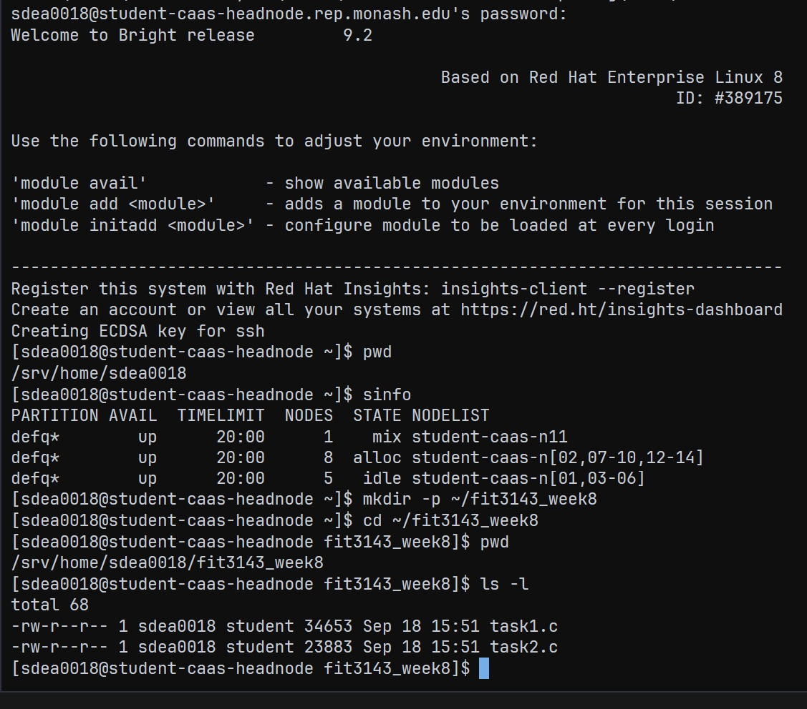
APPENDIX
CAAS evidence — access and job setup
CAAS head-node access and source upload
What this proves
• Authenticated CAAS head-node access
• SLURM defq reported idle compute nodes
• Task 1 and Task 2 sources uploaded
• Setup evidence only; no performance claim
This capture establishes the CAAS environment before the Task 1 job configuration and functional run in Appendices 4-5.
Appendix 3
Notes:
Source: evidence/screenshots/caas_login_and_setup.jpg. Authentic CAAS setup screenshot. It documents head-node access, scheduler visibility, and uploaded source files.

Slide 12
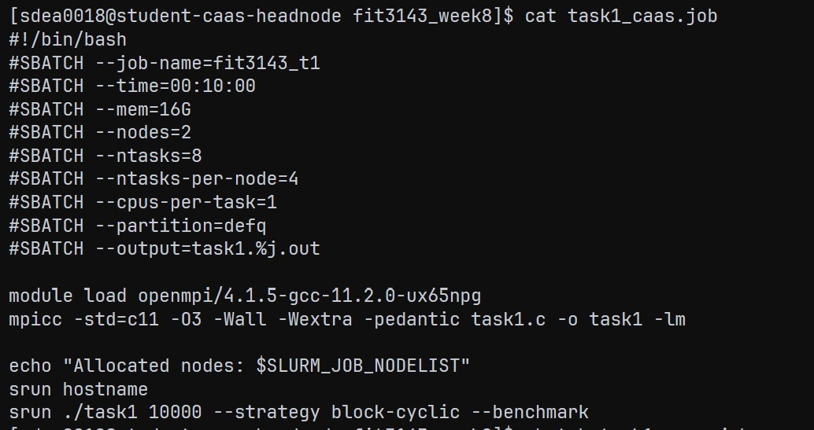
APPENDIX
CAAS evidence — Task 1 job configuration
SLURM script for the two-node Task 1 run
What this proves
• 2 nodes and 8 MPI tasks requested
• 4 MPI ranks per node, 1 CPU per rank
• Open MPI module loaded before compilation
• srun executes Task 1 at n = 10,000
Configuration evidence for the submitted CAAS Task 1 run shown in Appendix 5.
Appendix 4
Notes:
Source: evidence/screenshots/caas_task1_job_configuration.jpg. Authentic Task 1 SLURM job configuration. It documents the requested two nodes, eight MPI tasks, four tasks per node, compilation command, and srun invocation.

Slide 13
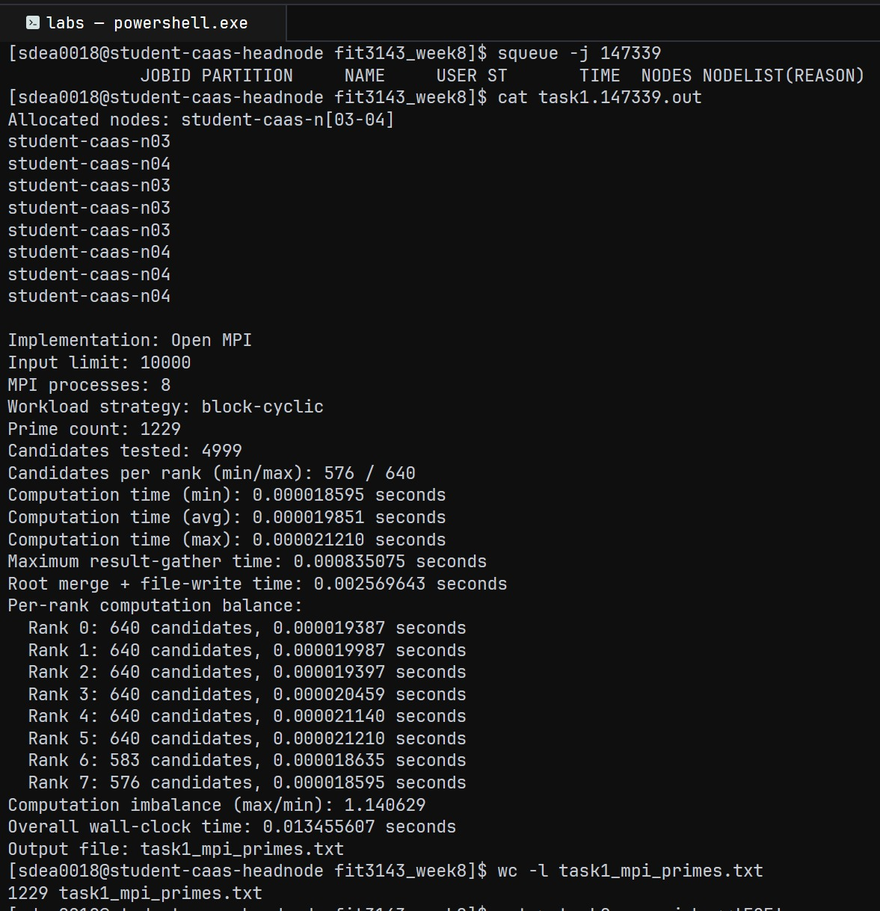
APPENDIX
CAAS evidence — two-node Task 1 run
Two-node CAAS Task 1 functional execution
What this proves
• Allocated nodes: student-caas-n03 and n04
• 8 MPI ranks, 4 ranks on each node
• Task 1 at n = 10,000 returned 1,229 primes
• wc -l confirms 1,229 output lines
CAAS functional evidence. The existing graphs and balance findings remain based on the documented local measurement files.
Appendix 5
Notes:
Source: evidence/screenshots/caas_task1_two_node_execution_with_line_count.jpg. Authentic two-node CAAS Task 1 functional run at n = 10,000. It verifies allocation of student-caas-n03 and student-caas-n04, eight MPI ranks, the correct 1,229-prime result, sorted output generation, and the 1,229-line output check. It does not support the local benchmark or balance conclusions.

Slide 14
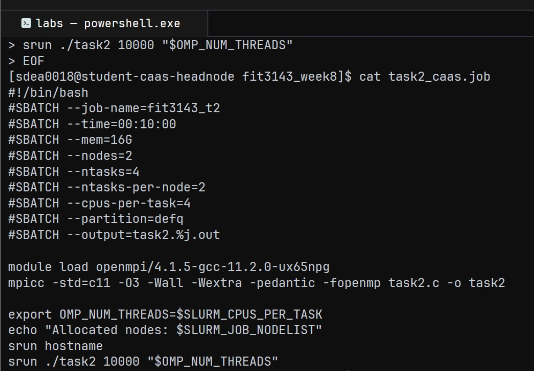
APPENDIX
CAAS evidence — Task 2 job configuration
SLURM script for the two-node hybrid Task 2 run
What this proves
• 2 nodes and 4 MPI tasks requested
• 2 MPI ranks per node, 4 CPUs per rank
• OMP_NUM_THREADS derives from SLURM_CPUS_PER_TASK
• Configuration only; no CAAS Task 2 output claim
Task 2 configuration evidence: the hybrid launch uses 4 MPI ranks × 4 OpenMP threads when scheduled as shown.
Appendix 6
Notes:
Source: evidence/screenshots/caas_task2_job_configuration.jpg. Authentic Task 2 hybrid SLURM job configuration. It documents the requested two nodes, four MPI tasks, two tasks per node, four CPUs per task, OMP_NUM_THREADS export, and srun invocation. It does not demonstrate a completed CAAS Task 2 execution.

Slide 15
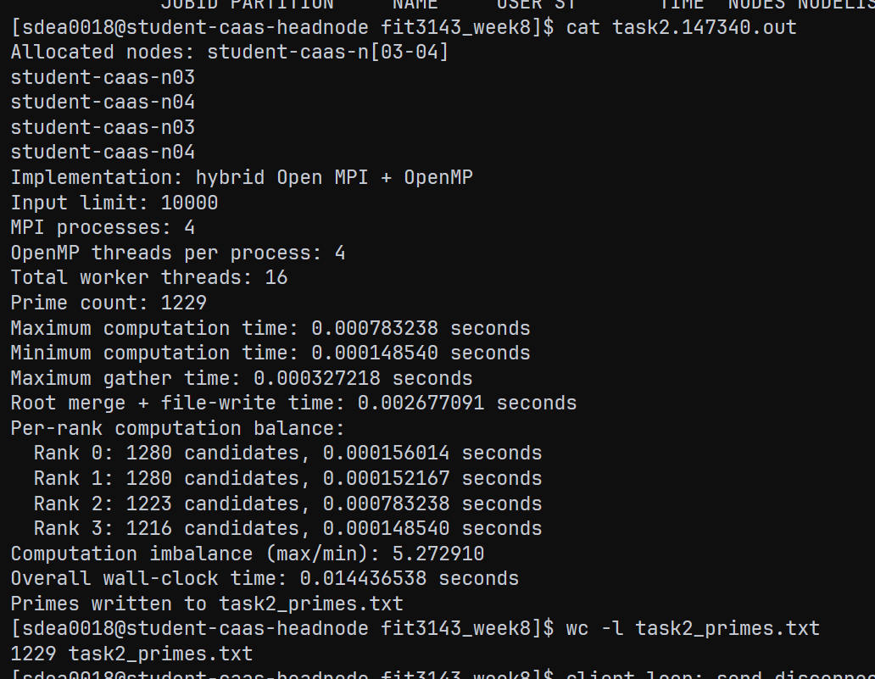
APPENDIX
CAAS evidence — two-node Task 2 run
Two-node CAAS hybrid MPI + OpenMP functional execution
What this proves
• Allocated nodes: student-caas-n03 and n04
• 4 MPI ranks × 4 OpenMP threads = 16 workers
• Task 2 at n = 10,000 returned 1,229 primes
• wc -l confirms 1,229 output lines
CAAS functional evidence only. The benchmark charts and balance findings remain based on the documented local measurement files.
Appendix 8
Notes:
Source: evidence/screenshots/caas_task2_two_node_execution.png. Authentic two-node CAAS Task 2 functional run at n = 10,000. It verifies allocation of student-caas-n03 and student-caas-n04, four MPI ranks, four OpenMP threads per process, the correct 1,229-prime result, output generation, and the 1,229-line output check. It does not support the local benchmark or balance conclusions.

Slide 16
APPENDIX
Generative AI use declaration
Scope of assistance
Generative AI assisted with interpreting the specification and rubric, teaching relevant concepts regarding MPI, but did not assist with implementation of any tasks.
Appendix 7
Notes:
This appendix declares the use of generative AI within the presentation itself. The assessment specification also requires the team to upload an authentic prompt/conversation record if AI was used. No separate AI declaration PDF is included.

