Slide 1
FIT3143 / LAB 3 / MAIN PRESENTATION
Distributed EV charging network
Hybrid MPI and OpenMP simulation
Three variants. 30 grid sizes. 30 line sizes. CAAS verification.
A measured study of neighbour communication and base-station congestion
handling.
Savin Vindiv De Alwis / 35221631
sdea0018@student.monash.edu
Shamle Thilaksiri / 35512075
wthi0003@student.monash.edu
AI use declaration: slide 13. Available prompt records accompany this presentation.
Savin Vindiv De Alwis 35221631 / Shamle Thilaksiri 35512075
1
Notes:
We implemented the EV charging network using a hybrid MIMD architecture. Our evidence includes three communication variants, correctness tests, and measurements over thirty grid sizes and thirty line sizes. I will explain the station design, base station decisions, and what the measurements actually show.
Sources: Lab3_Presentation_Documentation.pdf; results/analysis/all_message_delays.csv; W12 Lab #3 Assessment Specification and Rubric. Charts use recorded medians. Pale lines in appendices show min/max repeat values.

Slide 2
FIT3143 / LAB 3 / MAIN PRESENTATION
One station process, one thread per port
alerts
0
1
2
Base station: world rank 0
Station i: world rank i+1
3
4
5
OpenMP team (k=4 shown)
all ties
T0
T1
T2
T3
6
7
8
Only the initial thread calls
MPI. Barriers publish each
complete port snapshot.
Shared ports: [1, 0, 1, 0]
MPI Cartesian stations 0..N-1
No wraparound. Missing edges: MPI_PROC_NULL.
Savin Vindiv De Alwis 35221631 / Shamle Thilaksiri 35512075
2
Notes:
The base station is MPI world rank zero. Each charging station is one MPI process in a nonperiodic Cartesian communicator, with up to four orthogonal neighbours. Inside each station, a persistent OpenMP team represents the charging ports. Each thread owns one element of the shared port array. Only the initial thread calls MPI, so MPI_THREAD_FUNNELED is sufficient. We preserve the Applied One architecture and use MPI_Comm_split to separate the base from the Cartesian workers.
Sources: Lab3_Presentation_Documentation.pdf; results/analysis/all_message_delays.csv; W12 Lab #3 Assessment Specification and Rubric. Charts use recorded medians. Pale lines in appendices show min/max repeat values.

Slide 3
FIT3143 / LAB 3 / MAIN PRESENTATION
Congestion triggers neighbour queries, then alerts
broadcast CONTINUE
Query intent: 1 integer per real edge.
threads update ports[i]
barrier; count free ports
Report: ID, coordinates, UTC
timestamp, capacities, counts and
bytes.
exchange query intents with neighbours
reply only to requesting neighbours
Snapshot safety: one writer per port,
atomic count, OpenMP barriers.
if free < threshold:
if neighbour has capacity: redirect
else: send packed alert; receive advice
Tests: isolated node, full network,
empty network and all ties.
Persistent threads avoid creating a new team for each simulation cycle.
Savin Vindiv De Alwis 35221631 / Shamle Thilaksiri 35512075
3
Notes:
Each port periodically updates its occupied state. An atomic aggregate and barriers publish a consistent count of free ports. Stations exchange query intents, then reply with capacity only where requested. A congested station first chooses an available immediate neighbour. If none qualifies, it sends one packed alert to the base. The alert includes coordinates, discovery time, neighbour availability, and message counts and sizes. Tests cover isolated stations and simultaneous congestion.
Sources: Lab3_Presentation_Documentation.pdf; results/analysis/all_message_delays.csv; W12 Lab #3 Assessment Specification and Rubric. Charts use recorded medians. Pale lines in appendices show min/max repeat values.

Slide 4
FIT3143 / LAB 3 / MAIN PRESENTATION
The base returns every inferred nearest candidate
Receive the full batch, then update the cache.
Search the two-hop frontier in the Task 2 example. Manhattan
distance = 2.
0
1
2
Exclude recent self-alerts and fresh low-capacity observations.
3
4
5
Return all remaining ties, or an empty list. Silence permits inferred
availability.
6
7
8
Expiry is configurable. No reservation or guaranteed capacity is
claimed.
Orange: reporting station 0
Teal: equal-distance nodes 2, 4, 6
Savin Vindiv De Alwis 35221631 / Shamle Thilaksiri 35512075
4
Notes:
The base receives a complete alert batch and updates its cache before making recommendations. This removes dependence on report arrival order. Following the specification example, it searches the two-hop frontier using Manhattan distance. For station zero, the equal-distance candidates are two, four and six. A recent self-alert or low observation excludes a candidate. Missing or expired evidence permits an inferred candidate. We return all ties and explicitly avoid claiming that silence guarantees free capacity.
Sources: Lab3_Presentation_Documentation.pdf; results/analysis/all_message_delays.csv; W12 Lab #3 Assessment Specification and Rubric. Charts use recorded medians. Pale lines in appendices show min/max repeat values.

Slide 5
FIT3143 / LAB 3 / MAIN PRESENTATION
Three versions preserve the same decisions
Version | Neighbour exchanges | Base communication | Candidate work
V0 | Blocking Sendrecv | Rank-order Recv Blocking Send | Scan N nodes
V1 | Irecv / Isend Waitall | Probe ANY_SOURCE Blocking Send | 8 frontier offsets
V2 | Irecv / Isend Waitall | Preposted Irecv Batched Isend | 8 frontier offsets
Selection work per alert falls from O(N) to O(1). Nonblocking operations allow concurrency, while Waitall
guarantees completion.
Savin Vindiv De Alwis 35221631 / Shamle Thilaksiri 35512075
5
Notes:
Version zero uses blocking Sendrecv, rank-ordered base receives and a full candidate scan. Version one posts neighbour receives and sends nonblocking, and the base receives whichever alert is ready. Version two also preposts base receives and batches response sends. Both refined versions enumerate at most eight two-hop offsets. This reduces selection from linear work per alert to constant work while preserving decisions.
Sources: Lab3_Presentation_Documentation.pdf; results/analysis/all_message_delays.csv; W12 Lab #3 Assessment Specification and Rubric. Charts use recorded medians. Pale lines in appendices show min/max repeat values.

Slide 6
FIT3143 / LAB 3 / MAIN PRESENTATION
Timers measure local elapsed communication costs
Local study: two TCP-connected containers on one shared 16-CPU host.
30 grid sizes and 30 line sizes x 3 variants x 3 launches = 540 runs.
Two warmup cycles, six measured cycles, two port threads, mixed congestion.
MPI_Wtime starts and stops on the same rank. No cross-host clock subtraction.
Query/reply: phase completion. Alert send: MPI completion. Redirect: receive wait.
Round trip includes queueing and base computation. Raw rank-level records remain available.
CAAS job 199603: 90 scaling runs, 5 grids + 5 lines, two allocated compute nodes.
Savin Vindiv De Alwis 35221631 / Shamle Thilaksiri 35512075
6
Notes:
2:40-3:10. The full 30-grid and 30-line study uses two TCP containers on one shared host: two warmup cycles, six measured cycles, two port threads and three launches per case. CAAS separately tests five grids and five lines with twelve measured cycles, the same two warmups and three launches, across two allocated compute nodes. All timers stay on one rank. Query/reply results are phase costs; report send completion can be buffered. Round trip includes queueing and base processing. Raw rank-level measurements are retained for both environments.

Slide 7
FIT3143 / LAB 3 / MAIN PRESENTATION
Local grid scaling: bounded messages, increasing load
Selected V2, query: first five sizes 3312.2 us, last five 52526.6 us. Full ranges in appendix/CSV.
Savin Vindiv De Alwis 35221631 / Shamle Thilaksiri 35512075
7
Notes:
These four plots show grid query, reply, alert-send and redirect-receive times. The vertical scale is logarithmic. Each point is the median of three run-level means. Increasing the grid changes total traffic and competition for the shared host. Individual messages remain bounded in size and neighbour degree remains at most four. The measured curves therefore reflect scheduling and queueing as well as MPI operation cost. We retain the irregular measurements rather than forcing a smooth curve.
Sources: Lab3_Presentation_Documentation.pdf; results/analysis/all_message_delays.csv; W12 Lab #3 Assessment Specification and Rubric. Charts use recorded medians. Pale lines in appendices show min/max repeat values.

Slide 8
FIT3143 / LAB 3 / MAIN PRESENTATION
Local line scaling: bounded messages, increasing load
Selected V2, query: first five sizes 27.7 us, last five 28466.8 us. Full ranges in appendix/CSV.
Savin Vindiv De Alwis 35221631 / Shamle Thilaksiri 35512075
8
Notes:
The line experiments use one row and between two and thirty-one stations. They reduce neighbour degree to at most two, but the same base-station fan-in remains. A line has diameter N minus one, yet these neighbour messages travel only one logical edge. We should not multiply their cost by the full diameter. Total neighbour traffic still grows linearly. The measured line curves include the same host-sharing and synchronization limitations as the grid results.
Sources: Lab3_Presentation_Documentation.pdf; results/analysis/all_message_delays.csv; W12 Lab #3 Assessment Specification and Rubric. Charts use recorded medians. Pale lines in appendices show min/max repeat values.

Slide 9
FIT3143 / LAB 3 / MAIN PRESENTATION
Local control traffic and measured delay
Broadcast/gather are collective elapsed times. ACK is sender completion. Every plotted category also has a detailed appendix graph.
Savin Vindiv De Alwis 35221631 / Shamle Thilaksiri 35512075
9
Notes:
We also measure every control class: start and stop broadcast, alert-flag gather, and shutdown acknowledgements. The barrier and complete alert round trip have separate appendix graphs. Collective time can grow with process count even when a neighbour message is fixed in size. ACK timing measures send completion, and the base separately verifies an acknowledgement from every station before finalizing.
Sources: Lab3_Presentation_Documentation.pdf; results/analysis/all_message_delays.csv; W12 Lab #3 Assessment Specification and Rubric. Charts use recorded medians. Pale lines in appendices show min/max repeat values.

Slide 10
FIT3143 / LAB 3 / MAIN PRESENTATION
Local synchronization and response times
Barrier: waiting for the round. Round trip: report send through advice receipt, including base processing.
Savin Vindiv De Alwis 35221631 / Shamle Thilaksiri 35512075
10
Notes:
These plots show the global round barrier and complete alert-response round trip for both topologies. Barrier time exposes synchronization imbalance. The round trip measures the station waiting for a useful response, including report transfer, base processing and return communication. It is our selection criterion because a fast buffered send alone does not mean that the advice arrived quickly.
Sources: Lab3_Presentation_Documentation.pdf; results/analysis/all_message_delays.csv; W12 Lab #3 Assessment Specification and Rubric. Charts use recorded medians. Pale lines in appendices show min/max repeat values.

Slide 11
FIT3143 / LAB 3 / MAIN PRESENTATION
CAAS measurements and implementation trade-offs
CAAS: 5 grid sizes + 5 lines x 3 variants x 3 launches = 90 scaling runs.
Grid query: V0/V1 = 1.64x; V0/V2 = 1.81x.
Line query: V0/V1 = 2.34x; V0/V2 = 2.49x.
Grid round trip: V0/V2 = 1.09x; line = 1.30x.
Highest observed round-trip score: V2 (1.197).
Ratios above 1 favour the refined version. Three launches; descriptive evidence.
Candidate compute at N=10,000: V0/V2 = 1709.9x (isolated).
Local and CAAS results are separate. No universal best variant is established.
Savin Vindiv De Alwis 35221631 / Shamle Thilaksiri 35512075
11
Notes:
5:20-5:55. These are measurements from our CAAS allocation, separate from the 30-grid and 30-line local study. Compare the query phase and the full alert-response round trip, not just a buffered send. Ratios above one favour the refined implementation. The best observed score is descriptive across these ten matched sizes and three launches. The isolated candidate benchmark demonstrates reduced computational work; it is not a whole-program speedup. Source: results/caas/analysis/summary.json and all_message_delays.csv.

Slide 12
FIT3143 / LAB 3 / MAIN PRESENTATION
Evidence expiry trades caution for recovery speed
CAAS expiry (s) Alerts Candidate recommendations
0 24 6
0.1 24 6
1 24 0
30 24 0
Six rounds; accelerated 0.05-second tick. Shorter expiry can forget congestion sooner. Missing evidence does not guarantee capacity.
Limitations: synthetic arrivals, global round barriers, inferred capacity and three repeats. Next: longer controlled runs, portable reports and candidate confirmation.
Savin Vindiv De Alwis 35221631 / Shamle Thilaksiri 35512075
12
Notes:
5:55-6:35. These CAAS expiry runs compare zero, one tenth, one and thirty seconds under an accelerated cycle. Short expiry can forget congestion; longer expiry can hide recovery. Neither guarantees free capacity. CAAS adds distinct compute hosts, while the original containers still share hardware. Future work includes realistic arrival traces, more repetitions, portable message serialization and confirmation or reservation. Normal shutdown uses STOP, thread-team exit, completed requests, flushed logs, all ACKs and MPI_Finalize.

Slide 13
FIT3143 / LAB 3 / MAIN PRESENTATION
AI use declaration
Tool and scope
OpenAI Codex substantially assisted implementation and documentation: code review and fixes, validation, CAAS execution, results analysis, graphs and slides.
Student responsibility
Both students are responsible for understanding and verifying the submitted code, measurements and claims. AI-generated material is not claimed as independent student authorship.
Prompt records and assessment
Available prompts are retained in AI_Prompt_Records.pdf; unprovided histories have not been reconstructed. AI assisted preparation and did not perform an assessed presentation, interview or Moodle submission.
Savin Vindiv De Alwis 35221631 / Shamle Thilaksiri 35512075
13
Notes:
This is the single current AI-use declaration, replacing the former Questions slide. Codex substantially assisted preparation; the students remain responsible for understanding and verifying all submitted work. Available historical and current prompts remain in the required prompt-record PDF. This declaration is in the presentation, not a separate declaration document. End of the main presentation; remaining slides are reference appendices.

Slide 14
FIT3143 / LAB 3 / APPENDIX / LOCAL MEASUREMENTS
Neighbour query phase
Every measured size is retained. Lines show medians of three independent run means. Pale boundary lines show the observed minimum
and maximum.
Savin Vindiv De Alwis 35221631 / Shamle Thilaksiri 35512075
14
Notes:
Reference appendix. Use only if asked.
Sources: Lab3_Presentation_Documentation.pdf; results/analysis/all_message_delays.csv; W12 Lab #3 Assessment Specification and Rubric. Charts use recorded medians. Pale lines in appendices show min/max repeat values.

Slide 15
FIT3143 / LAB 3 / APPENDIX / LOCAL MEASUREMENTS
Neighbour reply phase
Every measured size is retained. Lines show medians of three independent run means. Pale boundary lines show the observed minimum
and maximum.
Savin Vindiv De Alwis 35221631 / Shamle Thilaksiri 35512075
15
Notes:
Reference appendix. Use only if asked.
Sources: Lab3_Presentation_Documentation.pdf; results/analysis/all_message_delays.csv; W12 Lab #3 Assessment Specification and Rubric. Charts use recorded medians. Pale lines in appendices show min/max repeat values.

Slide 16
FIT3143 / LAB 3 / APPENDIX / LOCAL MEASUREMENTS
Alert send completion
Every measured size is retained. Lines show medians of three independent run means. Pale boundary lines show the observed minimum
and maximum.
Savin Vindiv De Alwis 35221631 / Shamle Thilaksiri 35512075
16
Notes:
Reference appendix. Use only if asked.
Sources: Lab3_Presentation_Documentation.pdf; results/analysis/all_message_delays.csv; W12 Lab #3 Assessment Specification and Rubric. Charts use recorded medians. Pale lines in appendices show min/max repeat values.

Slide 17
FIT3143 / LAB 3 / APPENDIX / LOCAL MEASUREMENTS
Redirect receive completion
Every measured size is retained. Lines show medians of three independent run means. Pale boundary lines show the observed minimum
and maximum.
Savin Vindiv De Alwis 35221631 / Shamle Thilaksiri 35512075
17
Notes:
Reference appendix. Use only if asked.
Sources: Lab3_Presentation_Documentation.pdf; results/analysis/all_message_delays.csv; W12 Lab #3 Assessment Specification and Rubric. Charts use recorded medians. Pale lines in appendices show min/max repeat values.

Slide 18
FIT3143 / LAB 3 / APPENDIX / LOCAL MEASUREMENTS
Control broadcast
Every measured size is retained. Lines show medians of three independent run means. Pale boundary lines show the observed minimum
and maximum.
Savin Vindiv De Alwis 35221631 / Shamle Thilaksiri 35512075
18
Notes:
Reference appendix. Use only if asked.
Sources: Lab3_Presentation_Documentation.pdf; results/analysis/all_message_delays.csv; W12 Lab #3 Assessment Specification and Rubric. Charts use recorded medians. Pale lines in appendices show min/max repeat values.

Slide 19
FIT3143 / LAB 3 / APPENDIX / LOCAL MEASUREMENTS
Alert-flag gather
Every measured size is retained. Lines show medians of three independent run means. Pale boundary lines show the observed minimum
and maximum.
Savin Vindiv De Alwis 35221631 / Shamle Thilaksiri 35512075
19
Notes:
Reference appendix. Use only if asked.
Sources: Lab3_Presentation_Documentation.pdf; results/analysis/all_message_delays.csv; W12 Lab #3 Assessment Specification and Rubric. Charts use recorded medians. Pale lines in appendices show min/max repeat values.

Slide 20
FIT3143 / LAB 3 / APPENDIX / LOCAL MEASUREMENTS
Shutdown ACK
Every measured size is retained. Lines show medians of three independent run means. Pale boundary lines show the observed minimum
and maximum.
Savin Vindiv De Alwis 35221631 / Shamle Thilaksiri 35512075
20
Notes:
Reference appendix. Use only if asked.
Sources: Lab3_Presentation_Documentation.pdf; results/analysis/all_message_delays.csv; W12 Lab #3 Assessment Specification and Rubric. Charts use recorded medians. Pale lines in appendices show min/max repeat values.

Slide 21
FIT3143 / LAB 3 / APPENDIX / LOCAL MEASUREMENTS
Round synchronization
Every measured size is retained. Lines show medians of three independent run means. Pale boundary lines show the observed minimum
and maximum.
Savin Vindiv De Alwis 35221631 / Shamle Thilaksiri 35512075
21
Notes:
Reference appendix. Use only if asked.
Sources: Lab3_Presentation_Documentation.pdf; results/analysis/all_message_delays.csv; W12 Lab #3 Assessment Specification and Rubric. Charts use recorded medians. Pale lines in appendices show min/max repeat values.

Slide 22
FIT3143 / LAB 3 / APPENDIX / LOCAL MEASUREMENTS
Alert-response round trip
Every measured size is retained. Lines show medians of three independent run means. Pale boundary lines show the observed minimum
and maximum.
Savin Vindiv De Alwis 35221631 / Shamle Thilaksiri 35512075
22
Notes:
Reference appendix. Use only if asked.
Sources: Lab3_Presentation_Documentation.pdf; results/analysis/all_message_delays.csv; W12 Lab #3 Assessment Specification and Rubric. Charts use recorded medians. Pale lines in appendices show min/max repeat values.

Slide 23
FIT3143 / LAB 3 / APPENDIX / CAAS EVIDENCE
CAAS: Neighbour query phase
V0: blue-grey V1: orange V2: teal. Medians of 3 launches; pale lines are min/max.
Per measured cycle. Five sizes; log y-axis. Station counts exclude the base. All raw data are retained.
Savin Vindiv De Alwis 35221631 / Shamle Thilaksiri 35512075
23
Notes:
Source: results/caas/analysis/all_message_delays.csv, derived from all_timing_measurements.csv and manifest.csv. This slide is a reference appendix, outside the 13-slide main narrative. Values are rounded to 12 significant digits only in editable chart snapshots; original CSV precision is retained.

Slide 24
FIT3143 / LAB 3 / APPENDIX / CAAS EVIDENCE
CAAS: Neighbour reply phase
V0: blue-grey V1: orange V2: teal. Medians of 3 launches; pale lines are min/max.
Per measured cycle. Five sizes; log y-axis. Station counts exclude the base. All raw data are retained.
Savin Vindiv De Alwis 35221631 / Shamle Thilaksiri 35512075
24
Notes:
Source: results/caas/analysis/all_message_delays.csv, derived from all_timing_measurements.csv and manifest.csv. This slide is a reference appendix, outside the 13-slide main narrative. Values are rounded to 12 significant digits only in editable chart snapshots; original CSV precision is retained.

Slide 25
FIT3143 / LAB 3 / APPENDIX / CAAS EVIDENCE
CAAS: Alert send completion
V0: blue-grey V1: orange V2: teal. Medians of 3 launches; pale lines are min/max.
Per completed operation. Five sizes; log y-axis. Station counts exclude the base. All raw data are retained.
Savin Vindiv De Alwis 35221631 / Shamle Thilaksiri 35512075
25
Notes:
Source: results/caas/analysis/all_message_delays.csv, derived from all_timing_measurements.csv and manifest.csv. This slide is a reference appendix, outside the 13-slide main narrative. Values are rounded to 12 significant digits only in editable chart snapshots; original CSV precision is retained.

Slide 26
FIT3143 / LAB 3 / APPENDIX / CAAS EVIDENCE
CAAS: Redirect receive completion
V0: blue-grey V1: orange V2: teal. Medians of 3 launches; pale lines are min/max.
Per completed operation. Five sizes; log y-axis. Station counts exclude the base. All raw data are retained.
Savin Vindiv De Alwis 35221631 / Shamle Thilaksiri 35512075
26
Notes:
Source: results/caas/analysis/all_message_delays.csv, derived from all_timing_measurements.csv and manifest.csv. This slide is a reference appendix, outside the 13-slide main narrative. Values are rounded to 12 significant digits only in editable chart snapshots; original CSV precision is retained.

Slide 27
FIT3143 / LAB 3 / APPENDIX / CAAS EVIDENCE
CAAS: Control broadcast
V0: blue-grey V1: orange V2: teal. Medians of 3 launches; pale lines are min/max.
Per completed operation. Five sizes; log y-axis. Station counts exclude the base. All raw data are retained.
Savin Vindiv De Alwis 35221631 / Shamle Thilaksiri 35512075
27
Notes:
Source: results/caas/analysis/all_message_delays.csv, derived from all_timing_measurements.csv and manifest.csv. This slide is a reference appendix, outside the 13-slide main narrative. Values are rounded to 12 significant digits only in editable chart snapshots; original CSV precision is retained.

Slide 28
FIT3143 / LAB 3 / APPENDIX / CAAS EVIDENCE
CAAS: Alert-flag gather
V0: blue-grey V1: orange V2: teal. Medians of 3 launches; pale lines are min/max.
Per completed operation. Five sizes; log y-axis. Station counts exclude the base. All raw data are retained.
Savin Vindiv De Alwis 35221631 / Shamle Thilaksiri 35512075
28
Notes:
Source: results/caas/analysis/all_message_delays.csv, derived from all_timing_measurements.csv and manifest.csv. This slide is a reference appendix, outside the 13-slide main narrative. Values are rounded to 12 significant digits only in editable chart snapshots; original CSV precision is retained.

Slide 29
FIT3143 / LAB 3 / APPENDIX / CAAS EVIDENCE
CAAS: Round synchronization
V0: blue-grey V1: orange V2: teal. Medians of 3 launches; pale lines are min/max.
Per completed operation. Five sizes; log y-axis. Station counts exclude the base. All raw data are retained.
Savin Vindiv De Alwis 35221631 / Shamle Thilaksiri 35512075
29
Notes:
Source: results/caas/analysis/all_message_delays.csv, derived from all_timing_measurements.csv and manifest.csv. This slide is a reference appendix, outside the 13-slide main narrative. Values are rounded to 12 significant digits only in editable chart snapshots; original CSV precision is retained.

Slide 30
FIT3143 / LAB 3 / APPENDIX / CAAS EVIDENCE
CAAS: Shutdown ACK
V0: blue-grey V1: orange V2: teal. Medians of 3 launches; pale lines are min/max.
Per completed operation. Five sizes; log y-axis. Station counts exclude the base. All raw data are retained.
Savin Vindiv De Alwis 35221631 / Shamle Thilaksiri 35512075
30
Notes:
Source: results/caas/analysis/all_message_delays.csv, derived from all_timing_measurements.csv and manifest.csv. This slide is a reference appendix, outside the 13-slide main narrative. Values are rounded to 12 significant digits only in editable chart snapshots; original CSV precision is retained.

Slide 31
FIT3143 / LAB 3 / APPENDIX / CAAS EVIDENCE
CAAS: Alert-response round trip
V0: blue-grey V1: orange V2: teal. Medians of 3 launches; pale lines are min/max.
Per completed operation. Five sizes; log y-axis. Station counts exclude the base. All raw data are retained.
Savin Vindiv De Alwis 35221631 / Shamle Thilaksiri 35512075
31
Notes:
Source: results/caas/analysis/all_message_delays.csv, derived from all_timing_measurements.csv and manifest.csv. This slide is a reference appendix, outside the 13-slide main narrative. Values are rounded to 12 significant digits only in editable chart snapshots; original CSV precision is retained.

Slide 32
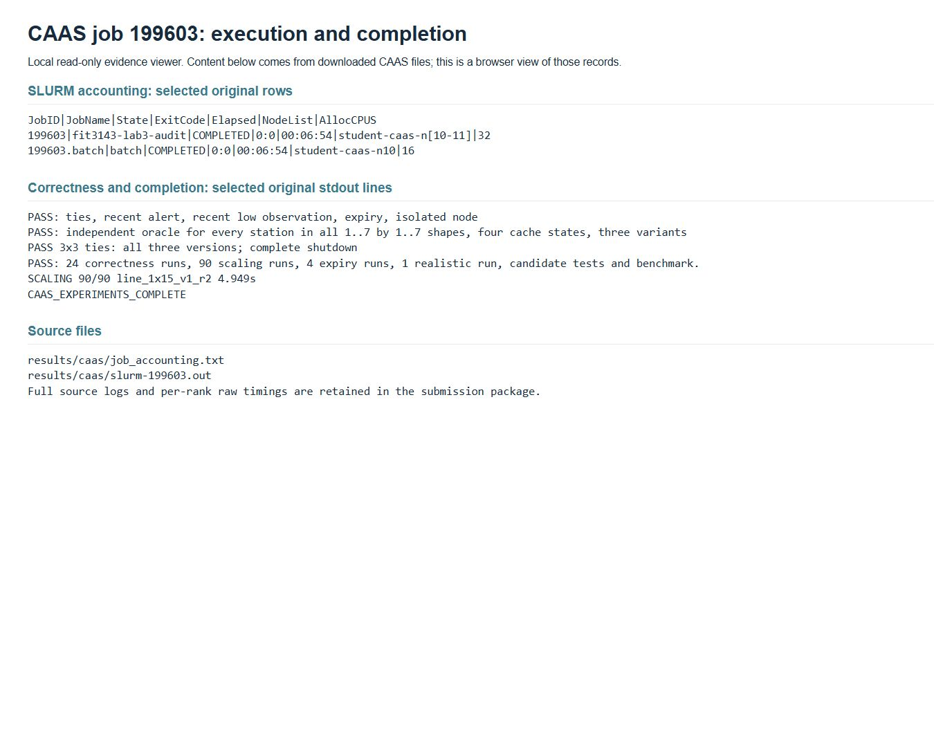
FIT3143 / LAB 3 / APPENDIX / CAAS EVIDENCE
CAAS completion and correctness evidence
Authentic screenshot of the local evidence viewer displaying unmodified CAAS scheduler/test output.
Savin Vindiv De Alwis 35221631 / Shamle Thilaksiri 35512075
32
Notes:
The screenshot is a real browser capture of the evidence viewer; it is not a generated terminal image. The underlying captured CAAS files are retained in results/caas/ and can be checked independently. No folder listing is used as proof of execution.

Slide 33
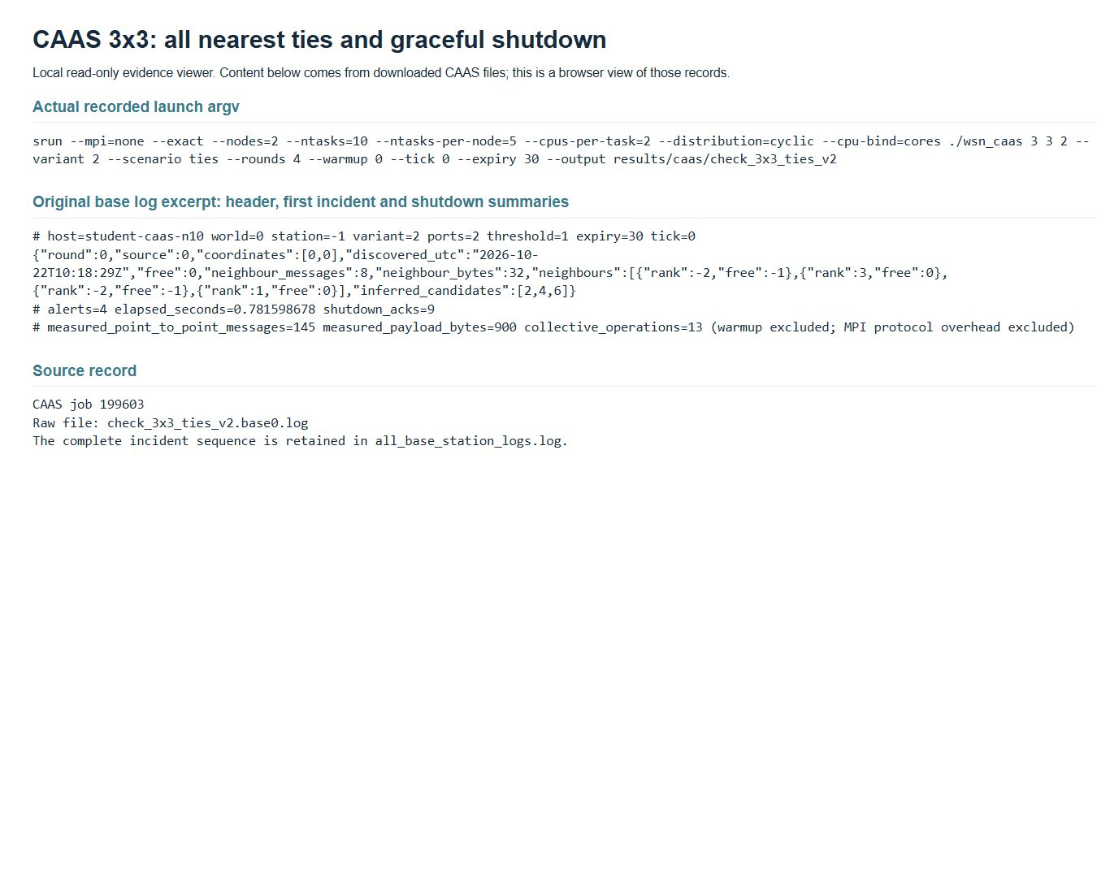
FIT3143 / LAB 3 / APPENDIX / CAAS EVIDENCE
CAAS all-ties and shutdown evidence
Authentic screenshot of the local evidence viewer displaying a CAAS 3x3 all-ties base log.
Savin Vindiv De Alwis 35221631 / Shamle Thilaksiri 35512075
33
Notes:
The screenshot is a real browser capture of the evidence viewer; it is not a generated terminal image. The underlying captured CAAS files are retained in results/caas/ and can be checked independently. No folder listing is used as proof of execution.

Slide 34
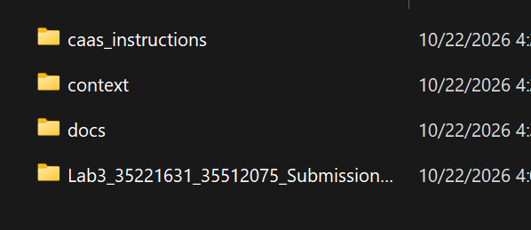
FIT3143 / LAB 3 / APPENDIX / SOURCE MATERIAL
Supplied project folder structure
User-supplied local folder structure: the assessment inputs and original implementation package.
This image records file organisation only. CAAS execution is evidenced by the separate verified logs and captures.
Savin Vindiv De Alwis 35221631 / Shamle Thilaksiri 35512075
34
Notes:
Recovered supplied attachment from the related Update Lab 3 Prompt chat. This is a local project-directory screenshot, not proof of CAAS login or execution. It is retained as source context only, outside the main presentation.

