Slide 1
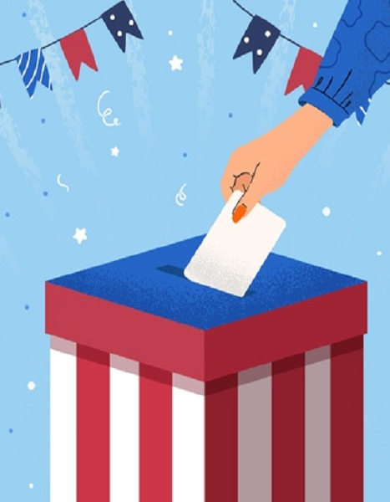
The PRESIDENTIAL RACE
Safal, Shamma & Fatima
TEAM GREEN

Slide 2


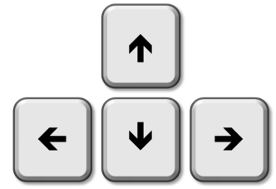


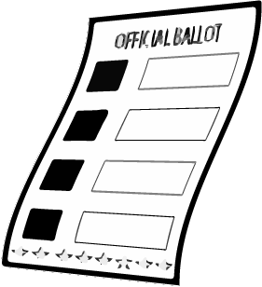

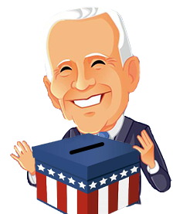
GAME DESCRIPTION
STRATEGY
Single player game / Movement by arrows
WIN STATE
Player recahes maximum of 270 votes
LOSE STATE
Opponent score reaches 270 votes
VOTE & SPEED
Gain points/ lose point
Increase/ Decrease Speed

Slide 3
GAME demo

Slide 4
STATES
“MAIN”
“PLAYER”
“DIFF”
“PLAY”
“OVER”

Slide 5
UML
Class (Game):
Attributes : self.state self.diff self.player self.score self.opp_score self.votes self.speed self.drop_rate self.sprite_count
Methods : Display Drop_object
Class (Vote):
Attributes : self.w self.h self.x self.y self.speed self.ability self.worth self.img
Methods : Display Update Collides

Slide 6
Class: (Player)
Attributes : self.w self.h self.g self.x self.left self.right self.img self.speed self.fast_time self.slow_time self.name self.trump_sprite self.biden_sprite self.update
Methods : Display update
Class (Trump):
Attributes : self.img
Methods :
Class (Biden):
Attributes : self.img
Methods :

Slide 7
safal
shamma
fatIma
Character images by use of Adobe Photoshop
Background design selections
Presentation Slides
Game Class
Special objects
Sound design
Collision
Animation
Final Design Integration
Object Class
Game Screens Design
Integration
Designing Objects (Illustrator)
Character Class
SIDE NOTE : We met on a daily basis for almost 2 hours to update each other on the work, combine our work and engage together on some parts

