Slide 1
MUSIC CLASSIFICATION
AND
RECOMMENDATION SYSTEM USING
MACHINE LEARNING
-Shammith R 2VX21CB024
VenkatReddy 2VX21CB032
Vishwanath Reddy 2VX21CB034
Jotiba Dukare 2VX21CB008

Slide 2
CONTENTS
Introduction
Problem Statement
Objectives
Methodology
System Requirements
Results and Analysis
Future Scope
References

Slide 3
INTRODUCTION
MRS
Music plays a crucial role in human emotions, influencing mood, feelings, and overall well-being. Traditional music recommendation systems rely on user history, genre preferences.
This project introduces an emotion-based music recommendation system. By utilizing the YouTube API, the system provides real-time, personalized recommendations.

Slide 4
MCS
Overview of Music Classification System (MCS)
Uses machine learning to classify music genres
Two input modes: File Upload & Audio Recording
Based on GTZAN Genre Classification Dataset

Slide 5
Problem Statement
MRS
Challenges
Extracting Accurate Emotion-to-Music Mapping
Handling Diverse User Preferences and Genres
Filtering and Selecting Relevant YouTube Content Dynamically
Providing a Seamless User Interface for Interaction

Slide 6
MCS
Challenges
1) Variability in music styles and composition
2) Background noise and distributions
3) Inbalanced datasets (biased classification)

Slide 7
OBJECTIVES
MRS
Emotion-Based Music Selection
Accurate Emotion-to-Music Mapping
Real-Time Music Retrieval Support for Multiple Languages
User-Friendly Interface

Slide 8
MCS
Develop an ML-based system for genre classification
Implement two input methods: File Upload & Audio Recording
Train an SVM model on extracted audio features
Improve accuracy using feature engineering and preprocessing

Slide 9
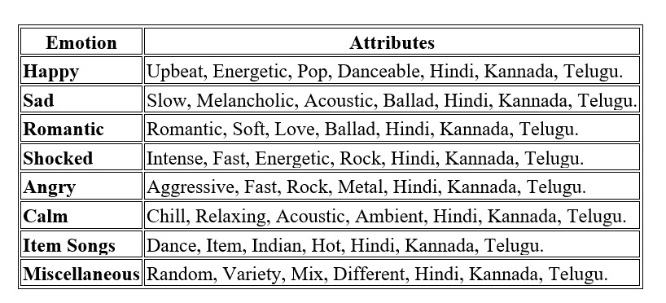
METHODOLOGY
MRS
Emotion-to-Attributes Mapping

Slide 10
MCS
Data Source: GTZAN dataset (10 genres, 1000 audio files)
Feature Extraction: MFCC, Spectral Centroid, Zero Crossing Rate, Chroma, Mel Spectrogram
Model: Support Vector Machine (SVM)
Training: 80-20 train-test split
Evaluation: Accuracy, Classification Report, Confusion Matrix

Slide 11
SYSTEM REQUIREMENTS
Hardware Requirements:
Minimum: Intel Core i3, 4GB RAM, 10GB free storage, internet connection.
Recommended: Intel Core i5/i7 or AMD Ryzen 5/7, 8GB RAM, SSD with 20GB free space.
Software Requirements:
OS: Windows 10/11, macOS, Linux
Language: Python
IDE: VS Code, PyCharm, Jupyter Notebook
Libraries: pandas, numpy, matplotlib, youtube-dl, Flask/Django
APIs: YouTube Data API v3

Slide 12
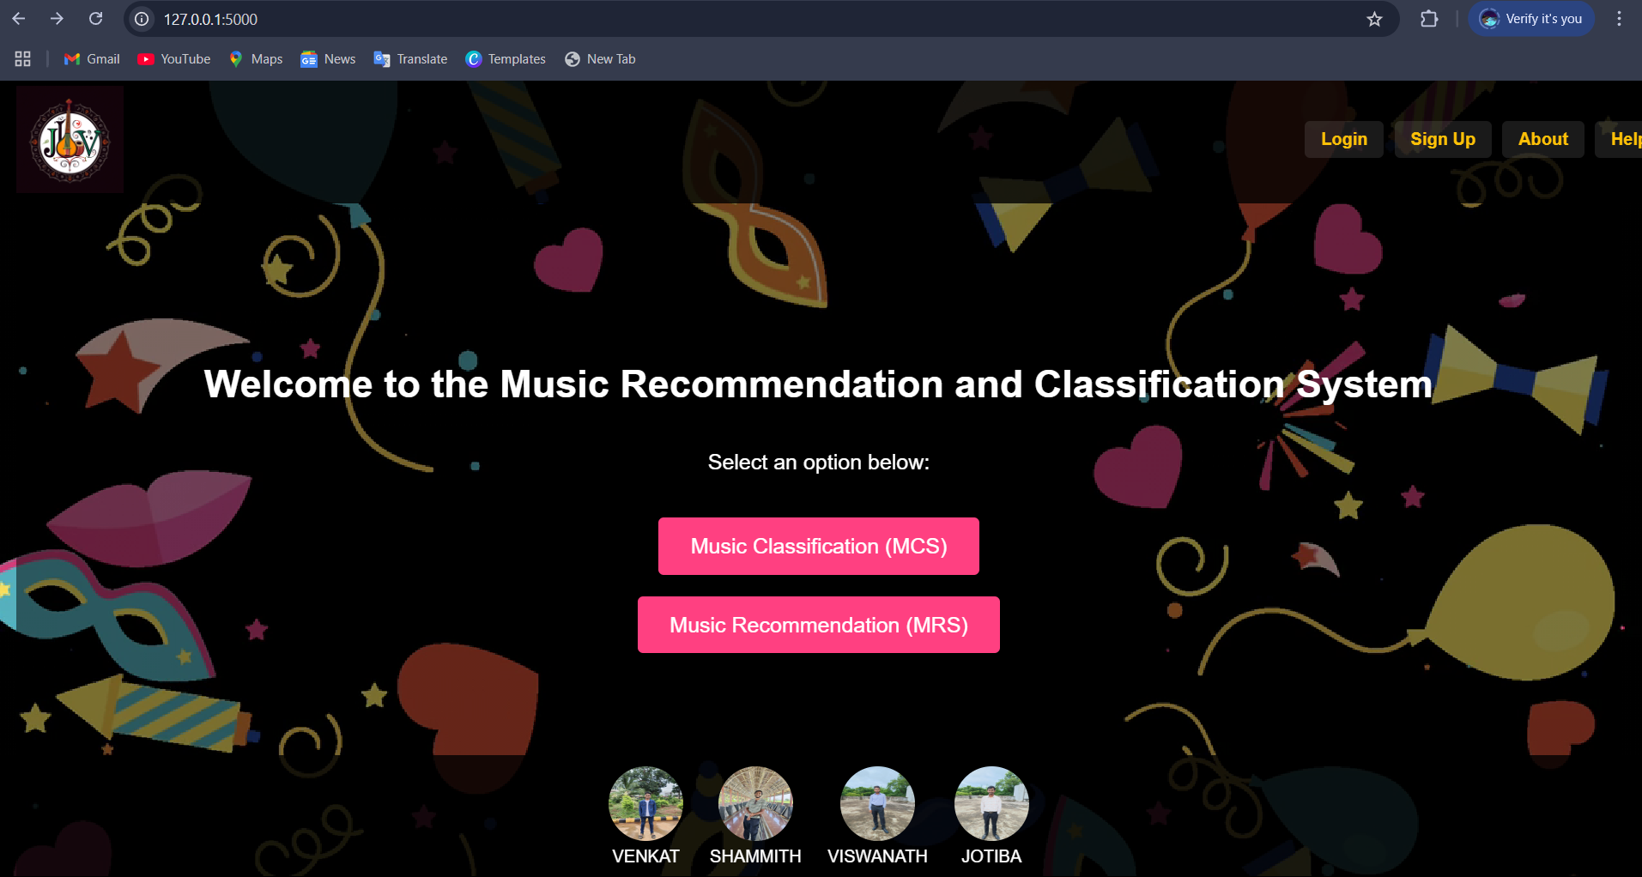
Results and Analysis

Slide 13
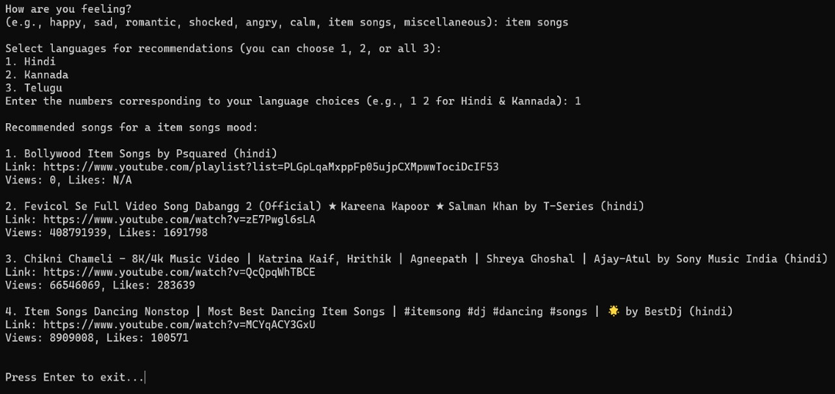
MRS

Slide 14
MCS
Model accuracy: For file_based -70% (SVM with optimized hyperparameters) and audio_based-10% (SVM with optimized hyperparameters)
Confusion matrix showing correct and incorrect classifications
Visualization: Genre-wise classification accuracy, performance metrics

Slide 15
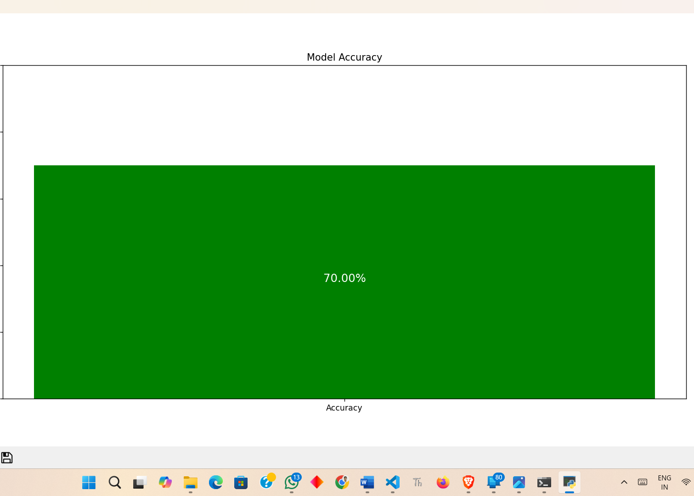
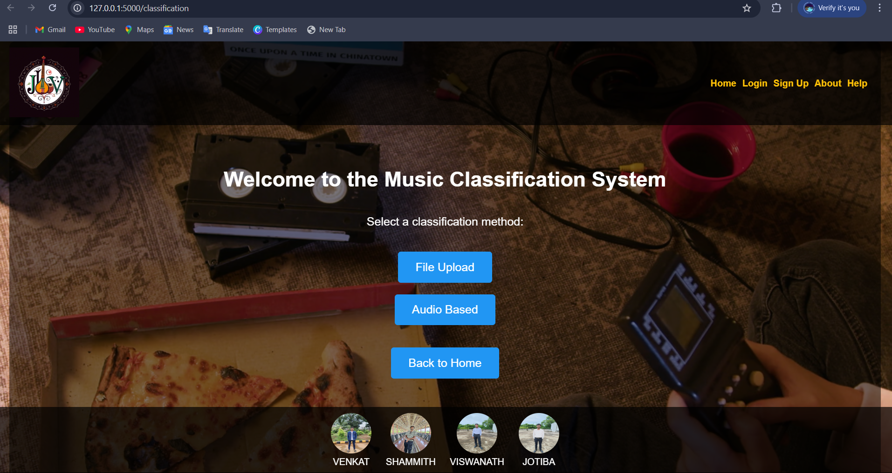
Fig., MCS Wepage-Home
Fig., Accuracy chart for file_based upload classification

Slide 16
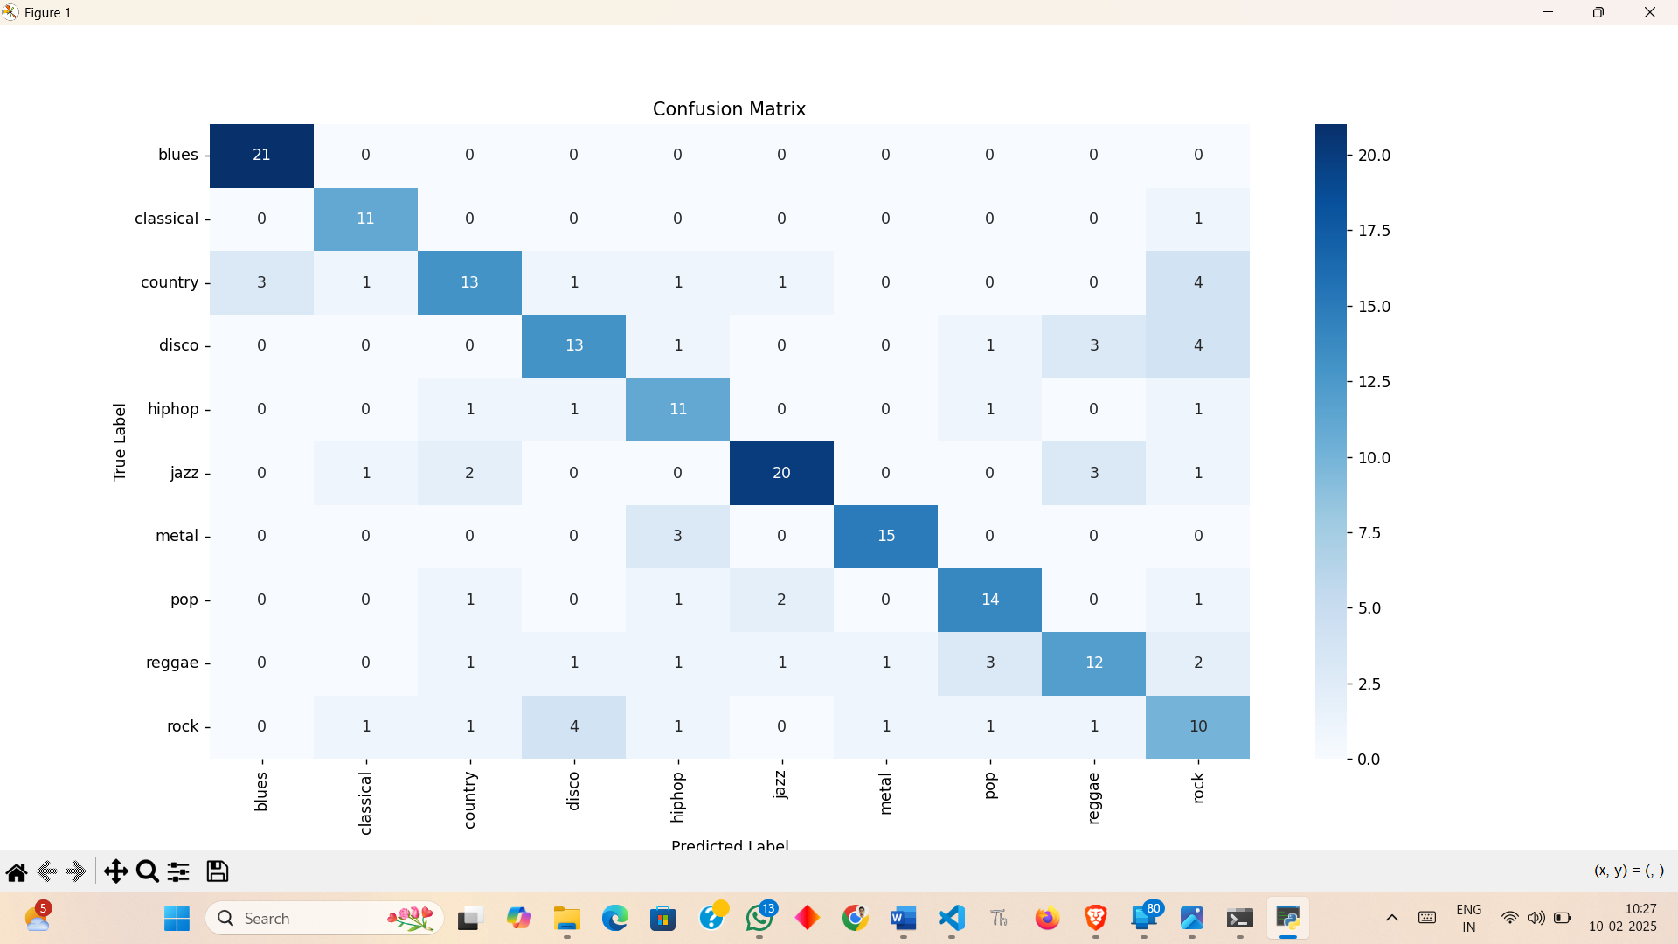
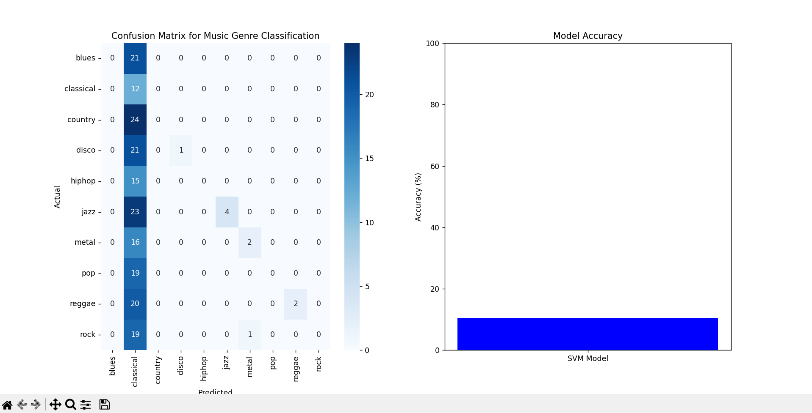
Fig. File_upload
Fig. audio_based

Slide 17
Thank you

