Slide 1
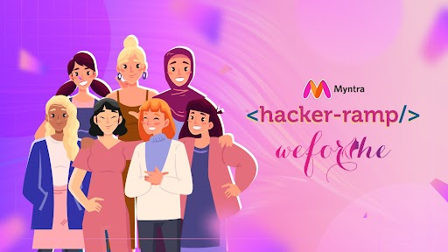
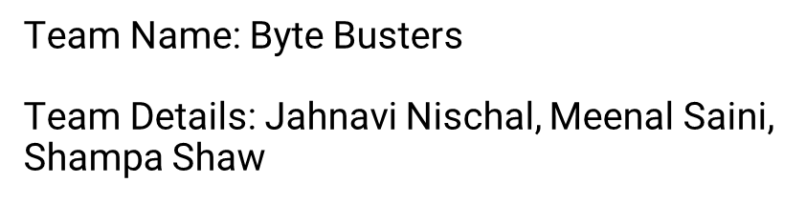

Slide 2
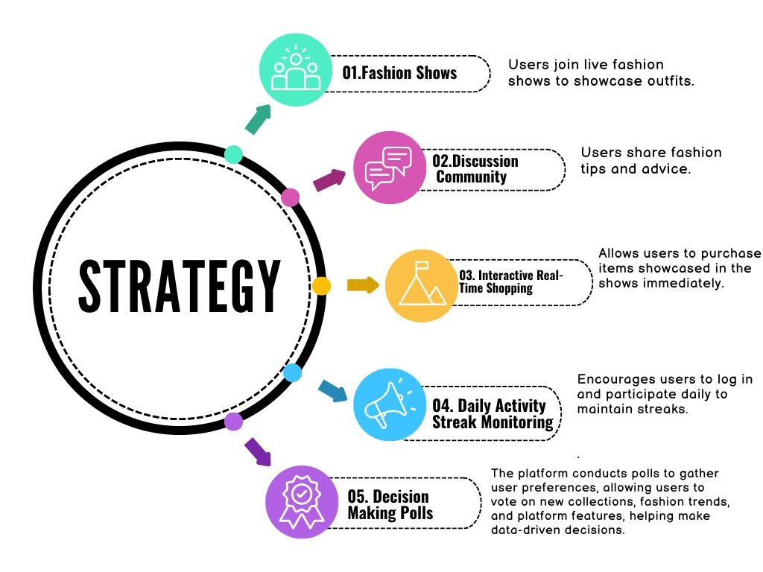
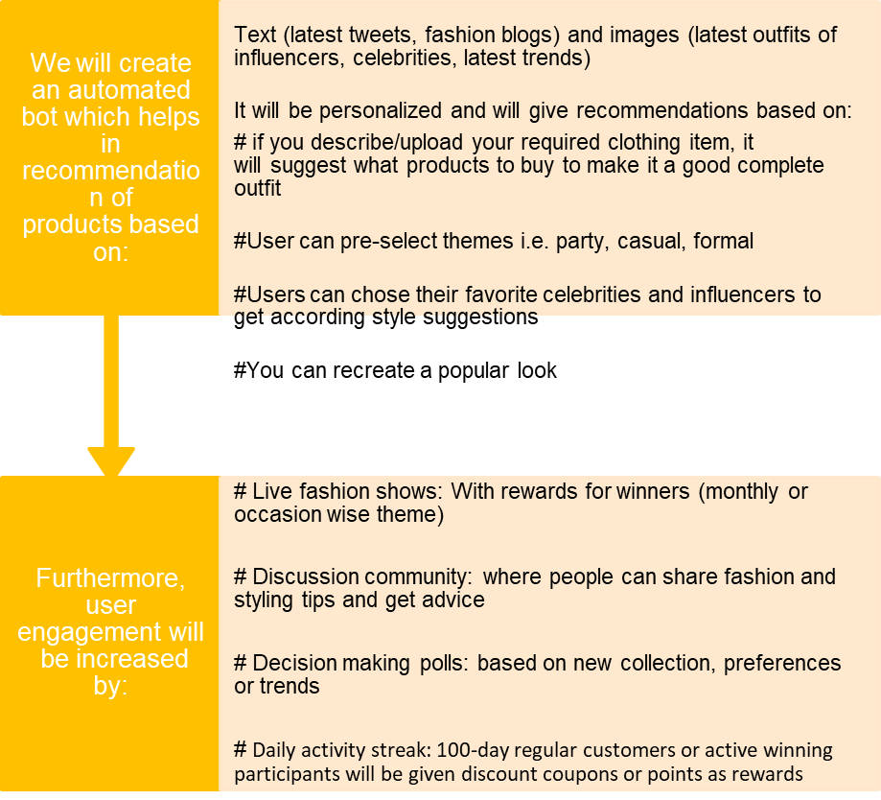

Slide 3
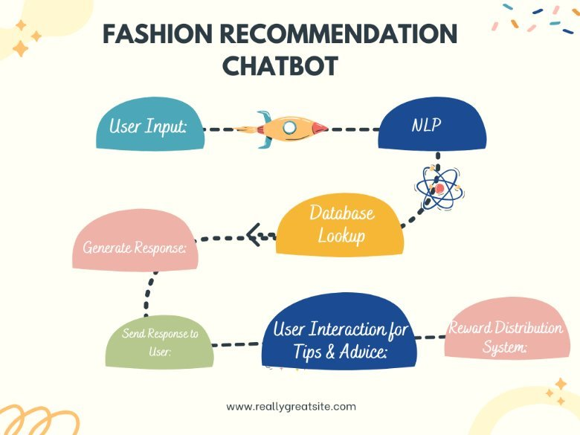
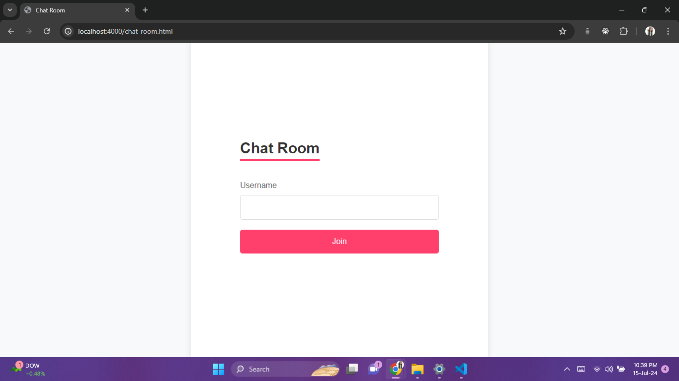
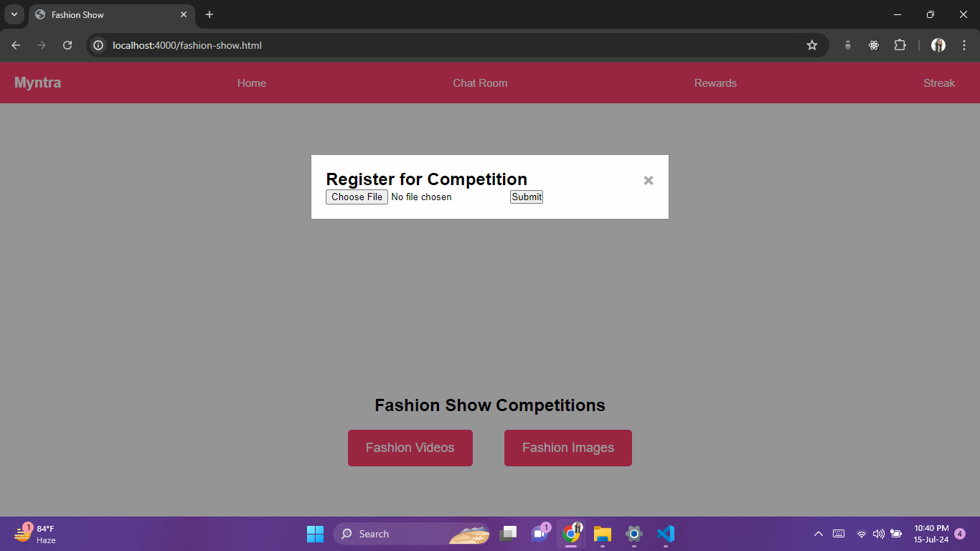
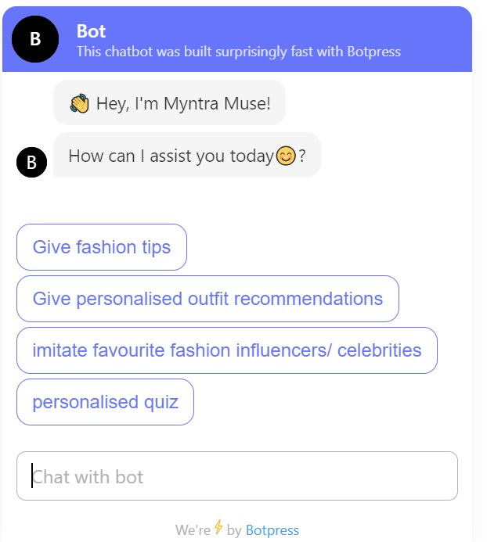
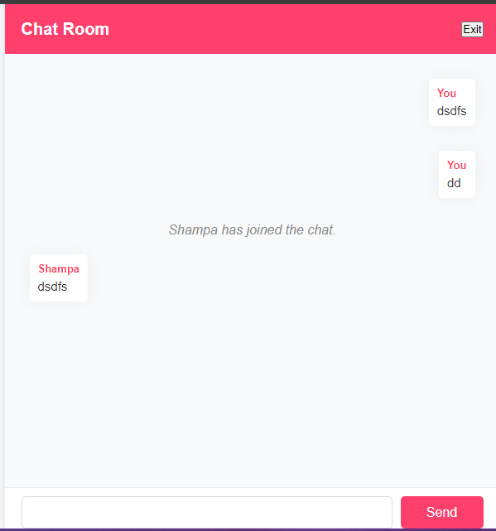
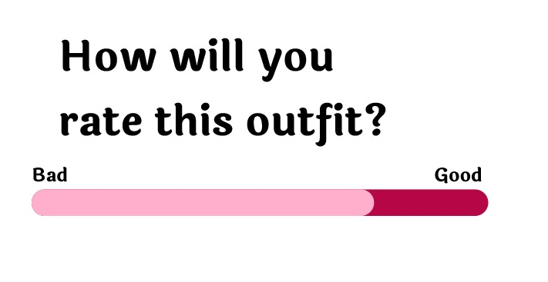
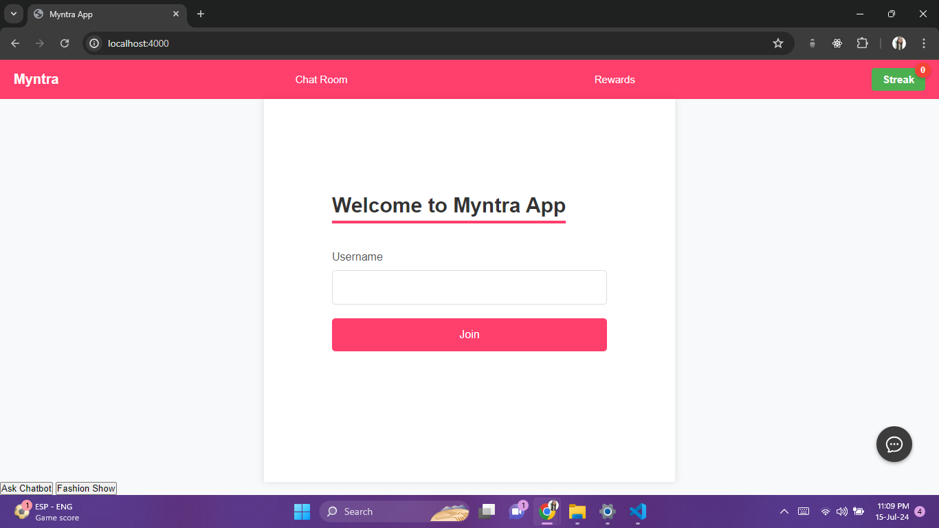
Features
Competition feature
Community chatroom feature
Chatbot feature
Rating meter
​
​
Streak feature
​
​
​

Slide 4
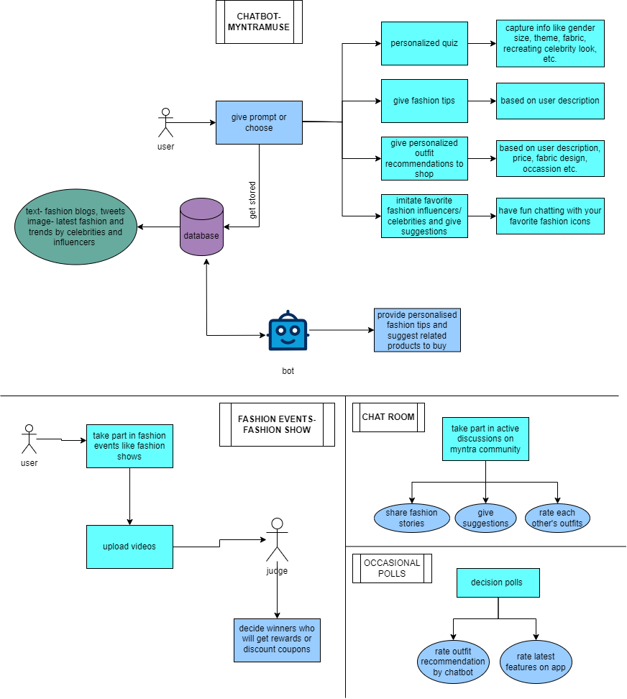
Workflow
Through chatbot- MyntraMuse, users can attempt a personalized quiz to tailor their preferences like theme(party, casual or work), favorite colours, fabric, size, etc. Users then provide a text or image prompt detailing the type of outfit they are looking for, asking for fashion tips or imitation of favorite fashion icons. This input is processed by bot, which accesses a database (tweets, fashion blogs, and images of latest fashion trends from fashion icons). The bot uses this data to suggest related products that users can buy, making the shopping experience more personalized and efficient.
Users can take part in fashion events like fashion shows. Users can upload videos of their participation, which are then reviewed by judges. These judges decide the winners, who are rewarded with prizes such as discount coupons. This interactive element adds a layer of excitement and competition, motivating users to actively engage with the platform.
Users can join discussions within the Myntra community chat room and rate each other's outfits, give fashion suggestions and share their fashion stories.
Users can be a part of decision polls, where they can rate outfit recommendations by chatbot or new features.
Through daily streak feature, consistent customers will be rewarded points or discount coupons.

Slide 5

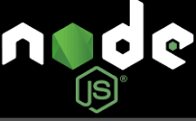

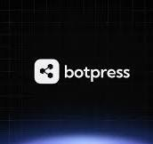


Tech Stack

Slide 6
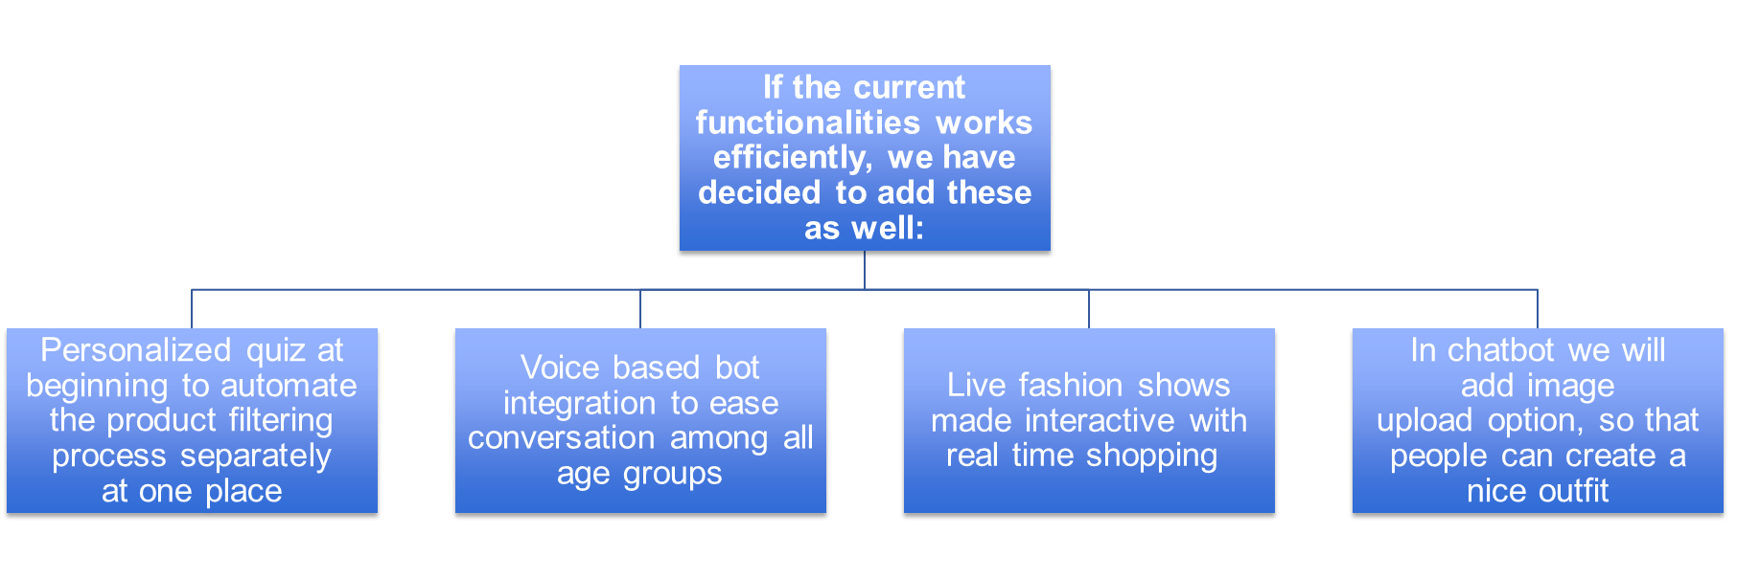
Future Work

