Slide 1
Before we begin
https://code.world/haskell
Make sure to use the /haskell!

Slide 2

Haskell
Lazy, Pure, Functional, And Your First Language

Slide 3
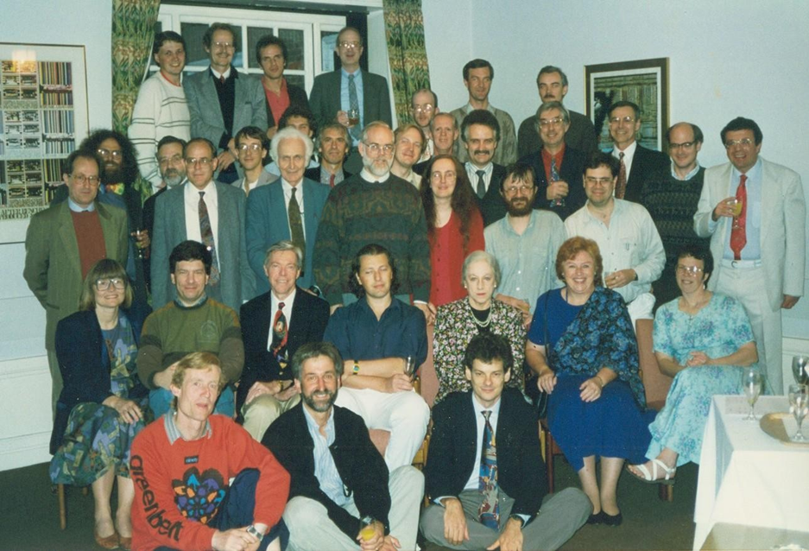
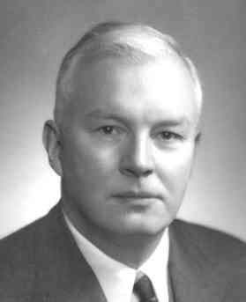
History
Alonzo Church: Famous Mathematician (1930s, λ-calculus)
Haskell Curry: Famous Logician (~1960, Curry-Howard Isomorphism)
John McCarthy: Computer Scientist (~1960, Lisp)
Simon Peyton Jones & conspirators (late 1980s, Haskell!)

Slide 4
What were all those terms from the first slide!?
Lazy
Values aren’t produced until they have to be.
`1 + 4 * 5` stays as `1 + 4 * 5` until you force it to be `21`
Pure(ish)
No side effects. Limited side effects!
A function from Integer to Integer can’t launch ICBMs, or print out.
No mutation (if x is 5, x is always 5)
Functional
Functions are values in themselves
Lots of other junk, and no formal definition
Notes:
Give examples!!!

Slide 5
DON’T WORRY IF THAT DIDN’T MAKE SENSE!

Slide 6
Let's start coding!

Slide 7
My first program
{-# LANGUAGE OverloadedStrings #-} import CodeWorld ourPicture :: Picture ourPicture = blank main :: IO () main = drawingOf ourPicture
Notes:
Mention SPJ + yellow Comic Sans on blue background

Slide 8
My first program
import CodeWorld ourPicture :: Picture ourPicture = blank main :: IO () main = drawingOf ourPicture
Notes:
Mention SPJ + yellow Comic Sans on blue background

Slide 9
Let’s spice it up
import CodeWorld ourPicture :: Picture ourPicture = circle 10 main :: IO () main = drawingOf ourPicture

Slide 10
This won’t work
import CodeWorld ourPicture :: Picture ourPicture = circle 5
ourPicture = circle 3 main :: IO () main = drawingOf ourPicture
Notes:
(im)Mutability!

Slide 11
Waddya think? (Number one)
mystery :: Integer mystery = mystery + 1

Slide 12
Waddya think? (Number one)
mystery :: Integer mystery = mystery + 1 = ∞
“Mystery is a value one greater than mystery, and the only number for which n = n + 1 is infinity!”

Slide 13
My first function
import CodeWorld
bigCircle :: Double -> Picture
bigCircle r = circle (1.5 * r)
ourPicture :: Picture ourPicture = bigCircle 5 main :: IO () main = drawingOf ourPicture

Slide 14
Side Note: Overlaying pictures
import CodeWorld
bigCircle :: Double -> Picture
bigCircle r = circle (1.5 * r)
ourPicture :: Picture ourPicture = bigCircle 5
originalCircle :: Picture
originalCircle = circle 5 main :: IO () main = drawingOf (ourPicture & originalCircle)

Slide 15
Abtholutely Thickening
import CodeWorld
bigCircle :: Double -> Picture
bigCircle r = circle (1.5 * r)
ourPicture :: Picture ourPicture = bigCircle 5
originalCircle :: Picture
originalCircle = solidCircle 5 main :: IO () main = drawingOf (ourPicture & originalCircle)

Slide 16
Abstracting Our Functions
import CodeWorld
myCircle :: Bool -> Double -> Picture
myCircle thick r = if thick then solidCircle r else circle r
ourPicture :: Picture ourPicture = myCircle False 7.5
originalCircle :: Picture
originalCircle = myCircle True 5 main :: IO () main = drawingOf (ourPicture & originalCircle)
Notes:
BE CLEAR ABOUT WHAT ABSTRACTION MEANS!

Slide 17
Side Note: Booleans
Booleans (Bools) are True or False values.
theSkyIsBlue :: Bool
theSkyIsBlue = True
itIsWednesday :: Bool
itIsWednesday = False
isItWednesday :: Day -> Bool

Slide 18
Abstracting Our Functions
import CodeWorld
myCircle :: Bool -> Double -> Picture
myCircle thick r = if thick then solidCircle r else circle r
ourPicture :: Picture ourPicture = myCircle False 7.5
originalCircle :: Picture
originalCircle = myCircle True 5 main :: IO () main = drawingOf (ourPicture & originalCircle)
Notes:
BE CLEAR ABOUT WHAT ABSTRACTION MEANS!

Slide 19
Checkpoint!

Slide 20
Where Bindings and Function Definition
import CodeWorld
myCircle :: Bool -> Double -> Picture
myCircle thick r = makeCircle r
where makeCircle = if thick then solidCircle else circle
ourPicture :: Picture ourPicture = myCircle False 7.5
originalCircle :: Picture
originalCircle = myCircle True 5 main :: IO () main = drawingOf (ourPicture & originalCircle)
Notes:
BE CLEAR ABOUT WHAT ABSTRACTION MEANS!

Slide 21
“Cross off both sides” (eta reduction)
import CodeWorld
myCircle :: Bool -> Double -> Picture
myCircle thick = makeCircle
where makeCircle = if thick then solidCircle else circle
ourPicture :: Picture ourPicture = myCircle False 7.5
originalCircle :: Picture
originalCircle = myCircle True 5 main :: IO () main = drawingOf (ourPicture & originalCircle)
Notes:
Currying :/

Slide 22
Side Note: Currying
f :: (Integer, Integer) -> Integer
f (a, b) = a * b + 9
f’ :: Integer -> (Integer -> Integer)
f’ a = helper
where helper b = a * b + 9
Or, f’ a b = a * b + 9 :: Integer -> Integer -> Integer
for any a and b: f’ a b = (f’ a) b = f (a,b)
Notes:
Currying is the idea that a function of 2 arguments is the same as a function of 1 argument that produces a function of one argument.
In Haskell, functions are curried by default, and the syntax of function definition/application is designed to support currying.
There is in fact a pair of functions that, given a curried/uncurried function, produce the equivalent uncurried/curried version

Slide 23
Inlineing
import CodeWorld
myCircle :: Bool -> Double -> Picture
myCircle thick = makeCircle
where makeCircle = if thick then solidCircle else circle
ourPicture :: Picture ourPicture = myCircle False 7.5
main :: IO () main = drawingOf (ourPicture & myCircle True 5)
Notes:
Operartor precedence!

Slide 24
Lists!
import CodeWorld
myCircles :: [Picture]
myCircles = [circle 3, circle 4, circle 5, circle 6]
main :: IO () main = drawingOf (pictures myCircles)
Notes:
Explain pictures

Slide 25
Map!?!! Our first HOF!
import CodeWorld
myCircles :: [Picture]
myCircles = map circle [3, 4, 5, 6]
main :: IO () main = drawingOf (pictures myCircles)
Notes:
V IMPORTANT!

Slide 26
Animation (our second HOF)!
import CodeWorld
main :: IO () main = animationOf circle
Notes:
AnimationOf

Slide 27
Animation + Lists
import CodeWorld main :: IO () main = animationOf concentric
where concentric t = pictures (map circle [1..t])
Notes:
Animations are described really beautifully in Haskell. Since functions are just regular old values, an animation can be viewed as a function from a double (the current time) to a

Slide 28
Lambdas make the world go round
import CodeWorld main :: IO () main = animationOf (\t -> pictures (map circle [1..t]))
Notes:
Animations are described really beautifully in Haskell. Since functions are just regular old values, an animation can be viewed as a function from a double (the current time) to a

Slide 29
A taste of what’s yet to come
tinyurl.com/CodeDayHaskell
Notes:
Animations are described really beautifully in Haskell. Since functions are just regular old values, an animation can be viewed as a function from a double (the current time) to a

Slide 30
So long, and thanks for all the fish
Resources:
HaskellBook.com
LearnYouAHaskell.com
seas.upenn.edu/~cis194
IRC #haskell
SeattleHaskell.org (watch out for a possible class with me)

