Slide 1



ORANGE
CODING ACADEMY
WEB
DEVELOPMENT
TEAM 2

Slide 2

CONTENT
01
WHAT IS THE DIFFERENCE BETWEEN THE INTERNET AND THE WEB?
02
WHAT IS WEB DEVELOPMENT?
03
JOBS IN WEB DEVELOPMENTS:
FULL STACK - FRONT-END - BACKEND - UI/UX - PROJECT MANAGER - QUALITY
04
MOST POPULAR TECHNOLOGIES ON THE WEB?
05
SALARIES FOR WEB DEVELOPERS?
06
MOST DEMAND FIELD IN WEB DEVELOPMENT?

Slide 3



1-WHAT IS THE DIFFERENCE BETWEEN THE INTERNET AND THE WEB?
Internet
A global system of interconnected computer networks that use TCP/IP protocol to link devices worldwide.
component: Hardware(servers, routers, devices), protocols(TCP/IP, FTP, SMTP, etc) and various services.
Web
is a massive collection of digital pages to access information over the internet.
The Web is viewed through web software such as Google Chrome
component Websites, web pages, web servers and hyperlinks that are used to navigate between them.

Slide 4




2- WHAT IS WEB DEVELOPMENT?
refers to the creating, building, and maintaining of websites. It includes aspects such as web design, web publishing, web programming, and database management. It is the creation of an application that works over the internet
Web Development can be classified into two ways:
1-Frontend Development
2-Backend Development

Slide 5




3-JOBS IN WEB DEVELOPMENTS:
full stack
front-end
backend

Slide 6
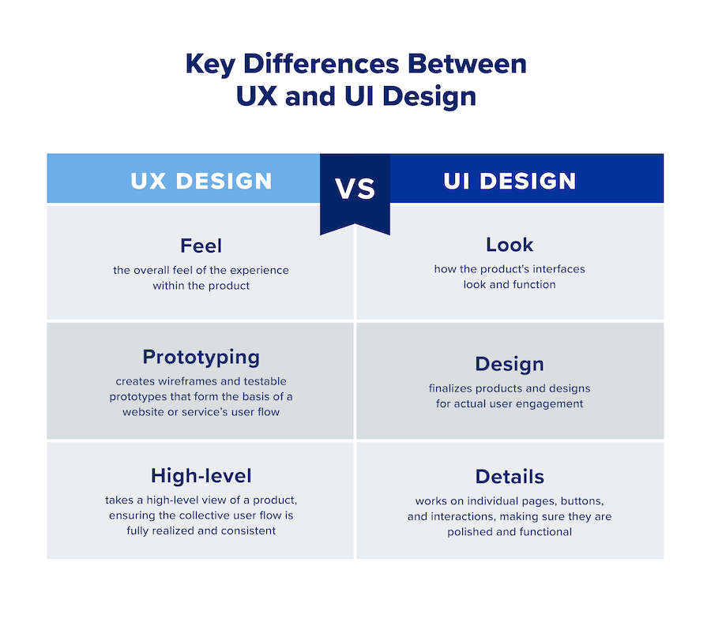

UI/UX :

Slide 7
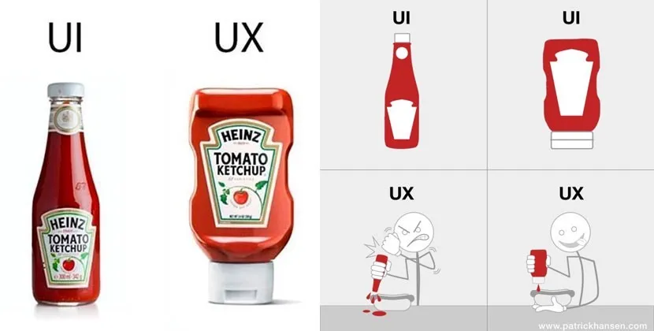

Slide 8

PROJECT MANAGER :
01
02
03
04
05
06
SCOPE
SCHEDULE
FINANCE
RISK
QUALITY
RESOURCES

Slide 9

MOBILE DEVELOPER:
creating mobile applications for phones and tablets, using programming languages.

Slide 10

QUALITY ASSURANCE AND QUALITY CONTROL :

Slide 11

DEVOPS:

Slide 12
4-MOST POPULAR TECHNOLOGIES ON THE WEB?
HTML, CSS, and JavaScript. These are the core technologies of web development, as they are used to create the structure, style, and functionality of web pages and applications. HTML stands for HyperText Markup Language, which defines the elements and attributes of a web page.

Slide 13
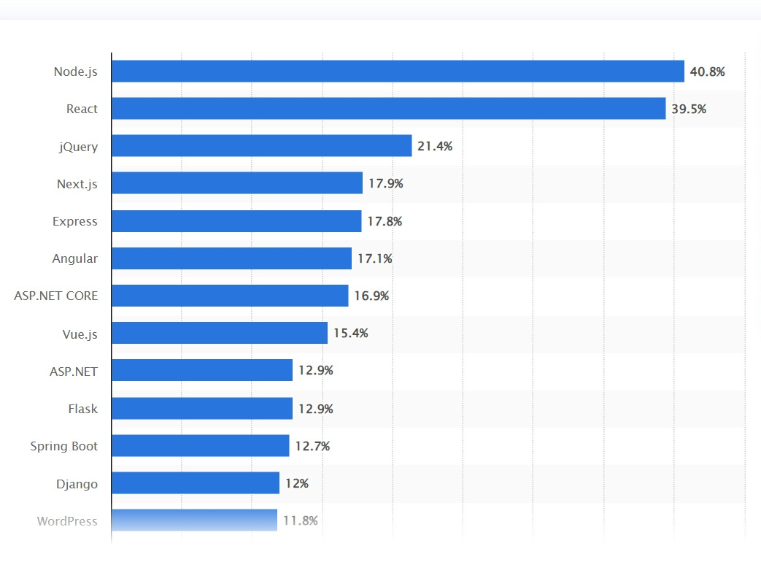
WHAT IS THE MOST USED WEB TECHNOLOGY?
Most popular web frameworks among developers worldwide 2024
Published by ionel Sujay Vailshery,Aug 7, 2024

Slide 14
WHAT IS THE BEST SOURCE FOR TECH NEWS?
https://techcrunch.com/
https://thenextweb.com/conference
https://techcrunch.com/
https://www.wired.com/
https://www.firstpost.com/tech/
https://gizmodo.com/
https://me.mashable.com/
https://www.theverge.com/

Slide 15
SALARIES FOR WEB DEVELOPERS?
01
02
03
04
05
06
EXPERIENCE
INDUSTRY
LOCATION
TECHNICAL SKILLS & JOB TITLE
SOFT SKILLS
COMPANY SIZE

Slide 16



TIPS YOU CAN APPLY TO IMPROVE YOUR SKILLS AND INCREASE YOUR SALARY
Building relationships and communications
Keep learning and updating your skills
Portfolio

Slide 17
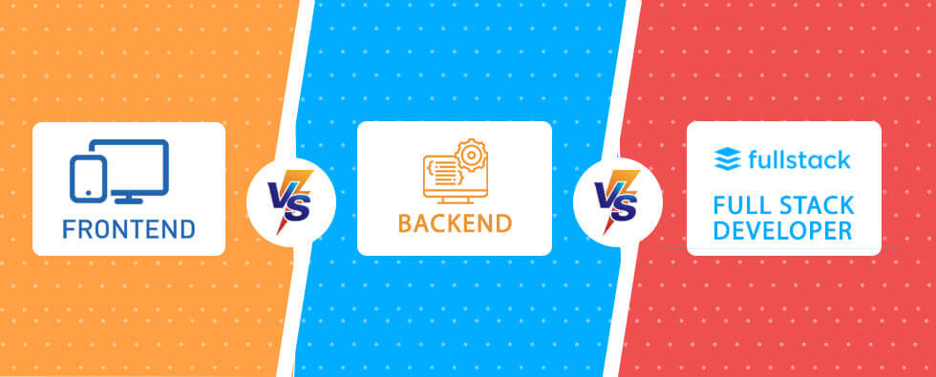
6-MOST DEMAND FIELDS IN WEB DEVELOPMENT?
Back-end vs Front-end vs Full-stack

Slide 18
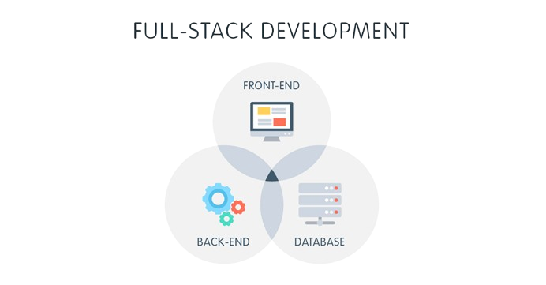
6-MOST DEMAND FIELD IN WEB DEVELOPMENT?
Why is the demand for Full-stack developers so high?

Slide 19
OUR TEAM
Shahed Altrakiah
Ahmad Alfararjeh
Shams Aldeen Alhajjaj
Salem Qundil
Belal Shakra
Haneen Alkhdour

Slide 20

THANK'S FOR WATCHING
ORANGE
CODING ACADEMY

