Slide 1

CAN IN THE TM4C123GH6PM microcontroller
A Standard Serial Communication Protocol
Author: Shams Eldin Elgohary

Slide 2
Introduction
CAN stands for Controller Area network. It is an Asynchronous serial communication protocol introduced in 1986 by Robert Bosch.
CAN protocol is a message based protocol not address based means transmitted data is available for all nodes and its receiver’s choice to receive data or not.
CAN nodes are connected on two wire(CAN_H and CAN_L) twisted pair cable(termed as CAN bus) terminated with 120Ω resistance to prevent the reflection.
CAN is basically designed to replace the conventional wiring used in old days in the automobile for communication between ECUs.

Slide 3
Introduction Cont.
In modern Automobile system, there are many ECUs for various subsystems like engine control unit, steering, suspension, ADAS etc. interconnection between each other is essential which would be very costly and complex through conventional wiring while CAN provide an economic and appropriate solution.
Controller Area Network (CAN) is a multicast, shared serial bus standard for connecting electronic control units (ECUs). CAN was specifically designed to be robust in electromagnetically-noisy environments.
Bit rates up to 1 Mbps are possible at network lengths less than 40 meters. Decreased bit rates allow longer network distances (for example, 125 Kbps at 500 meters).

Slide 4
APPLICATIONS
Originally CAN was developed by Bosch for in-Vehicle communication in passenger Cars but now a days due to its enrich features it is used in many industry.Some of the applicaton areas as follows:
In transportation system (rail vehicle, aircraft, marine, etc.)
In home and building automation (e.g. HVAC, elevators)
In industrial machine control systems
In mobile machines (construction and agriculture equipment)
In medical devices and laboratory automation

Slide 5
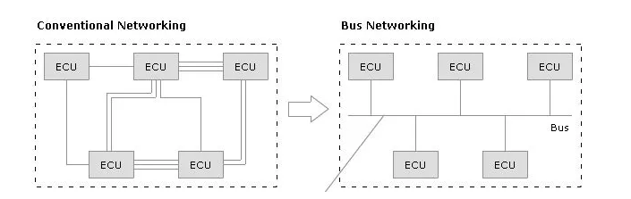
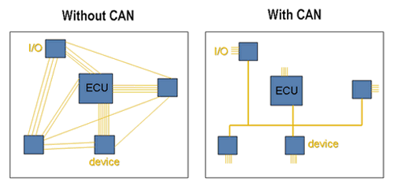
NEED OF CAN
In course of time, many more features and functionalities are added in the automobiles, as a result of this number of ECUs increased. These ECUs are connected with each other to share the information between them. this conventional wiring is very complex and very tough to handle.
To overcome this complexity of conventional wiring and increase the data transfer rate Bosch started to develop a serial protocol which is known as Controller Area Network.

Slide 6
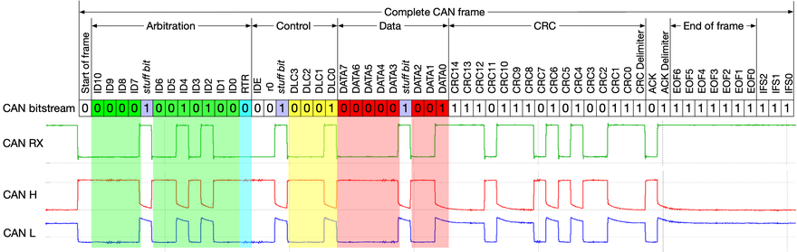
cAN Data/Remote Frame
A data frame contains data for transmission, whereas a remote frame contains no data and is used to request the transmission of a specific message object.
The CAN data/remote frame is constructed as shown in the Figure.
Message Identifier can be configured to be 11 bits (Standard) or 29 bits (Extended).
CAN Data Field can hold up to 64 bits (8 bytes)
The protocol controller transfers and receives the serial data from the CAN bus and passes the data on to the message handler, The message handler then loads this information into the appropriate message object based on the current filtering and identifiers in the message object memory.

Slide 7
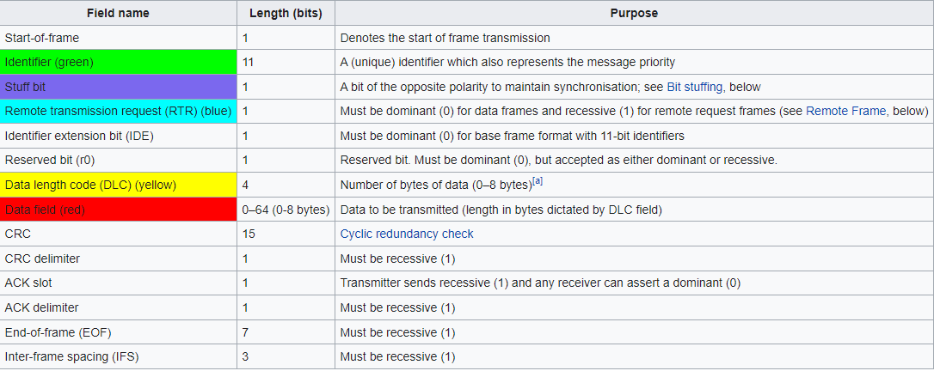

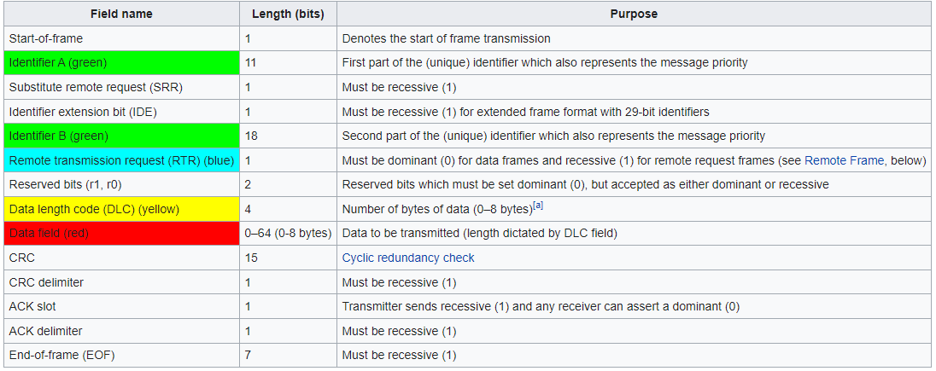
Extended format

Slide 8
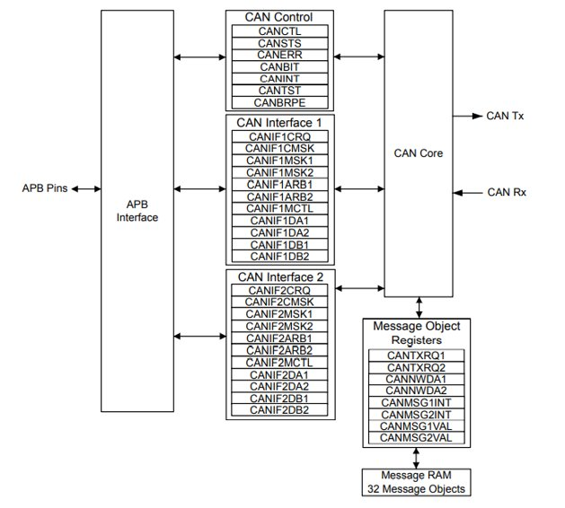
CAN Controller Block Diagram IN TM4C123GH6PM microcontroller
The TM4C123GH6PM microcontroller includes two CAN units.
The message object memory is a set of 32 identical memory blocks that hold the current configuration, status, and actual data for each message object. These memory blocks are accessed via either of the CAN message object register interfaces.
The message memory is not directly accessible in the TM4C123GH6PM memory map, so the TM4C123GH6PM CAN controller provides an interface to communicate with the message memory via two CAN interface register sets for communicating with the message objects.
These two interfaces must be used to read or write to each message object. The two message object interfaces allow parallel access to the CAN controller message objects when multiple objects may have new information that must be processed. In general, one interface is used for transmit data and one for receive data.

Slide 9
Initialization steps
1- To use the CAN controller, the peripheral clock must be enabled using the RCGC0 register
2- Configure the GPIO pins to enable the CAN0/CAN1 alternative functions using the
Enable clock for the appropriate GPIO module clock using RCGC2 register.
Set the GPIO AFSEL bits for the appropriate pins.
Configure the appropriate PMCn fields in the GPIOPCTL register to assign the CAN signals.
Enable Digital Mode for the appropiate pins.
3- Software initialization is started by setting the INIT bit in the CAN Control (CANCTL) register.
some configuration registers are only accessible while in the initialization state.
4- Both the INIT and CCE bits in the CANCTL register must be set in order to access the CANBIT register and the CAN Baud Rate Prescaler Extension (CANBRPE) register to configure the bit timing.
5- To leave the initialization state, the INIT bit must be cleared.

Slide 10
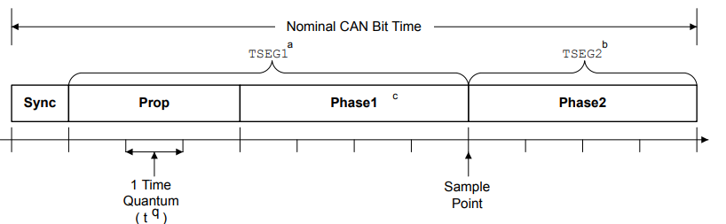
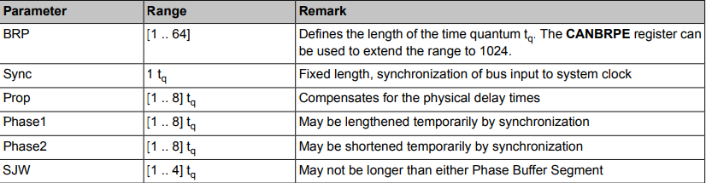

CAN BIT TIME
The CAN system supports bit rates in the range of lower than 1 Kbps up to 1000 Kbps. Each member of the CAN network has its own clock generator. The timing parameter of the bit time can be configured individually for each CAN node
The bit time is divided into four segments. Each segment consists of a specific, programmable number of time quanta ,Where ${ t}_{q}=\frac{BRP(Buad Rate Prescaler)}{f_{sys}}$
TSEG1 = Prop + Phase1
TSEG2 = Phase2
Phase1 = Phase2 or Phase1 + 1 = Phase2

Slide 11
OPERATION
Two sets of CAN Interface Registers (CANIF1x and CANIF2x) are used to access the message objects in the Message RAM
Once the CAN module is initialized and the INIT bit in the CANCTL register is cleared, the CAN module synchronizes itself to the CAN bus and starts the message transfer. As each message is received, it goes through the message handler's filtering process, and if it passes through the filter, it's stored in the message object specified by the MNUM bit in the CANIFnCRQ register.
The whole message (including all arbitration bits, data-length code, and eight data bytes) is stored in the message object.
If several transmit messages are assigned to the same message object (when the number of message objects is not sufficient), the whole message object has to be configured before the transmission of this message is requested.
The transmission of any number of message objects may be requested at the same time; they are transmitted according to their internal priority according to their ID.

Slide 12
Transmitting Message Objects
If the internal transmit shift register of the CAN module is ready for loading, and no data transfer is occurring between the CAN Interface Registers and message RAM, the valid message object with the highest priority that has a pending transmission request is loaded into the transmit shift register by the message handler and the transmission is started.
After a successful transmission, and if no new data was written to the message object since the start of the transmission, the TXRQST bit in the CANTXRQn register is cleared.
If the CAN controller is configured to interrupt on a successful transmission, TXIE bit in the CANIFnMCTL and the INTPND bit in the CANIFnMCTL register are set.
If the CAN lost the arbitration or if an error occurred during the transmission, the message is re-transmitted as soon as the CAN bus is free again (Messages are always transmitted in the order of their priority).

Slide 13
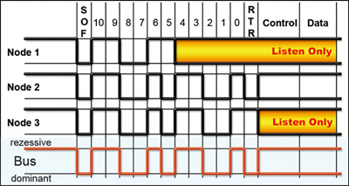
Can bus arbitration
Whenever the bus is free any CAN node can start transmitting a message.
If 2 or more CAN nodes start sending a message simultaneously, The node that gets the bus access depends on bitwise arbitration using the message identifier.
The node with the lowest message identifier has the highest priority as 1 is the recessive bit and 0 is the dominant bit.
The figure gives an example of an occurrence of a CAN bus arbitration.

Slide 14
Configure a Transmit Message Object
1-- In the CAN IFn Command Mask (CANIFnCMASK) register
Set the WRNRD (Write Not Read) bit to specify a write , specify whether to transfer the IDMASK, DIR, and MXTD of the message object into the CAN IFn registers using the MASK bit.
Specify which bits to transfer using the DATAA and DATAB bits.
Specify whether to transfer the ID, DIR, XTD, and MSGVAL of the message object into the interface registers using the ARB bit.
Specify whether to transfer the control bits into the interface registers using the CONTROL bit.
3- We have 2 types of formatting for the message ID:
For the 11 Bit Standard Format :
In the CANIFnMSK2 register the MSK[12:2] are used for bits [10:0] of the 11-bit message identifier for acceptance filtering.
Then Configure ID[12:2] in the CANIFnARB2 register for bits [10:0] of the 11-bit message identifier.
Clear the XTD bit to indicate standard identifier, and set the DIR bit to indicate transmit, and the MSGVAL bit to indicate that the message object is valid.

Slide 15
Configure a Transmit Message Object Cont.
For the 29 Bit Extended Format :
In the CANIFnMSK1 register the MSK[15:0] are used for bits [15:0] of the for acceptance filtering and in the CANIFnMSK2 register the MSK[12:0] are used for bits [28:16] of the 29-bit message identifier for acceptance filtering .
The same process is repeated for registers CANIFnARB1and CANIFnARB2 for the 29-bit message identifier .
Set the XTD bit to indicate an extended identifier, the DIR bit to indicate transmit; and the MSGVAL bit to indicate that the message object is valid
4- In the CANIFnMCTL register:
Optionally set the UMASK bit to enable the mask (MSK, MXTD, and MDIR specified in the CANIFnMSK1 and CANIFnMSK2 registers) for acceptance filtering.
Optionally set the TXIE bit to enable the INTPND bit to be set after a successful transmission, or the RMTEN bit to enable the reception of a matching remote frame.
Set the EOB bit for a single message object.
Configure the DLC[3:0] field to specify the size of the data frame.
5- Program the number of the message object to be transmitted in the MNUM field in CANIFnCRQ.

Slide 16
Updating a Transmit Message Object
The CPU may update the data bytes of a Transmit Message Object any time via the CAN Interface Registers
In order to only update the data in a message object, the WRNRD, DATAA and DATAB bits in the CANIFnMSKn register are set, followed by writing the updated data into CANIFnDAn, CANIFnDBn registers
Then the number of the message object is written to the MNUM field in the CAN IFn Command Request (CANIFnCRQ) register.
To begin transmission of the new data as soon as possible, set the TXRQST bit in the CANIFnMSKn register.

Slide 17
Configure a Receive Message Object
1- In the CAN IFn Command Mask (CANIFnCMASK) register
Set the WRNRD (Write Not Read) bit to specify a write , specify whether to transfer the IDMASK, DIR, and MXTD of the message object into the CAN IFn registers using the MASK bit.
Specify which bits to transfer using the DATAA and DATAB bits.
Specify whether to transfer the ID, DIR, XTD, and MSGVAL of the message object into the interface registers using the ARB bit.
Specify whether to transfer the control bits into the interface registers using the CONTROL bit.
2- Specify which bits to transfer using the DATAA and DATAB bits
3- We have 2 types of formatting for the message ID:
For the 11 Bit Standard Format :
- In the CANIFnMSK2 register the MSK[12:2] are used for bits [10:0] of the 11-bit message identifier for acceptance filtering.
- Then Configure ID[12:2] in the CANIFnARB2 register for bits [10:0] of the 11-bit message identifier.
- Clear the XTD bit to indicate standard identifier, and clear the DIR bit to indicate receive, and the MSGVAL bit to indicate that the message object is valid.

Slide 18
Configure a Receive Message Object Cont.
For the 29 Bit Extended Format :
- In the CANIFnMSK1 register the MSK[15:0] are used for bits [15:0] of the for acceptance filtering and in the CANIFnMSK2 register the MSK[12:0] are used for bits [28:16] of the 29-bit message identifier for acceptance filtering .
- The same process is repeated for registers CANIFnARB1and CANIFnARB2 for the 29-bit message identifier .
- Set the XTD bit to indicate an extended identifier, clear the DIR bit to indicate receive, and the MSGVAL bit to indicate that the message object is valid
4- In the CANIFnMCTL register:
- Optionally set the UMASK bit to enable the mask (MSK, MXTD, and MDIR specified in the CANIFnMSK1 and CANIFnMSK2 registers) for acceptance filtering.
- Optionally set the RXIE bit to enable the INTPND bit to be set after a successful transmission, and clear RMTEN bit to leave the TXRQST bit unchanged.
- Set the EOB bit for a single message object.
- Configure the DLC[3:0] field to specify the size of the data frame.
5- Program the number of the message object that will receive in the MNUM field in CANIFnCRQ.

Slide 19
Test Mode Types
Basic Mode
Basic Mode allows the CAN Controller to operate without the need of the message RAM.
Silent Mode
Silent Mode can be used to analyze the traffic on a CAN bus without affecting it by the transmission of dominant bits (Acknowledge Bits, Error Frames).
Loopback Mode
Loopback mode is useful for self-test functions. In Loopback Mode, the CAN Controller internally routes the CANnTX signal on to the CANnRX signal and treats its own transmitted messages as received messages and stores them (if they pass acceptance filtering) into the message buffer.
Loopback Combined with Silent Mode
Loopback Mode and Silent Mode can be combined to allow the CAN Controller to be tested without affecting a running CAN system connected to the CANnTX and CANnRX signals

Slide 20
THANK YOU

