Slide 1
Real time implementation of remote rover training system
Cody Herndon (A01393116)
Anwarul Azim (A02046664)

Slide 2
Scopes of the Project
Implementation of a mobile robot with a compact and responsive real-time operating system (RTOS).
Four core hardware components – electromechanical system, WiFi module, GPS module & processor board.
Both Wifi & GPS module would transmit data over UART (Universal Asynchronous Receiver/Transmitter).
Project functionality is comparable to mobile robotic platforms such as Pathfinder and Curiosity, but with reduced cost and complexity.

Slide 3
Modules used in Remote Rover
Main processor – Tiva-C development module consists of ARM Cortex M4F processor.
Wireless Functionality – ESP8266 Wi-Fi module, configurable as a client or ad-hoc hotspot and also acts as Wi-Fi to UART bridge.
GPS Functionality – U-Blox Neo-6M GPS module, transmits GPS data consists of longitude, latitude, orientation, velocity and altitude.
Four motor controllers mounted on steel chassis.

Slide 4
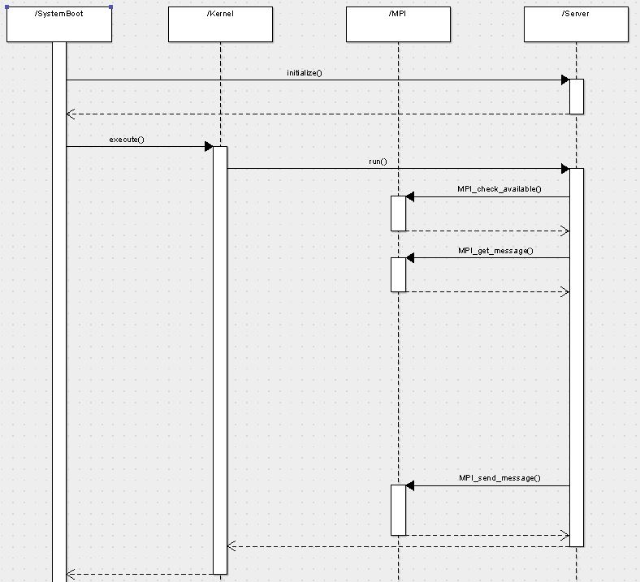
Generic Task Sequence Diagram

Slide 5
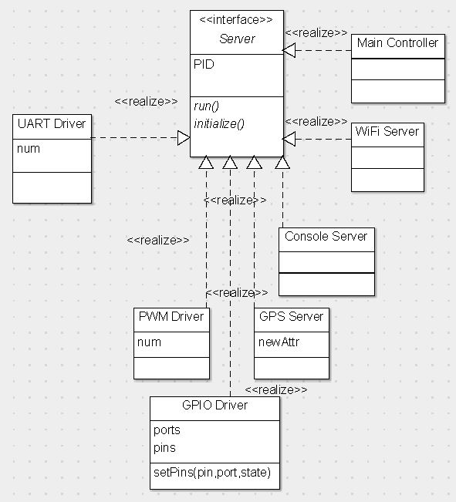
Task Interface Diagram

Slide 6
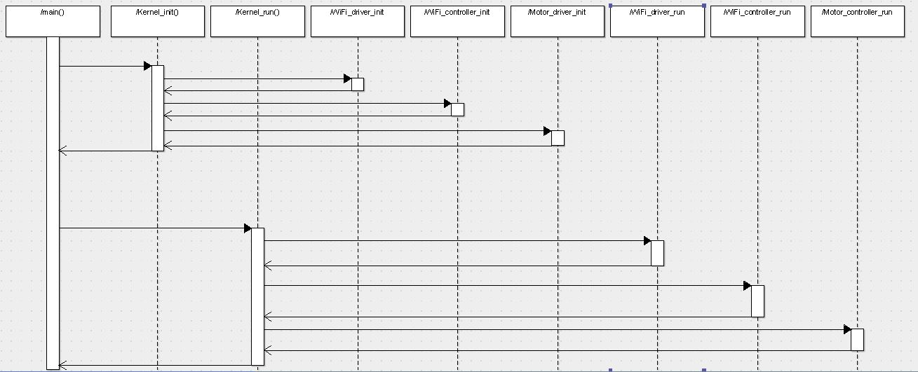
Kernel Sequence Diagram

Slide 7
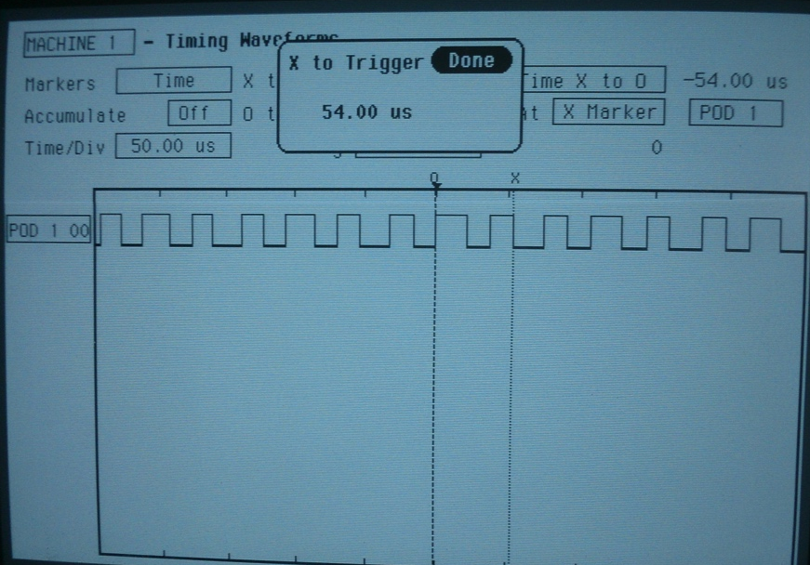
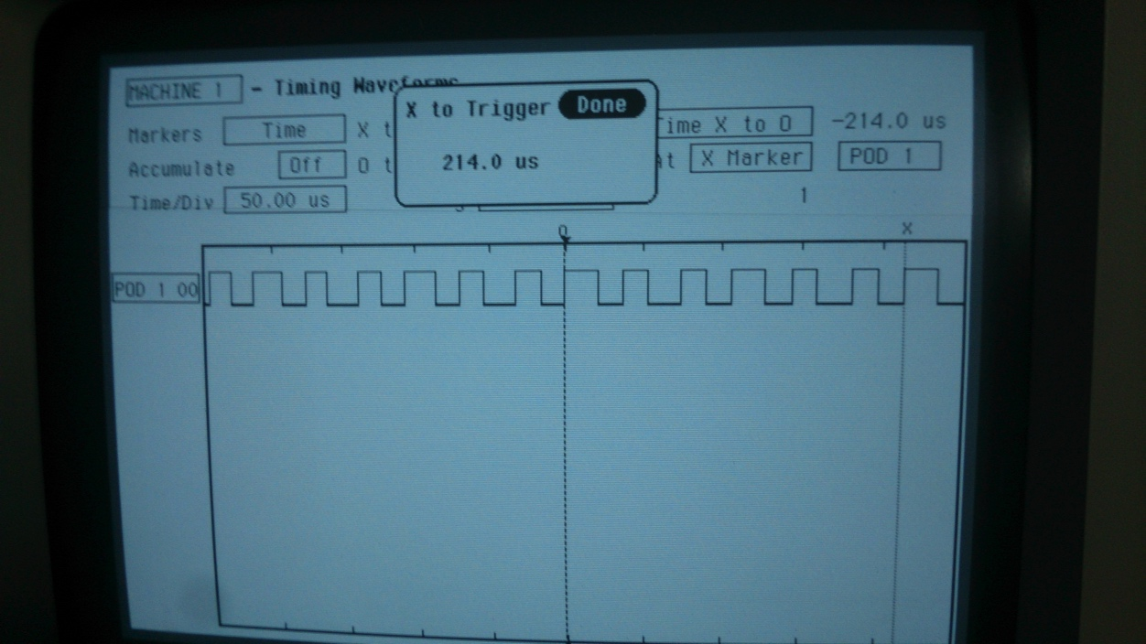
Average case execution time analysis
Single Hyperperiod
7 Hyperperiods

Slide 8
Task Classification
Characterization of task – interfacing with Wi-Fi module and motor controller through UART.
Tasks | C | T
Wi-Fi Driver |  | 0.8 ms
Wi-Fi Controller |  | 0.8 ms
Motor Controller |  | 0.8 ms

Slide 9
UART Deadlines
UART deadlines

Slide 10
Demo with IP address & Web server
Lets GO!!!!!!

Slide 11
Questions?

