Slide 1

BOOKMYSHOW/LIVE EVENTS DYANAMIC PRICING STUDY
By Shamshika, Spoorthi, Uday Sri

Slide 2

introduction
Book My Show is a digital platform for booking entertainment and live-event tickets.
It offers concerts, comedy shows, sports, festivals, and other events.
Dynamic pricing refers to prices changing based on demand, availability, timing, and event popularity.
This project studies how pricing affects ticket demand and sales.

Slide 3
motivation
Live-event ticket prices can change according to demand.
Popular events may have higher prices and limited availability.
Customers may change their purchase decisions based on price.
Studying dynamic pricing helps understand revenue generation and customer behaviour.

Slide 4
objection
Study live-event ticket pricing trends.
Understand the relationship between price and demand.
Identify factors affecting ticket prices.
Analyse customer preferences and event popularity.
Use Python to analyse and visualize the data.

Slide 5
Economic(co1)
Topic: Demand, Supply & Elasticity Estimation
Analyse the relationship between ticket price and demand.
Estimate Price Elasticity of Demand(PED).
Study how changes in price affect ticket sales.
Predict market outcomes under different pricing conditions.
Justification:
Economics helps understand customer response to changing ticket prices and supports better pricing decisions.

Slide 6
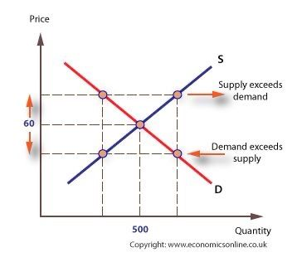


Slide 7
Business environment(co2)
Topic: Porter’s Five Forces
Analyse:
Competitive Rivalry – competition among ticket-booking platforms.
Threat of New Entrants
Bargaining Power of Customers
Bargaining Power of Suppliers/Event Organisers
Threat of Substitutes
Justification:
Porter’s Five Forces helps understand the competitive environment influencing Book My Show’s live-event pricing strategy.

Slide 8

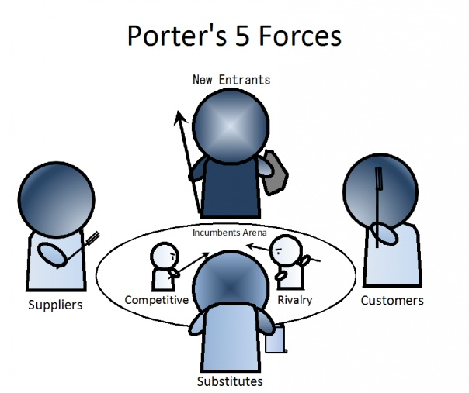

Slide 9
Python(co3)
Topic: Matplotlib & Plotly
Use Matplotlib to create clear business charts.
Use Plotly for interactive visualisations.
Visualise ticket prices, demand, availability, and event categories.
Present results through easy-to-understand graphs and dashboards.
Justification:
Python converts the collected data into meaningful visual insights for business decision-making.

