Slide 1
Agriculture Assist – AI-Powered Farming Advisor
Solving agricultural inefficiencies in APAC using Gemini AI

Slide 2
Team Details & Problem Statement
Team Name: katapa Cracker
Team Members: Daniyal Tahir Syed Ale Mustafa Shamsi, Khawaja Subhan, Ali Sher Javed
Problem Statement:
Smallholder farmers in APAC face low crop yields due to lack of access to localized farming guidance, pest control, and climate-smart practices.

Slide 3
Brief About the Solution
Agriculture Assist is an AI-based virtual farming advisor that leverages Gemini APIs to provide multilingual, real-time farming guidance. Farmers can ask questions in natural language, upload pest photos, and get personalized recommendations.

Slide 4
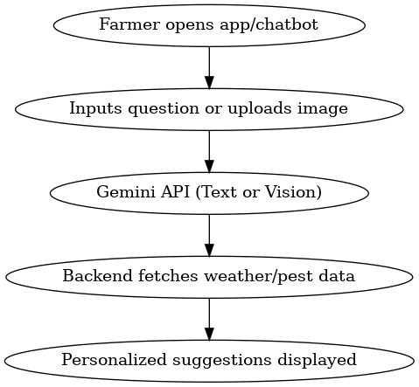
Flow Diagram

Slide 5
Opportunities & Uniqueness
• Local language support via Gemini API
• Visual pest detection
• Weather-based crop recommendations
• Sustainable agriculture tips
USP: Personalized, AI-driven, voice & image-enabled guidance for farmers.

Slide 6
Key Features
• AI chatbot for farming queries
• Pest & disease detection via image input
• Weather and soil condition tips
• Crop rotation & sustainability guidance
• Local language support

Slide 7
Process Flow Diagram
1. Farmer opens app or chatbot
2. Asks a question or uploads an image
3. Gemini API responds with actionable advice
4. Backend fetches weather/pest data
5. Personalized suggestions displayed

Slide 8
Wireframes / Mockups
Prototype includes:
• Home screen
• AI chatbot screen
• Weather advice view
• Pest detection via image
(Figma link to be included)

Slide 9
Architecture Diagram
Frontend: Flutter or React
Backend: Node.js / Firebase
AI Layer: Gemini APIs (text + vision)
Database: Firestore
External APIs: OpenWeatherMap

Slide 10
Technologies Used
• Gemini APIs (Gemini Pro, Vision)
• Firebase Auth & Firestore
• React or Flutter
• Figma
• OpenWeatherMap API
Gemini is mandatory and is central to the solution.

Slide 11
Future Development
• Support for SMS/IVR for non-smartphone users
• Farmer marketplace integration
• Voice-based reminders
• Soil sensor integration
• Community Q&A and expert support

Slide 12
Demo Video & Prototype
Demo Video:
https://youtu.be/iNgTK7sSXJs
Prototype: https://www.figma.com/design/R74A0RB6T4rhK4OvMRB662/Untitled?t=tEPU1RCJEbVjupMA-1
https://www.figma.com/proto/60lfrWfqY6JvSxlcdaT3rA/Agritech--farmer-Agriculture-solution-app-design--Community-?node-id=2639-4969&t=mm03CGJ1DmJ09XYc-1
GitHub: https://github.com/ShamsiRaptorz/APAC_Challenge.git
Thank you!

