Slide 1
Sustaining Local Economic Development Initiatives:
The Hexagon of LED
Jörg Meyer-Stamer
www.mesopartner.com

Slide 2
Conceptualizing Systemic Competitiveness at the Local and Regional Level: The Hexagon
Process management
Target group
Governance
Locational factors
Sustainability
Policy focus and
synergy

Slide 3
The First Triangle:
The Target Group
Planning, M+E
Target group
Governance
Locational factors
Sustainability
Policy focus and
synergy

Slide 4
The target group of regional economic development: firms
Attract suppliers and
complementary firms,
manufacturers of
capital goods,
service providers
supplier development,
outsourcing, spin-off;
support for owner
succession
streng-
thening
local firms
Attraction
of new
firms
Promotion
of start-ups
and entre-
preneurship
franchising

Slide 5
streng-
thening
local firms

Slide 6
Promoting local and regional companies
General principles:
Identify market failures
Avoid market distortions and discrimination

Slide 7
What is and what isn’t market failure?
Market failure is
the lack of response on the supply- or demand-side due to
  lack of information / high cost of information
  barriers to entry (economies of scale, indivisibilities, anti-competitive behaviour)
  lack of technical infrastructure
  ...
Market failure isn’t
marketing failure
the failure of a business to identify an adequate market
lack of demand for a company’s products
a crisis due to a downturn in a company’s main market

Slide 8
Market failure in practice: start-up businesses suffer from Catch-22
limited funds, limited advertisement effort, limited visibility, limited sales, limited funds
main market failure:
  low density of businesses
  few business contacts (little mouth-to-mouth advertisement)
frequent additional market failure:
  lack of formalised business structures
  lack of formalised business information (e.g. yellow pages)
  barriers to entry due to government regulations

Slide 9
Strengthening existing local and regional companies
General principles:
Identify market failures
Avoid market distortions and discrimination
Apply clear, simple, transparent rules
Eliminate government-created market failure
Specific instruments:
Demand-driven skills development and management upgrading
  Market research and product development
  Human resource management
  Technology and process management
Business angels, coaching
Business networking, business linkages, cluster promotion
Regional business fairs
Business information systems.

Slide 10
Attraction
of new
firms

Slide 11
The Virtuous Circle of Investment Promotion
Create favorable
investment conditions
Seek feedback
and upgrade
Communicate the
investment conditions

Slide 12
The force field of investment promotion
Stable and predictable
macroeconomic policy
Favorable regulatory
framework for
private investment
Investment
Promotion
Size and dynamism
of demand
Dynamic private
sector

Slide 13
Promotion
of start-ups
and entre-
preneurship

Slide 14
Promoting entrepreneurship
General principles:
Identify market failures (e.g. barriers to entry)
Avoid market distortions and discrimination
Reduce barriers to entry
Specific instruments:
Reduce regulatory barriers to entry
Entrepreneurship awareness building
Entrepreneurship training courses
Entrepreneurship networks
Business angels, coaching
Business incubators.

Slide 15
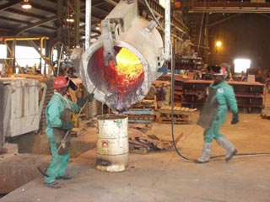
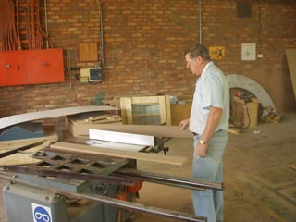
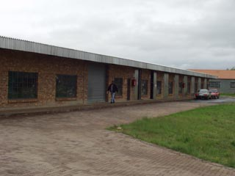
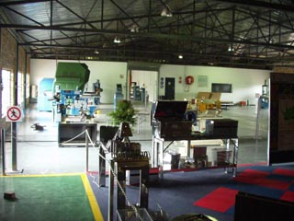
The First Triangle in action --
A practical example: The stainless cluster in Middelburg, South Africa
Upgrading effort at Columbus Steel and related companies
  strengthening existing business
Attracting downstream manufacturers of stainless products
  attracting companies
Promoting entrepreneurship
  Outsourcing
  Stainless Incubator

Slide 16
The Second Triangle:
Locational Factors
Planning, M+E
Target group
Governance
Locational factors
Sustainability
Policy focus and
synergy

Slide 17
Strengthening locational advantages
Tangible locational factors
Relevant for
individuals
Relevant
for firms
Intangible locational factors

Slide 18
Tangible locational factors
Geographical location with respect to supply and markets
Quality of transport infrastructure
Quality of communications infrastructure
Cost and quality of labor
Availability and cost of real estate
Cost of energy and environmental compliance
Local taxes
Incentives
Why “tangible factors”?
These factors can be quantified / measured.

Slide 19
How to strengthen tangible locational factors
Geographical location with respect to supply and markets
Quality of transport infrastructure
Quality of communications infrastructure
Cost and quality of labor
Availability and cost of real estate
Cost of energy and environmental compliance
Local taxes
Incentives
Location is a “static” factor
Upgrading
Upgrading, value-added services
Skills development
Real estate information systems
Efficient implementation of environmental regulations
Competitive local taxes
Competitive incentives

Slide 20
Intangible factors, relevant for individuals
Quality of habitation and neighborhoods
Environmental quality
Quality of schools and other training institutions
Quality of social infrastructure
Quality of leisure infrastructure
Security.

Slide 21
Intangible factors, relevant for firms
Competence, efficiency and business-mindedness of public administration
Economic climate of city and region
Image of city and region
Proximity of related and supporting industries
Universities, R&D infrastructure
Innovative milieu of region
Competence of business associations.

Slide 22
How to strengthen intangible factors, relevant for firms (1)
Economic climate of city and region
Competence, efficiency and business-mindedness of public administration
Image of city and region
Reduce the problems and obstacles created by public administration:
  Streamline regulations
  Implement regulations in a consistent and transparent way
  Speed-up processing of permits etc.
  Create First-Stop- or One-Stop-Agencies
  Fight corruption
  Advertise your achievements in these respects.

Slide 23
How to strengthen intangible factors, relevant for firms (2)
Proximity of related and supporting industries
Business information and support
Universities, R&D infrastructure; innovative milieu of region
Competence of business associations
Targeted, selective investment promotion
Promote private business development services (rather than substitute them / crowd them out) (BDS development)
Upgrade supporting institutions (training, technology, finance etc.)
Make supporting institutions more business-oriented
Strengthen chambers and business associations.

Slide 24
Static vs. dynamic locational factors
Static:
Advantageous location
Natural resources
Infrastructure
Disciplined workers
Universities, R&D institutes
Dynamic:
Distance to crucial markets in terms of hours
Simple extraction vs. adding value
Efficient, specialised infrastructure
Specifically qualified workforce
Universities and institutes which are market- and business-oriented

Slide 25
Why strengthen locational factors?
Reduce transaction costs for business
Create markets which work effectively
  e.g. specialised suppliers and service providers
Create a locational advantage
  which is unique
  which cannot be easily replicated elsewhere

Slide 26
Latitude for local initiatives: Industry life-cycle and business unit status
Life-cycle
little latitude for
locational policy =
increasing demands on
reskilling and promoting
new business
Decline
Maturity
Growth
high demands
on locational policy
Pioneer
Headquarters
Strategic
business unit
Affiliate
Screwdriver
plant

Slide 27
The first and second triangle
Planning, M+E
Target group
Hard-core
LED
Governance
Locational factors
Sustainability
Policy focus and
synergy

Slide 28
The Third Triangle:
Policy Focus and Synergy
Planning, M+E
Target group
Governance
Locational factors
Sustainability
Policy focus and
synergy

Slide 29
Focus and Synergy, 1:
Separating
Economic
Development:
Quick results
Competitiveness
Sustainability
Consumers
Profit vs.
solidarity
Time horizon
Social Development:
Support for disadvantaged
and marginalised
Beneficiaries
Solidarity
Urban Planning:
Long time horizon
Planning
Aesthetic criteria
Visual
vs.
substance

Slide 30
Why there is a tension between economic and community development
Principles of economic development:
Rivalry / competition
Invisible hand of the
market
Survival of the fittest
Principles of community / social development:
Solidarity
Collaboration
Support for the weak
and disadvantaged
Conclusion:
It is important to separate economic development and community development in terms of organization and implementation

Slide 31
The tension between economic development and urban planning
Urban planning and development
should be based on a masterplan
is usually based on detailed action planning
  to achieve a consistent quality and appearance
  to maximise the effective use of territory
  to avoid digging up recently paved roads
Economic development
should be based on business and market principles
must respond swiftly to changes in economic framework conditions
should be driven by upcoming economic opportunities
does not necessarily require a masterplan
  except in cases where the old economic base is falling apart

Slide 32
Focus and Synergy, 2:
Connecting
Redefine social
problems as
business
opportunities
Leverage infra-
structure and
facilities development
for LED
Focussed,
demand-driven
skills deve-
lopment
Economic
Development
Apply business
principles in social
endeavours
Improving
locational quality
Create a unique
profile
Stimulate
entrepreneurship
(as early in life
as possible)
Improve quality
of living in low-
income areas
Social / community
Development
Urban
Planning

Slide 33
The Fourth Triangle:
Sustainable Development
Planning, M+E
Target group
Governance
Locational factors
Sustainability
Policy focus and
synergy

Slide 34
The triangle of sustainable development at the regional level
e.g. processing of locally
available bio-mass
e.g. new types of living and
housing (for instance
for retirees)
economic
develop-
ment
e.g. regional recycling
economy
ecological
develop-
ment
social
develop-
ment
e.g. labor-intensive development
of industrial estates and infrastructure

Slide 35

Regional sustainable development: The example of IBA Emscher Park
Economic development:
* rehabilitate old estates
* creating high quality estates
* creating a positive image
* strengthening intangible
locational factors
Social development:
* employment programs
and skills development
* low cost housing
Ecological development:
* creating green spaces
* converting sewage canals into rivers
* ecological housing
* renewable energies

Slide 36
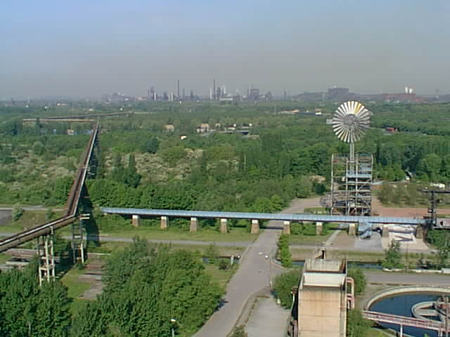
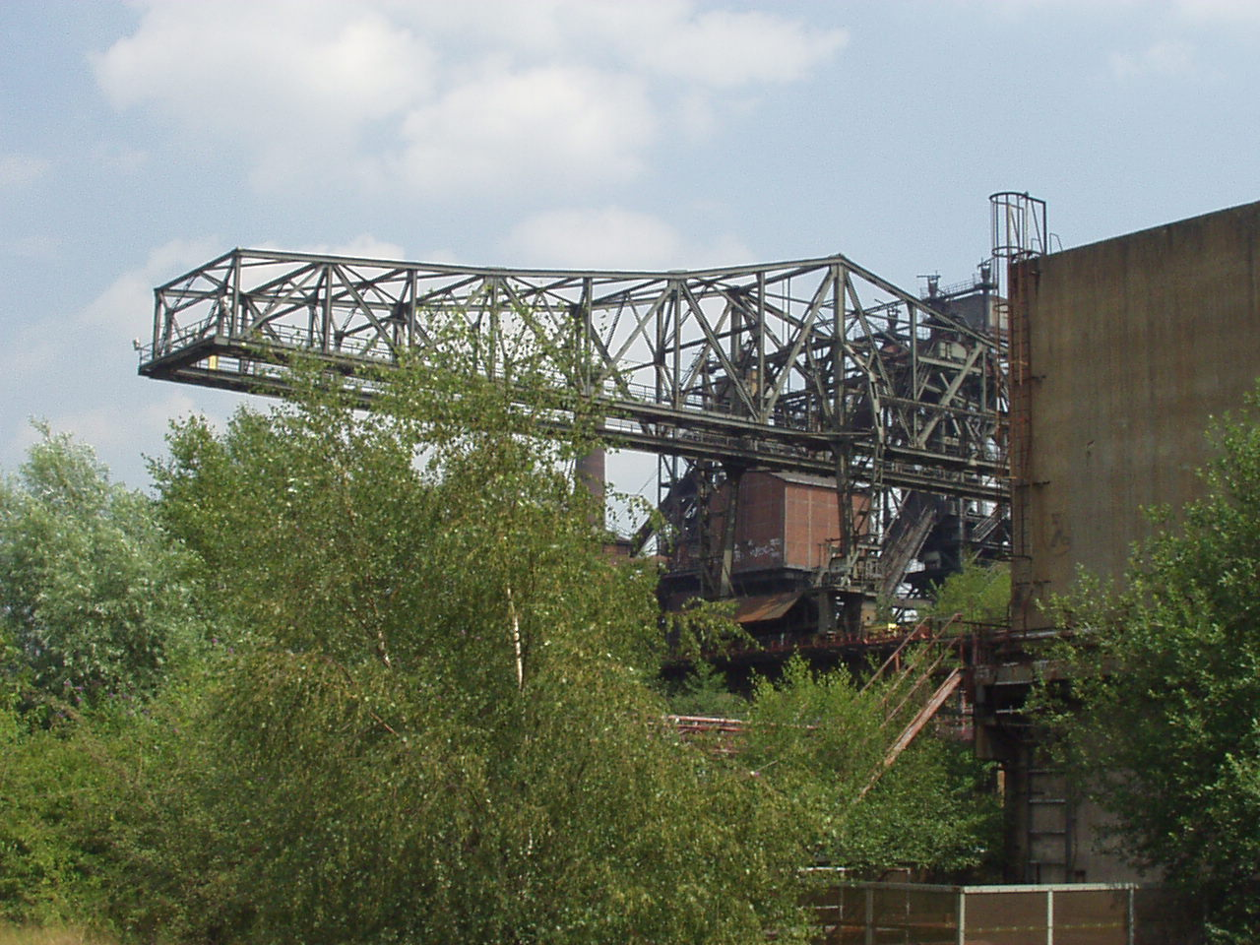
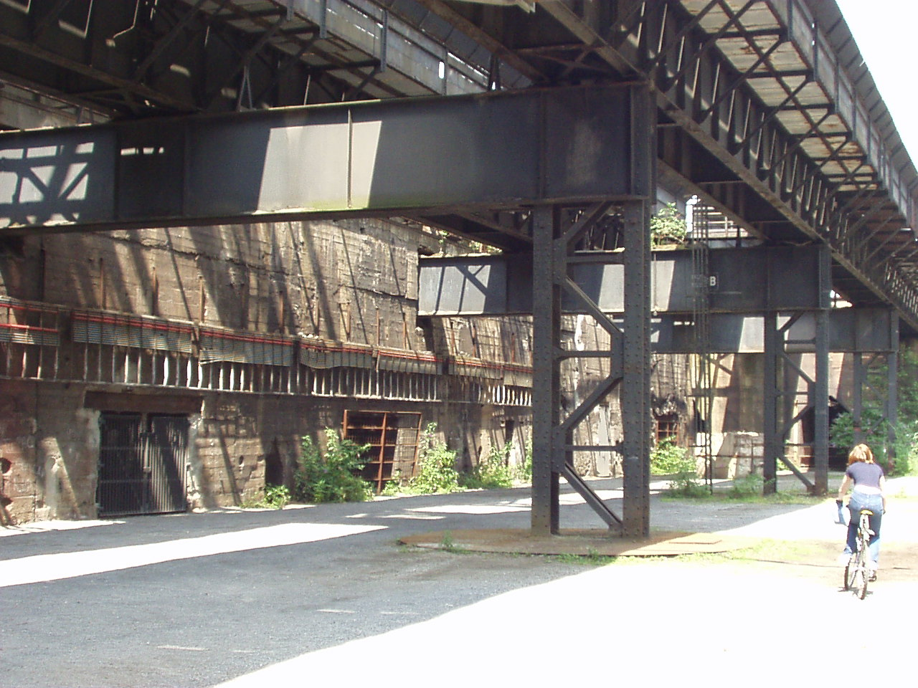
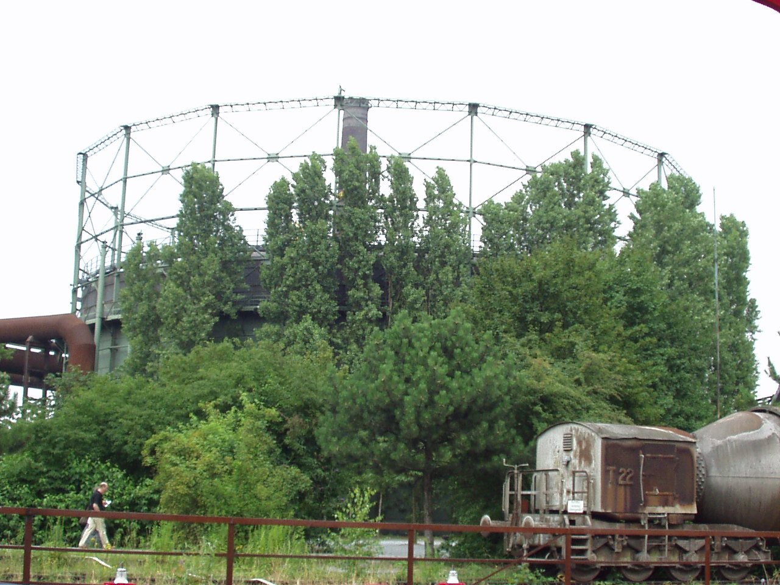
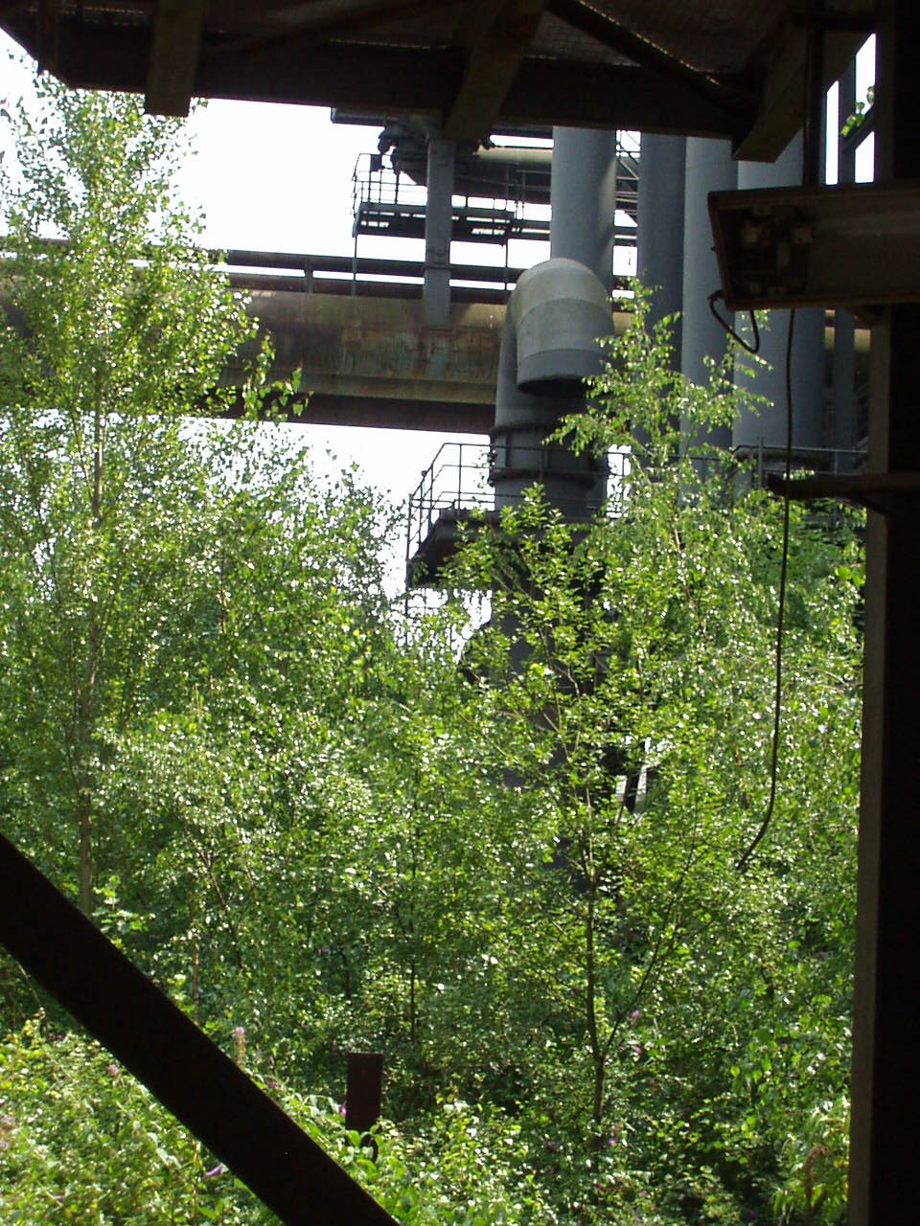
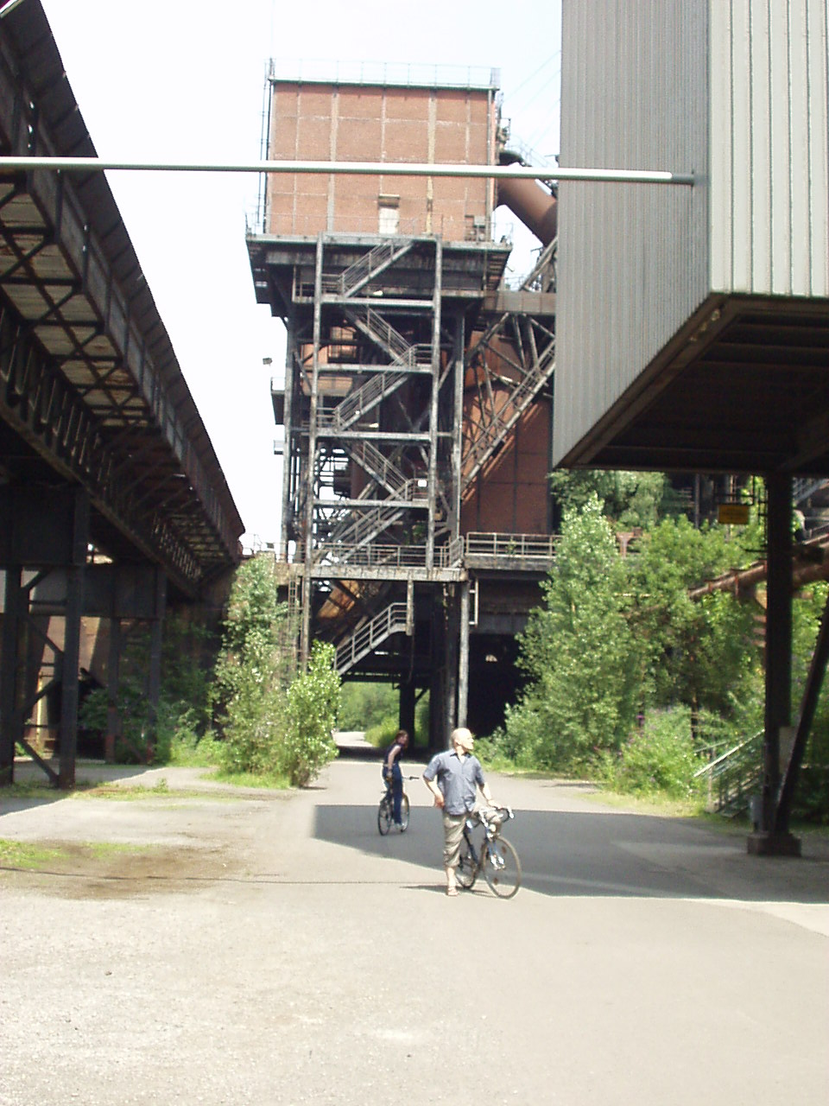
An IBA Emscher Park project: landscape park Duisburg-Nord
economic:
* unique place
for events
ecological:
* 200 hectares
of park
* unique eco-
systems
social:
* re-skilling of
long-term
unemployed

Slide 37
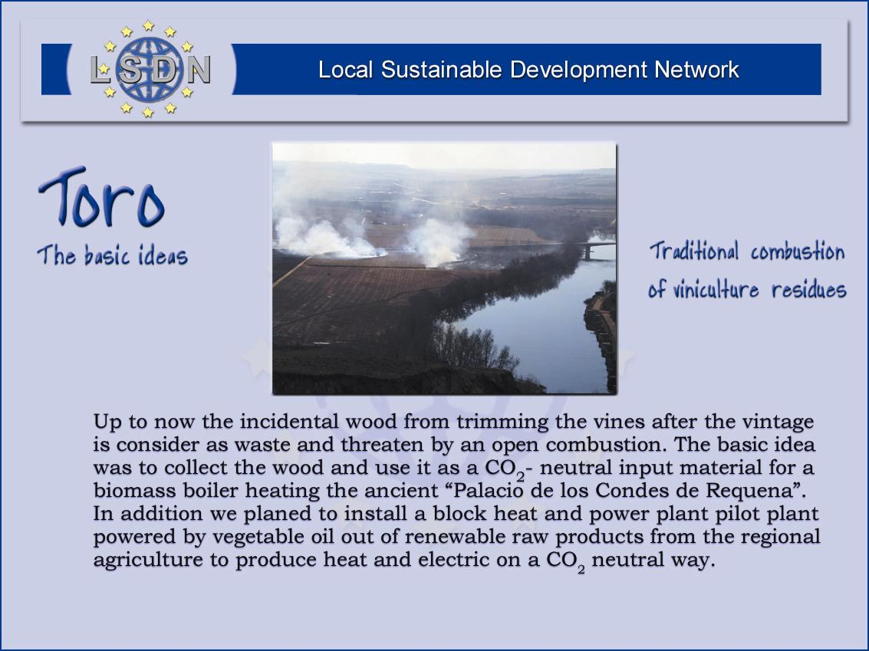

Slide 38
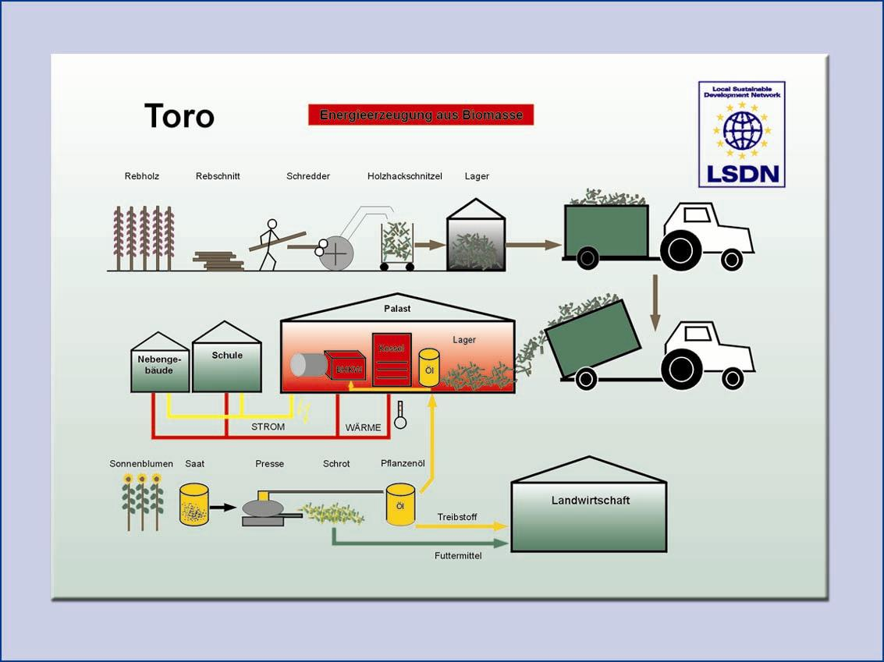

Slide 39
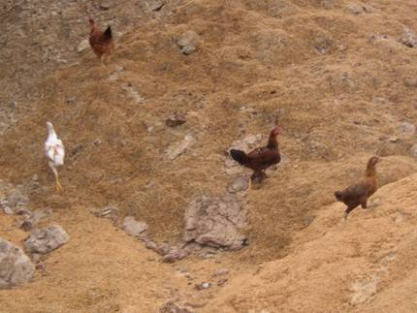
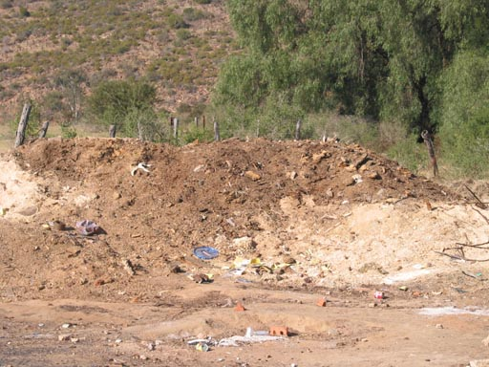
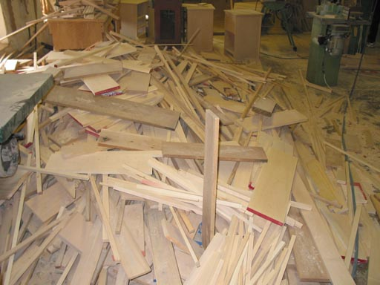
The sad reality in many developing countries
Production processes generate a awful lot of waste
Disposing of the waste is a serious challenge
Actors don’t realise that the waste is actually a valuable resource
A typical example: Wood processing
  saw dust can be pressed into bricks = source of energy
  pieces of wood can be used for handicraft production

Slide 40
The third and fourth triangle
Planning, M+E
Target group
Hard-core
LED
Governance
Locational factors
Widening the
perspective
Sustainability
Policy focus and
synergy

Slide 41
The Fifth Triangle:
Governance
Planning, M+E
Target group
Governance
Locational factors
Sustainability
Policy focus and
synergy

Slide 42
The actors involved in local economic development
Civil society
Local communities
Local government
Local business sector

Slide 43
Governance structures in local economic development
Traditional approach:
Hierarchical governance
Guidance by government
Strong reliance on committees
A committee is ten people doing the work of one person
Current approach in successful regions:
Network governance
  Distribution of responsibilities between various governmental and non-governmental organizations
  Negotiation and co-ordination without a clear decision center
Subsidiarity and decentralization
Participatory approaches.

Slide 44
The core role of every local government in LED
Facilitate goal
alignment among
stakeholders
Provide
infrastructure
Deliver
services
efficiently
Facilitate a
transparent
skills
development
market
Process
permit and
license
applications
swiftly and
consistently
Provide
education
Timely
payment of
bills
Local
govern-
ment

Slide 45
The role of advanced local government in LED
Market
adjustment
and market
development
for business
development
services
Strategic
catalytic
projects
to
leverage
business
oppor-
tunities
Facilitate goal
alignment among
stakeholders
Provide
infrastructure
Deliver
services
efficiently
Facilitate a
transparent
skills
development
market
Process
permit and
license
applications
swiftly and
consistently
Provide
education
Timely
payment of
bills
Local
govern-
ment

Slide 46
Who should do what in LED --
Local Government
Local government should:
remove government-created obstacles to business
provide infrastructure
remedy market failure
  e.g. barriers to entry for new business
address longer-term issues
  e.g. lack of entrepreneurial culture
facilitate
Local government should not:
run businesses or quasi-businesses (“projects”)
create an unfair advantage for some businesses
  e.g. direct funding to single companies
pick “winners”, create new industries
hand out business plans to wannabe-entrepreneurs
deliver LED activities

Slide 47
Who should do what in LED -- private sector
The private sector should
get effectively organised to sort out its own problems
organise effective collective action to solve joint problems
interact with local government to identify win-win-solutions
The private sector should not
try to monopolise the thinking, planning and implementation of LED
get involved in party politics

Slide 48
Who should do what in LED -- local communities
Local communities should
accept and encourage successful entrepreneurship (avoid PHD-syndrome)
get organised to address collective action issues
  security
  health
  education
  pollution
Local communities should not
waste time creating unsustainable quasi-businesses
expect that government is solving all their problems

Slide 49
What is the role of a stakeholder forum / LED forum?
What isn‘t the role of a forum?
formulate a strategy before any action
design LED projects
implement LED projects
What is the role of a forum
coordination:
  exchange information
  avoid duplication
leveraging:
  sharing (information on) resources: skills, finance, ...
troubleshooting:
  discuss / share solutions for problems and conflicts
An LED Forum
is an interim outcome of
a good LED process, but
never its beginning!

Slide 50
The Sixth Triangle: Diagnostic
Planning, Monitoring & Evaluation
Planning, M+E
Target group
Governance
Locational factors
Sustainability
Policy focus and
synergy

Slide 51
The Triangle of Diagnostic, Planning, Monitoring and Evaluating
Participatory
diagnostic
(PACA)
Feedback
Reference
Motivation
Participatory
M+E, Participatory
benchmarking
Participatory
planning
Implementation

Slide 52
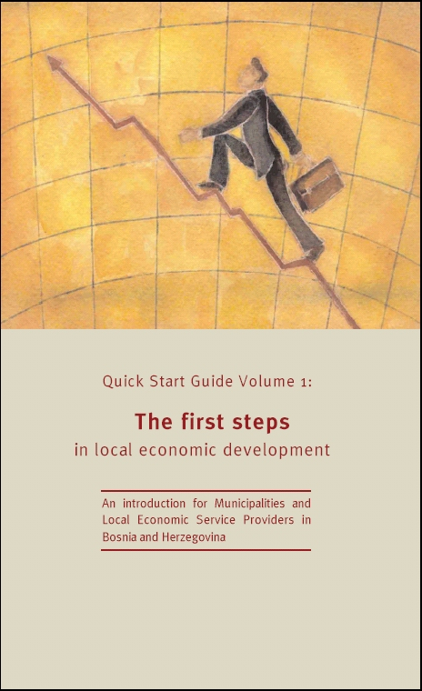
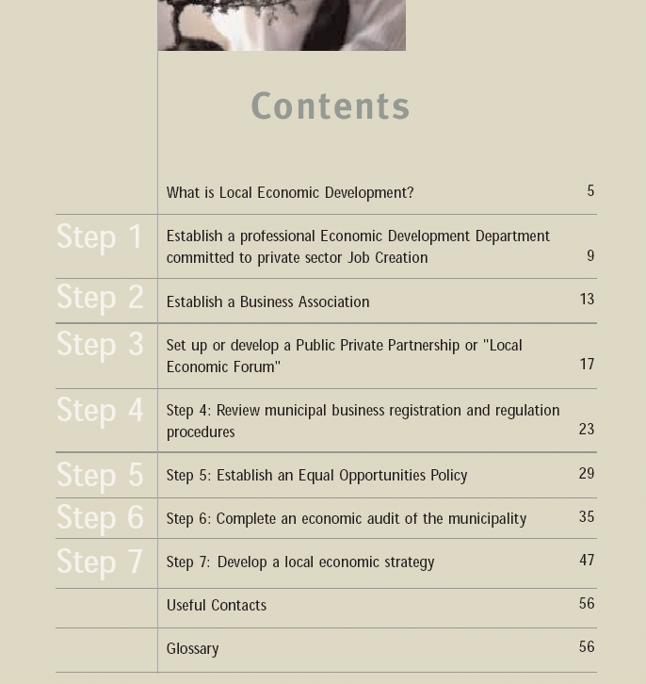
How not to sequence LED:
EU-supported projects in Bosnia

Slide 53
Better conceptualize LED as an iterative process
Crisis of
fragmentation
Implementation
Assessment
Reflection
Implementation
Adjustment
Planning for new
action
Assessment
Reflection
Adjustment
Planning for new
action
Implementation
Assessment
Reflection
Planning for
quick implementation
Rapid
appraisal (PACA)

Slide 54
Participatory diagnostic, participatory planning
PACA:
rapid appraisal
limited dependence on external expertise
action-oriented diagnostic, looking for quick, visible results
Participatory planning:
based on competent facilitation and participatory techniques
involving “beneficiaries”
avoiding extensive, time-consuming planning exercise to produce huge documents

Slide 55
Participatory M+E, benchmarking
Participatory monitoring + evaluation:
executed by actors themselves
actors agree on criteria
self-evaluation based on simple, culturally appropriate methods
immediate publication and discussion of results
frequent, limited evaluation
Participatory benchmarking:
using qualitative indicators and scoring technique
based on concepts such as Systemic Competitiveness
comparing the own place vs. similar places in other countries / more advanced places in the own country

Slide 56
M+E of PACA: The Compass of Local Competitiveness
Economic impact:
* business retention
* creation of jobs and income
* generation of start-ups
External perspective:
* distinctive locational profile
* improved locational marketing
* better standing with funders
* relationship with relevant
stakeholders
LED learning:
* LED skills accumulation
* alignment of goals and
objectives
* systematic M+E
LED Process:
* competent public service
* membership-driven Chamber
and business associations
* effective communication
between key LED players

Slide 57
The fifth and sixth triangle
Planning, M+E
Target group
Governing the
process of LED
Hard-core
LED
Governance
Locational factors
Widening the
perspective
Sustainability
Policy focus and
synergy

Slide 58
The Hexagon and LED interventions
Participatory approach
LED = iterative
process
Small business promotion
Investment promotion
Start-up promotion
Promotion of BDS
Encourage
independent
business
associations
Public-private
partnership
Effective governance
Efficient public
administration
Enabling
environment
Competitive
infrastructure
Skills
Innovation: Addressing
LED from a new angle
Synergy between different
fields of local development

Slide 59
Sustaining a local economic development effort
Planning, M+E
Target group
Effective
co-ordination
Basic
instruments
Governance
Locational factors
Innovative
instruments
Sustainability
Policy focus and
synergy

Slide 60
Thank you for your attention!

