Slide 1
Systemic Competitiveness:
Understanding the factors that make or brake dynamic development
Jörg Meyer-Stamer
jms@mesopartner.com

Slide 2
What is “Competitiveness”?
The ultimate measure of competitiveness is the ability of companies to thrive in competitive markets
  so that they can pay attractive wages and thus contribute directly to wealth generation
  so that they can pay taxes and thus enable government
    to create a basis for corporate competitiveness (education, infrastructure, security, etc.)
    to support those groups who are not / not yet / no longer capable of participating in a highly competitive, high performance environment

Slide 3
What is Competitive Advantage?
Comparative advantage
(static advantage)
Available of natural resources
Tourism attractions like waterfalls
Cheap labour
Availability of real estate
Competitive advantage
(dynamic advantage)
Created, high-value natural resources (e.g. FSC-certified plantations)
Value-added attractions around a natural attraction (e.g. canyoning)
Highly skilled and specialised labour
Highly efficient, value-added infrastructure

Slide 4
The orthodox view: Competitive companies as a result of an enabling environment
Macroeconomy
The sphere of economic
framework conditions, creating the right incentives through laws, institutions (property rights etc.) and generic policies (exchange rate, monetary policy, open trade policy, etc.)
Microeconomy
Growth through
entrepreneurship in
functioning markets

Slide 5
Why talk about “Systemic Competitiveness”?
A stable macro-economic framework and an enabling environment are necessary but not sufficient conditions for competitiveness and growth
Companies’ performance (micro-level) also depends on the availability of specialized factors and supporting institutions (meso-level)
It is essential to understand a society’s capacity to create a favorable environment for economic development (meta-level)
Dynamic development is not the result of isolated policies, but of the way numerous factors and policies interact inside a national or territorial system.

Slide 6
The four levels of systemic competitiveness
Meta level
The sphere of societal
framework conditions that guide
decisions about fundamental economic alternatives
Macro level
The sphere of economic
framework conditions, defining incentives through laws, institutions and generic policies
Meso level
The sphere of targeted
interventions to address temporary
and persistent market failure
Micro level
The sphere of allo-
cation through markets,
hierarchies & networks

Slide 7
Terminological confusion
Spatial development terminology
Macro = national
Micro = local
Meso = somewhere in between
often used in places without an intuitive understanding of “local” and “regional”
Blakely and Bradshaw 2002, xvi (standard US textbook on LED): The terms “local” and “regional” are used interchangeably
Systemic Competitiveness terminology
Macro = generic framework conditions that apply to all sectors / industries alike
Meso = targeted interventions, specialised organisations
Policies, factors and elements between Macroeconomics and Microeconomics
Micro = the world of micro-economics, i.e. companies and markets
Meta / Macro / Meso / Micro have no spatial connotation

Slide 8
Determinants of systemic competitiveness
Meta level
development-oriented patterns of political
and economic organization
value systems
which encourage
learning and change
social status of
entrepreneurs
capacity to
formulate visions
and strategies
collective memory
social cohesion,
social capital
competitive economic
system
Macro level
stable, competition-oriented macro-economic,
political and legal framework conditions
exchange-rate
policy
monetary policy
budgetary policy,
fiscal policy
Meso level
targeted policies to strengthen
the competitiveness of industries
anti-trust-policy
trade policy
consumer
protection
export promotion
regional policy
infrastructure
locational policy/
economic
promotion
industrial policy
environmental
policy
education
policy
technology policy
Micro level
intra-firm effort to
improve efficiency,
quality, flexibility,
responsiveness;
business strategy
formal and
informal co-
operation, networks,
alliances, collective
learning

Slide 9
Meso space:
Institutions and orientations
technology: contract research, information and technology transfer, consultancy, MSTQ -- business associations, universities and polytechnics
specialization, selectivity, networking
education, training: public and private institutions
quick adjustment to changing conditions
suppliers
customers
competitors
Firm
financing: investment credit, working capital,
collateral, venture capital, insurance
patience and risk-friendly disposition
SME-
support
Economic
promotion
infrastructure: communication,
logistics, energy, water, waste disposal
speed and efficiency
exports: market information, design, packaging, export credit and insurance, trading firms
specialization and close contact with firms and markets
environmental protection: supervision, technology and management advice
control / pressure and support

Slide 10
Meso level, meso policy and meso space
Meso level
Meso policy
Meso space
Analytical level
Targeted action of public and private actors
  to address market failure
  to strengthen the supporting environment for business
  to shape structural change
Selective interventions (as opposed to macro policy = generic interventions)
Public and private organizations which are tasked with strengthening the competitiveness of businesses

Slide 11
Meso level, policy, space:
Justification
Political justification:
assure legitimacy
  often creates perverse effects: interventions not guided by reason but by desparation, symbolic intervention, little performance pressure
Economic justification:
market failure
  crucial distinction: temporary vs permanent meso policy
transaction cost
  but: government-created generic and meso-level transaction cost undermines the legitimacy of meso policy

Slide 12
Temporary vs permanent meso-policy
Some meso-level interventions are permanent
  because in some segments the market rarely works, e.g. due to strong externalities (training, R+D)
Other meso-level interventions are permanent because they are clumsily designed
Most meso-level interventions ought to be fixed-term
  directly address the market failure
  design an exit strategy at the outset
  if necessary, empower business sector to take over initiative

Slide 13
Systemic competitiveness: not only at the national level
Supranational
National
Regional
Local
Meta
Competition between
different models of
market economy
National integration
Strategic capacity of
national actors
Regional identity
Strategic capacity of
regional actors
Local identity, trust
Strategic capacity
Creative milieu
Macro
International capital
markets (opportunity +
performance pressure)
International trade
Stable macro policy
Liberal trade policy
Anti-trust policy
Stable property rights
Solid budgetary policy
Government’s
investment capacity
Solid budgetary policy
Government’s
investment capacity
Efficient regulation
Meso
EU industrial policy
EU technology policy
Montréal protocol
Technology policy
Regional policy
Export promotion
Development
finance
Regional economic
promotion
Technology extension
Education + training
Local economic and
employment promotion
Competent chambers
Real estate developm.
Micro
Transnationals, inter-
national alliances
Global value chains
Medium + large firms
Disperse networks
Supply chains
SME
Clusters
Supply chains
Clusters
Industrial districts
Supplier relationships

Slide 14
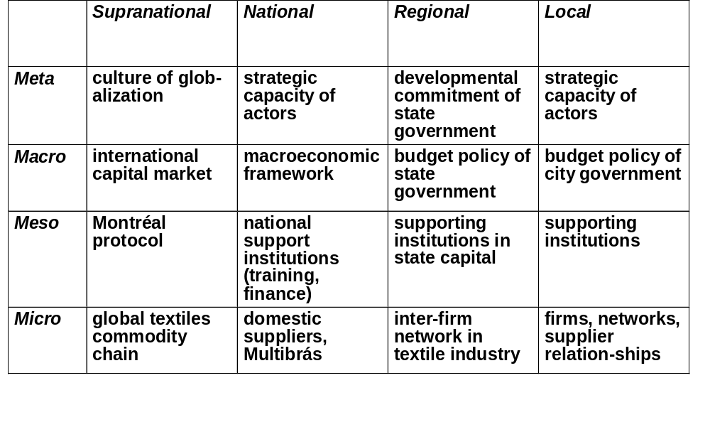
Levels of Systemic Competitive-ness and Levels of Policy-Making: The Case of Joinville (Brazil)

Slide 15
Towards Systemic Competitiveness: Sequences in Santa Catarina
Meta
Changes in the local
business culture
Fundamental
changes in
framework-
conditions
(national level)
Macro
Restructuring of
business associations
Meso
Foundation /
restructuring of
support institutions
Radical change
within firms
Micro
Incremental
adjustment
within firms
Restructuring of
inter-firm relations

Slide 16
Territorial development in the view of systemic competitiveness
understand the logic of non-cooperation
identify the existence of social capital
identify and remedy unfavorable macro-economic conditions which retard local growth, create a local enabling environment (cut red tape etc.)
restructure and re-orient existing institutions
create new support institutions
address market failure
attract complementary firms
initiate co-operation initiatives
  which address immediate necessities
  which give little opportunity for opportunistic behavior
  which contribute to creating social capital
Meta-level
Macro-level
Meso-level
Micro-level

Slide 17
Predictable outcome of a diagnostic based on the Systemic Competitiveness concept
Strength
Weakness
Meta
* Market economy
* Development orientation
* Willingness to engage in
collective effort to create
a competitive advantage
* Mutual mistrust + disarticula-
tion between public and
private sector
* Mistrust between firms
* Mistrust between SME and LE
Macro
* Low to moderate inflation
* Open trade regime
* Complex, unfair tax system
* Government deficit
Meso
* Existence of various institu-
tions: training, higher edu-
cation, SME support, finance
* Lack of customer focus
* Weak meso-micro link
* Weak business assns.
Micro
* Competitiveness of
leading firms
* Entrepreneurial spirit
* Survival economy
* Weakness of MSME: capital,
management, HR, technology
➔ This kind of result is boring and not very helpful!

Slide 18
Operationalizing Systemic Competitiveness for field research
Meta
level
Macro
level
Meso
level
Micro
level
Meta level factors
* entrepreneurial spirit
* co-operative spirit
* capacity of articulation
Macroeconomic
conditions
Government
Training
Tech-
nology
Finan-
cing
Business
Assns.
etc.
Relations with meso-institutions
Factors inside the firm
Relations with
suppliers +
subcontractors
Relations with
customers
Relations with
competitors

Slide 19
Using the Systemic Competitiveness concept: Leading questions
How do factors at different analytical levels influence each other?
  Are there vicious circles?
  Are there virtuous circles?
What is the capacity of actors / stakeholders
  to implement specific activities which you consider useful?
  to collaborate with other actors?
Where are the points of leverage to weaken vicious circles and strengthen virtuous circles?

Slide 20
A township economy vicious circle
Small businesses want
to stay small = invisible,
not getting robbed
Small businesses
don’t grow
Few jobs
created
Crime
Low income

Slide 21
An industrial cluster virtuous circle
High density of
specialised businesses
Easy availability of
suppliers and customers
Low barriers to entry
for new businesses
Easily visible business
opportunities

Slide 22
PACA effects: A Systemic Competitiveness perspective
Closer interaction
between public and
private sector
Meta
Macro
Meso
Micro
Feedback
loop
More effective
articulation of interest
More efficient public
service, less red tape
Supporting institutions
Chambers, business associations
Matching
Definition of purpose
Networking between
companies,
collective action
Matching
Business
development
services

Slide 23
Challenges for systemic competitiveness
Develop a realistic perspective at the latitude for government action
Develop a realistic perspective at the latitude for action of local stakeholders
Relieving government and stakeholders of non-priority tasks, create functioning markets (BDS, M4P)
Prepare the public sector to take over a new role: facilitate and moderate instead of intervening and distorting
Empower the private sector to take care of its problems = organizational development in business associations

Slide 24
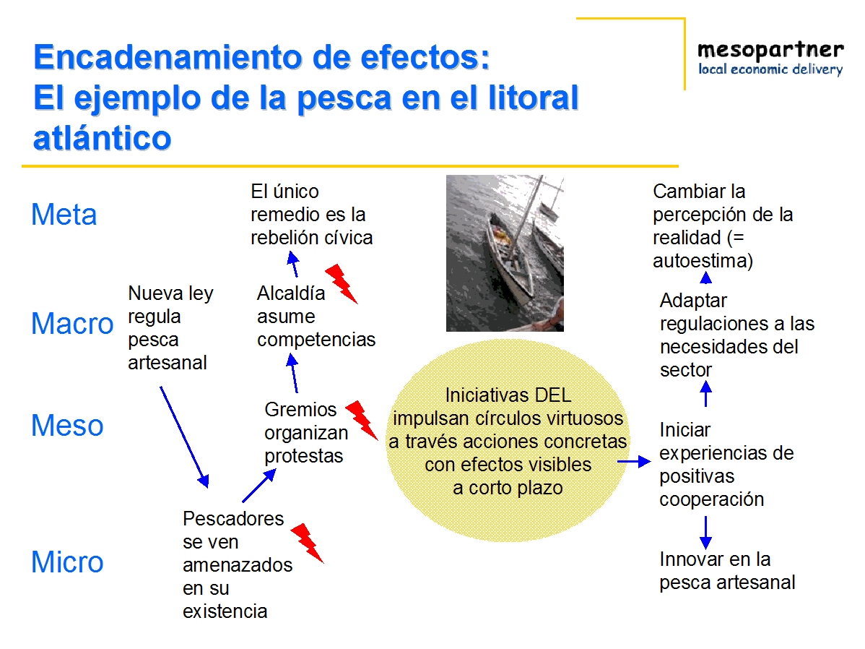
Thank you for your attention!

