Slide 1
What is Local Economic Development?
Jörg Meyer-Stamer
jms@mesopartner.com

Slide 2




What is a local economy? For instance, it may be like this:
Farmers and small
food processors
Wood value
chain
An integrated
furniture cluster
National / foreign buyers
Textile + garments
value chain
A garment
cluster
A large metal-
working company
Training
institutions
Regional service providers:
Health care
University
Wholesale trade
Business
promotion
Finance
institutions
Local producer services:
IT, transport, construction, ...
Local consumer services:
Retail, beauty, ...
Government

Slide 3
It may also look like this:
Farmers and small
food processors
A footwear
survival cluster
Some isolated
garment producers
Training
institutions
Regional service providers:
Wholesale trade
Business
promotion
Finance
institutions
Local producer services:
IT, transport, construction, ...
Local consumer services:
Retail, beauty, ...
Government

Slide 4
Why think about local and regional economic development?
Empirical observations:
fizzling-out of traditional, centralized industrial / technology / SME promotion policy
increasing problem-pressure felt at the local and regional level (unemployment, need for income generation)
Conceptual observations (academic research):
localized rivalry stimulates competitiveness and upgrading
localized competitive advantage through highly specialized supporting industries and institutions
localized learning -- positive externalities

Slide 5
Definitions of LED: World Bank
Local economic development is about local people working together to achieve sustainable economic growth that brings economic benefits and quality of life improvements for all in the community. "Community" is here defined as a city, town, metropolitan area, or sub national region.

Slide 6
Definitions of LED: UN-HABITAT
Local economic development (LED) is a participatory process where local people from all sectors work together to stimulate local commercial activity resulting in a resilient and sustainable economy. It is a tool to help create decent jobs and improve the quality of life for everyone, including the poor and marginalized.
Local economic development encourages the public, private and civil society sectors to establish partnerships and collaboratively find local solutions to common economic challenges.
The LED process seeks to empower local participants in order to effectively utilize business enterprise, labour, capital and other local resources to achieve local priorities (e.g., promote quality jobs, reduce poverty, stabilize the local economy generate municipal taxes to provide better services).

Slide 7
Definitions of LED: USAID
Local Economic Development is a process of strategic planning through partnerships between local government, the business community and NGOs.
Its objectives are to stimulate investments that will promote sustained high growth in a local community.
LED focuses on the region's potential and identifies specifically what local stakeholders can and need to do to ensure their local community reaches its potential.
In this context, Local Economic Development assesses a community's comparative advantage, identifies new or existing market opportunities for businesses, and reduces obstacles to business expansion and creation.
LED activities should have an impact on the economic viability of the entire city and surrounding region not just a particular sector of the local economy.

Slide 8
What is and isn’t Local Economic Development
What it is not only:
SME promotion
Urban / regional planning
Strategic planning
Creating a LED agency
What it is not at all:
Industrial policy
Community development
What it is:
A broad set of activities which aim at creating a competitive advantage
  for the city/region
  for the companies in the city region
... in order to create income and jobs

Slide 9
LED connects fragmented policy approaches at the territorial level
SME Promotion
Entrepreneurship promotion
Investment promotion
Export promotion
Employment promotion
Agricultural development
Research and development
Skills development
Technology extension
Urban development
Local Economic Development

Slide 10
More specifically: What is Local Economic Development?
Activities by
local government
local business associations
local companies
other stakeholders
  alone or in close collaboration
which
remove bureaucratic obstacles for local firms
tackle market failures
strengthen the competitiveness of local firms
create a unique advantage for the locality and its firms

Slide 11
There are also overarching objectives of LED initiatives:
Create opportunities to practice and learn the management of LED projects
Overcome fragmentation, stimulate networking
Create trust and social capital among local stakeholders
Develop a joint perspective at LED (objectives, instruments, governance pattern)

Slide 12
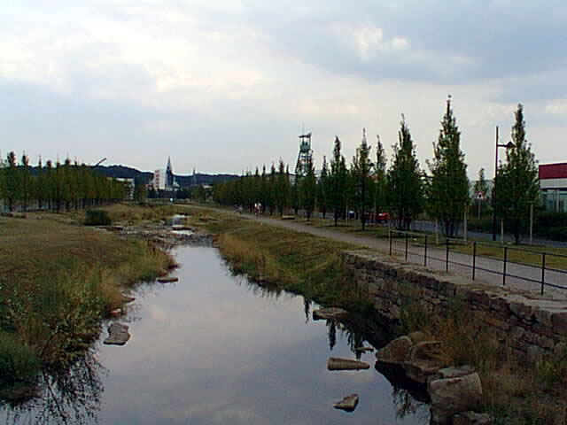
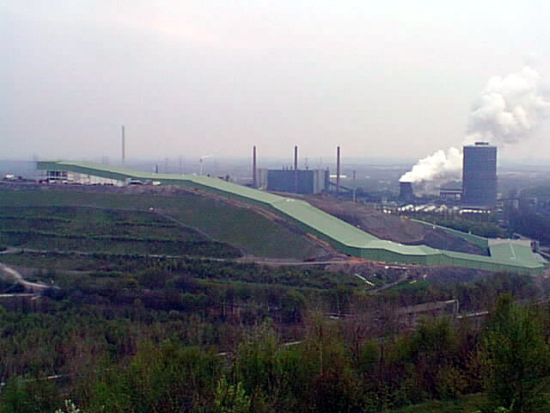
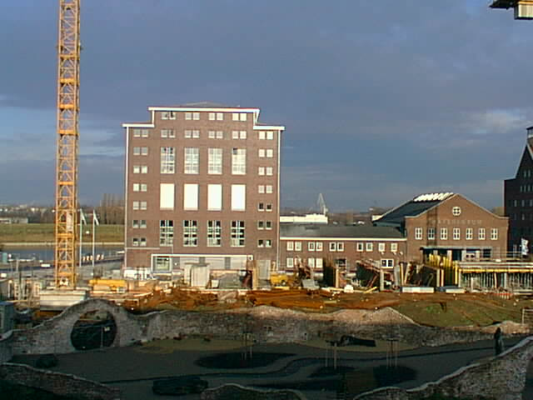
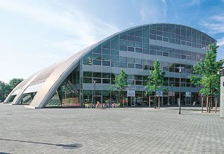
What does LED look like in practice? Industrialised countries:

Slide 13
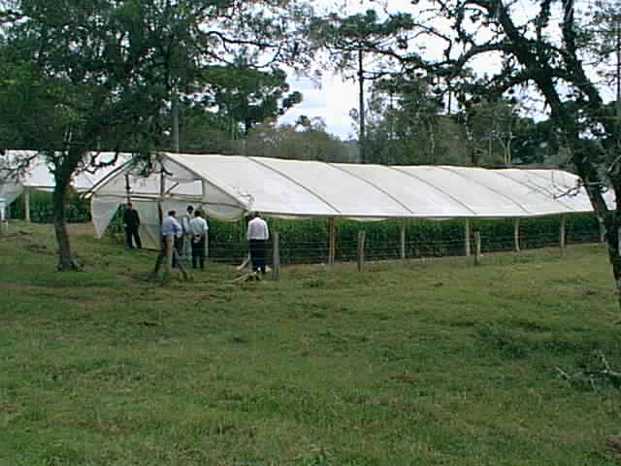
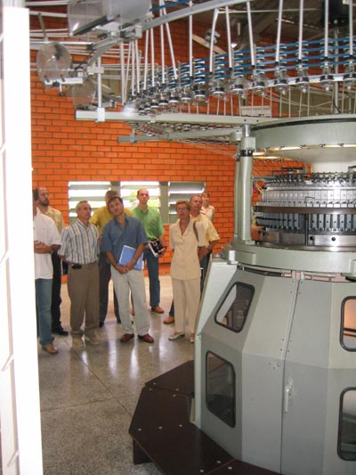
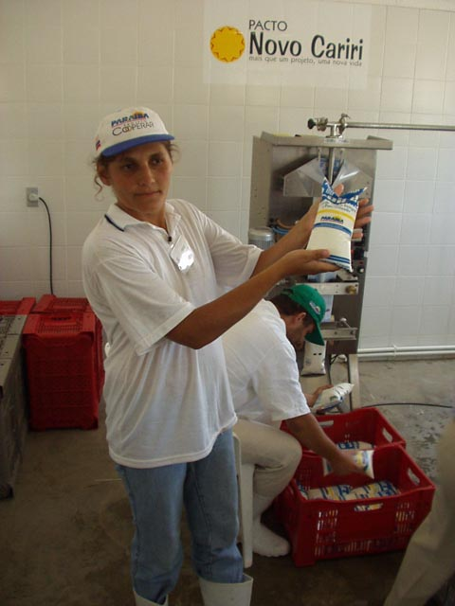
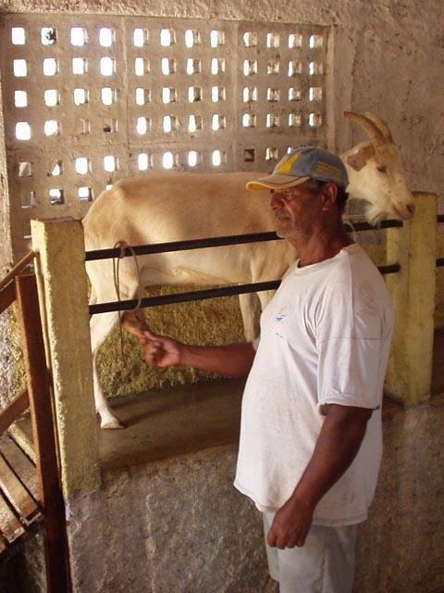
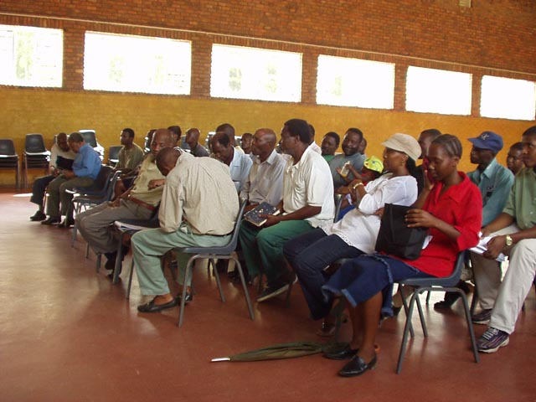
What does LED look like in practice? Developing countries:

Slide 14
Focus and Synergy, 1:
Separating LED and other approaches to local development
Economic
Development:
Quick results
Competitiveness
Sustainability
Consumers
Profit vs.
solidarity
Time horizon
Social Development:
Support for disadvantaged
and marginalised
Beneficiaries
Solidarity
Urban Planning:
Long time horizon
Planning
Aesthetic criteria
Visual
vs.
substance

Slide 15
Focus and Synergy, 2:
Connecting
Redefine social
problems as
business
opportunities
Leverage infra-
structure and
facilities development
for LED
Focussed,
demand-driven
skills deve-
lopment
Economic
Development
Apply business
principles in social
endeavours
Improving
locational quality
Create a unique
profile
Stimulate
entrepreneurship
(as early in life
as possible)
Improve quality
of living in low-
income areas
Social / community
Development
Urban
Planning

Slide 16
Structure and process in LED
Process:
Moderation
Facilitation
Communication
Trust building
Learning
Structure:
Professionals
Organisations
Networks
Dialogue structures
Systems of rules

Slide 17
Again: What is and isn’t Local Economic Development
SME promotion
Industrial policy
Urban / regional planning
Community development
Strategic planning
Creating a LED agency
is an important element of a LED initiative, but it also involves large companies
symbolizes top-down approaches, not local, bottom-up initiatives
is related to LED initiatives, makes them easier
follows a different logic, though there can be synergy
may be a medium-term result of an LED initiative, not the starting point
may also be a medium-term result of an LED initiative

Slide 18
Which focus for LED initiatives?
The orthodox view:
Define strategy and plan first
Address the main problems / bottlenecks for growth and poverty alleviation
Focus sectors with a strong growth potential
The PACA view:
Do quick scan, implement first actions swiftly
Address problems which can be solved easily and quickly
Focus sectors with a strong problem pressure and motivation for action

Slide 19
What is a good LED project?
Three main criteria:
realistic and feasible
apt for quick implementation
potential for quick, visible effect
Further criteria:
builds on local resources
connects local resources (networking)
can be implemented by Salami Tactics
builds trust, confidence, motivation
makes markets work
strengthens competitiveness
contributes to a unique profile of the location

Slide 20
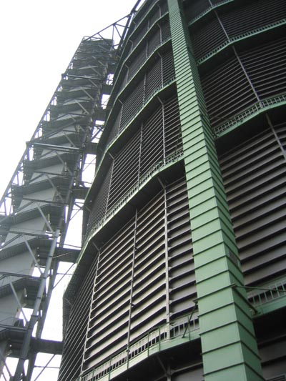

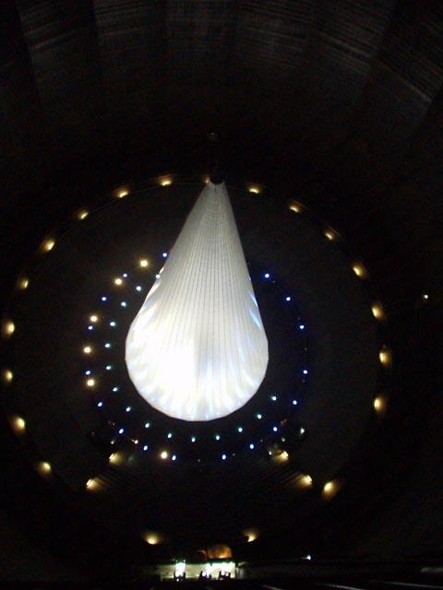
Thank you for your attention!

