Slide 1


HR Analytics Employee Attrition & Performance
Shams Khaled

Slide 2
Table of Contents
1
Problem Overview
2
Project Goals
3
Dashboard
4
Insights & Recommendations

Slide 3

Problem Overview:
IBM is currently dealing with a significant attrition rate of 16%, affecting 237 employees out of a total workforce of 1470. This project aims to investigate why employees are leaving by analyzing various factors such as demographics, job roles, compensation, satisfaction, and performance. The objective is to uncover insights that will help IBM develop strategies to improve employee retention and reduce turnover, ensuring a more stable and satisfying work environment.
Attrition Rate 16.12%

Slide 4


Project Goals:
Business Question:
What causes employees to leave the company, and how can we use this information to keep them longer?
Aims:
Identify the key variables that contribute to a high attrition rate
Provide a dashboard and business recommendations to enhance employee satisfaction and reduce attrition.

Slide 5
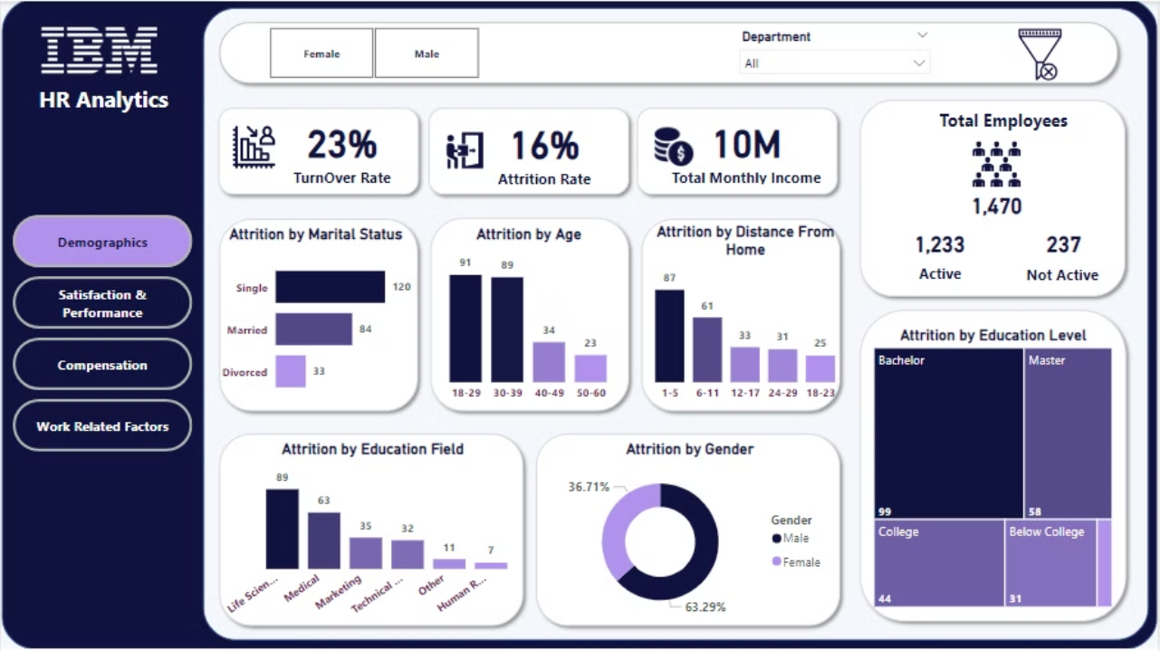
Dashboard
(Demographics Overview)

Slide 6
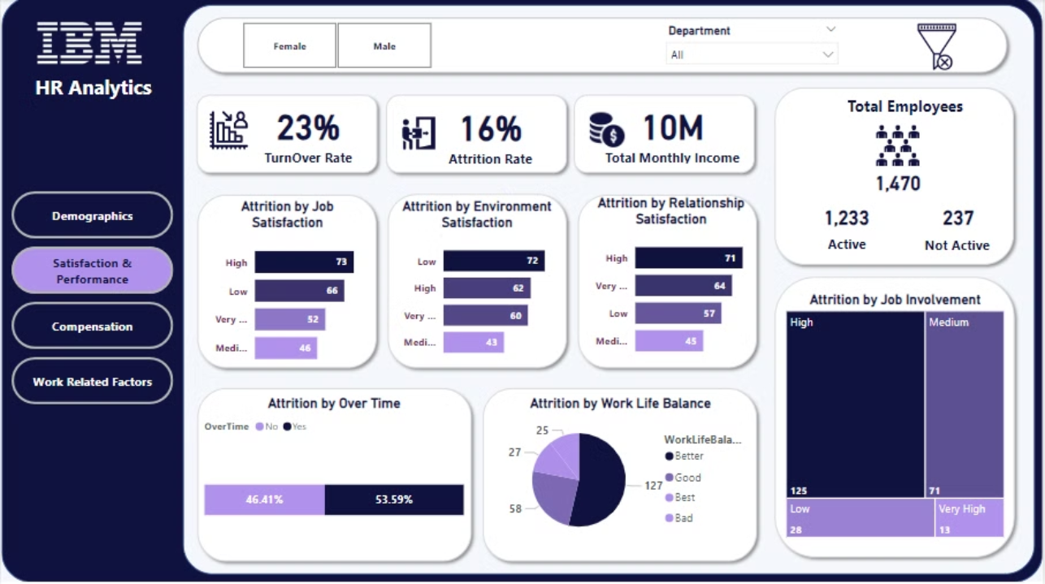
Dashboard
(Satisfaction&Performance Overview)

Slide 7
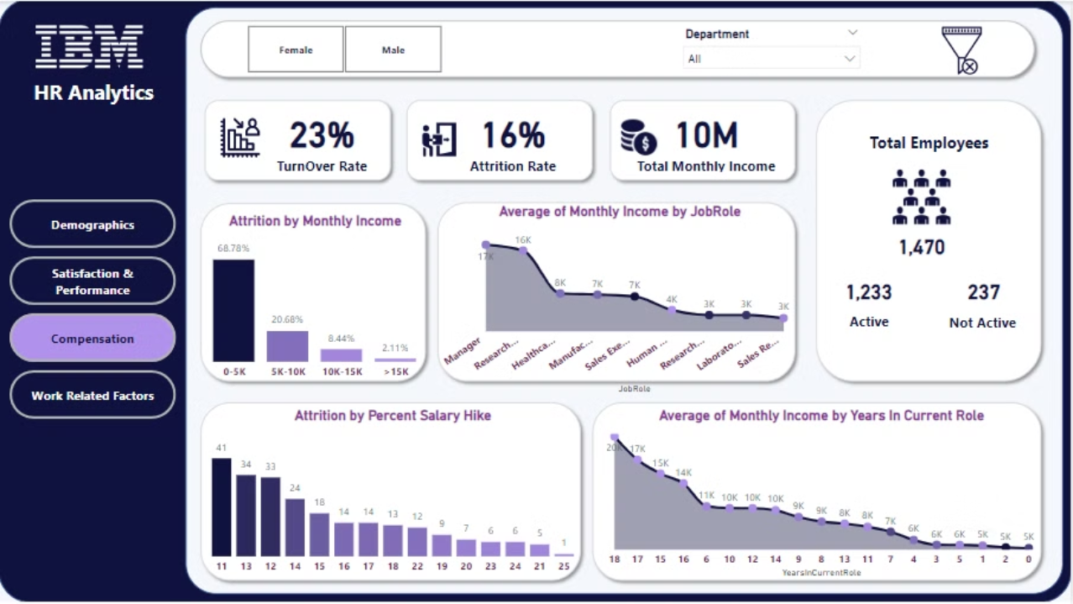
Dashboard
(Compensation Overview)

Slide 8
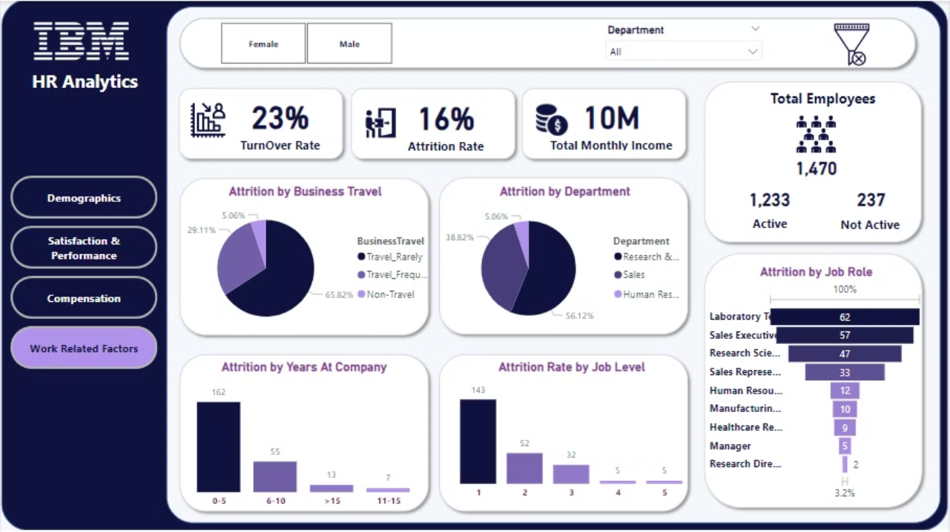
Dashboard
(Work Related Factors)

Slide 9
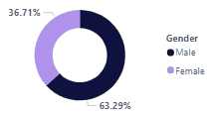
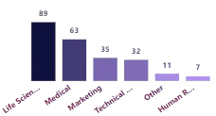

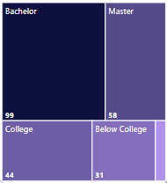
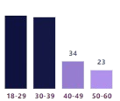
Insights:
According To Demographics:
 | Attrition is higher among males than females. |  | Employees with a background in Life Sciences have the highest attrition rate. While those with an educational background in Human Resources exhibit the lowest rate.
 | Single employees leave their jobs more often than married or divorced employees.
 |  |  | Employees with a bachelor’s degree have the highest attrition rates.
 | Younger employees are more likely to quit than older ones.

Slide 10
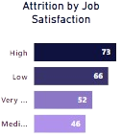
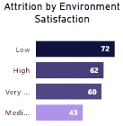
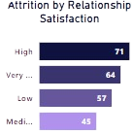
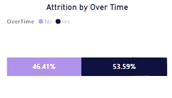
Insights:
According To Satisfaction & Performance:
Employees who are dissatisfied with their job, relationships, and work environment are more likely to leave.
 |  | Over half of employees who quit worked overtime, totaling 54%.

Slide 11
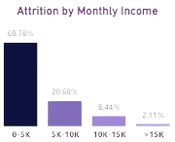
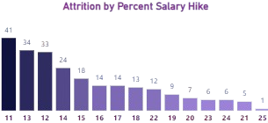
Insights:
According To Compensation:
 | 68% of attrition occurs in the monthly income range of $0-5K. The lower the monthly income, the higher the attrition rate.
 | The highest attrition is associated with a salary hike less than 15%. The lower the salary hike, the higher the attrition.

Slide 12
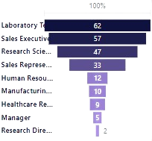
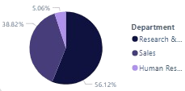
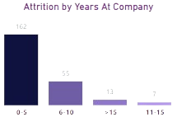
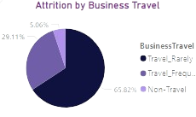
Insights:
According to Work Related Factors:
 | Attrition is highest in the Research and Development department (56%) and lowest in HR (5%). |  | Laboratory Technicians, Sales Executives, and Research Scientists have the highest attrition.
 | Employees who have been with the company for fewer years are more likely to leave. |  | Employees who travel rarely have the highest attrition rates.

Slide 13
Recommendations:
Implement career development programs and engagement strategies tailored to younger employees.
Invest in bachelor’s degree holders with career advancement opportunities.
Improve work environment, resolve conflicts, and offer employee support programs.
Evaluate and manage overtime policies to promote work-life balance.
Review and adjust compensation packages to remain competitive.
Implement transparent and fair salary increase policies.
Develop specific retention strategies for high-turnover departments like Research and Development.
Strengthen onboarding processes to integrate new employees effectively.
Create targeted retention programs for roles like Laboratory Technicians and Sales Executives.
Revise travel policies to accommodate employees’ preferences and needs.

Slide 14
THANK
YOU.

