Slide 1
THESIS DEFENSE PRESENTATION
The Development of a Mobile Application for Monitoring Poultry Egg Temperature and Security Updates
A Secure, Asynchronous, and Resilient Agricultural Cyber-Physical System
Presenter: Shamsudeen Anuoluwapo Adebayo Department of Computer Science | Hatchery Telemetry & Security Subsystem
Shamsudeen Anuoluwapo Adebayo | Egg Guardian Project | Slide 1 of 15

Slide 2
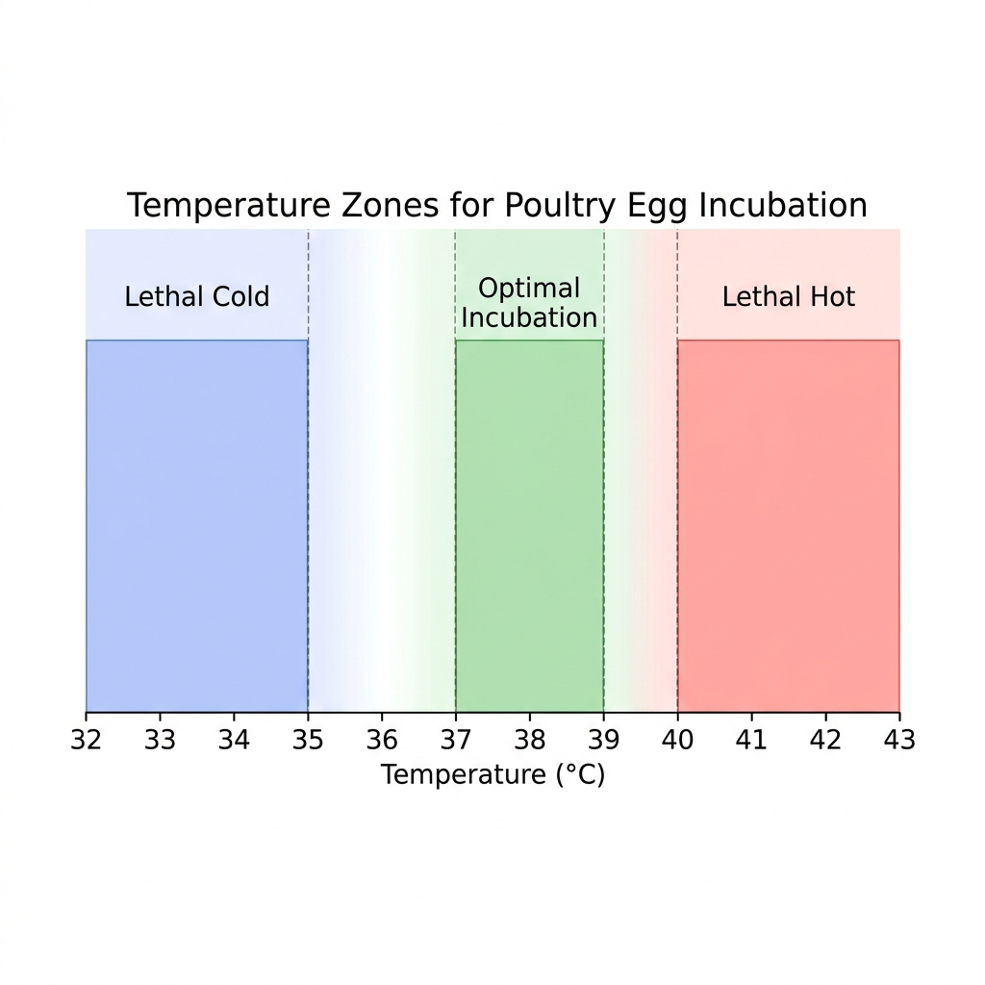
01 / INTRODUCTION
Poultry Production & Biological Incubation Constraints
Biological Constraints & Boundaries
• Poultry production stands as a cornerstone of global agriculture, providing animal protein to feed the global population (Okubanjo, 2025).
• Chicken eggs have a narrow optimal incubation window strictly defined between 37.0°C and 39.0°C (FAO, 2024).
• Sustained hypothermia (<35.0°C) slows cellular division, leading to congenital deformities or embryo death (Abraham & Stephen, 2025).
• Hyperthermia (>39.5°C) accelerates metabolic rates, denaturing proteins and killing the embryo in 20-30 minutes (Abdullah & Hamdan, 2023).
Shamsudeen Anuoluwapo Adebayo | Egg Guardian Project | Slide 2 of 15

Slide 3
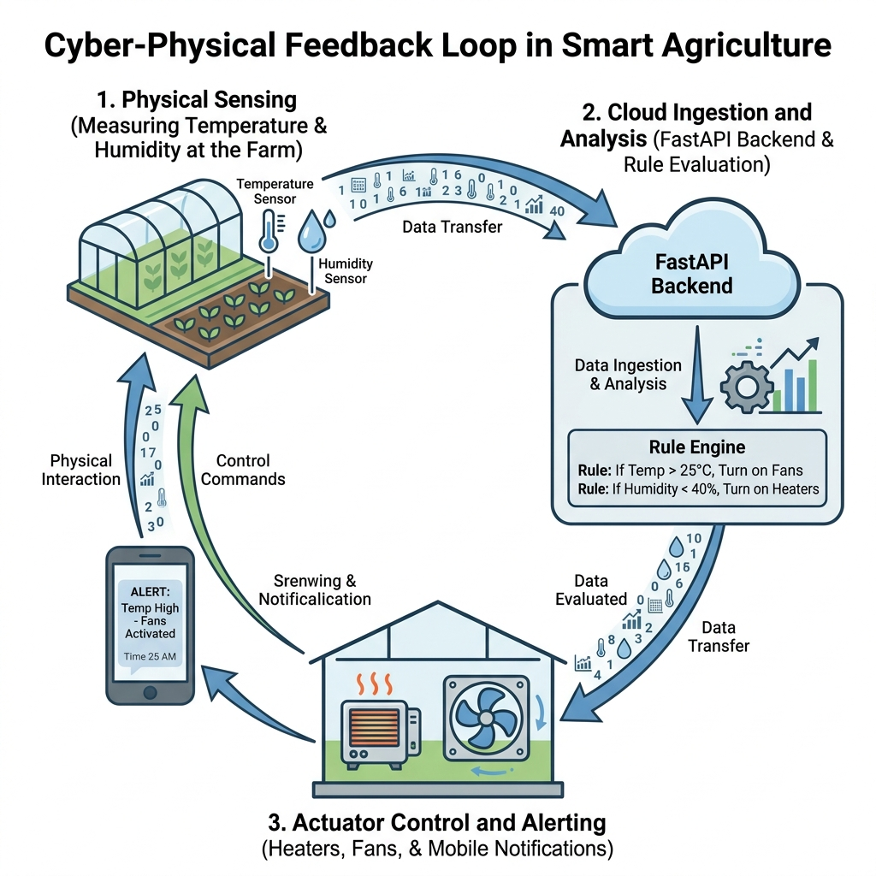
02 / INTRODUCTION
The Paradigm Shift to Agriculture 4.0
Sensing and Automation Loops
• Agriculture 4.0 leverages Cyber-Physical Systems (CPS), IoT, and cloud computing into daily farm operations (Gatkal et al., 2025).
• Physical environments are continuously monitored by networks of connected sensors, creating a feedback loop (Protopappas et al., 2025).
• Shifts management from manual scheduled checks to precision automation.
• Allows operators to detect micro-climate deviations immediately, optimizing environmental stability (Okello et al., 2025).
Shamsudeen Anuoluwapo Adebayo | Egg Guardian Project | Slide 3 of 15

Slide 4
03 / INTRODUCTION
The Role of IoT & Mobile HMI in Farm Automation
IoT Infrastructure (Edge Nodes)
• IoT provides physical infrastructure for environmental monitoring.
• ESP32 microcontrollers interface with DS18B20 digital probes (Trust, 2026).
• Edge nodes convert physical parameters into JSON payloads, transmitting them over MQTT (Abdullah & Hamdan, 2023).
Mobile Interface (WebSocket & FCM)
• Mobile applications serve as the primary human-machine interface (HMI).
• Persistent WebSockets allow mobile apps to update visual charts in real time (Nalendra & Waspada, 2025).
• Enables farm operators to receive push alerts if parameters drift (Dr. Brindha S et al., 2025).
Shamsudeen Anuoluwapo Adebayo | Egg Guardian Project | Slide 4 of 15

Slide 5
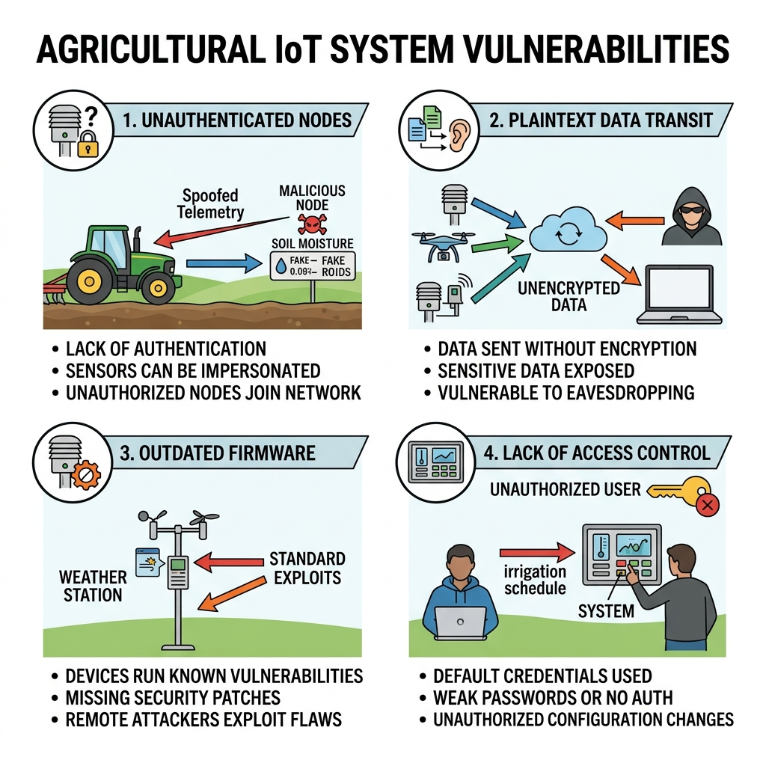
04 / RESEARCH GAPS
The Identification of Gaps in Existing Literature
Security & Buffering Gaps
• Plaintext Transmission: Prior setups (e.g. Blynk) transmit telemetry data in plaintext, exposing systems to spoofing.
• No Authentication: Lack of session controls allows unauthorized users to modify parameters.
• Firmware Neglect: Microcontrollers run outdated, insecure firmware without update warning check loops (Brindha et al., 2025).
• No Caching: Cloud platforms lack edge caching, causing complete data loss during Wi-Fi drops (Pacheco et al., 2023).
Shamsudeen Anuoluwapo Adebayo | Egg Guardian Project | Slide 5 of 15

Slide 6
05 / GOALS & OBJECTIVES
Project Aim & Core Targets
Research Aim & Purpose
• To develop a secure, real-time IoT-based mobile application framework (Egg Guardian) for monitoring poultry egg incubator temperatures.
• To implement a tracking mechanism that pushes automated firmware version warning notifications to operators when a mismatch is detected.
Specific Objectives
• Objective 1: Fabricate an ESP32 edge node with DS18B20 digital probes and offline caching queues.
• Objective 2: Build a FastAPI cloud API backend and cross-platform Flutter operator mobile application.
• Objective 3: Construct a security subsystem utilizing Bcrypt, JWT tokens, MQTTS over TLS 1.3, and version warnings.
• Objective 4: Evaluate system accuracy (MAE), data recovery rates, and end-to-end alert propagation latency.
Shamsudeen Anuoluwapo Adebayo | Egg Guardian Project | Slide 6 of 15

Slide 7
06 / IMPLEMENTATION MODEL
Iterative Software Development Life Cycle (SDLC)
Phases 1 - 3: Analysis to Coding
• Requirement Analysis: Mapping hatchery requirements, biological parameters, and security standards.
• System Design: Drafting entity-relationship schemas, UML data flow sequences, and hardware schematics.
• Development: Programming ESP32 firmware in C++, FastAPI routes in Python, and mobile UI in Dart/Flutter.
Phases 4 - 6: QA to Maintenance
• Testing: Running isolated unit evaluations on ring buffers, broker routes, and FCM alerts.
• Deployment: Hosting backend APIs in the cloud, flashing microcontroller nodes, and emulating mobile app runs.
• Maintenance: Adjusting threshold hysteresis values and publishing firmware version update notifications.
Shamsudeen Anuoluwapo Adebayo | Egg Guardian Project | Slide 7 of 15

Slide 8
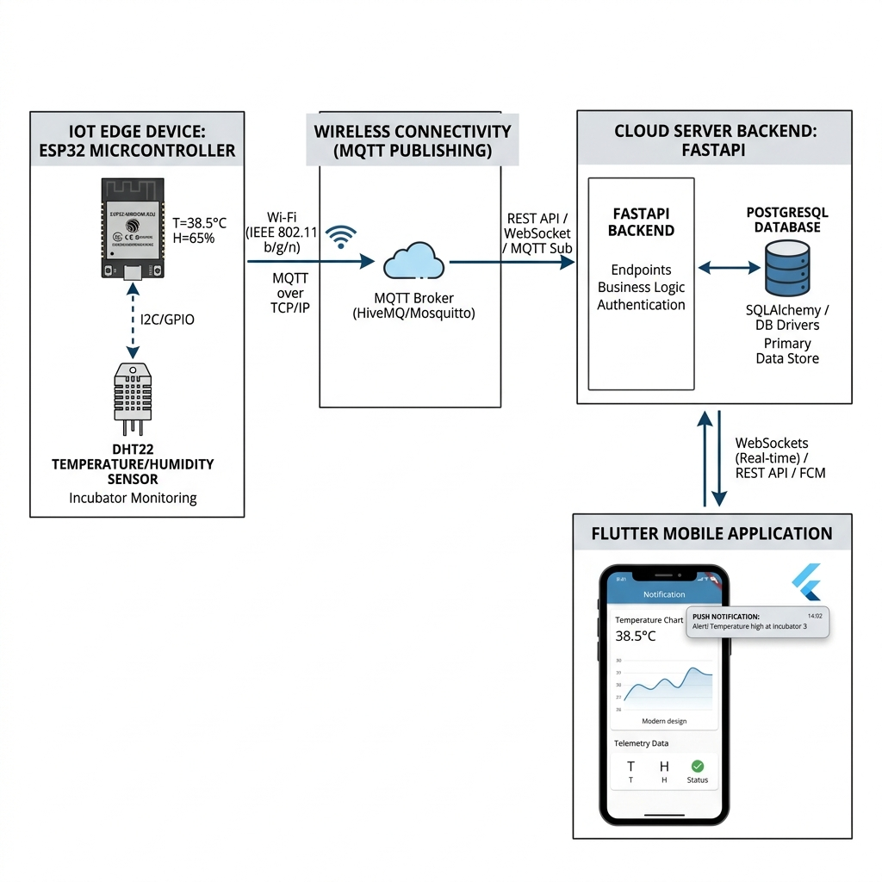
07 / SYSTEM DESIGN
Cyber-Physical Topology & Data Flows
Architectural Layers & Tiers
• Physical Layer: DS18B20 digital probes connect to the ESP32 node via a 1-Wire bus with pull-up resistors.
• Transport Layer: Node publishes serialized JSON telemetry over encrypted MQTTS (TLS 1.3 over port 8883) to the broker.
• Asynchronous Cloud: FastAPI processes telemetry, coordinates database writes, and streams data over WebSockets.
• HMI Layer: Flutter operator mobile app listens to WebSockets for real-time charts and registers FCM tokens.
Shamsudeen Anuoluwapo Adebayo | Egg Guardian Project | Slide 8 of 15

Slide 9
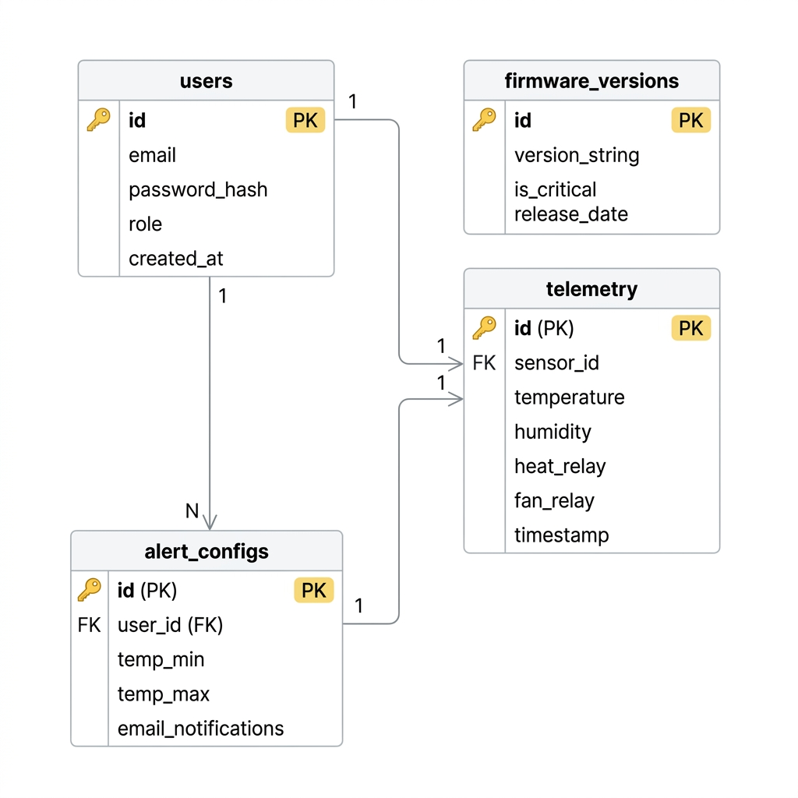
08 / RELATIONAL STORAGE
Database Design & Entity Schemas
Database Constraints & Tables
• Users Table: Stores user identifiers, unique emails, Bcrypt-hashed credentials, and user authorization roles.
• Temperature Records Table: Logs hardware sensor addresses (DS18B20 ROM string), decimal readings, and timestamps.
• Security Alerts Table: Logs event types (e.g., Firmware Mismatch), notification messages, and timestamps.
• Notifications Table: Manages user mappings, alert titles, body content, and delivery statuses.
Shamsudeen Anuoluwapo Adebayo | Egg Guardian Project | Slide 9 of 15

Slide 10
09 / HMI PLATFORMS
Operator Android Client & Web Admin Console
Flutter Mobile Handset HMI
• Authentication: Secure user login screen utilizing signed JWT tokens.
• Visual Dashboard: Real-time radial temperature gauges and 24-hour historical trend charts.
• Alert Logs: Scrollable logs displaying warning notifications and device update statuses.
Web Desktop Administration Console
• Telemetry Grid: Administrator tables showing live connection states and statuses across all nodes.
• Historical Audits: Filterable views for inspecting long-term temperature compliance logs.
• Control Console: Secure settings for adjusting temperature threshold limits.
Shamsudeen Anuoluwapo Adebayo | Egg Guardian Project | Slide 10 of 15

Slide 11
10 / CYBER SECURITY
Security Threat Mitigation Matrix
Transport & Account Security
• Eavesdropping: Plaintext telemetry intercepted over public networks. Mitigated by MQTTS/TLS over port 8883.
• Credentials Theft: Stolen passwords compromising user profiles. Mitigated by Bcrypt hashing.
• Session Hijacking: Unauthorized API actions. Mitigated by signed JWT token headers.
Device Integrity & Data Audits
• Vulnerable Code Execution: Exploits on outdated edge devices. Mitigated by version checks and warning banners.
• Telemetry Spoofing: Fabricated optimal values masking chamber failures. Mitigated by secure TLS handshakes.
Shamsudeen Anuoluwapo Adebayo | Egg Guardian Project | Slide 11 of 15

Slide 12
11 / EMPIRICAL RESULTS (PART A)
Thermal Accuracy & Caching Resilience
DS18B20 Calibration & MAE
• Sensor Precision: Calibrated digital DS18B20 probe against a mercury reference thermometer inside an incubation chamber.
• Mean Absolute Error (MAE): Measured at 0.24°C, well within the biological limit of ± 0.5°C.
• Digital 1-Wire signal remains resilient against long cable attenuation and analog noise.
Outage Buffering & Data Recovery
• Edge Caching: Tested node buffer during simulated Wi-Fi outages.
• Outage Recovery Rate: Achieved 100% data recovery for drops up to 100 seconds.
• Extended Outages: Local queue successfully overwrote oldest records first, preserving the 20 most recent readings.
Shamsudeen Anuoluwapo Adebayo | Egg Guardian Project | Slide 12 of 15

Slide 13
12 / EMPIRICAL RESULTS (PART B)
Communication Latency & Usability Scores
Alert & UI Refresh Latency
• WebSocket Delay: Real-time telemetry refreshes mobile charts in 142ms.
• FCM Notification Latency: Pushed alert payloads arrive on mobile handset in 1.14s over Wi-Fi, and 1.41s over 4G.
• Fast response times allow operators to intervene quickly during heating failures.
System Usability Scale (SUS)
• User Acceptance Testing: Field tested system usability with 10 poultry operators.
• SUS Questionnaire: Evaluated interfaces across 10 statements (likert-scale).
• Average SUS Score: Achieved 77.5/100, indicating 'excellent' usability.
Shamsudeen Anuoluwapo Adebayo | Egg Guardian Project | Slide 13 of 15

Slide 14
13 / SUBSYSTEM VERIFICATION
Edge Node Firmware lifecycle Tracking
Version Mismatch Alerts
• Firmware check logic: Backend compares edge node firmware version strings against database targets.
• Execution speed: Handshake version checks complete in 120ms.
• UI Warning Banner: Mismatches render a warning banner in the mobile app and push an FCM notification.
Device Integrity Benefits
• Helps operators identify and update outdated edge nodes.
• Provides version warning checks without complex gatekeeper frameworks.
• Ensures edge nodes run secure, authorized code.
Shamsudeen Anuoluwapo Adebayo | Egg Guardian Project | Slide 14 of 15

Slide 15
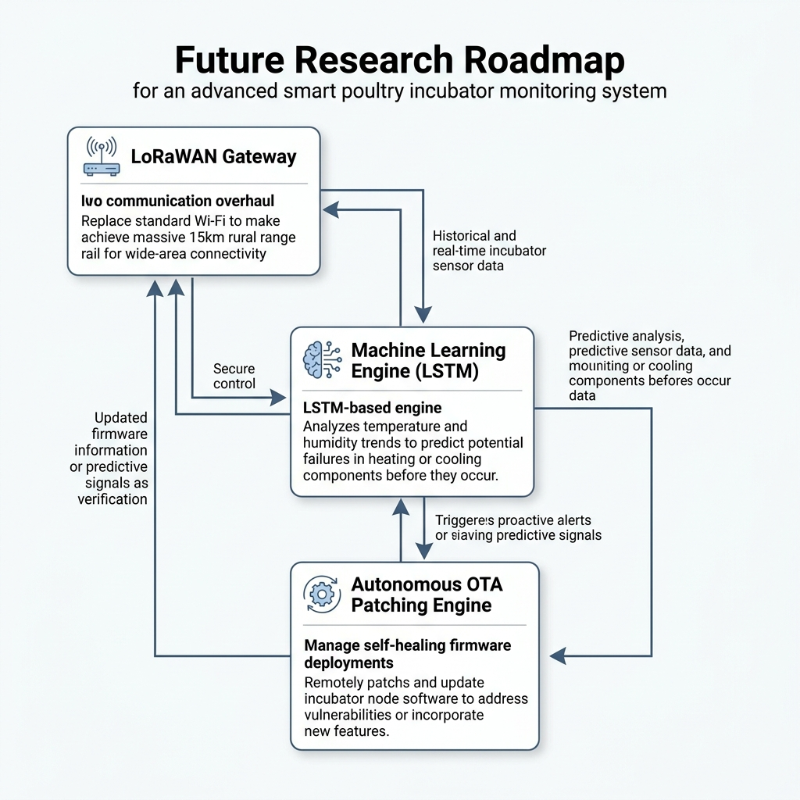
14 / SUMMARY & FUTURE SCOPE
Research Contributions & Future Recommendations
Contributions & Future Scope
• Edge Resilience: Local ring buffers maintain data completeness during Wi-Fi drops without expensive gateway hardware.
• Lifecycle Integration: Integrates security update alerts directly into smart farming telemetry.
• LoRaWAN Integration: Replacing Wi-Fi with LoRaWAN to allow long-distance transmission (up to 15 km).
• Predictive Analytics: Deploying server-side LSTM models to forecast heating/cooling failures.
Shamsudeen Anuoluwapo Adebayo | Egg Guardian Project | Slide 15 of 15

