Slide 1
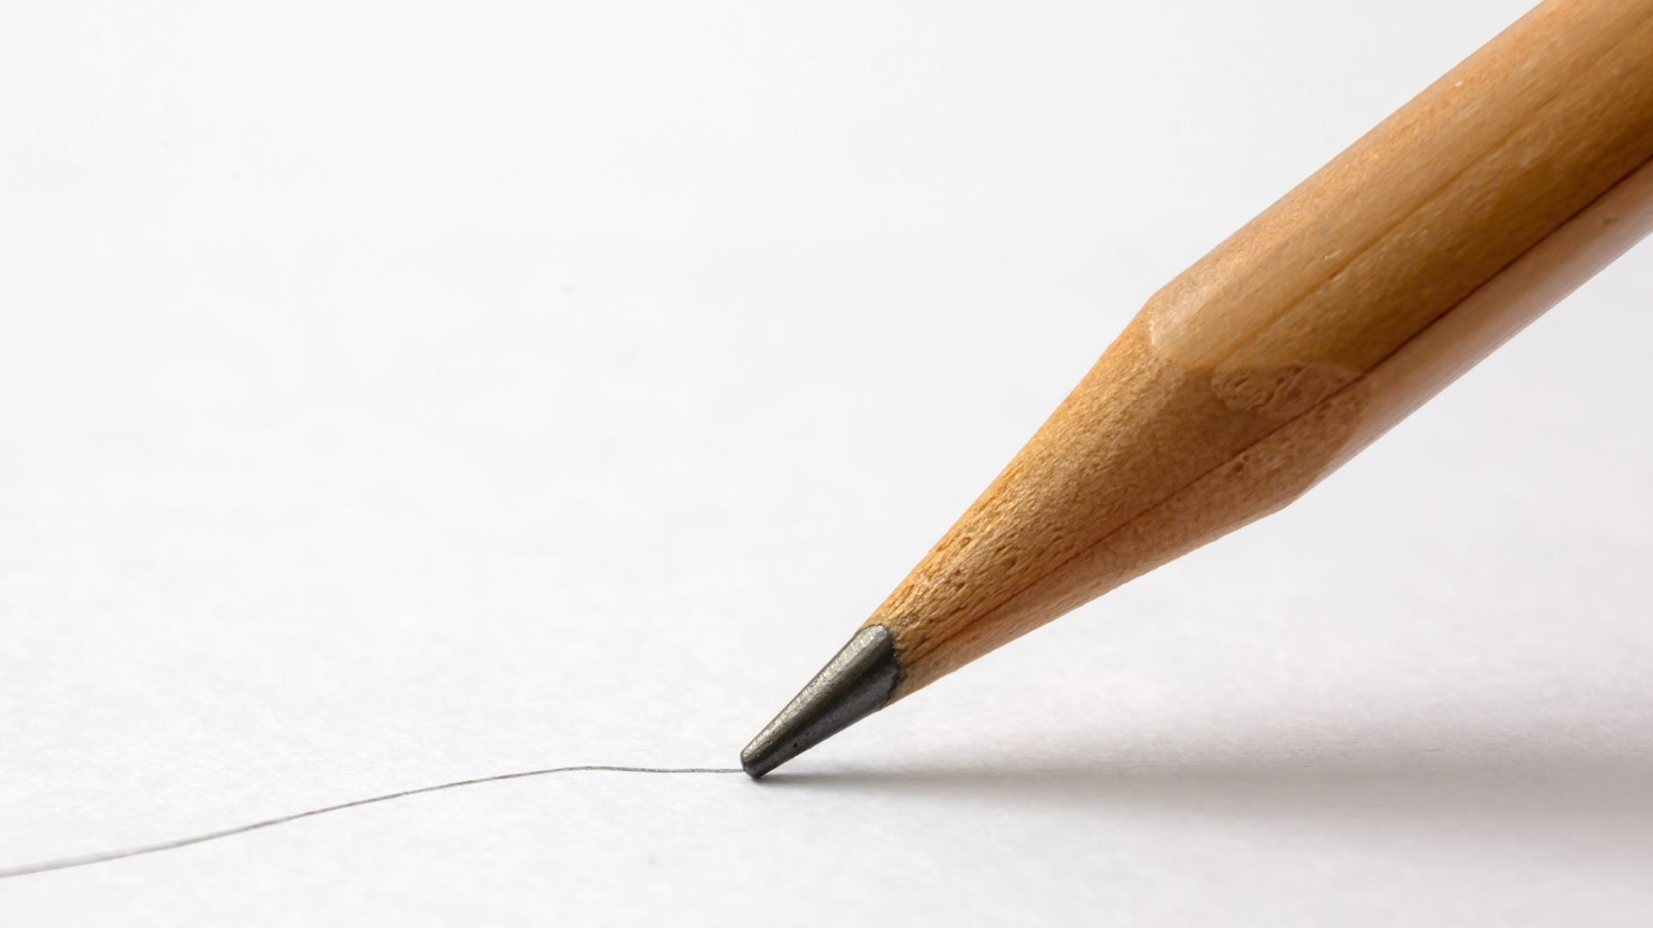
ForgeryGuard: Handwriting Forgery Detection using Siamese Networks
CS5330 Pattern Recognition and Computer Vision
A presentation by Shamya Haria

Slide 2

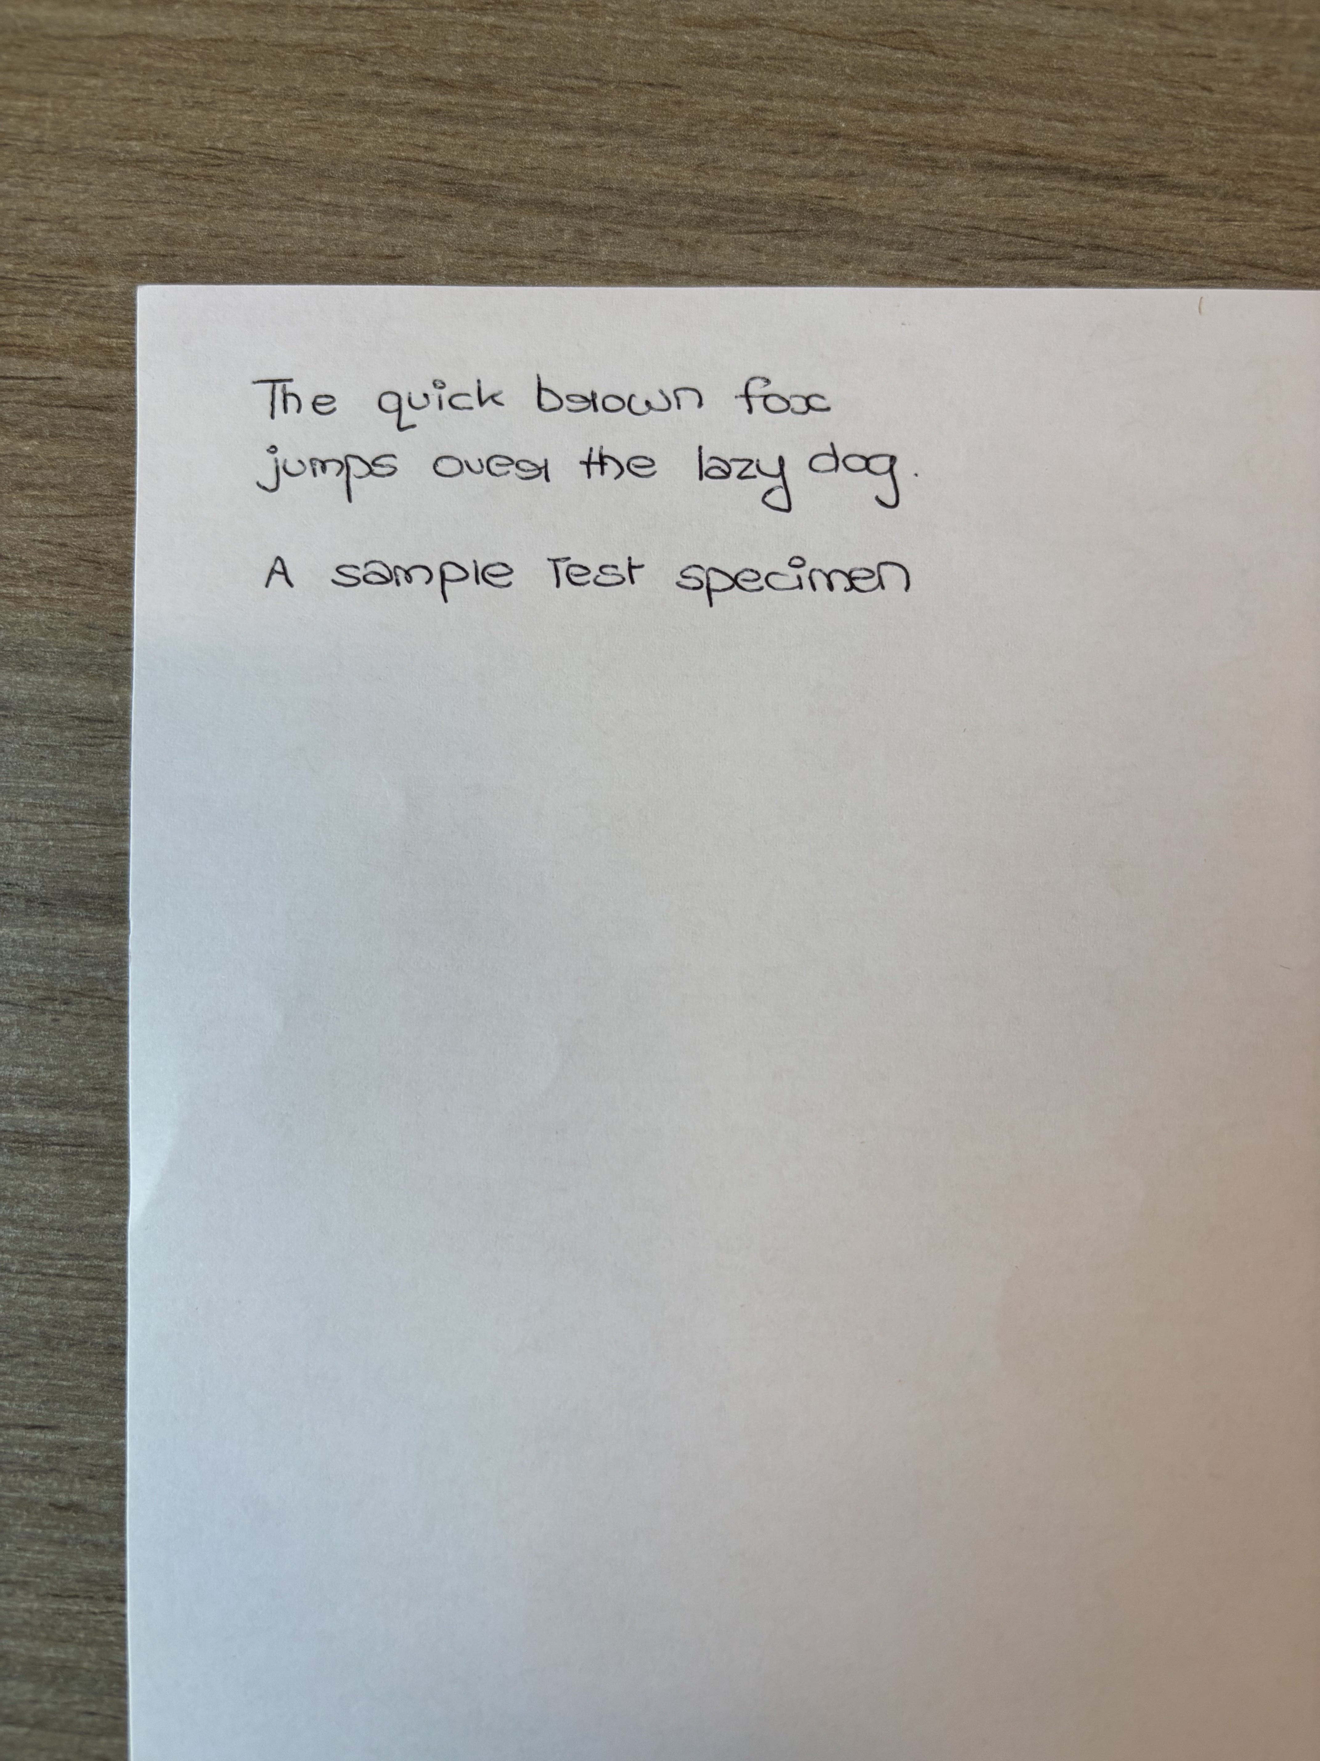
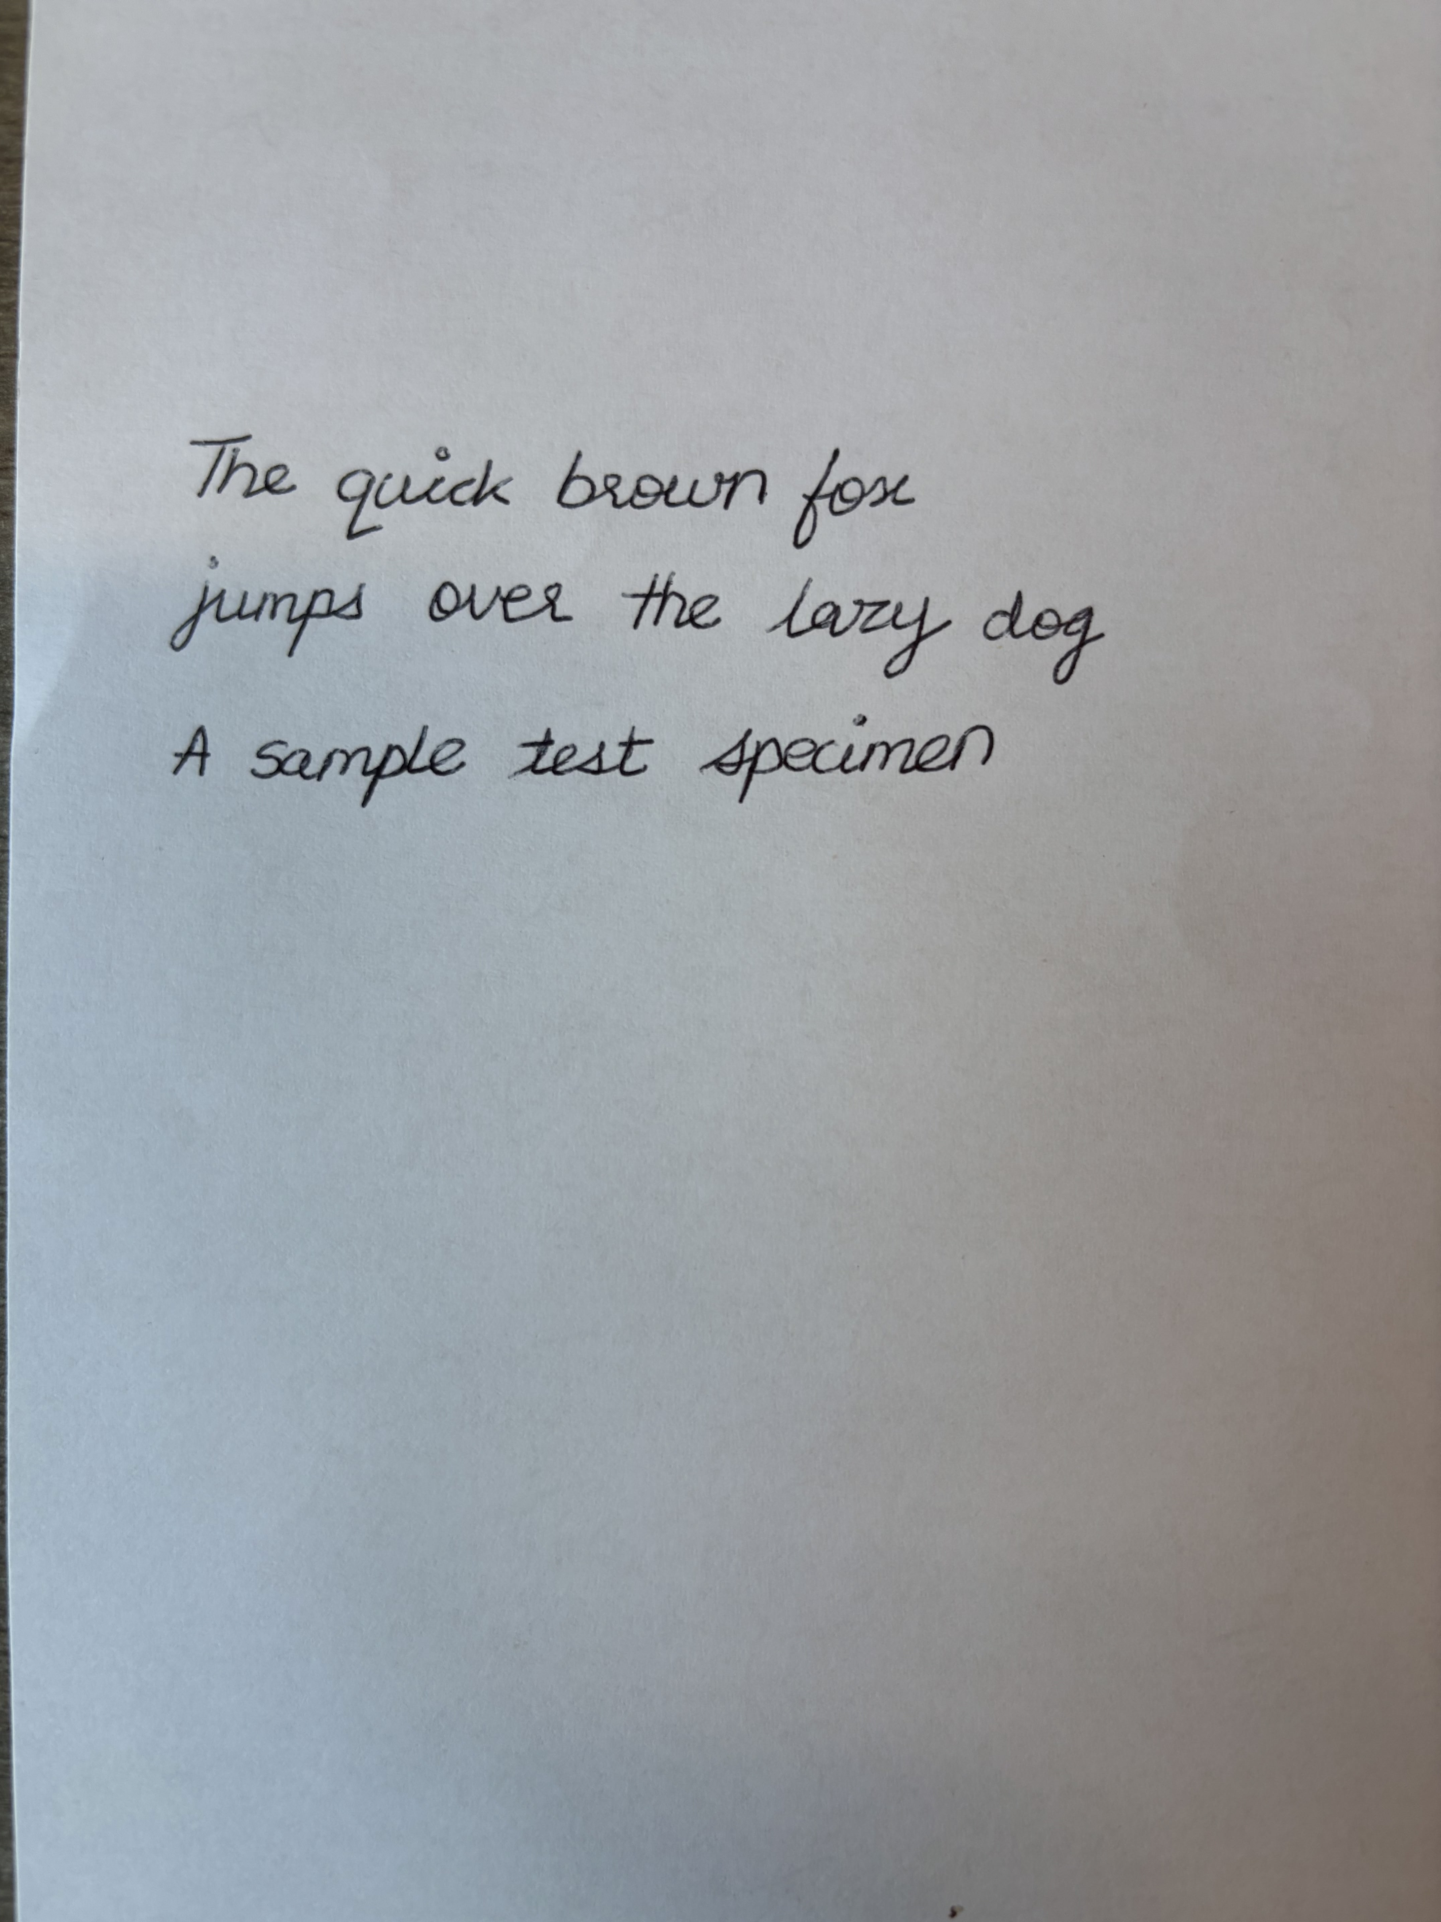
The Problem
Same Writer?
Different Writer?

Slide 3

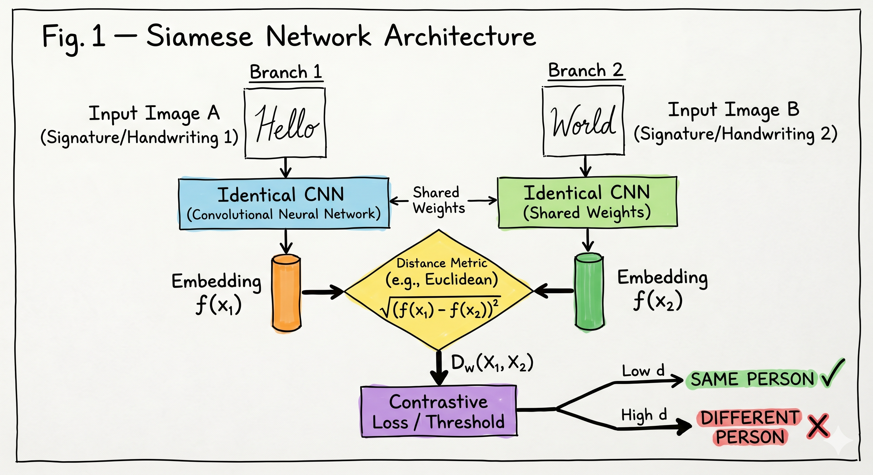
The Approach
The architecture is a Siamese Network is a two identical CNN branches that share the same weights process the two input images in parallel. Each branch produces a 256-dimensional embedding vector, and the Euclidean distance between those two vectors is what tells us how similar the two handwriting samples are. A small distance means same writer, a large distance means different writer. The network is trained with contrastive loss, which directly teaches it to pull same-writer pairs together and push different-writer pairs apart.

Slide 4
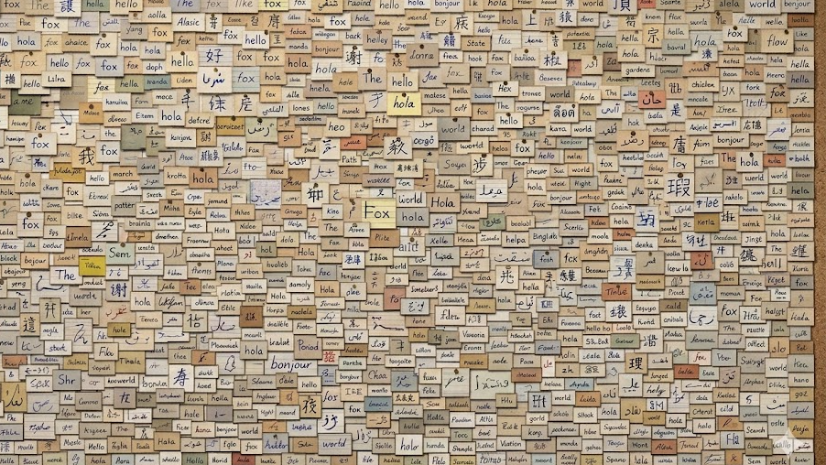

DATA
The main dataset is the IAM Handwriting Database, which contains word-level handwriting patches from over 600 writers. Training used 50,000 pairs sampled from 80% of the writers, with the remaining 20% held out for validation no writer appears in both sets. On top of that, a self-collected dataset was gathered from 6 people who each wrote the same fixed passage and a word list on paper and photographed it. None of these 6 writers appear anywhere in the training data, making it a genuine out-of-distribution test.

Slide 5

LIVE DEMO

Slide 6
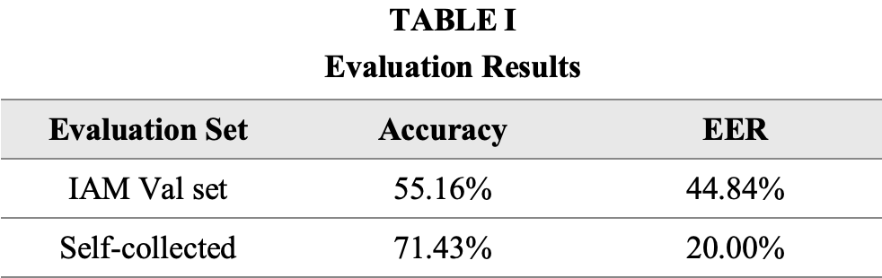
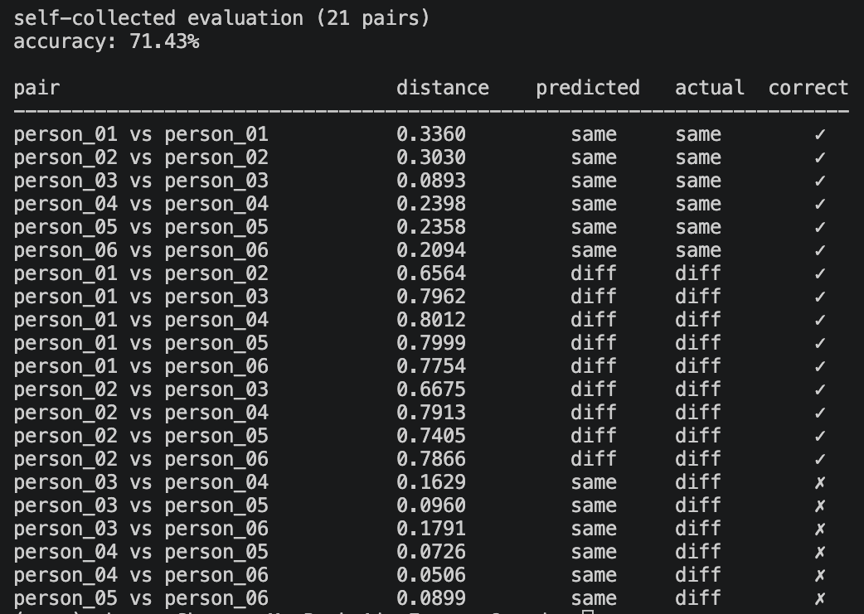
Results
The model performs noticeably better on the self-collected dataset despite never seeing those writers during training. The cleaner, line-level images give the network more handwriting style to work with compared to the small noisy word patches from IAM, which explains most of the gap between the two numbers.

Slide 7
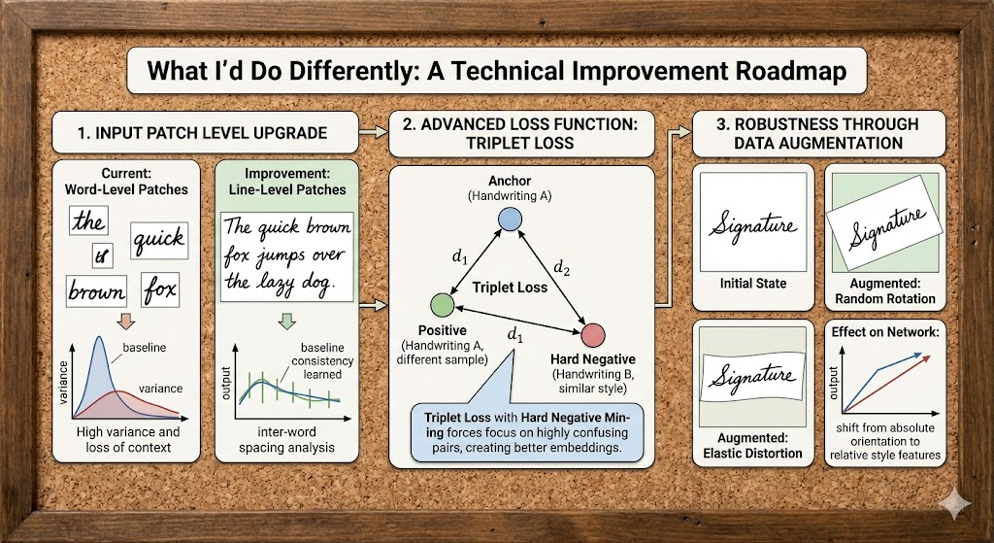
What I'd Do Differently
The biggest single improvement would be switching from word-level to line-level patches during training, the self-collected results make a strong case for that. Beyond that, triplet loss with hard negative mining would force the network to focus on the most confusing pairs rather than easy ones, which tends to produce much better embeddings. More training data with augmentation like random rotation and elastic distortion would also help the model stop relying on absolute stroke orientation and focus more on relative style features.

Slide 8
Thank You
CS5330 Pattern Recognition and Computer Vision

