Slide 1
CST8917 • SERVERLESS APPLICATIONS
Expense Approval
Workflow
A
CODE-FIRST
Two implementations. One business process.
Durable Functions vs. Logic Apps + Service Bus
B
VISUAL
Shan Jiang• [041179466] • Summer 2026
Notes:
Hello everyone. My name is [your name], and this is my CST8917 Assignment 2. In this project, I built the same expense approval workflow in two ways. Version A uses Azure Durable Functions, and Version B uses Azure Logic Apps with Service Bus. My main goal was to compare a code-first approach with a visual and declarative approach.

Slide 2
BUSINESS CONTEXT
One workflow, six rules
Auto-approve
Approve
Validate
required fields + category
Amount
< $100?
Notify employee
with final outcome
Manager decision
Reject
Timeout → Escalated
Valid categories
travel • meals • supplies • equipment • software • other
The implementation changes; the business rules do not.
02
Notes:
Both versions use exactly the same business rules. The input includes the employee name and email, amount, category, description, and manager email. The workflow first checks all required fields and makes sure the category is valid. If the amount is below one hundred dollars, it is approved automatically. If the amount is one hundred dollars or more, the workflow waits for a manager. If the manager does not answer before the timeout, the expense is auto-approved but marked as escalated. At the end, the employee receives the final result by email.

Slide 3
DURABLE FUNCTIONS
Version A keeps orchestration logic in code
Activity
validate
Orchestrator
coordinates state
Activities
process + notify
Final status
+ employee email
HTTP client
start request
External event
+ durable timer
Design decisions
• Orchestrator stays deterministic
• I/O work remains inside activities
• Instance ID correlates status, logs, and manager events
03
Notes:
This is the Durable Functions architecture. An HTTP client starts the orchestration and returns an instance ID and status URL. The orchestrator first calls the validation activity. For a small expense, it goes directly to processing and notification. For a larger expense, it waits for a ManagerDecision external event and a durable timer at the same time. A separate HTTP endpoint simulates the manager decision. The last activities create the final result and send the employee notification. The important point is that the orchestrator only coordinates tasks. Input and output operations, such as email, are placed in activity functions.
[Sources]
- https://learn.microsoft.com/azure/azure-functions/durable/durable-functions-overview
[/Sources]

Slide 4
HUMAN INTERACTION PATTERN
The first completed task decides the outcome
Manager event
Durable timer
wait_for_external_event(
"ManagerDecision")
Approve → approved
Reject → rejected
create_timer(deadline)
No response before deadline
→ auto-approved + escalated
External event
Timer
task_any
One final outcome
04
Notes:
For expenses of one hundred dollars or more, I used the Human Interaction pattern. The orchestrator creates two durable tasks. One waits for a manager event, and one waits for the timeout. The task-any operation selects whichever task finishes first. If the manager answers, I cancel the timer and use the approve or reject choice. If the timer finishes first, I mark the request as escalated. This is natural in Durable Functions because the workflow can wait without keeping a server thread running.
[Sources]
- https://learn.microsoft.com/azure/azure-functions/durable/durable-functions-human-interaction
- https://learn.microsoft.com/azure/azure-functions/durable/durable-functions-timers
[/Sources]

Slide 5
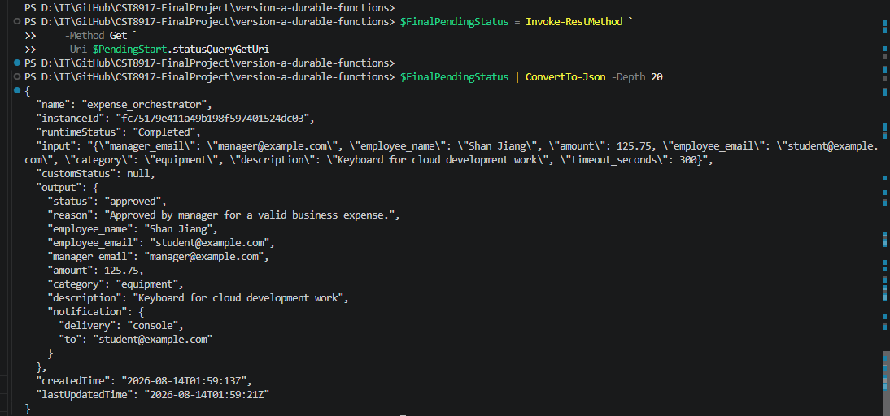
TEST EVIDENCE
Version A proves all six paths with repeatable HTTP tests
Evidence shown
1. Durable Functions host loaded six functions
2. Valid request completed successfully
3. Manager approval and rejection were tested
4. Timeout returned escalated
5. Missing fields and invalid category returned validation errors
6. Console notification logs were captured
05
Notes:
Now I will demonstrate Version A. First, the Functions host is running, and these are my two HTTP endpoints. I will send a valid request for seventy-five dollars from the HTTP test file. The starter returns an instance ID and a status URL. When I open the status URL, the orchestration is completed and the final status is approved because the amount is below one hundred dollars. Next, I will show a request for two hundred and fifty dollars. This instance waits for manager input. I copy the instance ID to the manager decision request and send an approve decision. After I refresh the status, the final result is approved by the manager. For the timeout case, I prepared a completed run so we do not need to wait during the video. No manager event was sent, and the output is escalated. I also tested missing fields and an invalid category. Both return a validation error before the approval logic starts. Finally, this is the employee notification for the completed request.

Slide 6
LOGIC APPS + SERVICE BUS
Version B turns integration into a visible workflow
Azure Function
validation
Logic App
visual orchestration
Service Bus queue
expense-requests
Service Bus topic
expense-outcomes
Employee
email
Outlook
approval email
Filtered outcome subscriptions
approved
rejected
escalated
Standard tier is required because Basic does not support topics.
06
Notes:
Version B begins with an expense message in the Service Bus queue. The Logic App receives the message and calls the validation Azure Function. The Logic App then applies the amount condition and, when required, sends a manager approval email. The final outcome is published to a Service Bus topic. Three filtered subscriptions separate approved, rejected, and escalated results. The Logic App also sends an email to the employee. I used Service Bus Standard because the Basic tier does not support topics and subscriptions.
[Sources]
- https://learn.microsoft.com/azure/service-bus-messaging/service-bus-queues-topics-subscriptions
- https://learn.microsoft.com/azure/service-bus-messaging/service-bus-quickstart-topics-subscriptions-portal
[/Sources]

Slide 7
MANAGER APPROVAL CHOICE
Logic Apps uses a connector timeout and run-after scope
Set approved
or rejected
Send approval email
Options: Approve / Reject
Response received?
Publish + notify
Run after timeout
Set escalated
Demo timeout: PT2M
Production could use P2D or another policy based on the business SLA.
Trade-off: quick Microsoft 365 integration, but stronger connector dependency.
07
Notes:
Logic Apps does not provide the Durable Functions Human Interaction pattern in the same code form. My solution uses the Office 365 Send approval email action. This connector waits for a manager response. For the classroom demo, I set a two-minute timeout. An escalation scope is configured to run after a timeout or failure. If the manager selects Approve or Reject, the normal condition sets the status. If there is no response, the escalation scope sets the status to escalated. The solution works well with Microsoft 365, but it has stronger connector dependency than the Durable Functions version.
[Sources]
- https://learn.microsoft.com/azure/connectors/connectors-native-webhook
- https://learn.microsoft.com/azure/logic-apps/error-exception-handling
[/Sources]

Slide 8
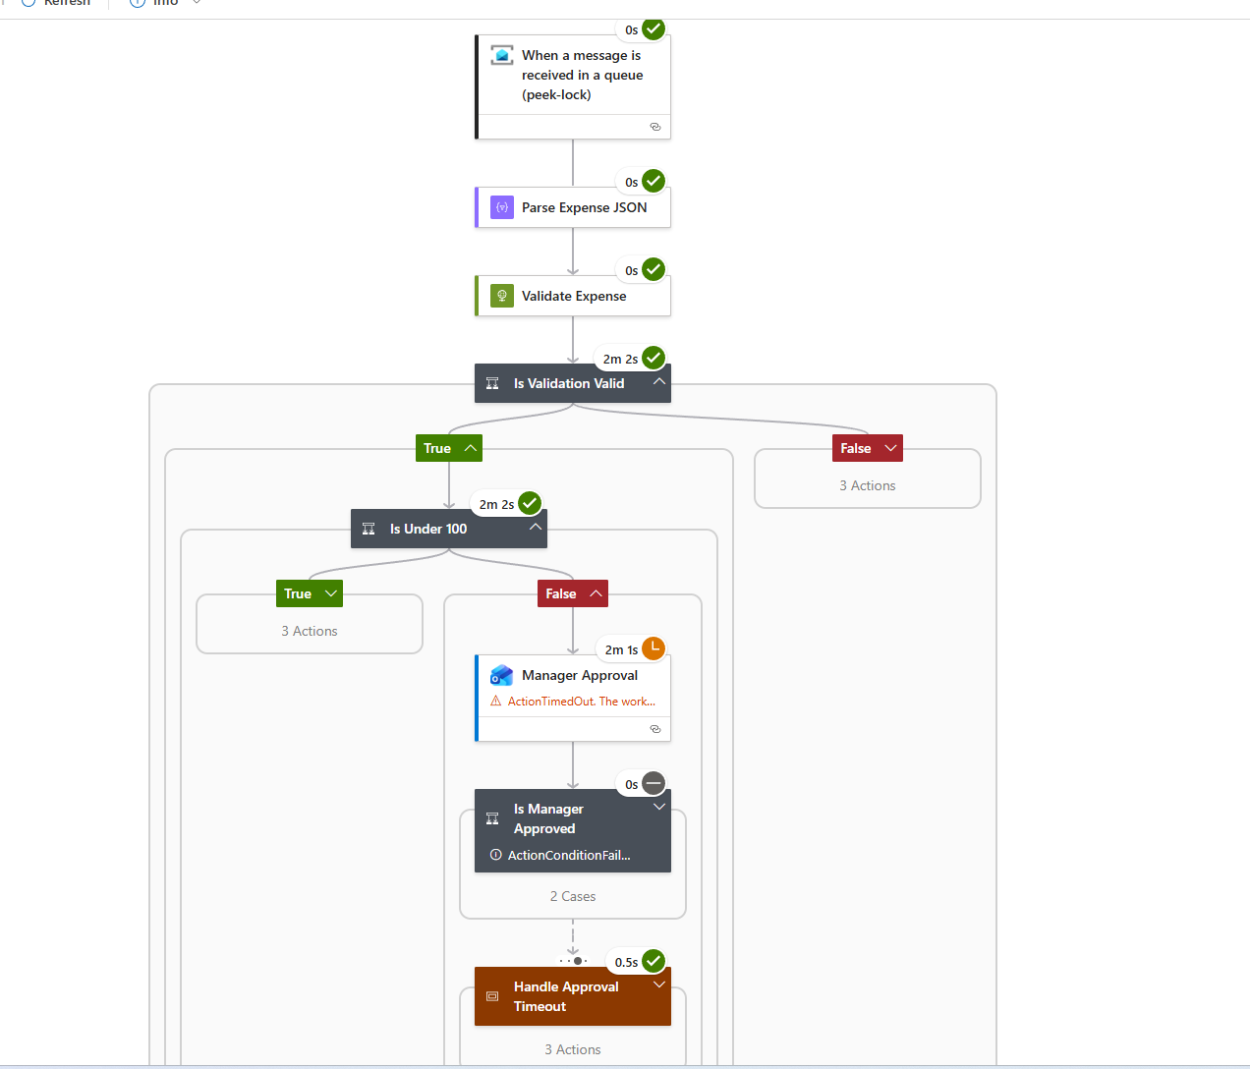
TEST EVIDENCE
Run history makes every Logic App branch visible
Evidence shown
1. Queue message received by the Logic App
2. Azure Function validated the request
3. Under-$100 requests were auto-approved
4. Manager approve and reject paths succeeded
5. Timeout created an escalated result
6. Invalid input returned a validation error
08
Notes:
Now I will demonstrate Version B. I will send a new under-one-hundred-dollar request through the submit-expense HTTP endpoint. The Function places the message in the incoming queue. A new Logic App run starts. In the run details, the validation Function returns valid equals true, and the amount condition follows the auto-approval branch. The workflow publishes an approved message and sends the employee email. This previous run shows a manager approval. The approval action received the selected option, and the final status is approved. This other run shows the timeout. The approval action timed out, and the escalated scope ran successfully. Here are the three subscriptions. The message counts show that each outcome went only to its matching filtered subscription. This is the final email received by the employee. I have hidden personal information in the recording.

Slide 9
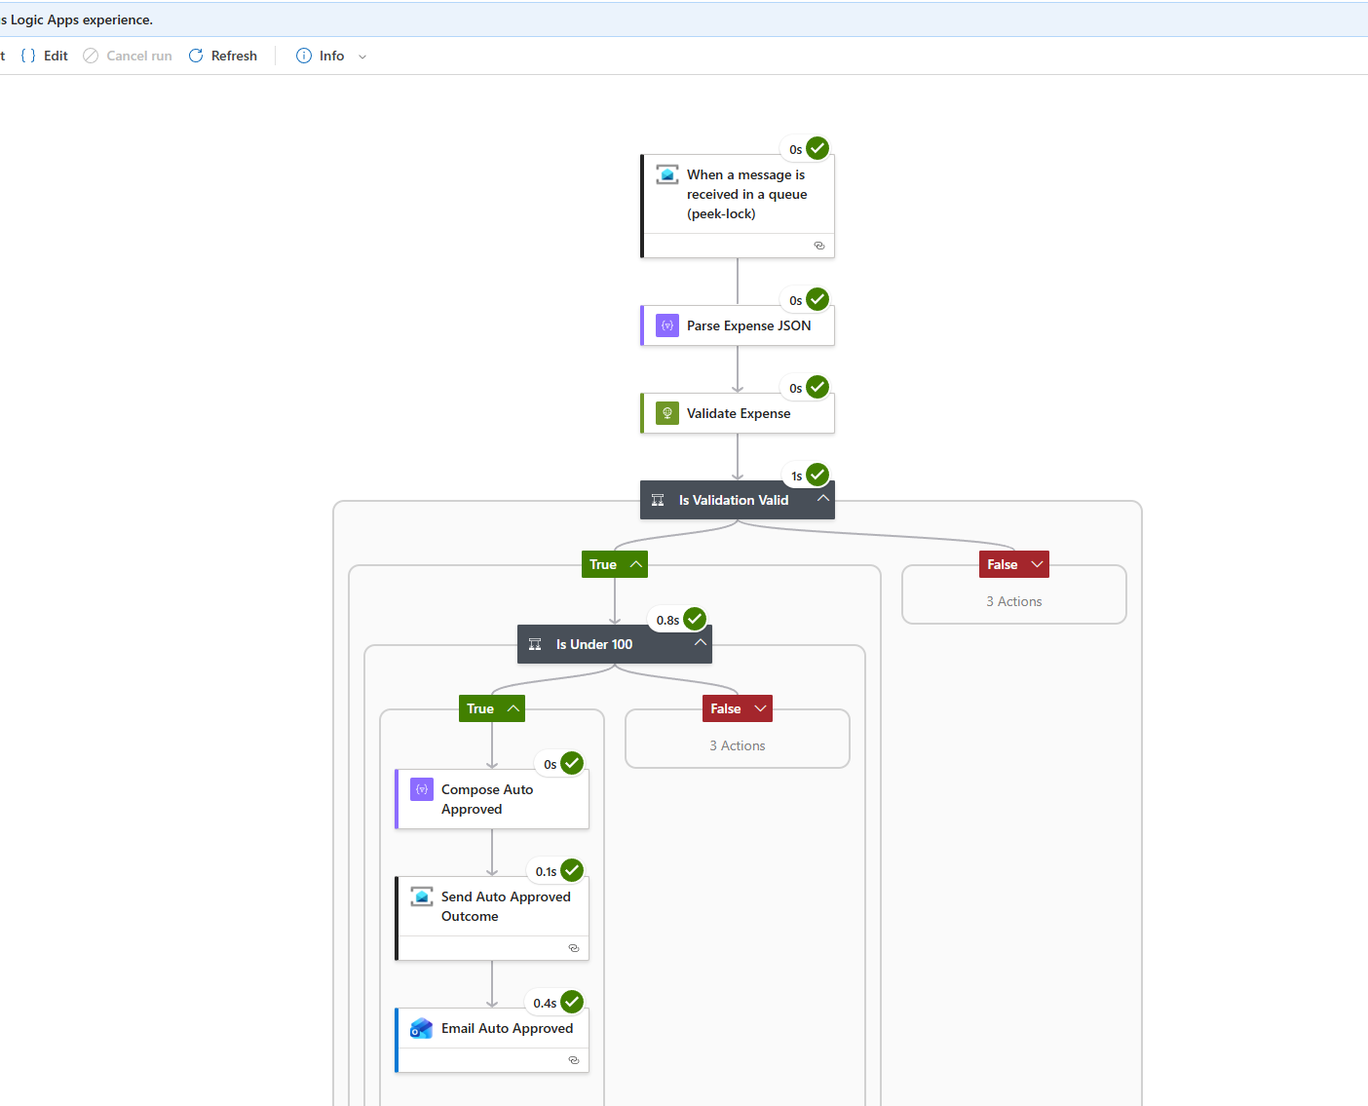
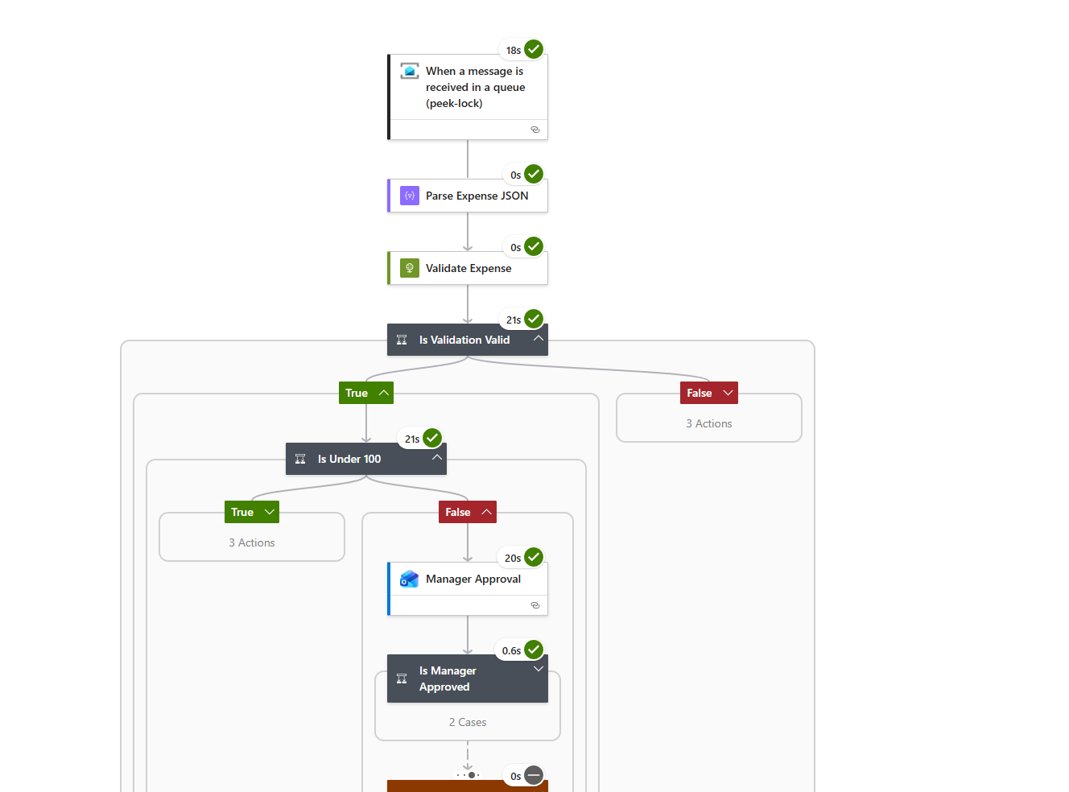
Auto-approved
Manager approved

Slide 10
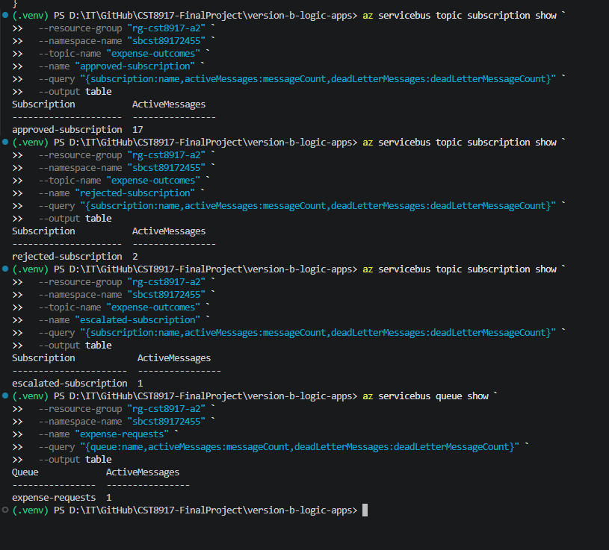
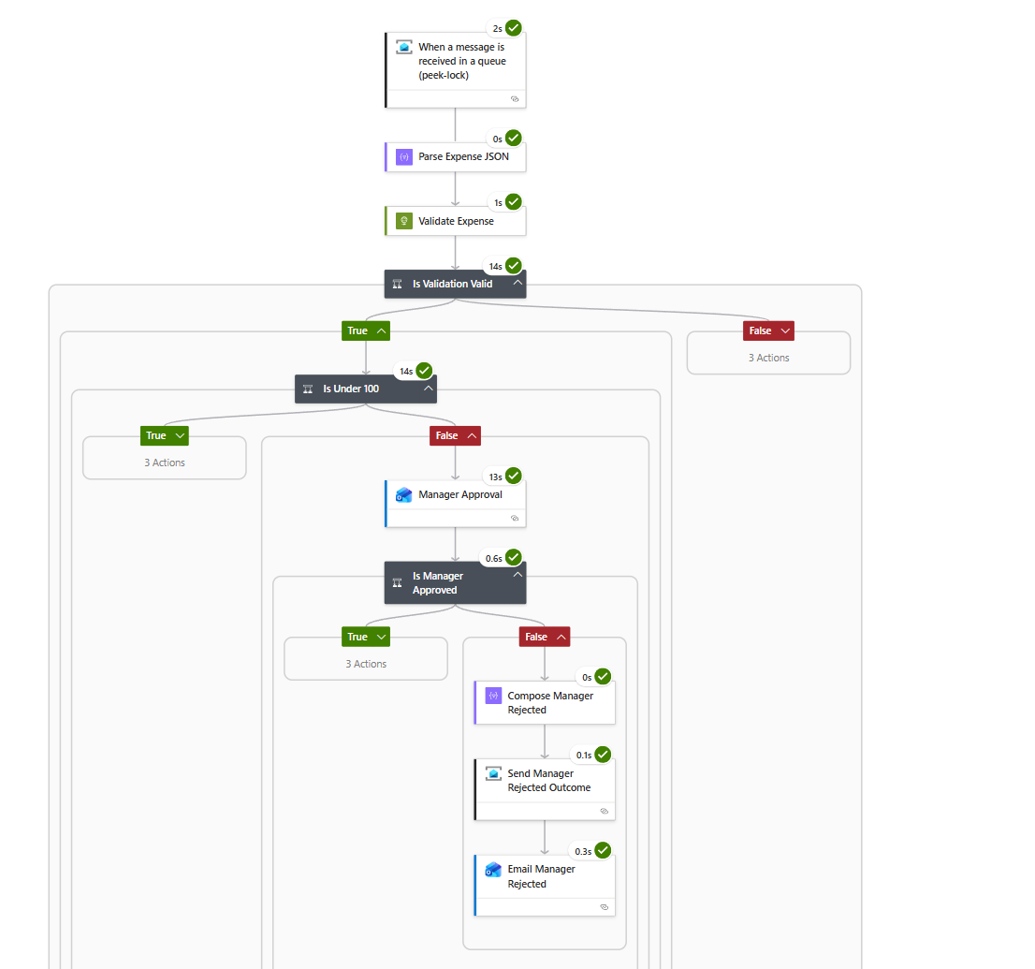
Manager rejected
Topic subscriptions

Slide 11
SIX-PART COMPARISON
The best tool changes by dimension
Dimension | Durable Functions | Logic Apps + Service Bus
Development | More code; clearer complex logic | Faster connector setup
Testability | Strong local + automated testing | Full path needs Azure resources
Error handling | Precise retries and recovery in code | Built-in retry and run-after
Human interaction | Natural event-versus-timer race | Approval connector + timeout scope
Observability | Custom telemetry; correlate by instance ID | Best visual run history
Cost | Low usage cost; storage also matters | Fixed Service Bus base + per-action cost
Durable Functions leads when logic and testing dominate; Logic Apps leads when integration speed dominates.
09
Notes:
I compared the two versions in six areas. Logic Apps was faster for connecting Azure and Microsoft 365 services, but Durable Functions gave clearer control when the logic became complex. Durable Functions was easier to test locally and is more suitable for automated Python tests. Logic Apps has convenient retry and run-after settings, while Durable Functions gives more detailed control in code. The Human Interaction pattern was more natural in Durable Functions. For observability, Logic Apps run history was easier to explain visually, but Durable Functions can provide richer custom telemetry through Application Insights. The final choice depends on both technical complexity and the team's skills.

Slide 12
ESTIMATED MONTHLY PLATFORM COST
Connector calls drive the high-volume cost gap
Assumptions
• 30 days/month
• 20% need manager approval
• Functions Consumption plan
• Logic Apps Consumption plan
• Service Bus Standard
• Email, taxes, support, and heavy logging excluded
Verify your own region and currency in the Azure Pricing Calculator before submission.
10
Notes:
These estimates use thirty days per month and assume twenty percent of expenses require manager approval. At one hundred expenses per day, the Durable Functions usage is likely inside the monthly free grant, so the main extra cost is storage and email. The Logic Apps version is around twelve US dollars per month in my estimate, mainly because Service Bus Standard has a base charge. At ten thousand expenses per day, Durable Functions still has a relatively low platform cost under my execution assumptions. Logic Apps becomes more expensive because actions and standard connector calls are charged by use. These are estimates only. Actual prices depend on region, currency, logging, email licensing, and the Azure agreement.
[Sources]
- https://azure.microsoft.com/pricing/details/functions/
- https://azure.microsoft.com/pricing/details/logic-apps/
- https://azure.microsoft.com/pricing/details/service-bus/
[/Sources]

Slide 13
RECOMMENDATION
Choose Durable Functions for the production core
Choose Logic Apps when…
Primary choice
Durable
Functions
• The workflow is mostly integration
• Microsoft 365 connectors are already approved
• Business rules change often
• Visual support and fast delivery matter most
Best fit for a long-running approval process with custom rules, testing, and source-controlled logic.
Production additions: managed identity • Key Vault • idempotency • retry policies • alerts
11
Notes:
For production, I would choose Durable Functions for the main workflow. The external event and durable timer match this long-running approval process clearly. The logic can be reviewed in Git, tested with code, and extended with custom retry and security rules. I would still consider Service Bus as an entry point when the system needs load leveling. I would choose Logic Apps when the workflow is mainly integration, the company already uses Microsoft 365, and the process changes often. In that situation, the visual designer and connector library can save development time.

Slide 14
LESSONS LEARNED
Serverless orchestration is
mostly about waiting well.
1
Waiting model
2
Operations
3
Next iteration
External events and timeouts shape the architecture.
Visual run history and custom telemetry serve different users.
Add automated integration tests, identity, secrets, and alerts.
Final verdict
Durable Functions for complex logic. Logic Apps for fast integration.
Notes:
The biggest lesson was that serverless orchestration is not only about writing less code. The waiting model, error handling, observability, and connector dependency can change the best design. Durable Functions required more understanding of deterministic orchestration and replay. Logic Apps required careful configuration of run-after conditions and message properties. If I continued this project, I would add automated integration tests, managed identity, Key Vault, idempotency checks, and better monitoring alerts. My final conclusion is that Durable Functions is stronger for complex and testable workflow logic, while Logic Apps is stronger for fast integration and visual operations. Thank you for watching.

