Slide 1
Multi-Label Organelle Segmentation
from FIB-SEM Electron Microscopy
Toward Automated Annotation of Novel Electron Tomograms
George S. George
Department of Computer Science • Interdisciplinary Quantitative Biology Program
Lab Meeting • February 2026
Notes:
Hi everyone, thanks for having me. Today I'll walk you through my rotation project — building a segmentation model for electron microscopy data. The long-term goal is a model that can take novel electron tomograms and automatically label every organelle.
I'll cover why we chose CellMap as our training ground, the 8-step pipeline from baseline selection to novel tomograms, how we picked a stable loss function, the systematic ablation study — 59 experiments across 5 sweeps — key 2D results so far, and where we're headed next.

Slide 2

The Big Picture: Why CellMap?
The Long-Term Goal
• Build a model that takes novel electron tomograms and produces fully labeled organelle segmentations — automatically
• No manual annotation — the model generalizes to unseen biology
• Everything we learn here transfers directly to our own tomograms
Why Is This Hard?
• 48 organelle classes, 22 biological samples
• Partial annotations — unlabeled ≠ absent; standard losses penalize correct predictions
• 6+ orders of magnitude class imbalance
• 3D volumes need up to 512 GB host RAM
Why CellMap as the Training Ground?
• Largest public FIB-SEM segmentation benchmark
• Diverse biology: HeLa, mouse kidney/liver/ heart, fly brain, jurkat, macrophage...
• Has a leaderboard → objective evaluation
• Same imaging modality as our own data
48
organelle classes
22
biological samples
289
annotated 3D crops
42.3B
total voxels
Notes:
The long-term goal is to build a model that takes in novel electron tomograms — data our lab generates — and automatically produces fully labeled organelle segmentations. No manual annotation.
Why CellMap? It's the largest publicly available FIB-SEM segmentation benchmark. 48 organelle classes, 22 biological samples. It has a leaderboard so we can objectively measure how well we're doing. And it's the same imaging modality as our own tomograms.
What makes this hard: annotations are partial — each crop only labels a subset of classes. Unlabeled does NOT mean absent. Class imbalance spans 6+ orders of magnitude. And 3D training needs 512 GB of host RAM just for data loading.

Slide 3
The Roadmap
1
Baseline Selection
Quick test to identify stable loss function
✅ Done
2
Infrastructure Rebuild
Native zarr pipeline, all 48 classes
✅ Done
3
Systematic Ablation
59 experiments, 5 sweeps (2D + 3D)
← In Progress
4
Compose Optimal Config
Best of each sweep → single config
5
Full Architecture Training
8 architectures × 100 epochs
6
Threshold Tuning
Per-class IoU optimization on validation
7
Per-Class Ensemble
Best architecture per organelle
8
Apply to Novel Tomograms
The Goal
Notes:
Here's the full pipeline from start to finish. We're at step 3.
Step 1: ran a short test to identify a stable loss function for ablations. Step 2: rebuilt the entire pipeline with native zarr and all 48 classes. Step 3 is where we are now — 59 experiments across 5 sweeps.
Steps 4–8 are ahead: compose optimal config, full architecture training, per-class threshold tuning, per-class ensemble, and apply to novel tomograms.

Slide 4
Step 1: Choosing a Baseline Loss Function
Before running 59 ablation experiments, we needed a stable loss function that would give real, comparable results across sweeps.
What we did
• Ran a short test across several common loss functions
• Identified BalancedSoftmaxTversky (BST) as a stable baseline — handles partial annotations and class imbalance without collapsing
• Used BST as the constant loss in all ablation sweeps, isolating the effect of each variable being tested
→ BST loss = constant across all sweeps → minimal confounding variables
Notes:
Before spending thousands of GPU hours on ablations, we ran a short test to find a loss function that was stable and gave real results.
BalancedSoftmaxTversky handles partial annotations and 6 orders of magnitude of class imbalance without collapsing. It became the constant loss across all our ablation sweeps, so each sweep isolates just one variable.

Slide 5
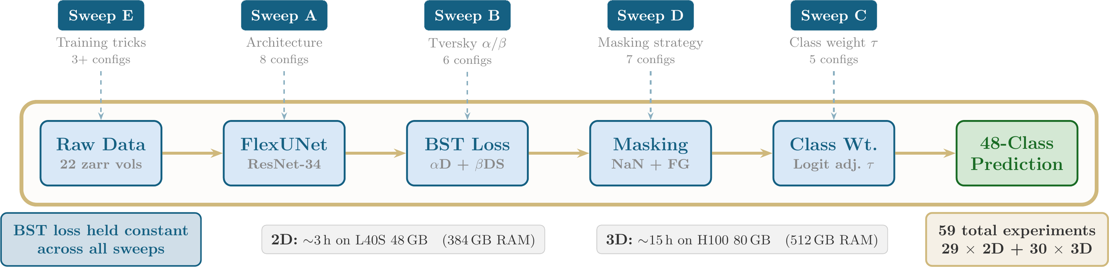
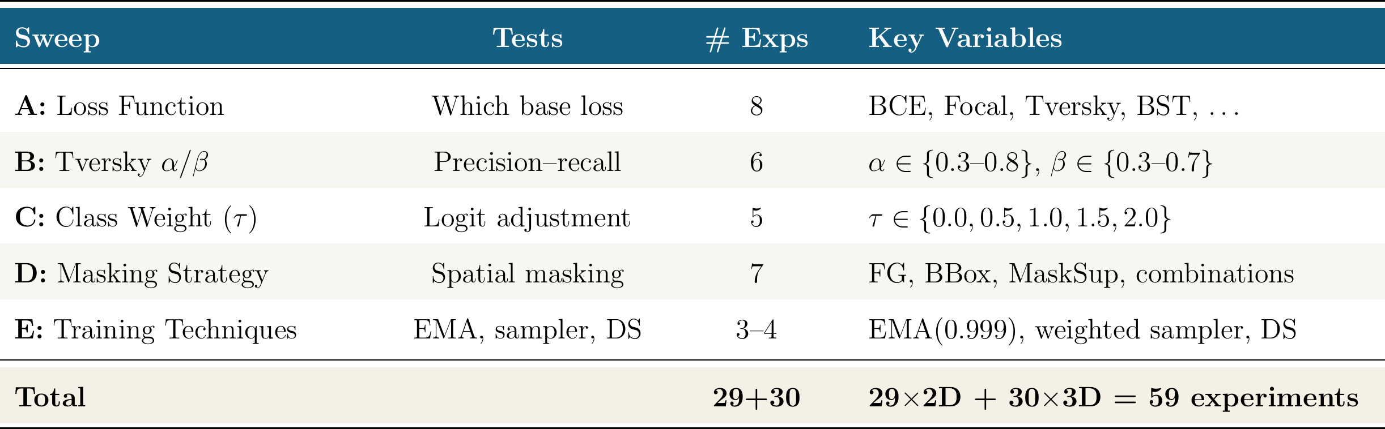
The Pipeline — 59 Ablation Experiments
Notes:
Here's the full pipeline. Data flows left to right: 22 zarr volumes, 289 crops across 48 classes, weighted sampler, FlexUNet with ResNet-34 encoder.
The loss pipeline: NaN mask for partial annotations, BalancedSoftmaxTversky loss, and logit adjustment.
5 ablation sweeps, each varying one component. Sweep A: 8 loss functions. B: Tversky alpha-beta (6). C: class weight tau (5). D: masking strategy (7). E: training tricks (3+).
59 experiments total: 29 in 2D, 30 in 3D. 2D takes ~3h on L40S, 3D takes ~15h on H100 with 512 GB RAM.

Slide 6
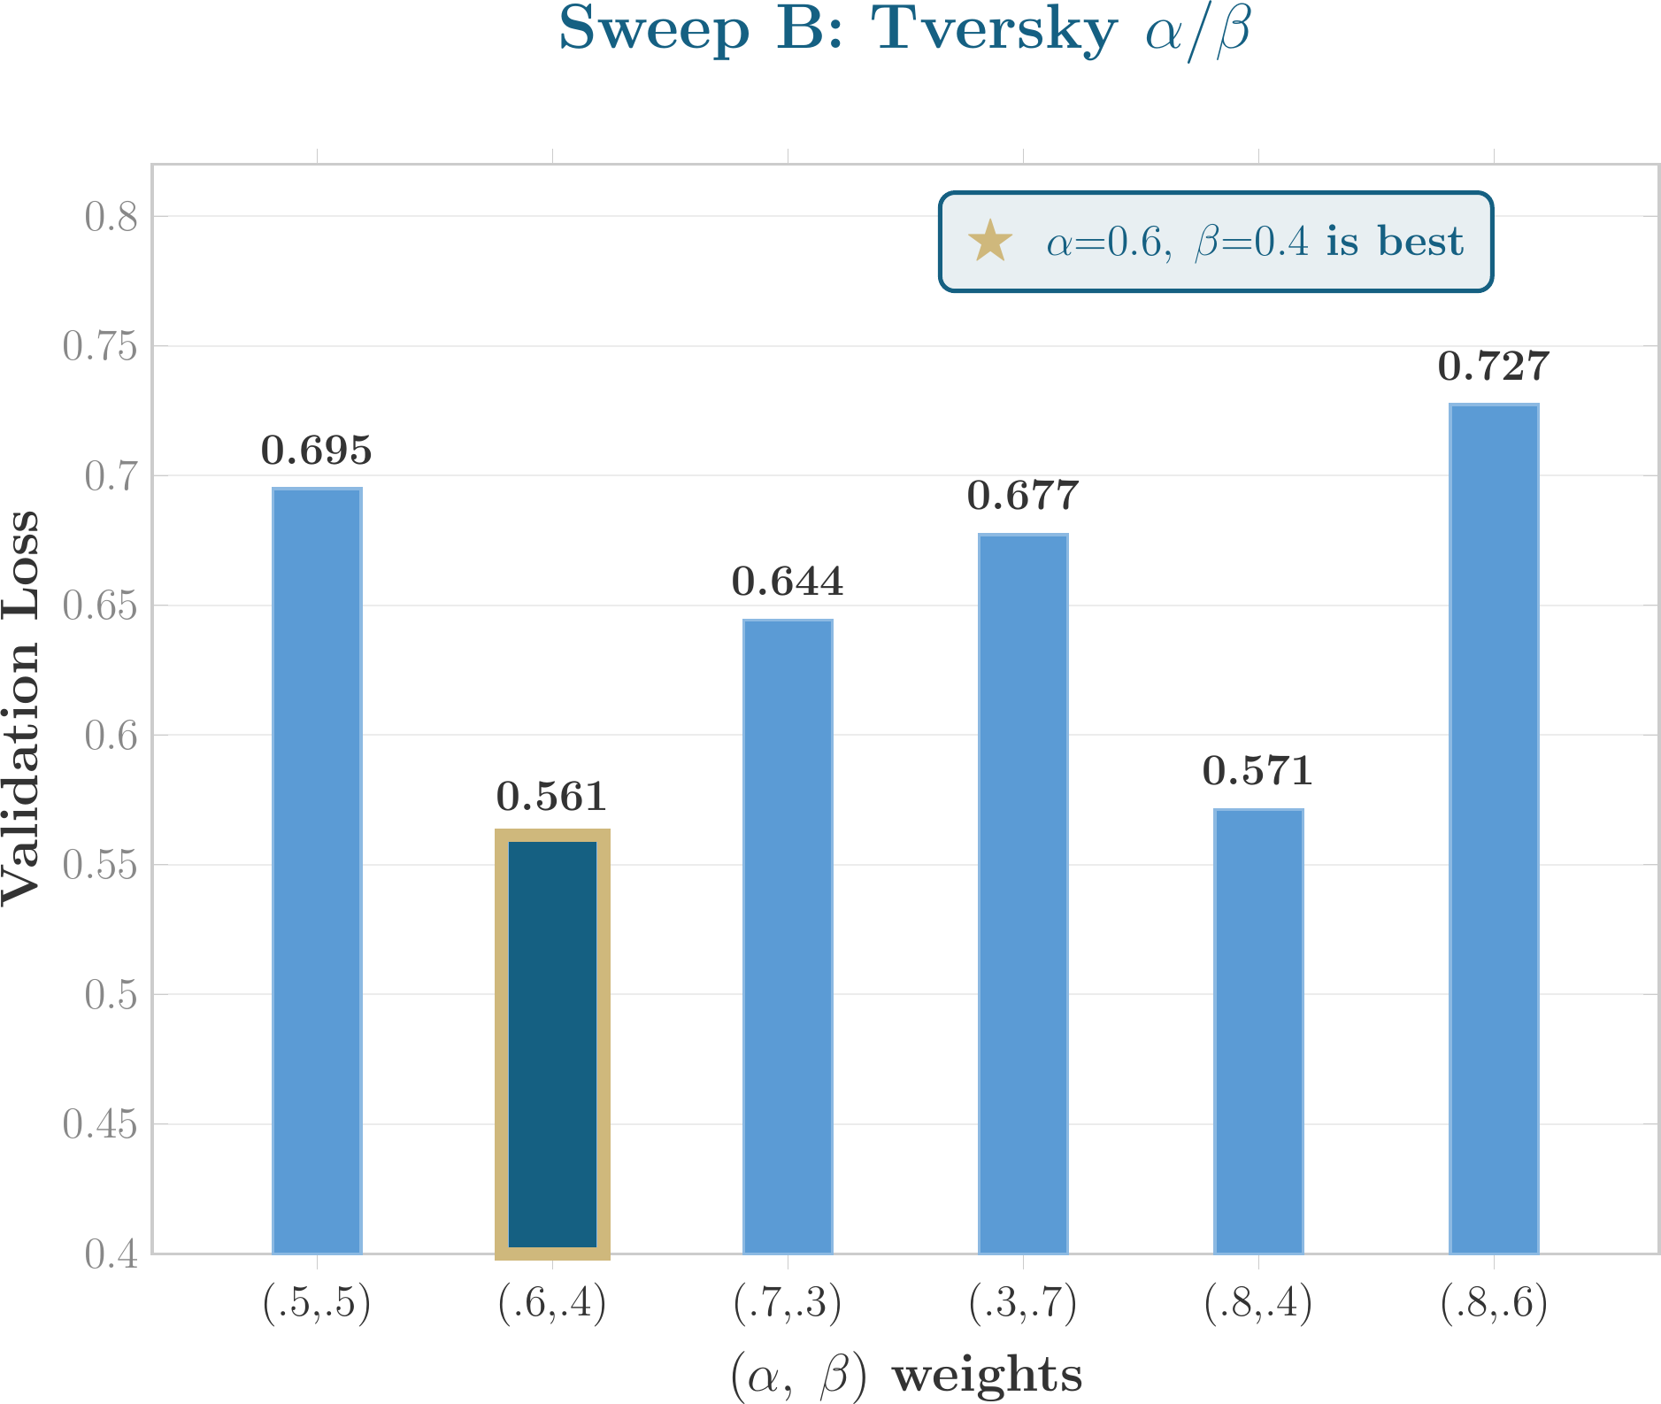
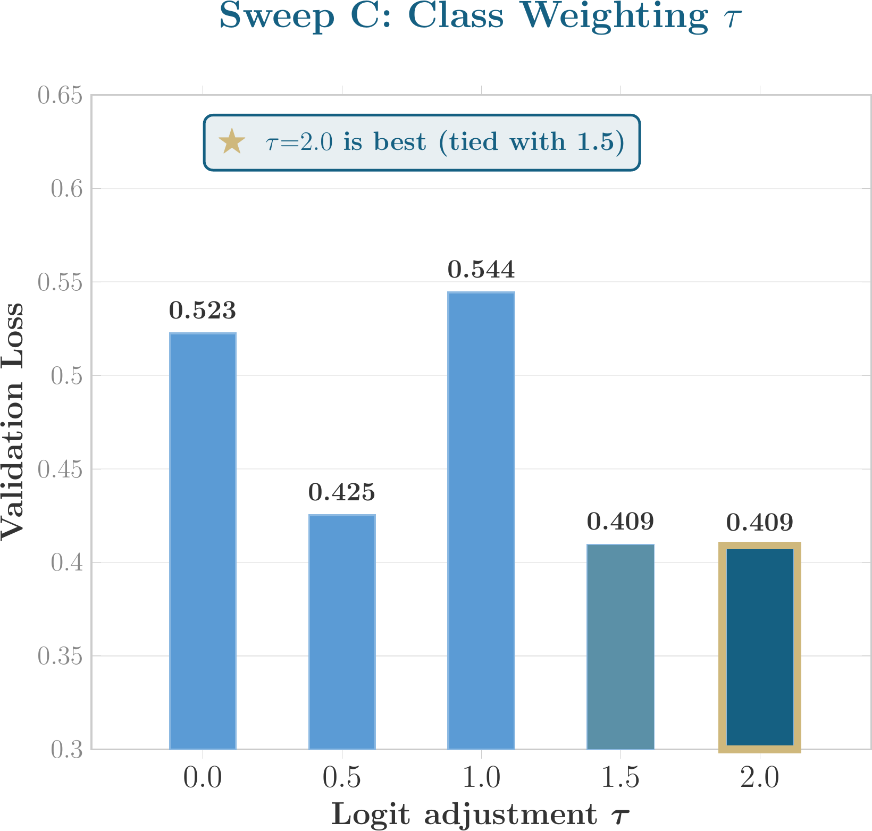
2D Results: Tversky α/β and Class Weighting τ
Val losses comparable within each sweep (same loss family). 25/29 complete; 4 relaunched after bug fixes.
Winner: α=0.6, β=0.4 (val_loss = 0.561)
Mild precision bias outperforms balanced Dice (α=β=0.5).
Winner: τ=2.0 (val_loss = 0.409)
Stronger logit adjustment needed for 48 classes with extreme imbalance.
Notes:
Sweep B: Tversky alpha-beta tradeoff. Alpha 0.6, beta 0.4 wins at 0.561. Mild precision bias — penalizing false positives more — works best.
Sweep C: logit adjustment tau. Tau 2.0 wins. With 48 classes and extreme imbalance, a stronger logit adjustment is needed to prevent the majority classes from dominating.

Slide 7
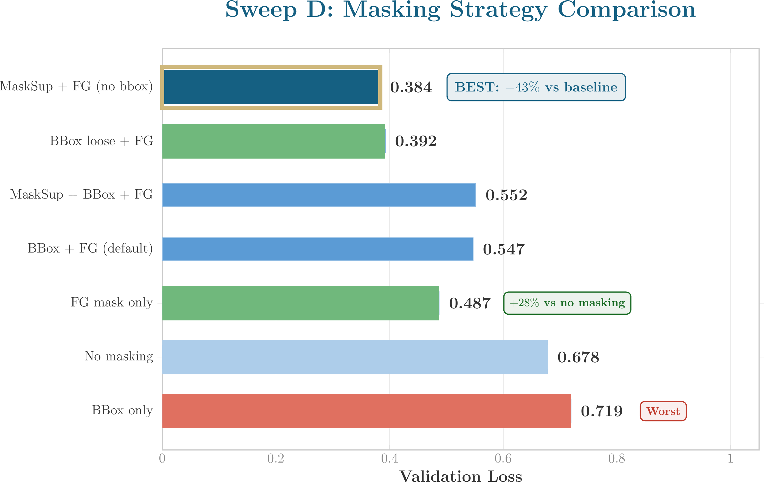
2D Results: Masking Strategy & Winners Summary
All Sweep Winners
B: α=0.6, β=0.4 (0.561)
Mild precision bias outperforms balanced Dice
C: τ=2.0 (0.409)
Stronger logit adjustment needed for 48 classes
D: masksup + FG, no bbox (0.384)
Surprise: tight bbox alone HURTS (0.719) FG mask + mask-supervised recon wins
A: BST (pending 2 relaunches)
focal_tversky & unified_focal still running
E: EMA leading (pending 2 relaunches)
no_weighted_sampler & focal_tversky_mild still running
Preliminary Phase 2 Config:
BST(τ=2.0, α=0.6, β=0.4) + masksup=0.3, no bbox, FG mask + EMA(0.999) [pending final A & E]
Notes:
The masking sweep is the most interesting. No masking gives 0.678. FG masking alone: 0.487 — 28% improvement for free. But tight bbox alone is WORSE than nothing at 0.719.
Winner: mask-supervised reconstruction plus FG masking without bbox at 0.384.
Putting it all together: BST with tau=2.0, alpha=0.6, beta=0.4, masksup=0.3, no bbox, foreground mask, and EMA. That becomes the Phase 2 baseline config.

Slide 8
What’s Next: Steps 4–8
Component | Status | Details
2D Ablation (25/29) | ✅ Complete | All converged at 50 epochs
2D Relaunches (4) | 🟡 Running | Bug fix applied → relaunched on L40S
3D Ablation (11/30) | 🟡 Running | Sycamore H100 cluster
3D Pending (22/30) | ⏳ Queued | ~15h per job — done ~Wed Feb 26
Compute & Timeline
2D relaunches: done within hours (L40S)
3D ablation: ~Wed Feb 26 (H100 cluster)
Phase 2 architecture training: ~2 weeks
~2,200 GPU-hours spent so far
Remaining Pipeline
4. Compose Config
Take winner from each sweep → single optimal configuration
~1 day after ablation
5. Full Arch Training
4 archs × 2D + 4 archs × 3D, 100 epochs, 1000 iter/epoch
~2 weeks on cluster
6. Threshold Tuning
Per-class threshold optimization on validation (default 0.5 is suboptimal)
~2 days
7. Per-Class Ensemble
Different architectures excel at different organelles → composite
~1 day
8. Final Model
Submit to CellMap leaderboard → apply to novel tomograms
End goal
Notes:
25 of 29 2D experiments complete, 4 relaunched after a bug fix. 3D ablation has 11 of 30 done, rest queued, should finish by Wednesday.
Then: compose winning config, full architecture training across 8 models, per-class threshold tuning, per-class ensemble, submit to leaderboard, and apply to our own novel tomograms.

Slide 9
Thank You!
Questions?
George S. George • gsgeorge@unc.edu
Code: github.com/Shan-CU/CellMap-Segmentation
Notes:
Thank you! Happy to take any questions.

