Slide 1
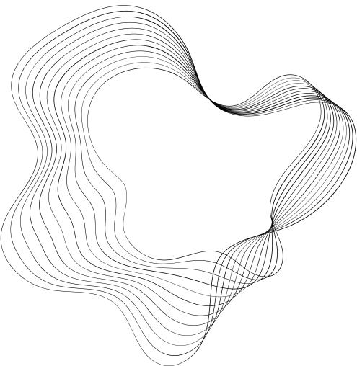

MINIPROJECT
PHASE II
DE1-SOC SNAKE GAME

Slide 2

TEAM MEMBERS
Sampreety Pillai:
Rollno: 2101CS71
Contribution: Responsible for creating the snake, the ball and its movements
M Shanmukha Priya:
Rollno: 2101CS40
Contribution: Responsible for the shapes, score/game over logic, and colouring.

Slide 3
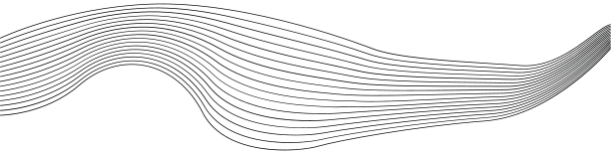
TECH STACK
01
BOARD USED: DE1-SOC
02
LIBRARIES USED: VGA
03
LANGUAGES: C

Slide 4

INTRODUCTION
RULES
1.Game ends when snake clashes with the wall.
2. User moves the snake around using push buttons. (Key[0] = move down, Key[1] = move up, Key[2] =
move left, Key[3] = move right)
3.Score increases when the ball hits the walls of the ’snake’.
The project is a snake game. The snake is represented by the rectangles. The snake’s meal/ball is represented
by the bouncing ball. The aim of the game is for the snake to eat(clash) with the ball which increases the
score.

Slide 5
WORKING
The Snake
The snake is represented by a series of green rectangles. The user can use push buttons to move the snake either north, south, east or west. Direction is chosen according to which key is pressed (Key[0] = move down, Key[1] = move up, Key[2] = move left, Key[3] = move right). Two keys pressed simultaneously do not change the snake's coordinates. It shifts its position by 20 units with each clock cycle. The snake successfully achieves its aim/ eats the ball when its head, i.e. the first rectangle, collides with the ball. The remainder of its body changes position according to the previous location of the head( the middle portion places itself where the head was previously, and the tail sets itself to the previous location of the snake's middle). The game is considered over if the snake's head clashes with any of the four walls.

Slide 6
WORKING
The Ball
The Ball
The red circle on the screen represents the ball. It remains bouncing throughout the game. It moves diagonally with a slope of +-1. Every time the ball goes through the surface of the snake's head, it increases the score by 1. The user cannot alter the position of the ball.
Text Display and Screen
The screen constantly displays the current score. It clears all the pixels as well as characters at every new iteration. It increments itself according to when the snake has clashed with the ball. Whenever the game ends, i.e., the snake touches a wall, the "Game Over" message is displayed on the screen.

Slide 7

Click here to check out the demo video: https://drive.google.com/file/d/1F3049XMHmeEqXB9FN8a7M8ew5WMusLTO/view?usp=sharing
THANK YOU

