Slide 1
AdmitFlow
Admissions conversations
with context for your team
Telegram for students. A workspace for institutions.
shan
Notes:
Source: https://github.com/Shan091/admitflow/tree/f532f1cf9ada099c9bbb2bda8fef277aeb162c3a . See SPEC.md, tasks/todo.md and docs/event evidence. Owner name supplied by the user: shan. The demonstration uses synthetic institution and student data. Existing foundation work must be disclosed to the organizers. The local bot and app require the local services; no production deployment is claimed.

Slide 2
The admissions handoff
Students ask in chat.
Staff need the course, the answers already given
and the reason behind the next step.
Product hypothesis: less repeated information collection.
Customer demand and time savings remain unmeasured.
Notes:
Source: https://github.com/Shan091/admitflow/tree/f532f1cf9ada099c9bbb2bda8fef277aeb162c3a . See SPEC.md, tasks/todo.md and docs/event evidence. This problem statement is a product hypothesis, not interview or market-validation evidence. Proposed initial users are admissions teams in Kerala institutions. The insight is to retain conversational context and code-evaluated rules across the student/staff handoff.

Slide 3
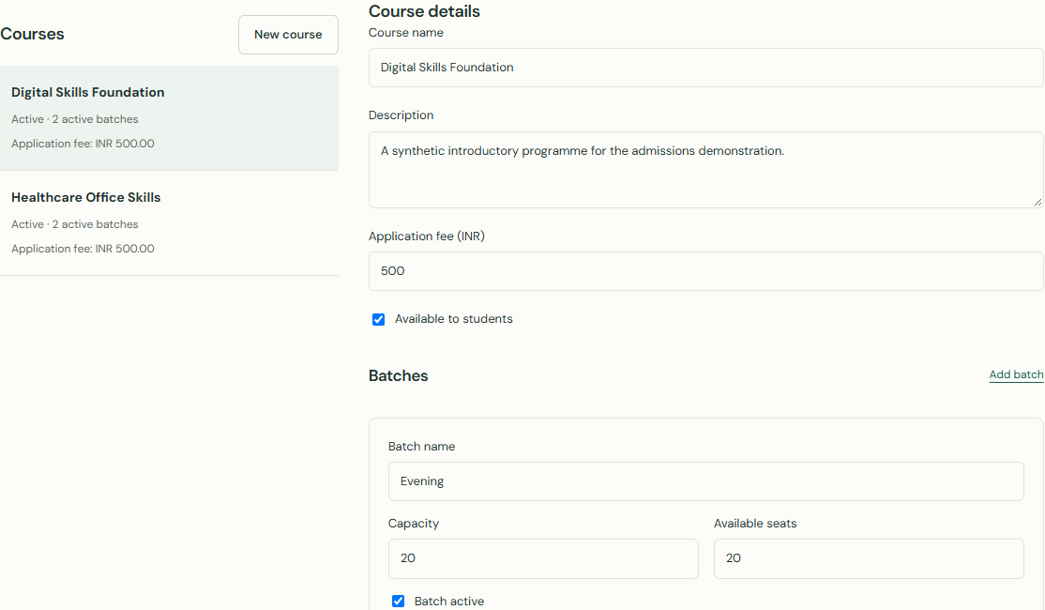
A working institution workspace
Telegram collects course choices and explicit answers.
Staff control the catalog, batches and application fees.
Actual product screen with synthetic institution data.
Notes:
Source: https://github.com/Shan091/admitflow/tree/f532f1cf9ada099c9bbb2bda8fef277aeb162c3a . See SPEC.md, tasks/todo.md and docs/event evidence. Screenshot captured from the actual isolated Compose staff app, using the seeded synthetic institution. No mock responses or live applicant data were used. Applications/review, staff takeover/co-pilot, consent-aware follow-ups and management are implemented. Actual Razorpay card/webhook/Telegram validation is still pending. Eligibility does not confer admission or reserve a seat.

Slide 4
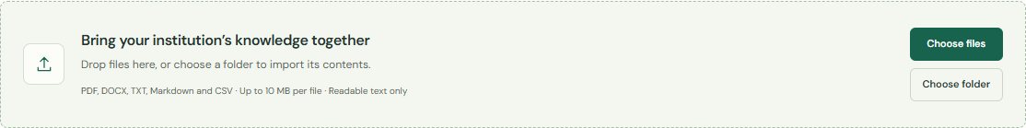
Answers from approved documents
PDF tables and headings stay together.
OpenAI searches and reranks approved evidence.
Answers stay grounded or abstain.
Digital PDF, DOCX and text. OCR is outside this version.
Notes:
Source: https://github.com/Shan091/admitflow/tree/f532f1cf9ada099c9bbb2bda8fef277aeb162c3a . See SPEC.md, tasks/todo.md and docs/event evidence. Actual upload control screenshot from the isolated Compose app. Docling performs offline CPU layout/table extraction and heading recovery; semantic chunking repeats ancestor and column headers. Real complex-PDF PostgreSQL publication and live native Redis/Docling/OpenAI/search checks pass. This is bounded fixture evidence, not a guarantee for every PDF layout. The owner confirmed a Lotus Hall answer from the uploaded synthetic PDF. Student replies omit source footers; internal evidence and staff search sources are retained.

Slide 5
AI with institution control
OpenAI
Interpretation, typed extraction, embeddings
and evidence reranking.
Code
Eligibility, fees, tenant access
and application changes.
Verification
Live OpenAI and a confirmed Telegram roundtrip.
252 default tests and 87 PostgreSQL checks.
FastAPI, PostgreSQL/pgvector, Redis/TaskIQ and Next.js.
Notes:
Source: https://github.com/Shan091/admitflow/tree/f532f1cf9ada099c9bbb2bda8fef277aeb162c3a . See SPEC.md, tasks/todo.md and docs/event evidence. Validation scope: 252 default tests, strict typing across 117 source files, 87 PostgreSQL cases including the real layout model, two separate Redis checks, frontend lint/build, live OpenAI structured output and 1536-dimensional embeddings. Required reranking preserves the relevance floor and falls back to filtered retrieval on timeout/refusal. Multi-tenant staff sessions, encrypted identifiers/conversations and scoped deletion/retention are implemented. General language fluency, real-applicant outcomes and production readiness remain unvalidated.

Slide 6
An institution pilot
Proposed buyer: admissions teams in Kerala institutions.
A paid institution workspace is the business model to test.
Pricing and willingness to pay remain unvalidated.
Pilot measures: repeated questions, staff review time
and application completion.
Next: payment validation and an approved institution pilot.
Notes:
Source: https://github.com/Shan091/admitflow/tree/f532f1cf9ada099c9bbb2bda8fef277aeb162c3a . See SPEC.md, tasks/todo.md and docs/event evidence. GTM proposal: recruit one institution through direct admissions-team interviews, obtain permission for institution references and a bounded pilot, then evaluate usefulness before setting prices. No revenue, customers or measured conversion improvement are claimed. Public deployment is on hold until the owner explicitly authorizes it. Final organizer prior-work permission, portal details and a final working-build recording remain pending.

