Slide 1

REVIEW 2
GridWeave
Implementation, Execution & Evaluation
Tools & Setup · Multi-Agent Execution · Demo & Testing · Code Structure & Scalability
Shantharam P · Gauri Nandana S Pai · Akshitha · akolla646
Notes:
Review 2 covers how we built it, how the agents run together, how we tested it, and how it scales.

Slide 2
Tool & Package Selection
Tools & Setup · 3M
Chosen for reproducibility, zero setup friction, and verifiability
Tool | Used for | Why this choice
Python 3.10+ (standard library) | All agents, market, supply, coordinator | Zero runtime dependencies; deterministic and seeded; runs anywhere
dataclasses + typing.Protocol | Messages and agent contracts | Immutable, self-validating messages; any agent swappable behind a protocol
Pure-Python ridge regression | Learned demand forecaster | 6 features — no heavy ML framework needed; fully inspectable
pytest · pytest-cov · ruff | 581 tests, coverage, linting | Industry-standard; one command to verify everything
GitHub Actions | CI on every push | Tests + lint on Python 3.10, 3.11, 3.12 and 3.13
http.server + Chart.js | Interactive web dashboard | No web framework or build step; opens in any browser
matplotlib (optional) | Report figures | Only for evidence plots; core stays dependency-free
Notes:
Deliberately small toolset. The learned forecaster is a small regression implemented directly, so no ML framework is needed and no LLM is used anywhere; every number comes from deterministic code.

Slide 3



Setup & Reproducibility
Tools & Setup · 3M
From clone to running dashboard in four commands
git clone https://github.com/Shan713/GridWeave.git
cd GridWeave && python -m venv .venv
.venv/bin/pip install -e ".[dev,viz]"
.venv/bin/python scripts/run_campus_simulation.py \
--scenario grid_outage --web
0
4
runtime dependencies
Python versions tested in CI
581
100%
automated tests
seeded runs — same seed, same result
Seeded everything
Held-out evaluation
One-command evidence
Demand, noise and events come from fixed seeds
Models chosen on one set of seeds, reported on unseen seeds
make_figures.py regenerates every chart from fresh runs
Notes:
Show the install commands. Emphasise reproducibility: the same seed always gives the same result, and model choices were validated on held-out data.

Slide 4
Multi-Agent Execution — The Closed Loop
Multi-Agent Execution · 3M
Every 15 minutes, 96 times a day, typed messages flow between agents
1
Observation
2
SupplyOffer
3
Bid
Environment → Building: real demand of the last slot
Grid / Solar / Battery → Market: kW available + price
Building → Market: requested, minimum, critical kW, priority, price
4
Revised Bid
5
ClearingResult
6
DispatchResult
Coordinator announces scarcity → Buildings trim flexible load
Market → all: allocations + dispatch requests, validated
Sources → Coordinator: delivered kW, new battery charge
7
Realised demand
8
Settlement
9
Feedback
Environment reveals what each building actually needed
Building: served / critical short / deferred / curtailed
Settlement → Environment; backlog and charge carry forward
Notes:
These are the actual message types in the code. The coordinator validates every clearing (one allocation per bid, total within supply) and every dispatch before applying it.

Slide 5


Interaction Contracts & Robustness
Multi-Agent Execution · 3M
Agents never call each other's internals — only shared protocols
Protocol | Implemented by | Contract
DemandAgent | Building agent (P1) | observe · generate_bid · settle · abort_bid
Auctioneer | Market engine (P2) | clear(slot, bids, offers) → allocations + dispatch
SupplyProvider | Grid + Solar + Battery (P3) | offers(slot) · dispatch(requests)
EnvironmentStream | Coordinator's campus (P4) | step() → real demand · apply_settlement()
Checked every slot
One allocation per bid; none above its request
Total allocated ≤ total supply offered
Dispatch equals allocation, within each offer
Energy conserved for every building
Market failure
Source under-delivers
Bad meter reading
Every building settles at zero — nobody is left waiting
Allocations scaled down to what was delivered
Reported and recovered; other buildings still settle
Notes:
Protocols make the multi-agent system modular. Robustness: a failure in one agent never leaves another stuck, and it is always reported.

Slide 6
Execution in Action — Daytime Grid Outage
Multi-Agent Execution · 3M
Critical load kept on, per mode, while the grid is down 11:00–16:00
Before 11:00 all modes serve every critical kW
During the outage only solar + battery remain
Equal share lets critical load fall away; critical-first and GridWeave track the need
Buildings re-bid in 40 slots of the run, trimming flexible load
Notes:
This is real simulation output. The black line is the campus's critical need; each coloured line is how much each mode actually served.

Slide 7
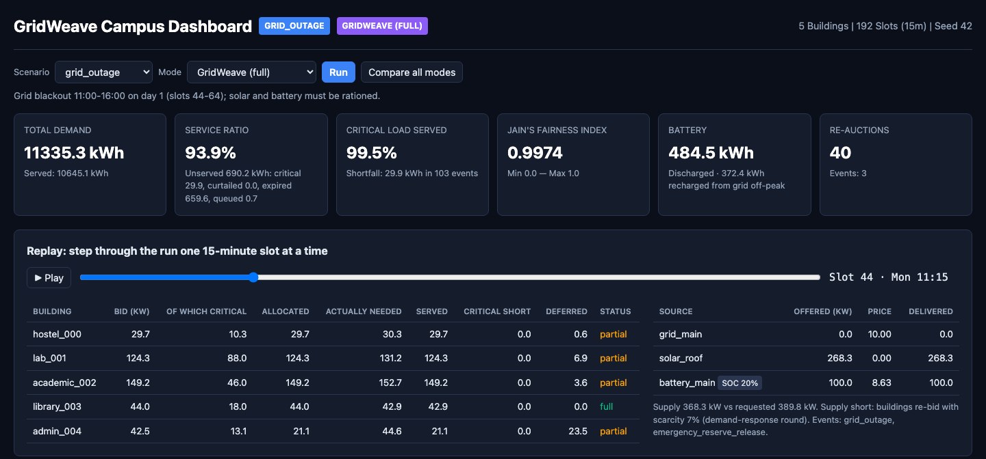
Live Demo — Interactive Dashboard
Demo Quality · 3M
5-minute demo script
1
Normal day: fully served; battery refills overnight, discharges at the evening peak
2
Grid outage: replay slot 44 — grid 0 kW, buildings re-bid, critical load kept on
3
Compare all modes: 113 → 32 → 30 kWh of critical load unserved
4
Scarcity: 387 → 54 → 47 kWh; note the fairness trade-off
Grid outage at 11:15: grid offers 0 kW, solar + battery are rationed, buildings re-bid.
Features: scenario & mode picker · Compare all modes · slot-by-slot replay with play/pause · battery and price charts
5
Run the test suite live
Notes:
Run: python scripts/run_campus_simulation.py --scenario grid_outage --web and open localhost:8050. Follow the five steps on the right.

Slide 8
Testing Scenarios
Testing Scenarios · 3M
Eight scenarios, each targeting a different stress on the system
Scenario | Days | What it tests | Service | Critical served | Critical short (kWh)
normal | 3 | Baseline — solar + battery make a 250 kW grid enough | 100% | 99.9% | 5.5
solar_drop | 2 | Loss of renewable supply | 98.4% | 99.9% | 7.5
battery_outage | 3 | Storage unavailable; costs rise | 99.9% | 99.9% | 6.2
battery_derate | 2 | Battery power capped | 100% | 99.9% | 4.3
tariff_spike | 2 | Price shock — changes cost & battery timing | 100% | 99.9% | 4.1
grid_outage | 2 | Rationing solar + battery | 93.9% | 99.5% | 29.9
scarcity | 1 | Supply ≈ half of demand all day | 62.1% | 98.3% | 46.8
mixed_stress | 3 | Cloud + outage + price spike together | 95% | 99.4% | 51.5
Notes:
Every scenario's event is checked by a test to have a measurable effect compared with the same days without it.

Slide 9
Automated Testing
Testing · 3M
Every claim we make is a named, passing test
Claim | Proved by test
Energy conserved for every building, every mode | modes_and_dashboard
Critical-first halves critical shortfall in an outage | modes_and_dashboard
Every supply event has a measurable effect | claims (6 scenarios)
Scarcer supply never reduces shortfall | claims
Forecast errors reach real outcomes | building_workflow
Learned forecaster beats baselines on held-out data | linear_ar
Forecasting never sees future data | linear_ar, forecasting
Battery refills every night | battery_grid_charging
No agent stranded by a failure | coordinator
Runs are reproducible | building_workflow
581
4
0
tests passing
Python versions in CI
known failing tests
Notes:
Unit tests check every component; integration tests check the whole loop; claim tests prove each statement in the design document.

Slide 10
Results — Before → After
Demo & Testing · 3M
Same campus and events; only the decision-making changes
Notes:
Left: three stress scenarios. Right: a supply sweep, averaged over three seeds. The gap between the baseline and GridWeave widens as supply becomes scarcer.

Slide 11
Code Structure
Code Structure · 1M
One package, four owned sub-packages, one set of shared contracts
models · interfaces · contracts
Design principles
Shared, frozen message types & protocols
One BuildingAgent class for every building — configured, not subclassed
Immutable, self-validating messages: invalid states cannot be built
Agents talk only through protocols; each part is replaceable
Config-driven: new buildings, scenarios or sources need no code change
No sub-package imports another's internals
agents · forecasting · bidding · simulation
P1 building intelligence
auction
P2 market mechanism
supply
P3 grid, solar, battery
coordinator
P4 loop, scenarios, modes, dashboard
Notes:
The dependency direction is one-way: every workstream depends on the shared models and protocols, never on each other.

Slide 12
Scalability
Scalability · 1M
Runtime grows linearly with the number of building agents
52 ms
per 15-minute slot with 100 buildings (full system)
500
building agents run in the building-layer benchmark
Adding buildings is configuration only. The loop is sequential and single-process today; agents are independent within a slot, so they could run in parallel.
Notes:
About half a millisecond per building per slot. A full day for 100 buildings simulates in about 5 seconds.

Slide 13
Thank you
Live demo & questions
Zero-dependency Python core · 581 passing tests · CI on 4 Python versions
Four workstreams interacting through validated protocols in a closed 15-minute loop
Interactive dashboard with scenario picker, mode comparison and slot replay
Notes:
Move to the live demo.

