Slide 1
Predicting Customer Churn For SyriaTel
Non Tech Presentation
Shan Chesseret

Slide 2
Table of contents
02
01
04
03
Problem Statement
Business Understanding
What are the objectives of conducting the analysis?
Why is the churn rate important to SyriaTel?
Recommendations
Model Evaluation
You can describe the topic of the section here
What is the way forward?

Slide 3

01
Bussiness Understanding

Slide 4
Objectives Of The Company
SyriaTel, a telecommunications company that aims to :
- Focus on customer satisfaction, offer competitive pricing, attractive packages and customer support.
-It has continually upgraded its technology to offer advanced services and features.
- Provide reliable and high quality telecommunications services to its customers.

Slide 5
Business Understanding
1. Predicting churn accurately helps develop effective retention strategies and minimize revenue loss.
2. Customer churn is a critical concern in the competitive telecommunications industry.
3. Analyzing historical customer data enables proactive identification of potential churners and tailor retention efforts.

Slide 6

02
Problem Statement

Slide 7
Problem Statement
SyriaTel would like to increase the customer retention rate as well as seek to address the challenge of customer churn by developing binary classification models that predicts the likelihood of customers discontinuing their services. The primary goal of the project is to identify patterns in customer behavior in order to help the company reduce financial losses associated with customer churn.

Slide 8
Objectives
1
Accurate Models
2
Patterns that lead to churn
Develop an accurate churn prediction model for SyriaTel.
Identify patterns in order to identify high-risk churn customers.
Develop new strategies
3
Optimize retention strategies, allocate resources and minimize financial losses.

Slide 9
03
Model Evaluation

Slide 10
Tuned Scores
MODEL | ACCURACY | PRECISION | F1 SCORE | RECALL
Logistic Reg | 0.79 | 0.94 | 0.84 | 0.76
Decision Tree | 0.90 | 0.95 | 0.94 | 0.93
Random Forest | 0.9360 | 0.9402 | 0.7636 | 0.6428
K-Nearest Neighbors | 0.853 | 0.588 | 0.1785 | 0.105

Slide 11
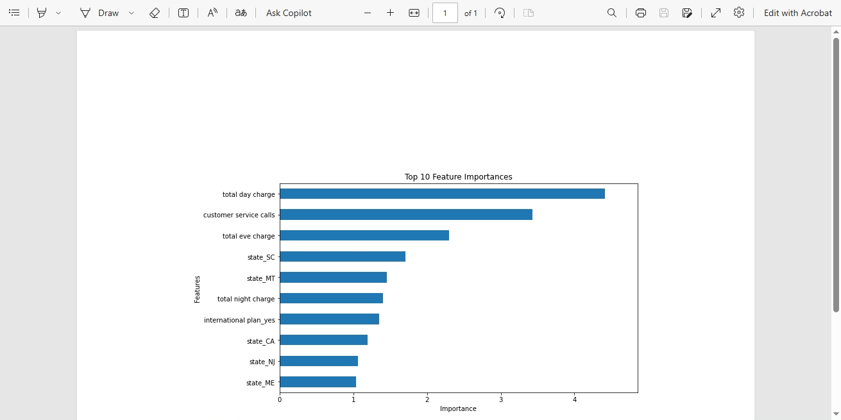

Slide 12
04
Recommendations

Slide 13
Recommendations
Customizable Plan Options
1
2
Improved customer service
Improve customer service by addressing issues raised during calls and ensuring well-trained staff who adhere to good customer service norms.
Adopt a customer-centered approach by offering customizable plans to cater to the diverse needs of the customer base
3
Affordable service Costs
SyriaTel should reconsider service costs to accommodate customers with specific budget constraints.

Slide 14
THANK YOU
WE HAVE COME TO THE END OF THE PRESENTATION.

