Slide 1








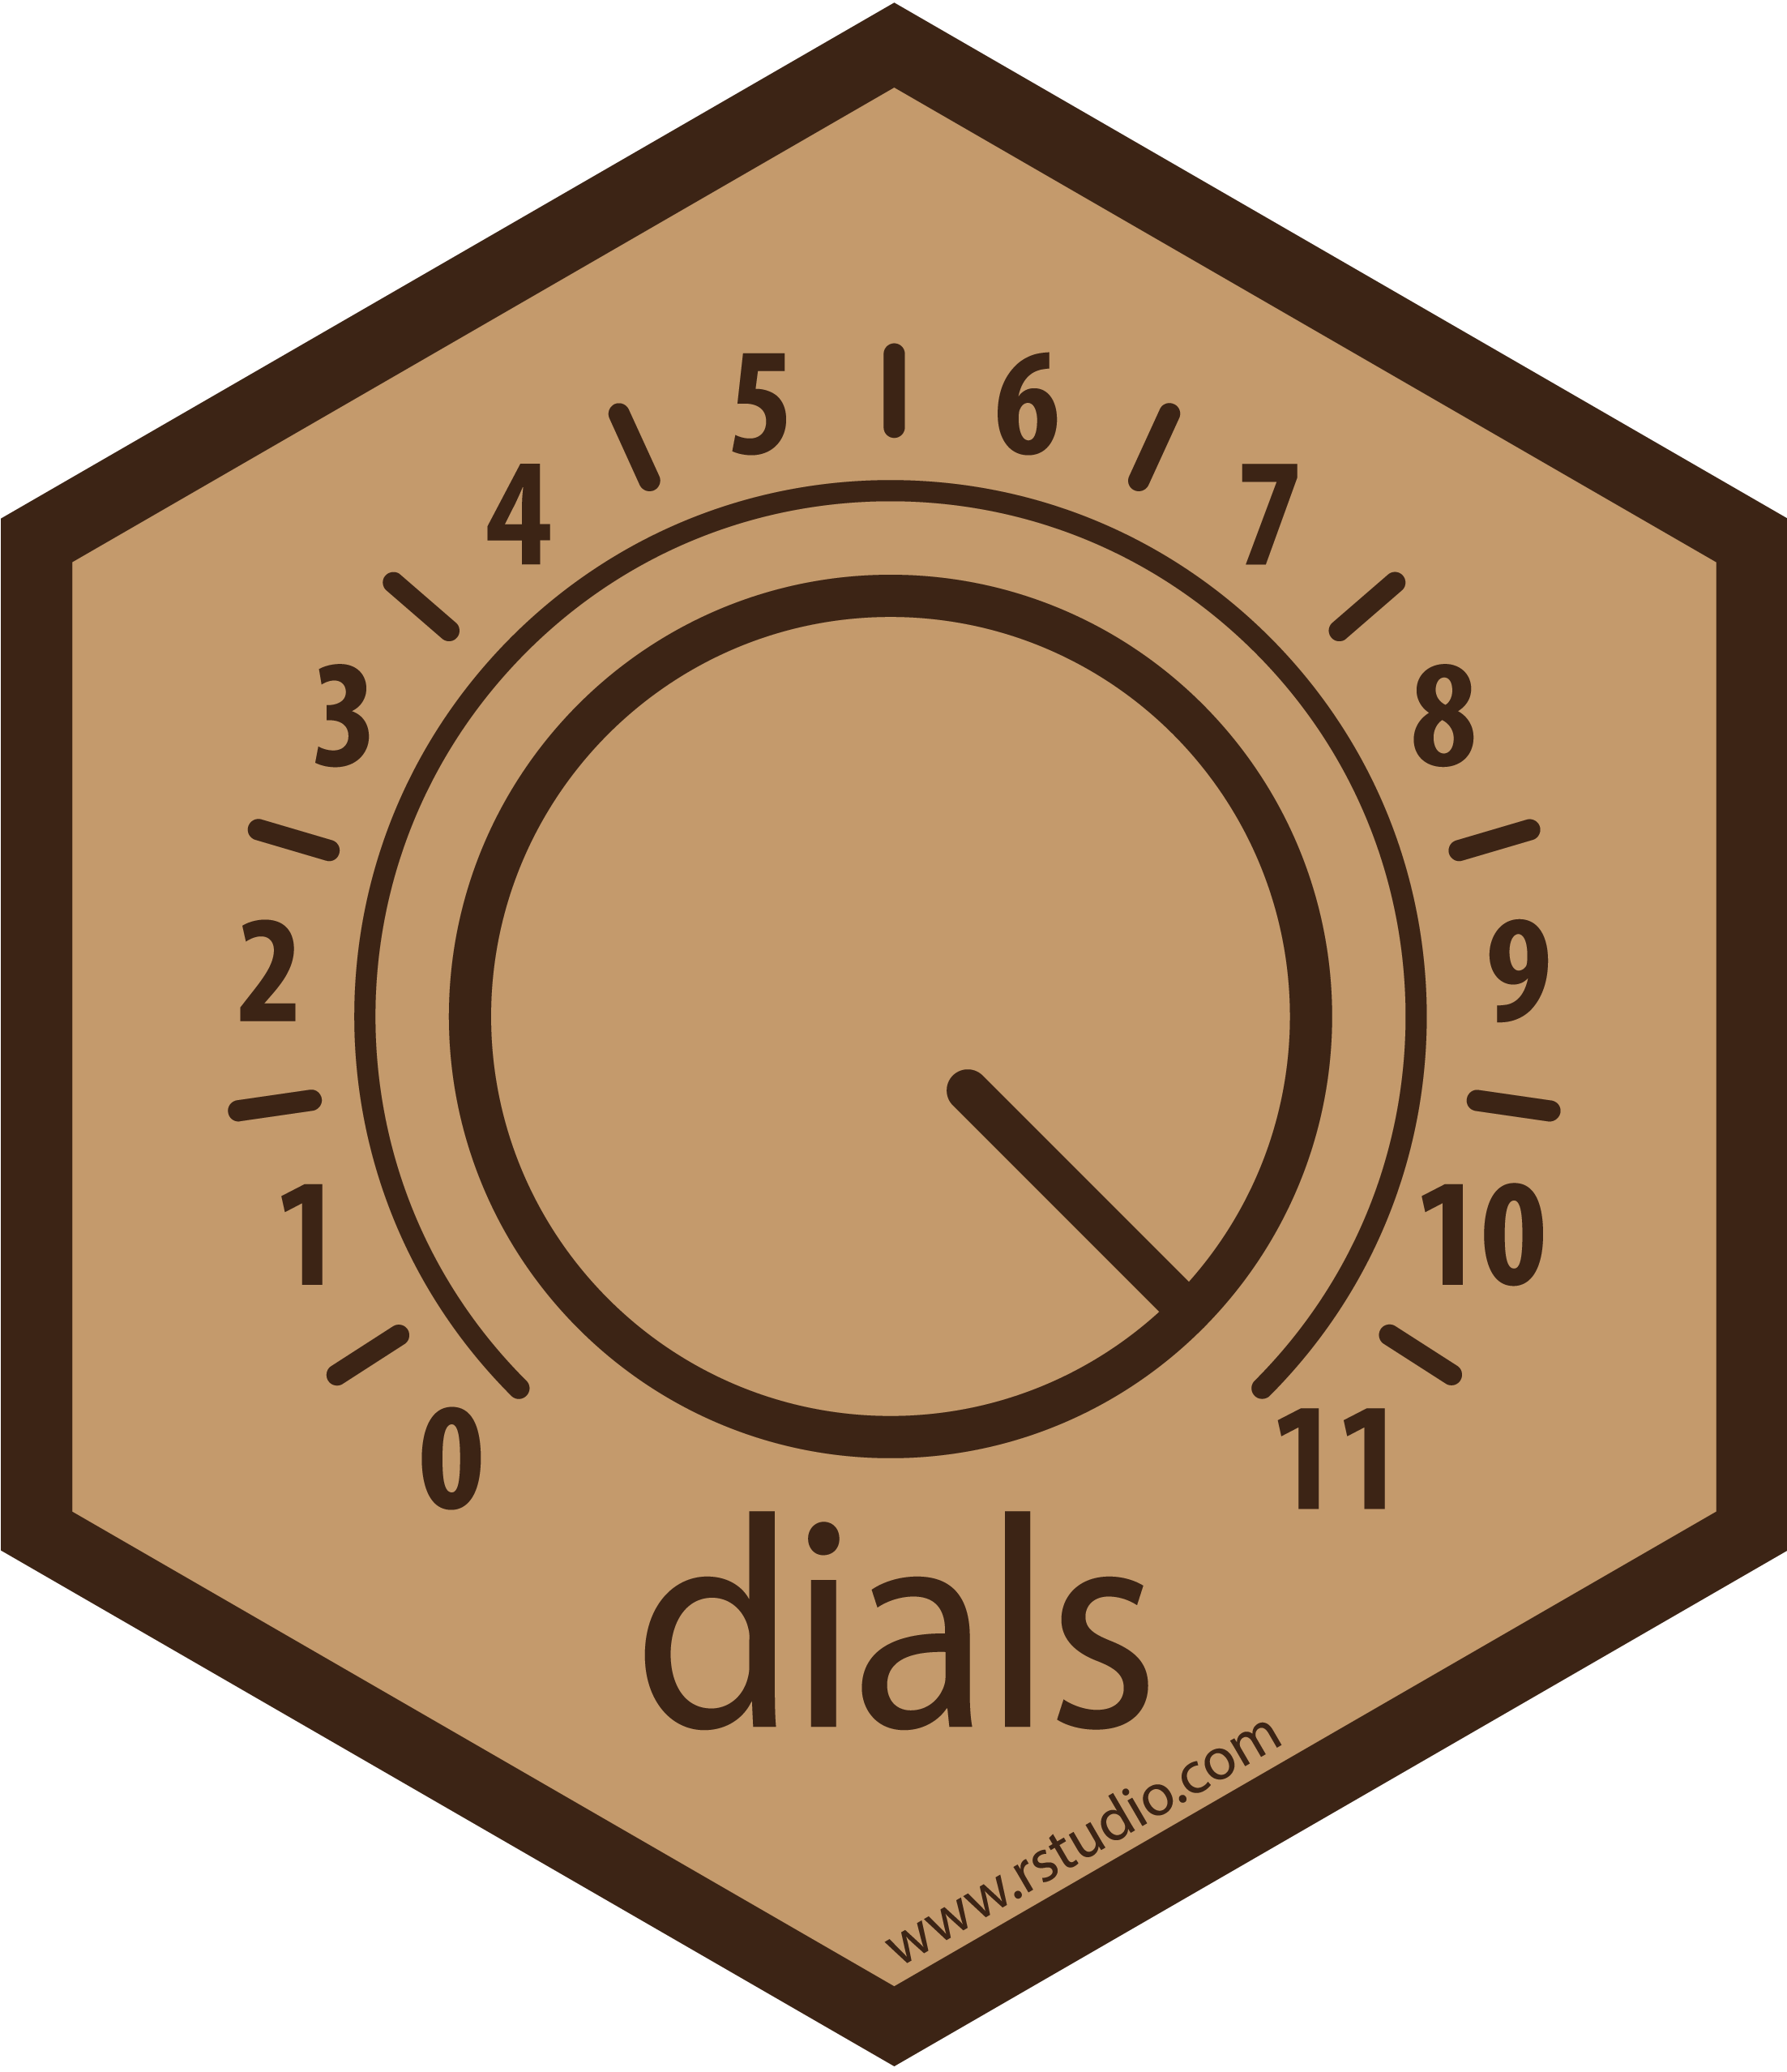
Assign variable roles and
preprocess data
4. Fit the training data
Assigning variable roles
update_role()
outcome~.
Specifying preprocessing steps
step_*()
Preprocess the training data if not using a workflow or just to see it!
juice()
Preprocess the testing data if not using a workflow or just to see it!
bake()
Create a workflow and fit raw data
Make workflow:
workflow()
add_recipe()
add_model()
Prep and fit model all at once using the raw training data!
parsnip::fit()
No need to juice()!
No need to bake()!
Fit the model with parsnip (older option but good for getting more detailed information)
Fit the model on the preprocessed training data (from recipes::juice())
parsnip::fit() – be careful about id variables!
Or…
Evaluate final model performance
Choose best model based on training performance
tune::finalize_workflow()
Fit the testing data
tune::last_fit()
Evaluate performance
tune:collectmetrics()
Get predictions
tune::collectpredictions() or
parsnip::predict() for more info
Or…
1. Split the data
3. Specify model
Advanced : Cross Validation
Fit resamples and get metrics
tune::fit_resamples()
tune::collect_metrics()
Advanced : Tuning hyper-parameters / Cross Validation
Perform tuning using tune package
tune_grid()/tune_bayes()
(Use dials::grid*_() for more targeted tuning)
Fit resamples and get metrics
tune::fit_resamples()
tune::collect_metrics()
testing/training
initial_split()
testing()
training()
Specify type/mode
set_mode() class/reg.
Specify model implementation
set_engine()
Advanced: Cross validation
vfold splits
vfold_cv()
analysis()
assessment()
5. Evaluate performance
with training data
Advanced: Specify tuning
Specify hyper-parameters to tune
x = tune()
yardstick:: metrics()
tune::collect_metrics() if using cross validation
broom::augment for getting fitted values and other stats
possibly return to step 2 or 3
to improve performance

Slide 2
Splitting data
Preprocessing
Model specifications
Model performance
View models and metrics in a tidy way
Make modeling
workflow
Tune hyperparameters and get performance metrics
Tune hyperparameters

Slide 3
Data Exploration
Data Splitting
Variable Assignment
Feature Selection
Pre-processing
Model Specification/
Model Fitting/
Model Tuning
Model
Performance
Evaluation

Slide 4
Assign variable roles and
preprocess data
Assigning variable roles
update_role()
outcome~.
Specifying preprocessing steps
step_*()
Preprocess the training data
juice()
Preprocess the testing data
bake()
3. Specify model
(and tuning)
Specify type/mode
set_mode() classification/regression
Specify model implementation
set_engine()
Specify hyper-parameters to tune
set_args(x – tune())
1. Split the data
testing/training
initial_split()
testing()
training()
cross validation
vfold_cv()
analysis()
assessment()
(Optional)
Evaluate final performance with testing data
Choose best model based on training performance
When ready with final model fit the testing data
last_fit()
Evaluate performance
yardstick::metrics() or
tune::collect_metrics()
Get predictions
tune::collect_predictions()
parsnip::predict()
(for more details)
4b. Tuning hyper-parameters and cross validation
Perform tuning
tune_grid()/tune_bayes()
(use dials::grid*_() for more control)
Get tuning metrics
tune::fit_resamples()
tune::collect_metrics()
Get performance metrics for cross validation sets
tune::fit_resamples()
tune::collect_metrics()
5. Evaluate performance
with training data
yardstick:: metrics()
tune::collect_metrics() if using cross validation
broom::tidy() for getting additional stats
possibly return to step 2 or 3
Or…
4. Put it together and fit the model! (Optional!)
Make workflow
workflow()
add_recipe()
add_model()
Prep and fit model all at once using the raw training data! parsip::fit()
4.(older option) Fit the model with parsnip!
Fit the model on the preprocessed training data (from juice())
fit() – be careful about id variables!

Slide 5
Splitting the data
Possible_predictor_2
Possible_predictor_n
Training
Possible_predictor_1
For learning:
to create and optimize the model
outcome
…
…
…
…
Observation_1
Observation_2
…
…
…
…
Observation_n
Initial Data
Testing
Only for performance evaluation
Not for Training!!!
rsample::initial_split()
Observation rows are assigned at random

Slide 6
First step of making a recipe: assign variable roles
Starting a recipe
Training
Training
recipes::recipe(y ~ x₁ + x₂)
and/or
recipes::recipe(update_role())
recipes::recipe(y ~ x₁ + x₂)
and/or
recipes::recipe(update_role())
Predictors
Id variables
Outcome(s)
Predictors
ID variables
Outcome(s)

Slide 7

Making a recipe
Making a recipe
Training
Training
recipes::recipe(y ~ x₁ + x₂)
and/or
recipes::recipe(update_role())
Assign Variable
Roles
recipes::recipe(y ~ x₁ + x₂)
and/or
recipes::recipe(update_role())
Assign Variable
Roles
Predictors
Id variables
Outcome(s)
Predictors
recipes::step_*() %>%
step_*() %>%
step_*()
Specify Pre-processing Steps
ID variables
Outcome(s)
Recipe
recipes::step_*() %>%
step_*() %>%
step_*()
Specify
Pre-processing Steps
Recipe

Slide 8

Training Data Pre-processing
Classic Way to Create Design Matrix
Predictors
Predictors
Recipe
Recipe
Id variables
Outcome(s)
ID variables
Outcome(s)
recipes::prep(retain = TRUE)
Estimate Parameters for Pre-processing
recipes::prep(retain = TRUE)
Estimate Parameters for Pre-processing
Updated Recipe
Updated Recipe
recipes::juice()
Extract Pre-processed Training Data
recipes::juice()
Extract Pre-processed Training Data
Pre-processed Training Data
Predictors
(Likely fewer)
Training Data
Based Design Matrix
Id variables
Pre-processed Training Data
Outcome(s)
Predictors
Training Data
Based Design Matrix
Id variables
Outcome(s)

Slide 9
Testing Data Pre-processing
Training Data
Training Data
Predictors
Predictors
Recipe
Recipe
Id variables
Outcome(s)
ID variables
Outcome(s)
recipes::prep()
Estimate Parameters for Pre-processing
recipes::prep(retain = TRUE)
Estimate Parameters for Pre-processing based on training data
Updated Recipe
Updated Recipe
recipes::bake(new_data = testing_data)
Extract Pre-processed Testing Data
recipes::bake(new_data = testing_data)
Extract Pre-processed Testing Data
Pre-processed Testing Data
Training Data
Based Design Matrix
Predictors
Id variables
Pre-processed Testing Data
Outcome(s)
Predictors
Testing Data
Based Design Matrix
Id variables
Outcome(s)

Slide 10
All ways to Create Design Matrix
Predictors
Recipe
Predictors
Recipe
Id variables
Id variables
Outcome(s)
Outcome(s)
recipes::prep(retain = TRUE)
Estimate Parameters for Preprocessing
recipes::prep(retain = FALSE)
Estimate Parameters for Preprocessing
Estimate Parameters for Preprocessing
recipes::juice()
or
recipes::bake(new_data = training data)
or
template of output of prep()
prepped_rec$template
Updated Recipe
Updated Recipe
Extract Preprocessed Training Data
recipes::bake(new_data = training data)
Extract Preprocessed Training Data
Extract Preprocessed Training Data
Preprocessed Training Data
Preprocessed Training Data
Predictors
(Likely fewer)
Training Data
Based Design Matrix
Predictors
Training Data
Based Design Matrix
Training Data
Based Design Matrix
Id variables
Id variables
Outcome(s)
Outcome(s)

Slide 11
old
Predictors
Recipe
Id variables
Outcome(s)
recipes::prep(retain = TRUE)
Estimate Parameters for Preprocessing
Updated Recipe
recipes::juice()
or
recipes::bake(new_data = training data)
Extract Preprocessed Training Data
Preprocessed Training Data
Predictors
(Likely fewer)
Training Data
Based Design Matrix
Id variables
Outcome(s)

Slide 12


Initial Data
Rows are assigned at random
V-fold Validation
rsample::initial_split()
Initial Data
Cross Validation Folds
Training
Testing
1
2
3
4
workflows::fit_resamples()
Fit model using different combinations of v-1 folds
Rows are assigned at random
rsample::vfold(v = 4)
Training Data
1
2
3
4
Cross Validation Folds
Fit and Assess:
Iteration 1
One fold is retained (blue)
as a “Testing/Assessment set” to evaluate the performance
of the model built on the
other folds (yellow)
1
2
3
4
1,2,3
Test
workflows::fit_resamples()
Fit model using different combinations of v-1 folds
1
2
3
4
1
2
3
4
1,2,4
Test
Fit and Assess:
Iteration 2
Fit and Assess:
Iteration 1
One fold is retained (blue)
as a “Testing/Assessment set” to evaluate the performance
of the model built on the
other folds (yellow)
Performance across iterations is used to tuned parameters for optimal performance → Final Model
1,2,3
Test
1
2
3
4
1
2
3
4
1,3,4
Test
Fit and Assess:
Iteration 3
1,2,4
Test
Fit and Assess:
Iteration 2
1
2
3
4
Performance across iterations is used to tuned parameters for optimal performance → Final Model
The initial testing set is used for the evaluation of the final model performance
1
2
3
4
2,3,4
Test
Fit and Assess:
Iteration 4
Testing
1,3,4
Test
Fit and Assess:
Iteration 3
1
2
3
4
The initial testing set is used for the evaluation of the final model performance
2,3,4
Test
Fit and Assess:
Iteration 4
Testing

Slide 13
Splitting the data for vfold validation
Possible_predictor_2
Possible_predictor_n
Possible_predictor_1
outcome
…
1
2
3
4
Sample_1
Sample_2
…
…
…
…
Sample_n
Initial Data
rsample::initial_split()
Sample rows are assigned at random
1
2
Training
3
Testing
4
For learning:
to create and optimize the model
Only for performance evaluation
Not for Training!!!
rsample::vfold(v = 4)
Sample rows are assigned at random
Cross Validation Folds – equal subsets of the training data
1
2
3
4

Slide 14
V-fold Validation
1
2
3
4
One fold is retained (blue)
as a “Testing/Assessment set” to evaluate the performance
of the model built on the
included \ folds (yellow)
1,2,3
Test
Analyze and Assess:
Iteration 1
1
2
3
4
1,2,4
Test
Analyze and Assess:
Iteration 2
Performance across iterations is used to tuned parameters for optimal performance → Final Model
1
2
3
4
1,3,4
Test
Analyze and Assess:
Iteration 3
1
2
3
4
The actual testing set is used for the evaluation of the final model performance
2,3,4
Test
Analyze and Assess:
Iteration 4
Testing

Slide 15
Initial Data
Rows are assigned at random
rsample::initial_split()
Initial Data
Training
Testing
Rows are assigned at random
rsample::vfold(v = 4)
Training Data
V-fold Validation
Cross Validation Folds
1
2
3
4
fit model using different combinations of v-1 folds
workflows::fit_resamples()
1
2
3
4
1,2,3
Test
Fit and Assess:
Iteration 1
One fold is retained (blue)
as a “Testing/Assessment set” to evaluate the performance
of the model built on the
other folds (yellow)
1
2
3
4
1,2,4
Test
Fit and Assess:
Iteration 2
Performance across iterations is used to tuned parameters for optimal performance → Final Model
1
2
3
4
1,3,4
Test
Fit and Assess:
Iteration 3
1
2
3
4
The actual testing set is used for the evaluation of the final model performance
2,3,4
Test
Fit and Assess:
Iteration 4
Testing

Slide 16
Initial Data
Rows are assigned at random
rsample::initial_split()
Initial Data
Training
Testing
Rows are assigned at random
rsample::vfold(v = 4)
Training Data
V-fold Validation
Cross Validation Folds
1
2
3
4
workflows::fit_resamples()
Fit model using different combinations of v-1 folds
1
2
3
4
1,2,3
Test
Fit and Assess:
Iteration 1
One fold is retained (blue)
as a “Testing/Assessment set” to evaluate the performance
of the model built on the
other folds (yellow)
1
2
3
4
1,2,4
Test
Fit and Assess:
Iteration 2
Performance across iterations is used to tuned parameters for optimal performance → Final Model
1
2
3
4
1,3,4
Test
Fit and Assess:
Iteration 3
1
2
3
4
The initial testing set is used for the evaluation of the final model performance
2,3,4
Test
Fit and Assess:
Iteration 4
Testing

Slide 17
Initial Data
rsample::initial_split()
Training
Testing
Training Data
Training data is divided by row into folds:
Each fold contains all outcome and predictor variables but different subsets of samples
rsample::vfold(v = 4)
1
2
3
4
1
2
3
4
One fold is retained (blue)
as a “Testing/Assessment set” to evaluate the performance
of the model built on the
included \ folds (yellow)
1,2,3
Test
Analyze and Assess:
Iteration 1
1
2
3
4
1,2,4
Test
Analyze and Assess:
Iteration 2
Performance across iterations is used to tuned parameters for optimal performance → Final Model
1
2
3
4
1,3,4
Test
Analyze and Assess:
Iteration 3
1
2
3
4
The actual testing set is used for the evaluation of the final model performance
2,3,4
Test
Analyze and Assess:
Iteration 4
Testing

