Slide 1
EI Visualization
File created on: 4/28/19 10:06:49 EDT

Slide 2
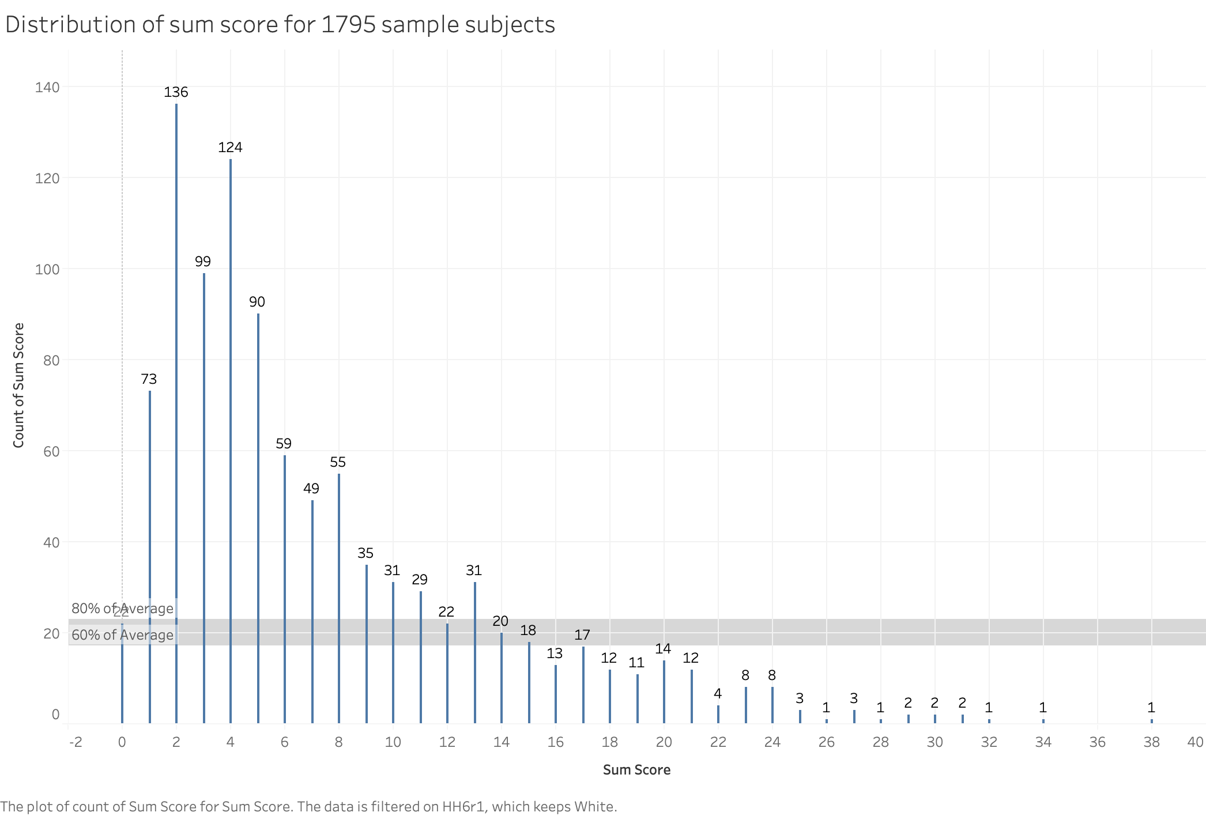

Slide 3
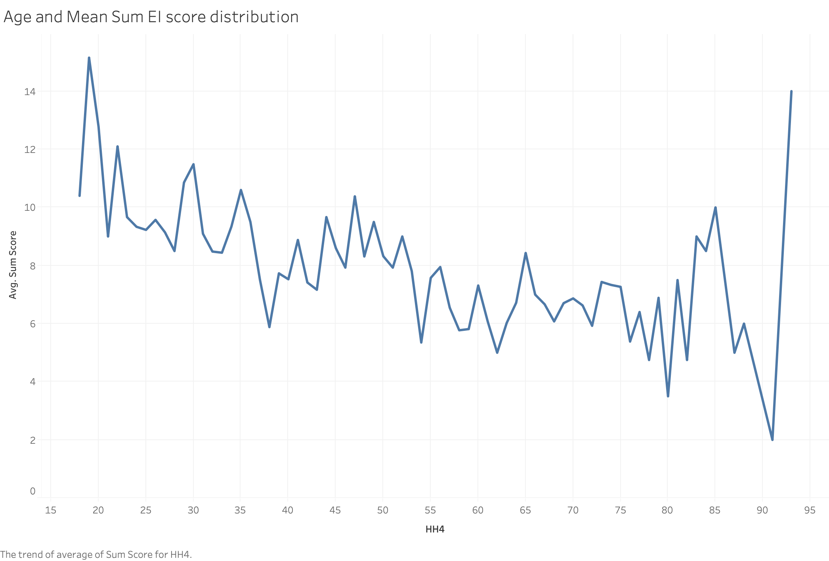

Slide 4
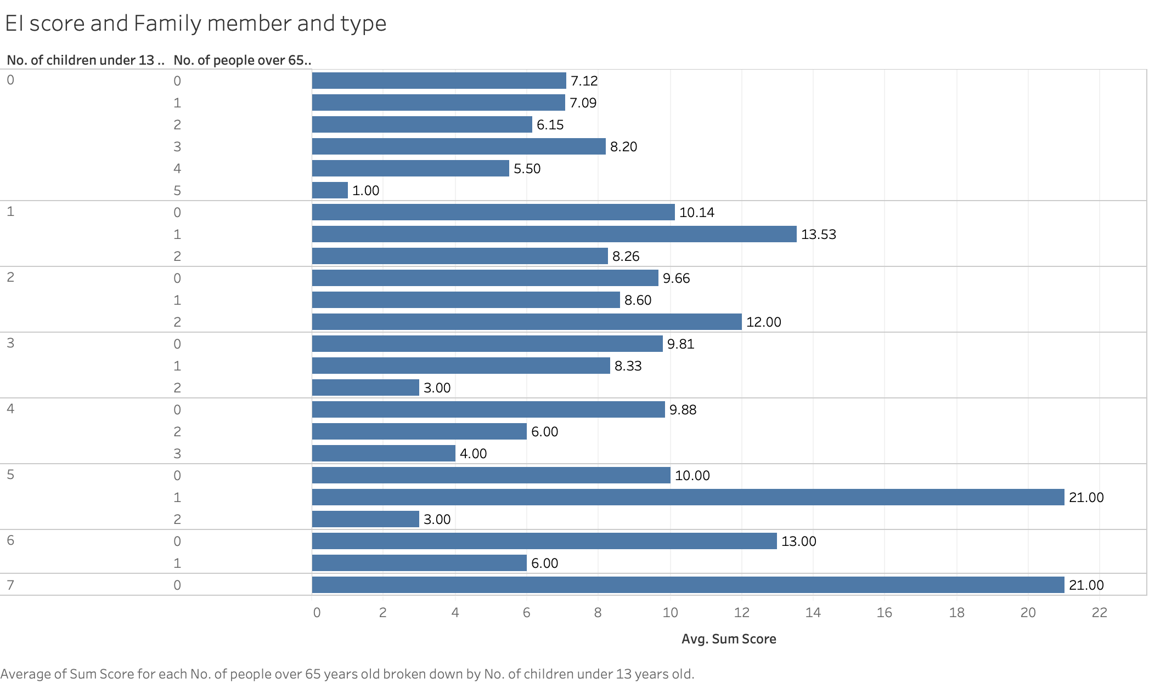

Slide 5


Race

Slide 6


Race

Slide 7

Race/Ethnicity comparison

Slide 8
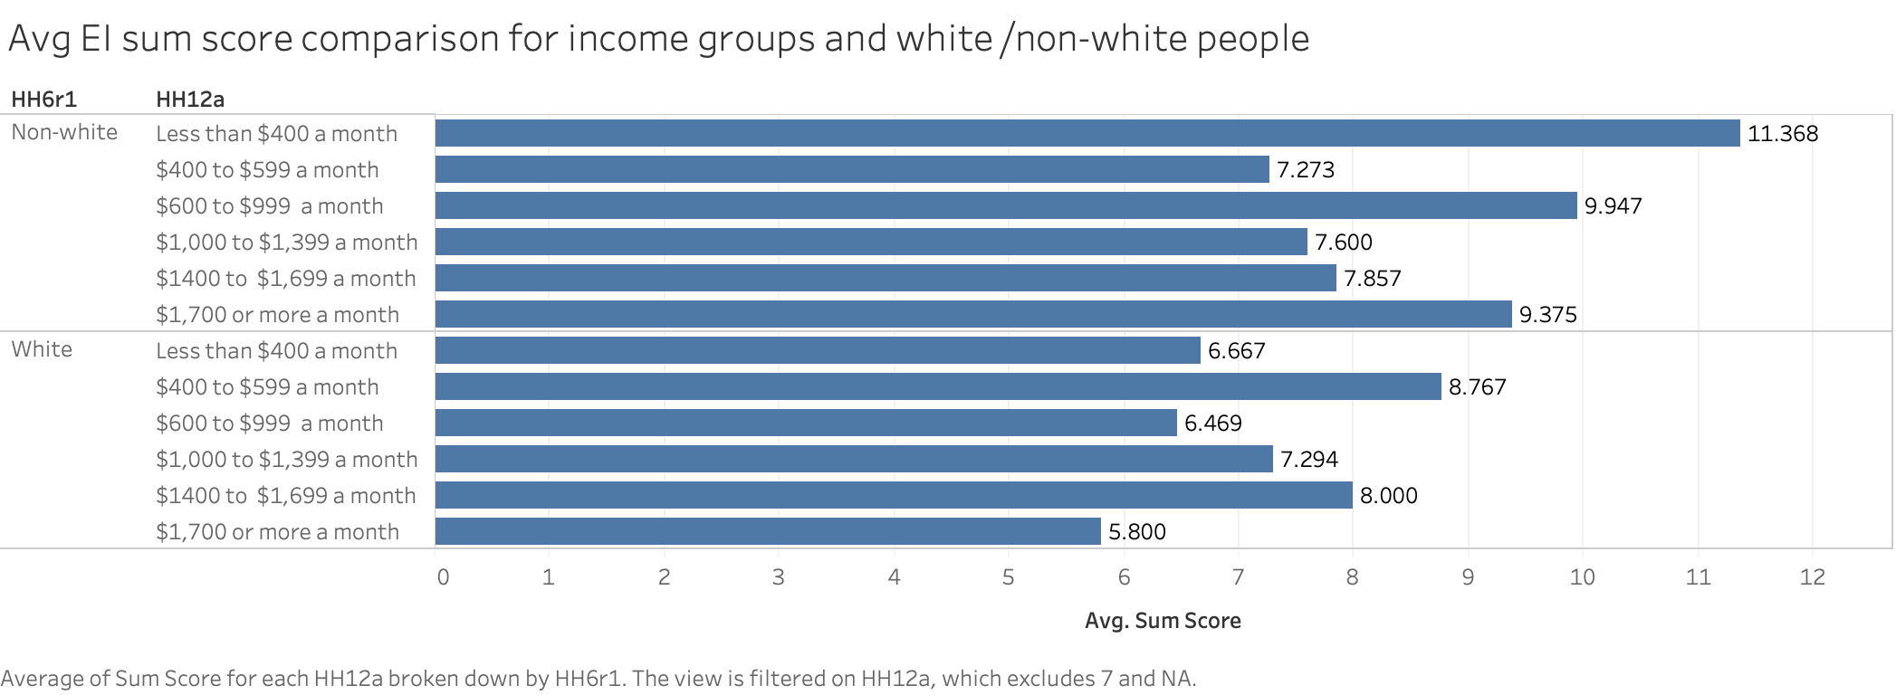
Race /house expenses

Slide 9

HH7:
Rent
/own house
/other Type

Slide 10
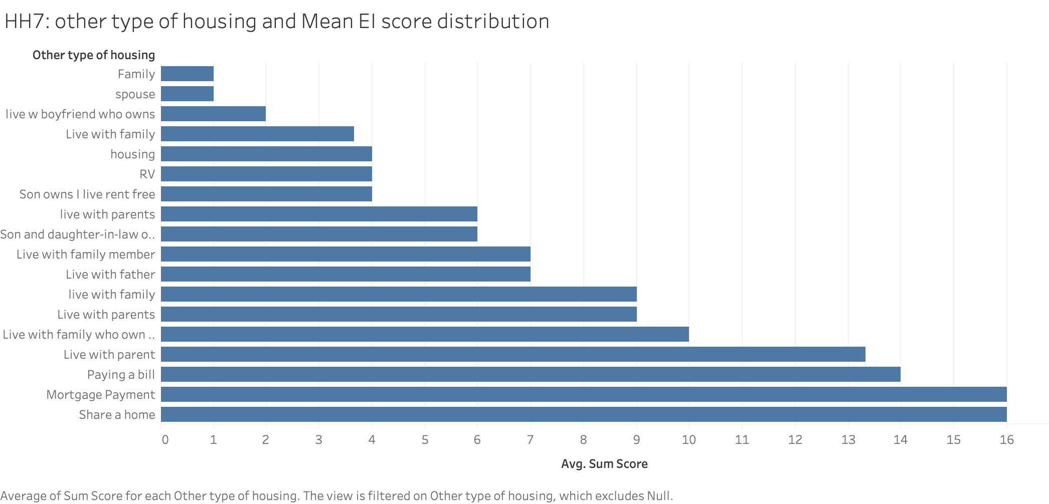
Other Types and EI score

Slide 11
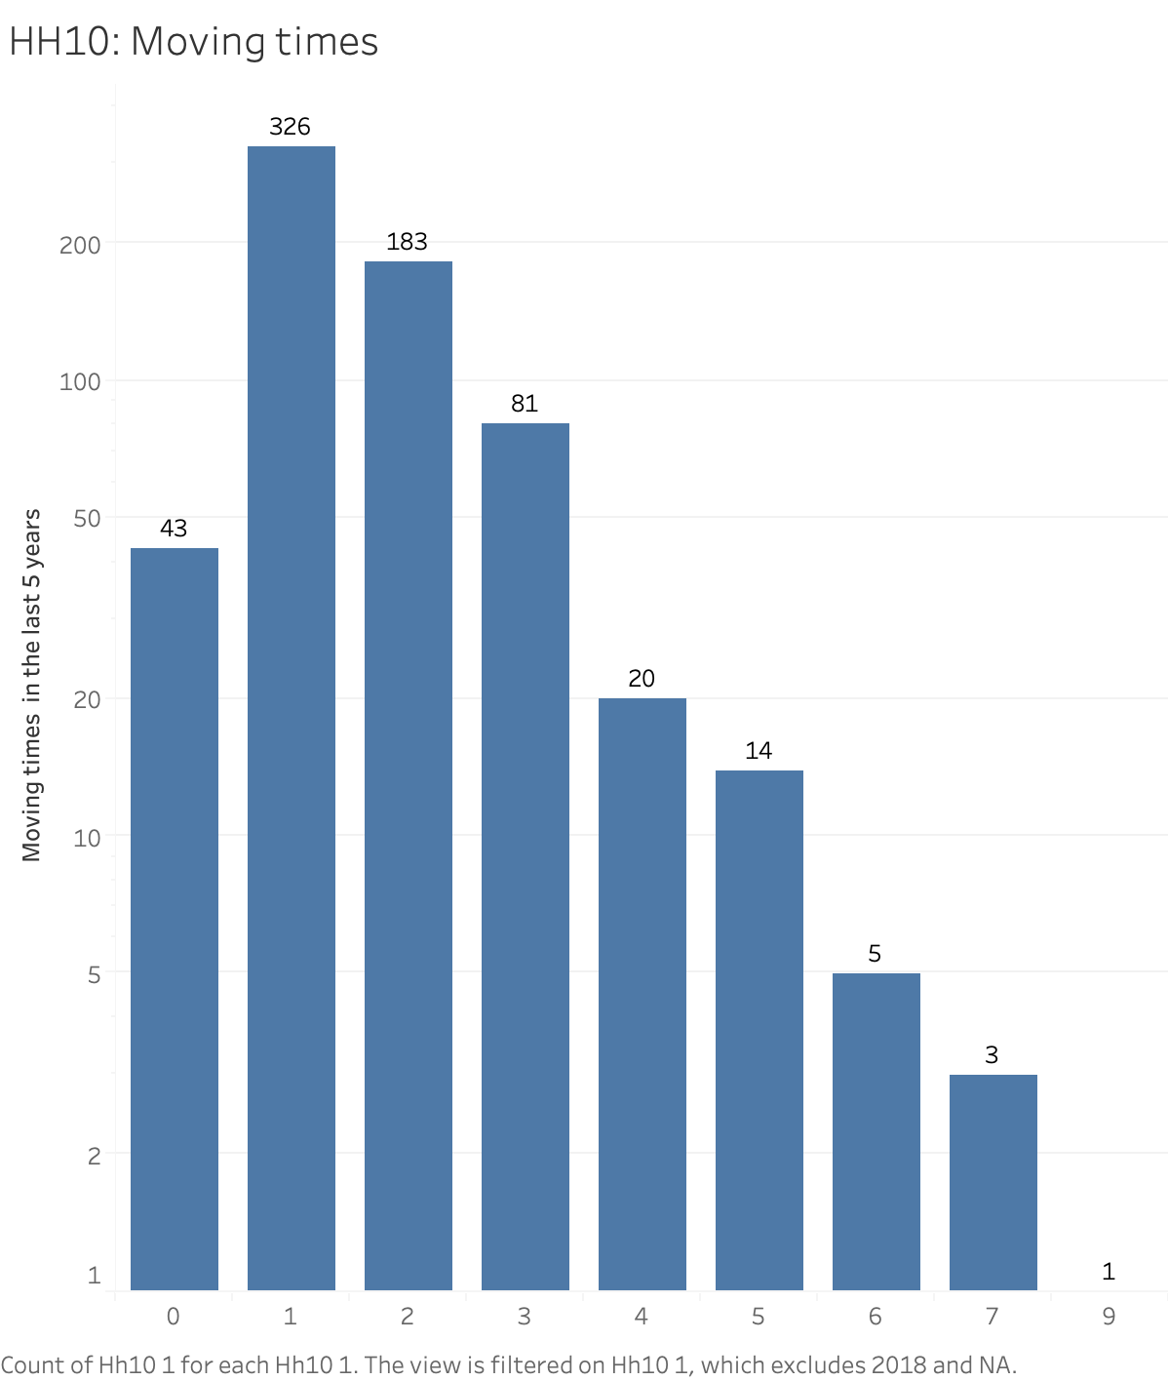

Slide 12

Room Built year

Slide 13

Moving times and EI

Slide 14

Income and EI score

Slide 15

Income and EI score

Slide 16

Income and EI score

Slide 17

Education and EI score

Slide 18
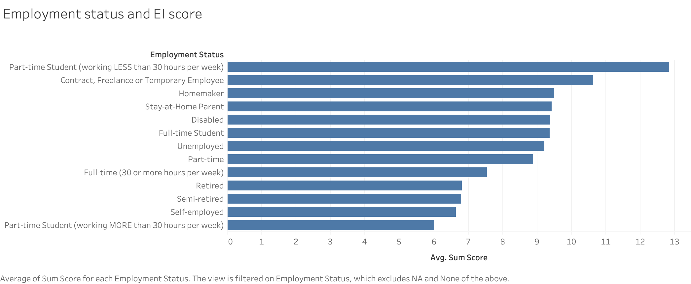

Slide 19


