Slide 1

Pokedex
( Pokemon character finder )
IOS Application
Shan Kwan Cho
Deming Yan
Aye Win
I

Slide 2
Let’s Find Pokemon!!!!
Mainly detect which pokemon characters &
Show result of high accuracy (eg. 90% above)

Slide 3
Main Technology
Keras
Machine Learning
Deep Learning Dataset
Convolutional Neural Network
Core ML
Explain overall process
-
Notes:
Overall process is
Building a deep learning image dataset using Python scripts with Bing Search API, For training a deep neural network, download images, purning the downloaded image dataset

Slide 4

Collect Data (Pokemon characters images) for training the Deep
Neural Network

Slide 5
For dataset
Collected 200-300 images of Pokemon Characters
( for train ) &
2, 3 % for test dataset
Notes:
In Machine learning stratagies, train set and test set ratio are 80 % , 20 % or 90 % 10% and so on. To learn more experiences and get more accuracy!

Slide 6
Train the model

Slide 7
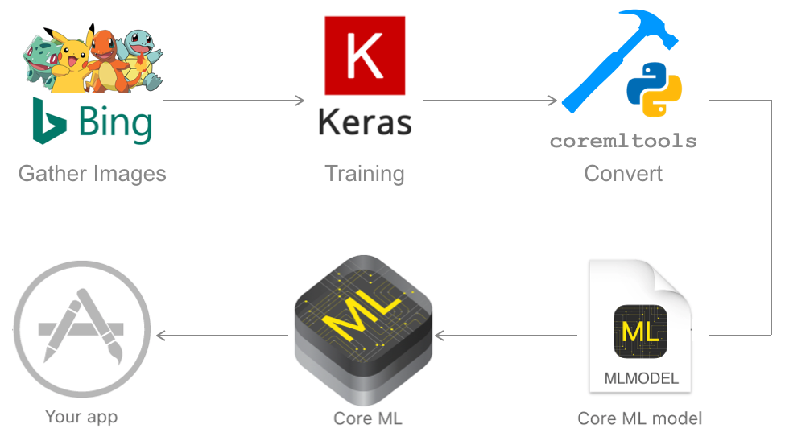
Flow chart CoreML
Notes:
To make a CoreML deep learning computer vision app on your iPhone, follow these steps: (1) Gather images, (2) Train and save your model with Keras, (3) Convert your model file coremltools, (4) Import the model into your Xcode Swift app, (5) Write Swift code to run inferences on frames from your camera, (6) Deploy to your iPhone and have fun!
CoreML is a machine learning framework created by Apple with the goal of making machine learning app integration easy for anyone that wants to build a machine learning mobile app for iOS/iPhone.
CoreML supports Caffe, Keras, scikit-learn, and more.

Slide 8
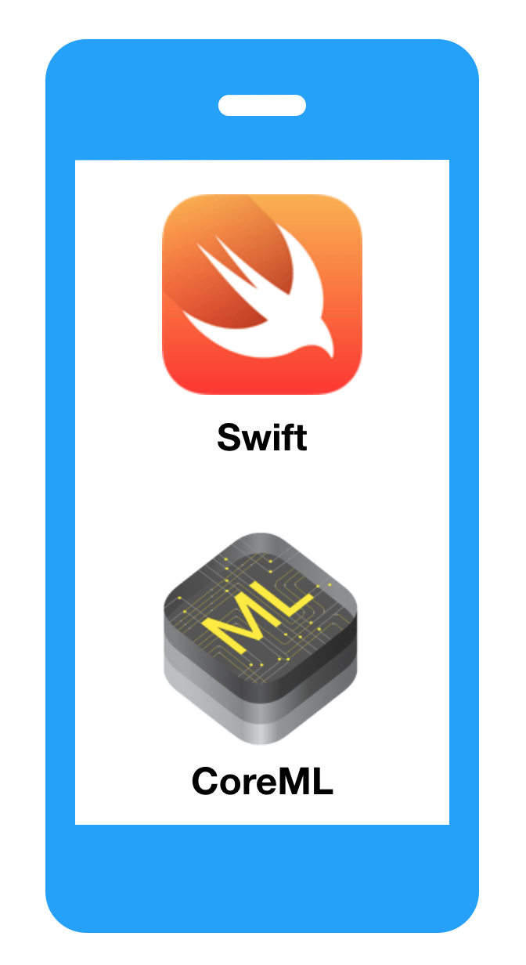
Embedded with Xcode Swift & coreML
Deploy iOS application

Slide 9


Slide 10


Slide 11


