Slide 1

PRODUCT LISTING WEBSITE
Presenter:
Adarsha Madival
Piyush Padmarag
Shanmugavel Mathiselvan
Abhay Naik
Sandeep Tammanagoudra

Slide 2

Outline
Problem statement
Objective
Project flow
Pipeline
Technical flow
Technology and tools
Conclusion

Slide 3
Problem Statement
Client wants a product listing website for his cool Angry bird merchandise but he is unable to do it by himself.

Slide 4

Objective
Our objective is to build and deploy the
website on server also provide best user
experience to the client so that he can sell
his merch. online.

Slide 5
Project Flow
Home
Dashboard
Products
Create Product
Lists
Product id
Name
Serial No.
Price
Image url
Product Details
View
Edit

Slide 6
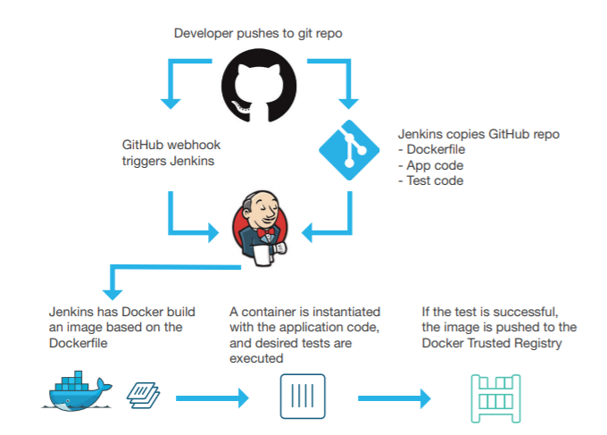
Pipeline
.

Slide 7
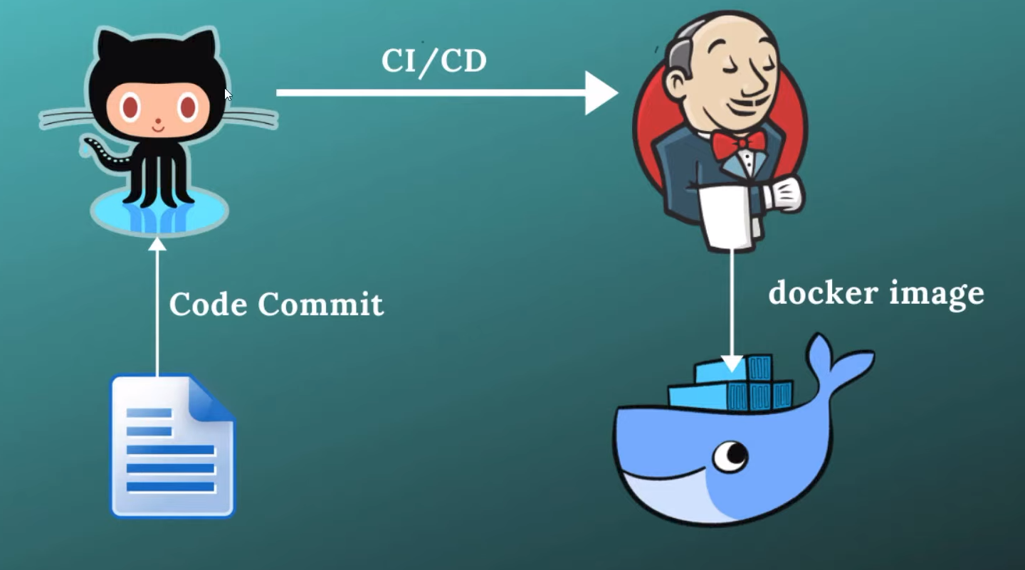
Project Technical Flow
Code commit
Push to GitHub
Jenkins Automation
Build Docker image and Containers

Slide 8






Technologies and Tools
.

Slide 9

Github
We use github to fetch the code using webhook

Slide 10

Docker
We use docker to deploy
application's microservices
inside the container

Slide 11

Jenkins
We use jenkins to perform CI-CD
workflows called as pipeline.
This Photo by Unknown author is licensed under CC BY-SA.

Slide 12

Conclusion
The Product listing website helps the client to list there Products online. It also helps to add new products and modify their products that are alredy listed.

Slide 13

Thank You
This Photo by Unknown author is licensed under CC BY-ND.

Slide 14

.
This Photo by Unknown author is licensed under CC BY-SA-NC.

