Slide 1
COMP90054 Azul project
Azul_project_group_29:
Rongbing Shan
Xinzhe Li
Congxin Zhang
University of Melbourne
2020 Semester 1

Slide 2
Overview on Azul
Perfect Information
Board state is visible to all players
Discrete
Players make well defined move, one after another
Deterministic
For same state, a same move will lead to a deterministic new state
Solve the problem with tree search

Slide 3
Techniques used
There are multiple agents developed with below techs:
Best first search
Monte Carlo Tree Search
Model free Reinforcement Learning

Slide 4
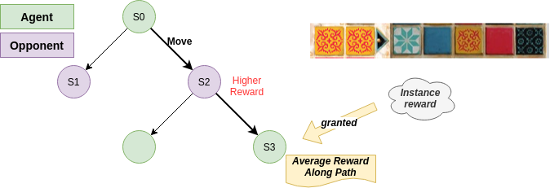
Best first search
Challenges:
Heuristic evaluation function
Large state space
Execution time limitations
Decisions:
Instance reward
As far as it goes
Improvements:
Only 2 step search
Other strategies

Slide 5
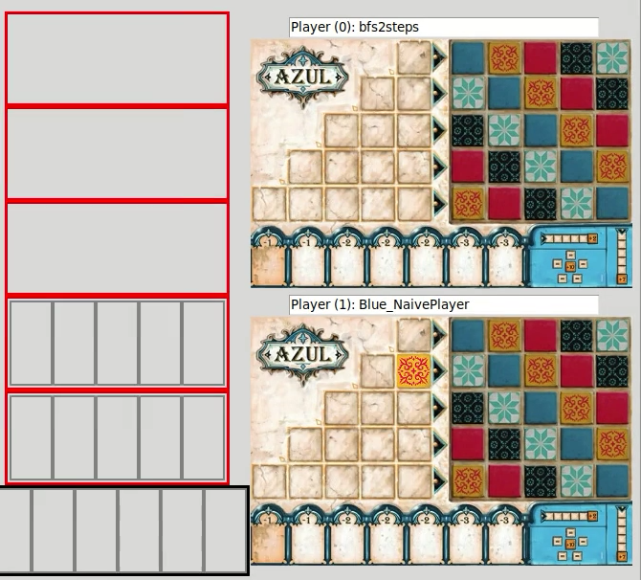

Slide 6
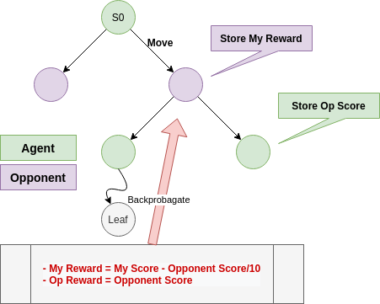
Monte carlo tree search
Challenges:
One second limitation
Large state space
Simulation on opponent
Policy in simulation
Random state generation when new round starts

Slide 7
Monte carlo tree search
Decisions:
Learn policy for opponent
Different rewards heuristic to encourage for different strategies
Naïve player in simulations instead of random
Plan for each round, not whole game
Improvements:
Better policy in simulation
Better reward strategies
Use other algorithm when state space is large

Slide 8
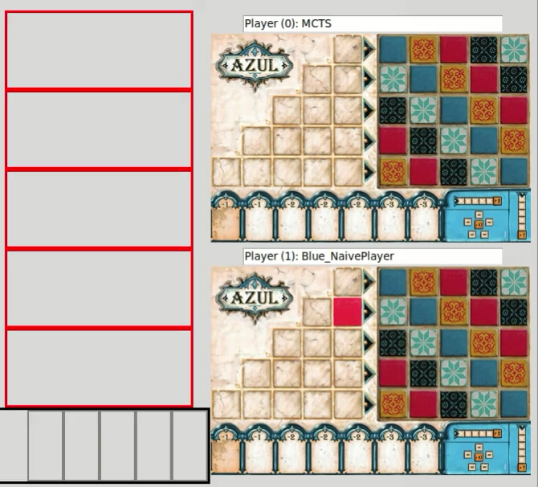

Slide 9
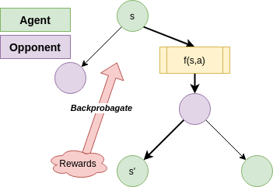
Reinforcement learning
Challenges:
Large State Space, state-action pairs
Simulation for opponents
Hard to explain the outcome and adjust
Decisions:
Linear Function Approximation Q
Model free agent
Improvements
Better feature space f(s,a)
Double Q learning
Combine with MCTS for rewards backprobagation

Slide 10
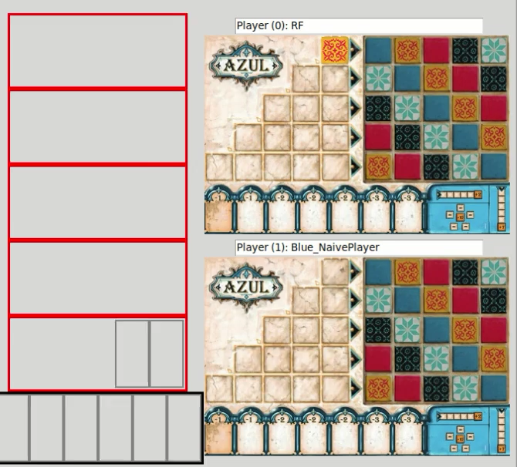

Slide 11
Thank You

