Slide 1
DCAITI-Projekt: Anonymization of dashcam recordings
Name: Rui Li <rui.li@campus.tu-berlin.de>
Shanshan Yin <shanshan.yin@campus.tu-berlin.de>
Betreuer: Iskander Tschinibaew

Slide 2
Anonymization of dashcam recordings
Agenda
Motivation
Task and Goal
Approach
Plan

Slide 3


Anonymization of dashcam recordings
Motivation
What is anonymization?
A data processing technique that removes or modifies personally identifiable information
Why is data anonymization so important?
Guaranteed privacy requires data anonymization

Slide 4



Anonymization of dashcam recordings
Task
Research of algorithms for object detection
Implementation and accuracy contrast
Integration on mobile and benchmarking running time
Goal
Human face License plate
The method to anonymize with high accuracy and short runtime
Test on a Android device

Slide 5

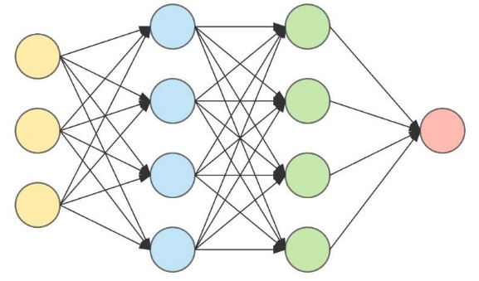
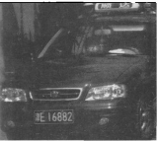
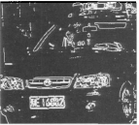
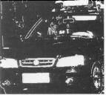
Anonymization of dashcam recordings
Approach
YOLO, R-CNN, etc.
Morphology-based Algorithms
...
[1] Car license plate location algorithm based on mathematical morphology, Li Gang
[1]

Slide 6

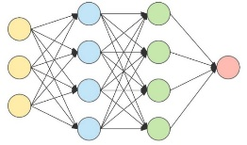
Anonymization of dashcam recordings
Approach
Morphology-based
Algorithms

Slide 7

Anonymization of dashcam recordings
Lecture 2
Lecture 3
Milestone 1
Milestone 2
Final Submission
Successful detection of the human face and license plate
Implement 2 feasible approaches
Executable application in mobile

Slide 8
Thanks for your attention
Rui Li <rui.li@campus.tu-berlin.de>
Shanshan Yin <shanshan.yin@campus.tu-berlin.de>

