Slide 1
Medical Insurance Cost Prediction
Created by Shanawaj Haque

Slide 2
Introduction
This project predicts medical insurance costs based on different factors such as age, gender, BMI, smoking habits, number of children, and region. The goal is to help insurance companies estimate charges efficiently.

Slide 3
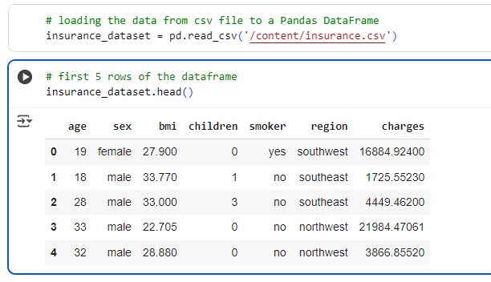
Dataset Overview
The dataset contains information about individuals including their age, sex, BMI, number of children, smoking status, region, and insurance charges.

Slide 4
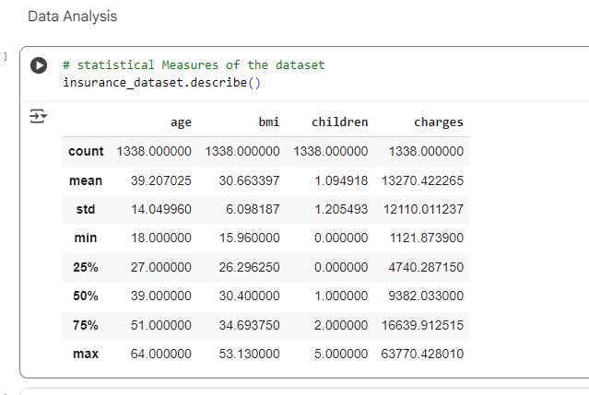
Data Analysis
Statistical summary shows the count, mean, minimum, maximum, and quartile distribution for each column in the dataset.

Slide 5
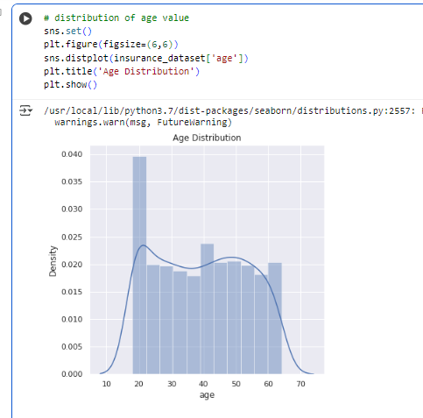
Age Distribution
Most customers are between 20 to 50 years old. This shows the age range where most medical insurance customers belong.

Slide 6
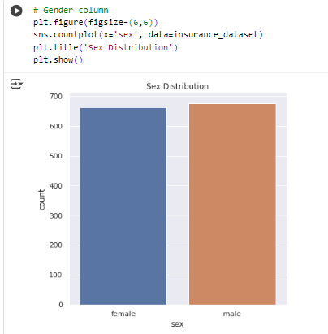
Gender Distribution
The number of male and female customers is nearly equal, showing a balanced gender ratio in the dataset.

Slide 7
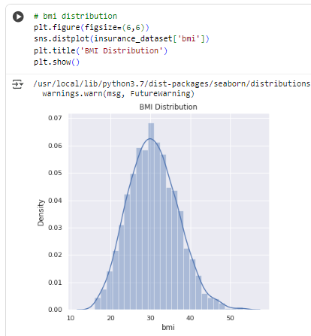
BMI Distribution
BMI shows how body mass index is distributed. Most customers have a BMI between 25 and 35, which is slightly overweight range.

Slide 8
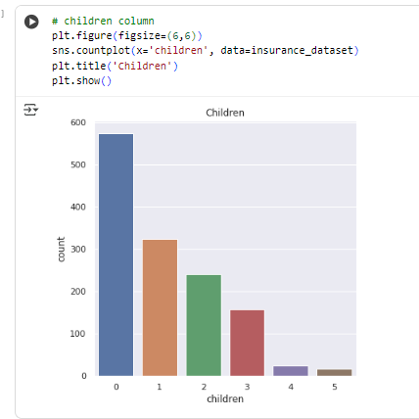
Children Distribution
Most people have 0 to 2 children. This affects insurance cost slightly depending on family size.

Slide 9
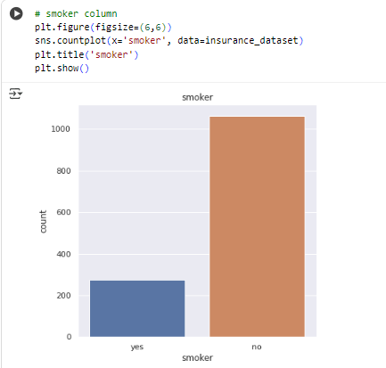
Smoker Distribution
Majority of the people are non-smokers, while a small percentage are smokers. Smokers tend to have higher medical insurance costs.

Slide 10
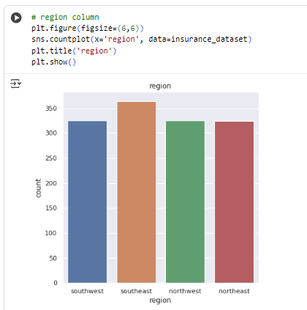
Region Distribution
People are fairly distributed across all four regions: southeast, southwest, northeast, and northwest.

Slide 11
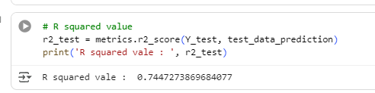
Model Evaluation
The model achieved an R² score of around 0.74, which means it can explain about 74% of the variation in insurance costs accurately.

Slide 12
Conclusion
✅ The model can predict medical insurance costs using key factors.
✅ It helps insurance companies in risk assessment and premium calculation.
✅ Future improvements can include more advanced algorithms for better accuracy.

