Slide 1

CAREERPILOT AI · FINAL YEAR PROJECT
System Design
ER Diagram & UI Wireframes
This section presents the database structure and user interface design of CareerPilot AI — an AI-based career and placement preparation platform for college students.
PROJECT SNAPSHOT
Type
Web-based AI career & placement platform
Users
Students, Placement Officers
Frontend
React.js + Tailwind CSS
Backend
Node.js + Express.js
1
2
3
4
5
AI Layer
Python + FastAPI + OpenAI/Gemini
User
CareerPilot AI
Database
AI Modules
Dashboards
Database
PostgreSQL
CareerPilot AI | System Design
1

Slide 2
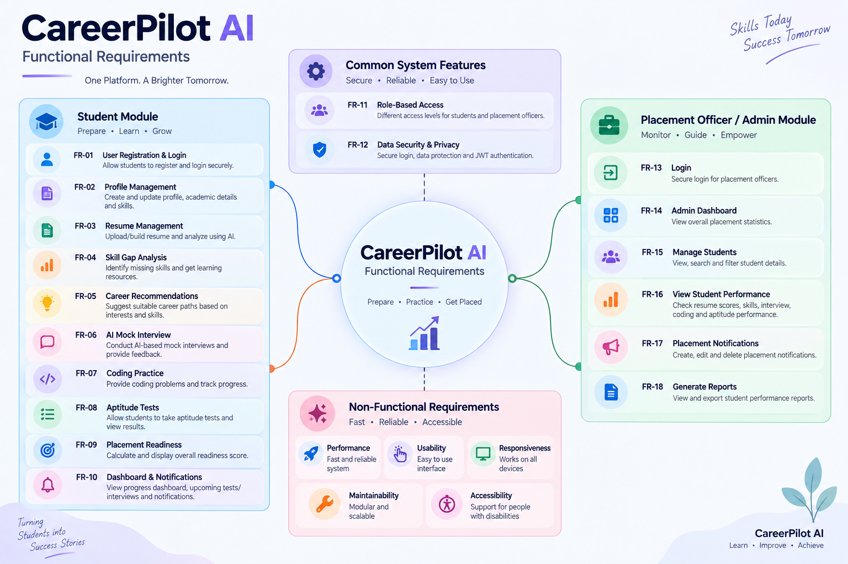

Slide 3
CareerPilot AI — System Design Overview
Three-layer architecture as defined in the SRS
1
2
3
USER INTERFACE
APPLICATION / AI LAYER
DATABASE
React.js
+ Tailwind CSS
Node.js + Express.js
Python + FastAPI + OpenAI/Gemini
PostgreSQL
Authentication — JWT-based secure sessions
Key Point: A clear separation of UI, application/AI logic, and data storage keeps the system modular and easy to maintain.
CareerPilot AI | System Design
2

Slide 4
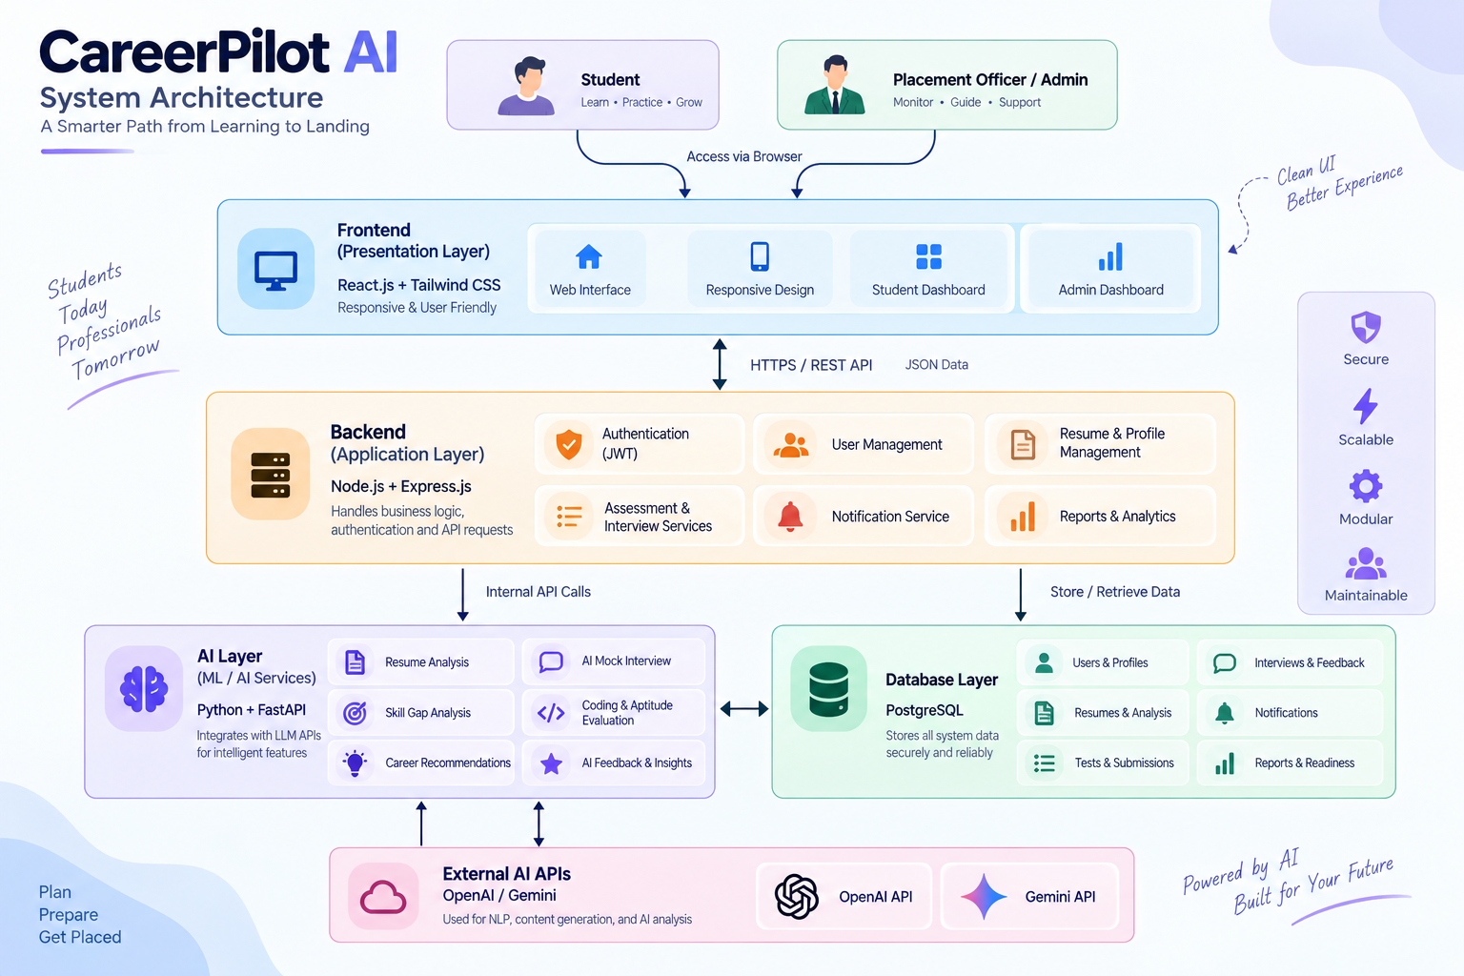

Slide 5
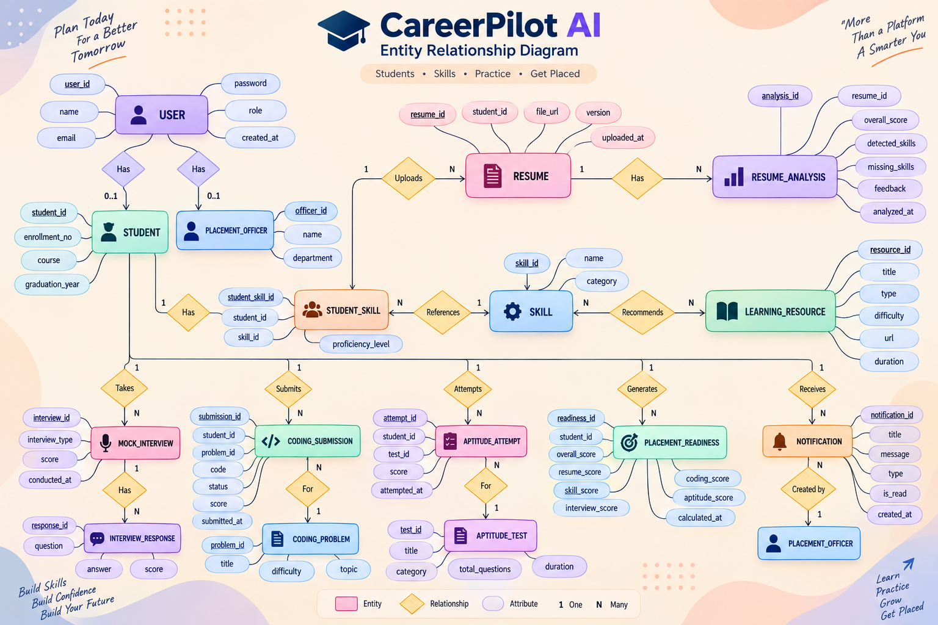
Entity Relationship Diagram
Core entities and relationships supporting CareerPilot AI's major features
CareerPilot AI | System Design
3

Slide 6
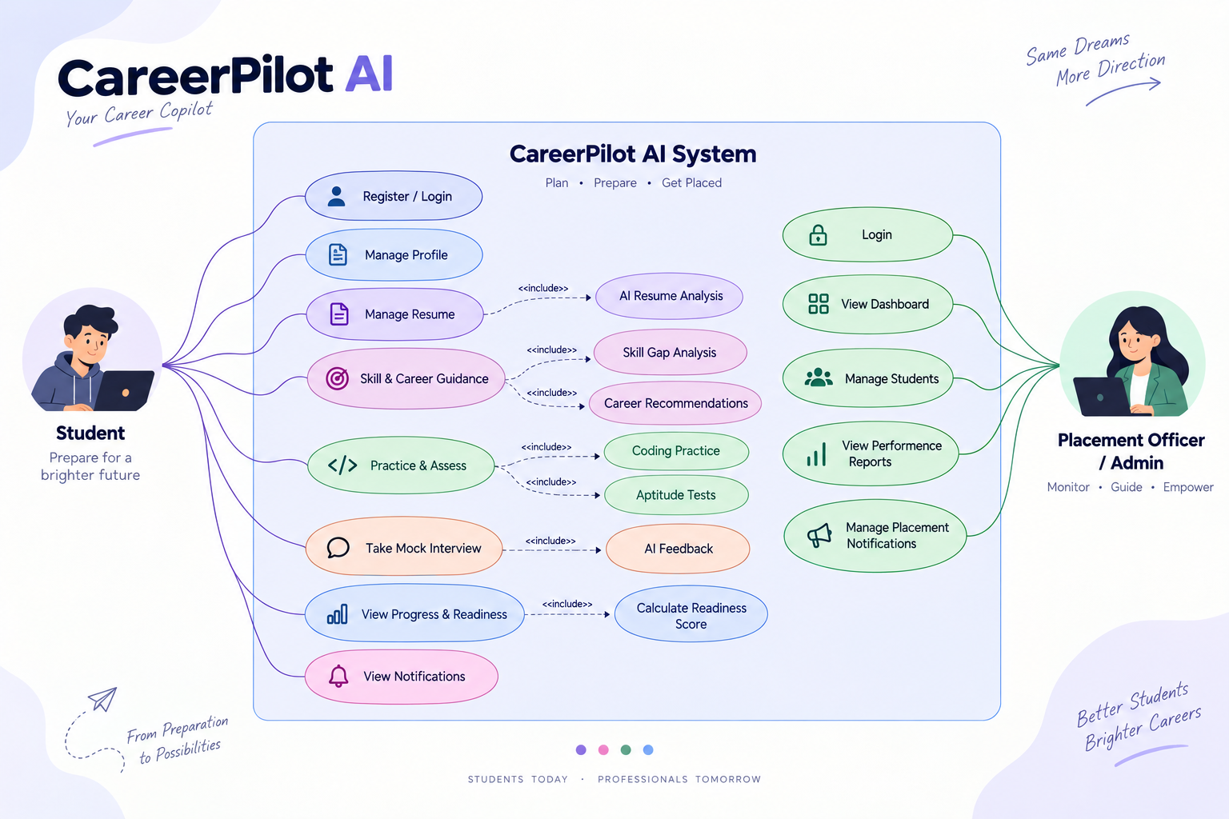

Slide 7
Understanding the Database Structure
How the major features are backed by entity relationships
1
Student
→ uploads →
Resume
→ analyzed by →
Resume Analysis
2
Student
→ has →
Student Skills
→ references →
Skills
3
Student
→ takes →
Mock Interview
→ contains →
Interview Responses
4
Student
→ attempts →
Coding / Aptitude
→ recorded as →
Submissions / Attempts
5
Student
→ receives →
Placement Readiness
Key Point: The ER diagram shows how student placement data is stored and connected across every feature.
CareerPilot AI | System Design
4

Slide 8
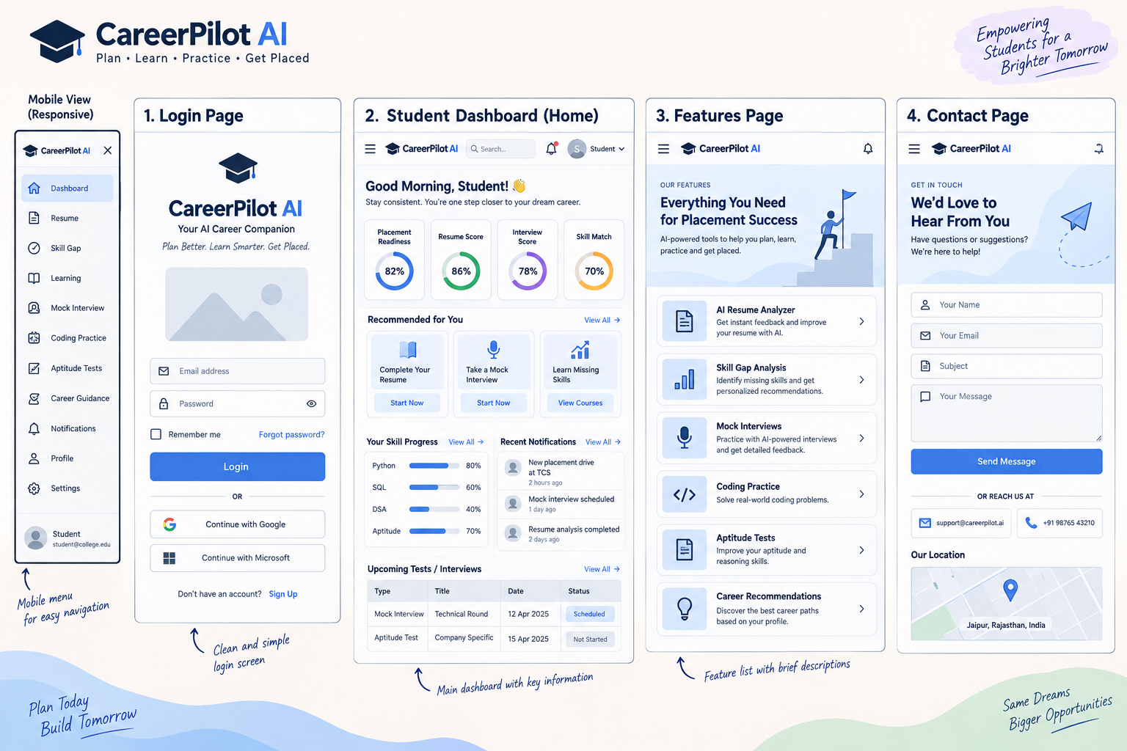
Student Module — Wireframe Overview
Reference screens sketched during UI planning — login, dashboard, feature list, and contact
CareerPilot AI | System Design
5

Slide 9
Student Dashboard — Wireframe
Main working screen for students after login
Dashboard
ANNOTATIONS
Good Morning, Student
Resume
1
Readiness summary — quick glance at overall placement readiness
○
○
○
○
Skill Gap
Placement
Readiness
Resume
Score
Interview
Score
Skill
Match
Career Recs.
2
Recommended actions — nudges the student toward the next task
Learning
Recommended Actions
Mock Interview
[ Complete Resume ] [ Take Mock Interview ] [ Learn Missing Skills ]
Coding Practice
3
Skill progress — visual bars per tracked skill
Aptitude Tests
Skill Progress
Recent Notifications
Python ▬▬▬▬▬▬▬░░
SQL ▬▬▬▬▬░░░░
DSA ▬▬▬░░░░░░
• New placement drive at TCS
• Mock interview scheduled
• Resume analysis completed
Placement Readiness
Notifications
4
Recent notifications — latest placement & system updates
Profile
Settings
Upcoming Tests / Interviews
Mock Interview — Technical Round — Scheduled | Aptitude Test — Company Specific — Not Started
5
Upcoming assessments — scheduled interviews and tests
CareerPilot AI | System Design
6

Slide 10
AI-Powered Features — Wireframes
Resume analysis feeds skill gaps, which feed the mock interview
RESUME AI ANALYSIS
SKILL GAP ANALYSIS
AI MOCK INTERVIEW
Resume Score: 86%
Target Role: SDE-1
Interview Type: Technical
Detected Skills
Python, SQL, React
Current Skills
Question
"Explain REST APIs"
Missing Skills
Docker, System Design
Missing Skills
[ Answer Area ]
Skill Severity: High
AI Suggestions
• Add project metrics
• Quantify achievements
[ Submit ]
Progress 3/10
Recommended Resources
• DSA course
• Docker basics
AI Feedback
Placement Readiness
CareerPilot AI | System Design
7

Slide 11
Placement Officer Module — Wireframes
Administrative screens for monitoring and managing placements
1. ADMIN DASHBOARD
2. STUDENT MANAGEMENT
Total Students | Avg. Readiness
[ Search ] [ Filters ▾ ]
Resume Completion | Interview Participation
Student List (table)
Skill Gap Trends (chart)
Readiness Score column
3. STUDENT PERFORMANCE REPORT
4. PLACEMENT NOTIFICATIONS
Resume Score | Skills | Skill Gaps
[ Create Notification ] [ Edit ] [ Delete ]
Interview Performance
Notification History (list)
Coding | Aptitude | Overall Readiness
CareerPilot AI | System Design
8

Slide 12
Connecting the UI with the Database
Every screen maps directly to entities in the ER diagram
UI / FEATURE
DATABASE ENTITY
Resume Upload
RESUME
AI Resume Analysis
RESUME_ANALYSIS
Student Skills
STUDENT_SKILL + SKILL
Mock Interview
MOCK_INTERVIEW + INTERVIEW_RESPONSE
Coding Practice
CODING_PROBLEM + CODING_SUBMISSION
Aptitude
APTITUDE_TEST + APTITUDE_ATTEMPT
Readiness Dashboard
PLACEMENT_READINESS
Notifications
NOTIFICATION
Key Point: This mapping demonstrates that every wireframe is backed by a concrete part of the database design.
CareerPilot AI | System Design
9

Slide 13
CareerPilot AI — User Flow
End-to-end journey for students and placement officers
STUDENT FLOW
ADMIN / OFFICER FLOW
Login
Admin Login
Student Dashboard
Admin Dashboard
Resume
Student Management
AI Analysis
Performance Reports
Skill Gap
Placement Notifications
Learning Recommendations
Mock Interview
Coding / Aptitude
Placement Readiness
Progress Dashboard
CareerPilot AI | System Design
10

Slide 14
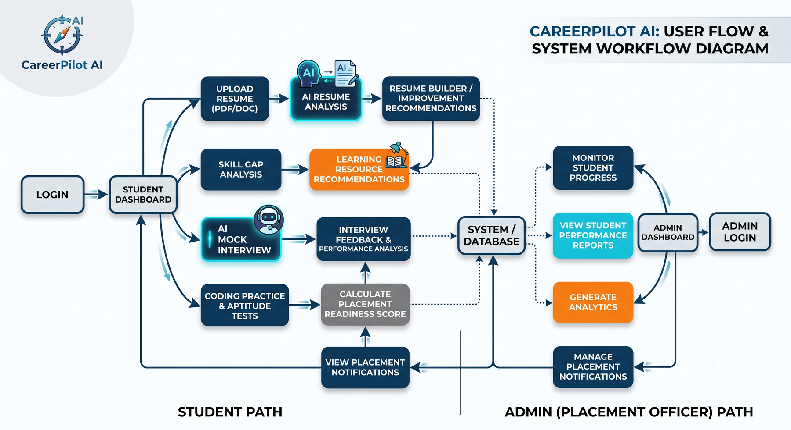
User Flow & System Workflow Diagram
How students and placement officers move through the platform, from login to the shared system database
CareerPilot AI | System Design
11

Slide 15
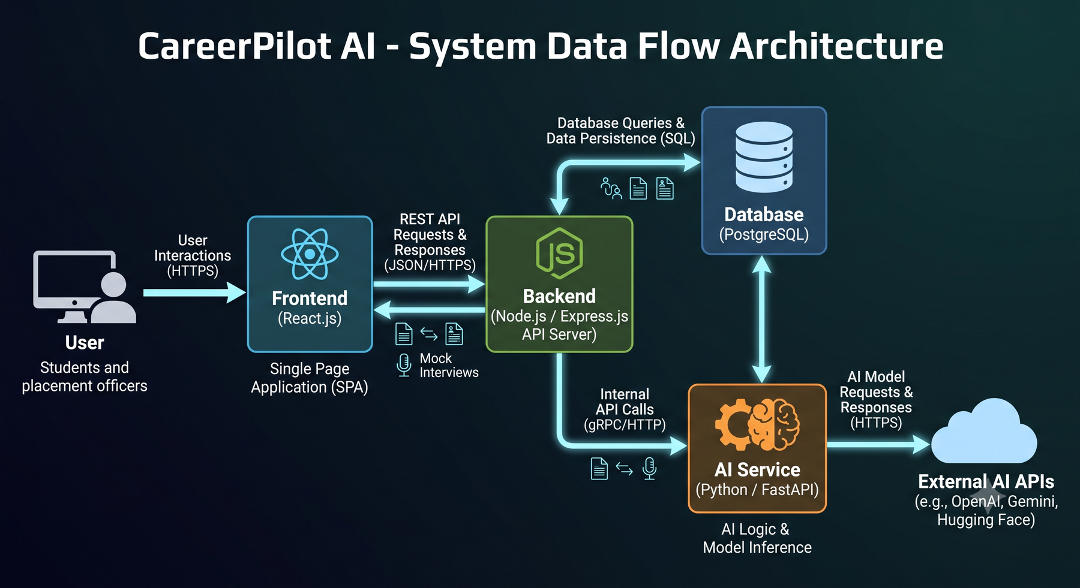
System Data Flow Architecture
How requests and data move between the frontend, backend, database, and AI service layers
CareerPilot AI | System Design
12

