Slide 1

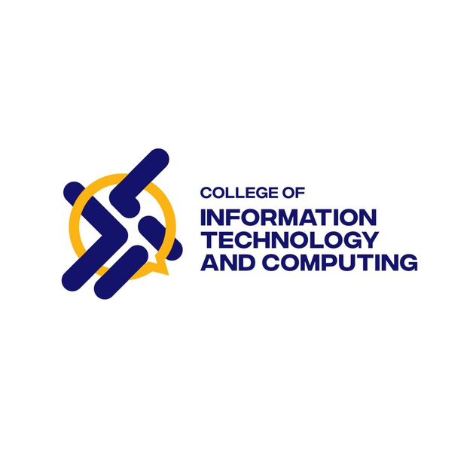
IT224 - WEB SYSTEMS AND TECHNOLOGIES
WELLMEADOWS HOSPITAL MANAGEMENT SYSTEM
BY: GROUP 5
Alabe, Lovely
Anggaon, Kelly Angela
Caboverde, Chanice
Parco, Sheena
Fabria, Frincez

Slide 2
PURPOSE OF THE APPLICATION
The Hospital/WellMeadows Information System was developed to provide a centralized and web-based platform for managing the daily operations of the hospital. The system aims to improve the management of patient records, staff information, appointments, ward and bed assignments, medication tracking, and hospital supply monitoring through a Laravel-based application integrated with a database system. By automating these processes, the system helps reduce data redundancy, improve accessibility of information, and support faster and more efficient hospital services for both staff and patients.
IT2R6
SYSTEMS OF DATABASE SYSTEM

Slide 3
TARGET USERS AND INTENDED USE OF THE SYSTEM
Target Users:
Clinical Staff — responsible for managing patient consultations, treatment details, and medical records.
Nurses — oversee patient care, ward and bed assignments, medication monitoring, and treatment updates.
Personnel Officer — handles staff information, employee assignments, qualifications, and scheduling.
Medical Director — supervises hospital operations, resource management, and overall hospital performance.
Cashier — processes billing, payments, and other financial transactions of patients.
The system aims to enhance hospital operations by offering quick access to patient data, systematic record management, efficient appointment handling, accurate ward and bed allocation, and improved monitoring of hospital resources through a centralized web-based system.
IT2R6
SYSTEMS OF DATABASE SYSTEM

Slide 4
SYSTEM FEATURES AND MODULES
Patient Management Module
Register and update patient information
Maintain patient medical records
Track patient admission and discharge details
Staff Management Module
Manage and maintain staff records
Handle staff schedules and duty assignments
Assign staff to departments and wards
Ward and Bed Management Module
Manage ward information and details
Monitor bed availability and occupancy
Assign beds to admitted patients
Appointment and Treatment Module
Schedule and manage patient appointments
Record diagnosis, treatments, and patient care details
Billing and Reporting Module
Manage patient billing and payment transactions
Generate reports for patients, staff, appointments, and hospital operations
Provide organized summaries for monitoring and decision-making
IT2R6
SYSTEMS OF DATABASE SYSTEM

Slide 5
TECHNOLOGIES USED
Frontend Technologies
Blade (Laravel Views) — used for creating dynamic and reusable user interfaces
Tailwind CSS — used for responsive and modern UI design
Alpine.js — used for lightweight interactive frontend features
Vite — used for fast asset bundling and development build tools
JavaScript — used for custom client-side functionalities and interactions
Font Awesome — used for icons and visual elements
Custom CSS — used for additional styling and layout customization
Backend Technologies
PHP 8.2+ — main programming language used for server-side development
Laravel 12 — PHP framework used for system logic, routing, and backend processes
Laravel Controllers & Routes — used for handling requests and system navigation
Eloquent ORM / Query Builder — used for database operations and data management
PostgreSQL — relational database used for storing and managing hospital data
IT2R6
SYSTEMS OF DATABASE SYSTEM

Slide 6
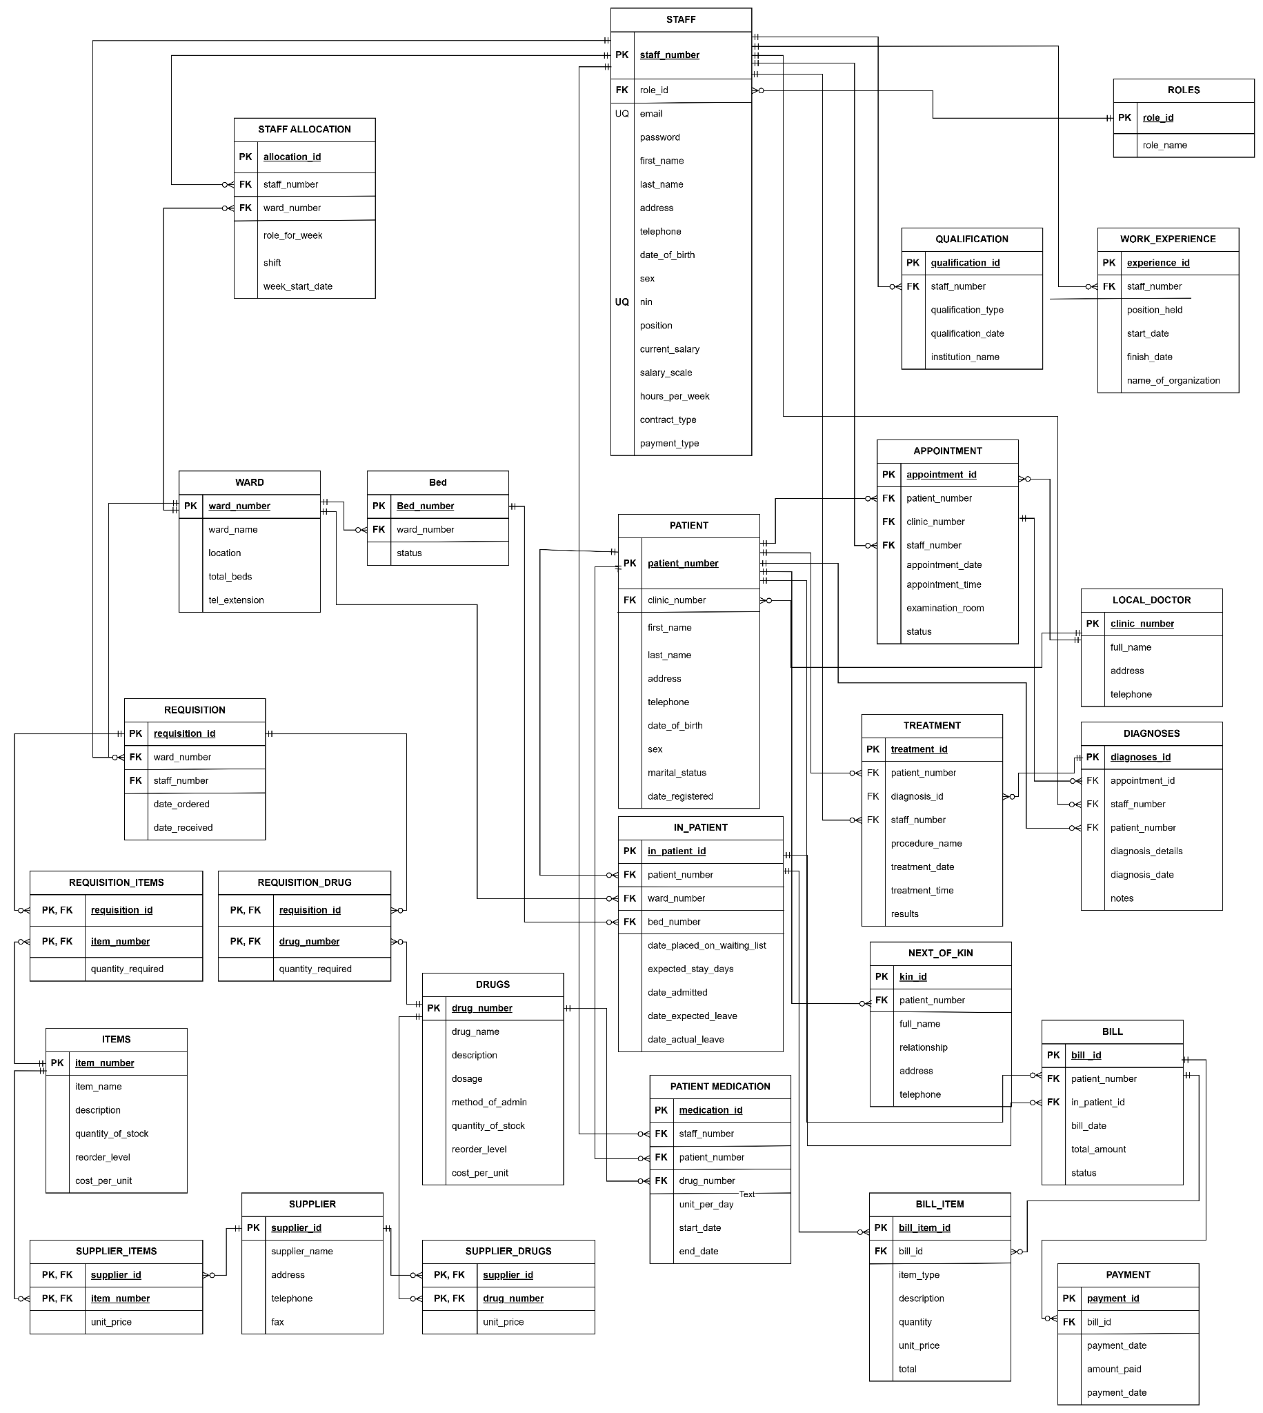
ERD
IT2R6
SYSTEMS OF DATABASE SYSTEM

Slide 7
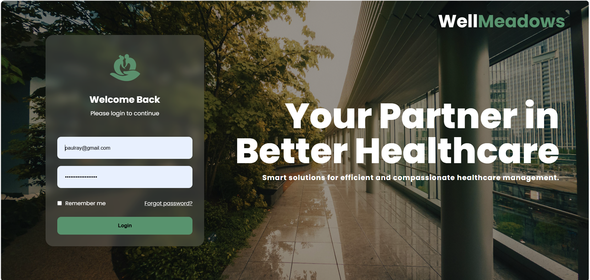
SYSTEM INTERFACE
LOG IN
IT2R6
SYSTEMS INTEGRATION AND ARCHITECTURE

Slide 8
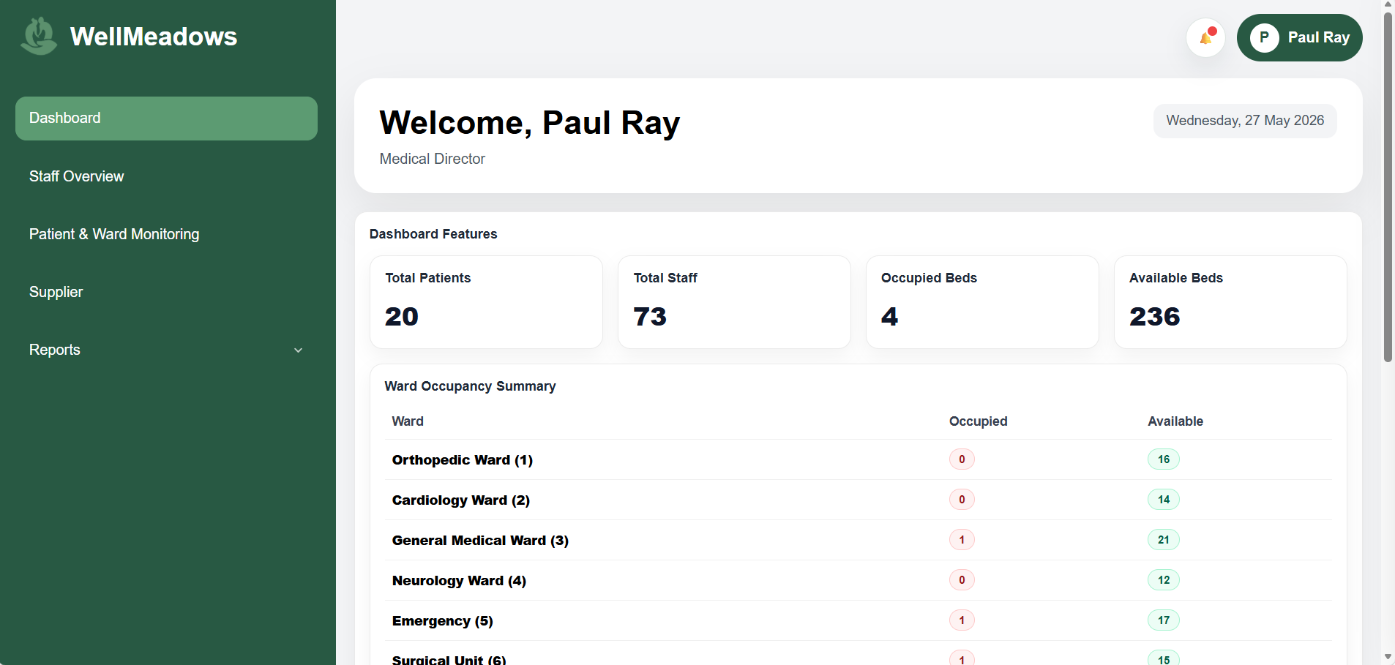
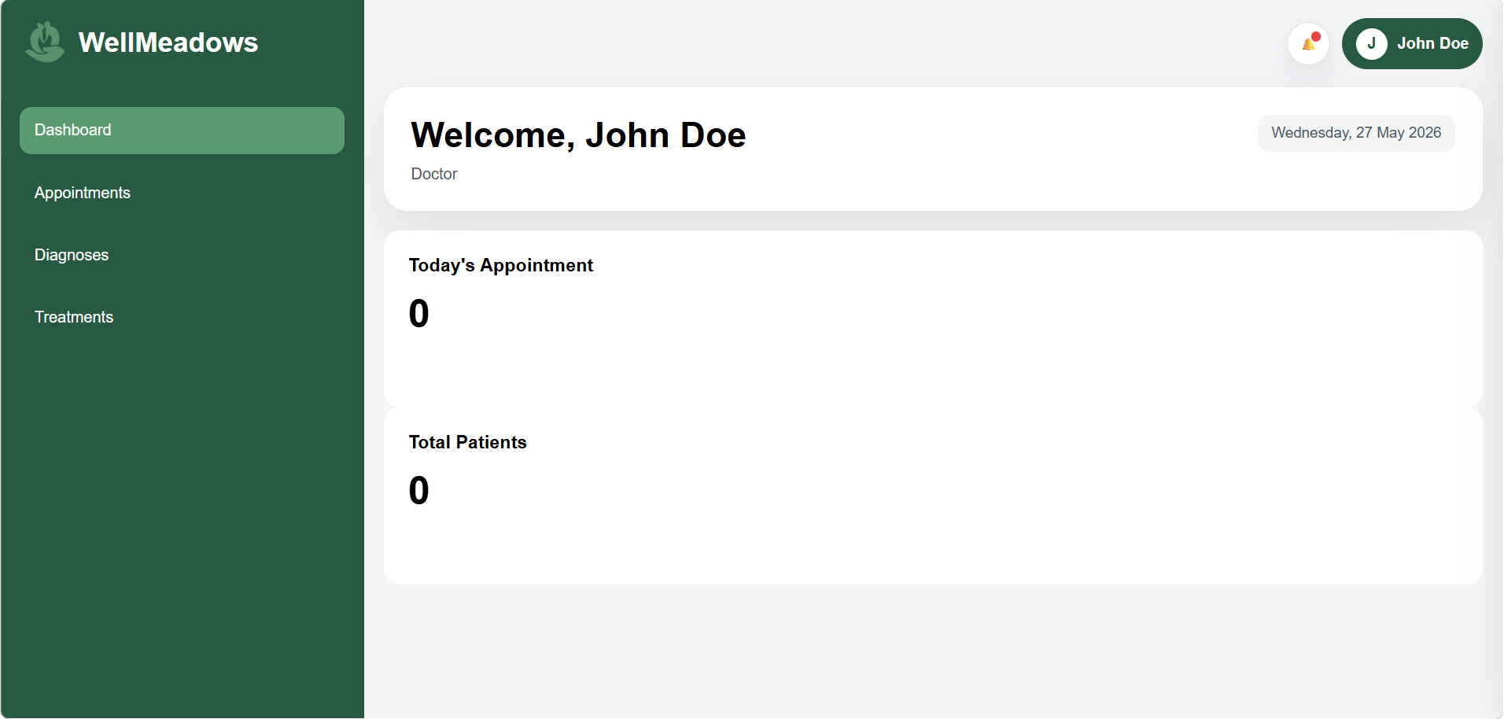
SYSTEM INTERFACE
Medical Director Interface
Clinical Staff Interface
IT2R6
SYSTEMS INTEGRATION AND ARCHITECTURE

Slide 9
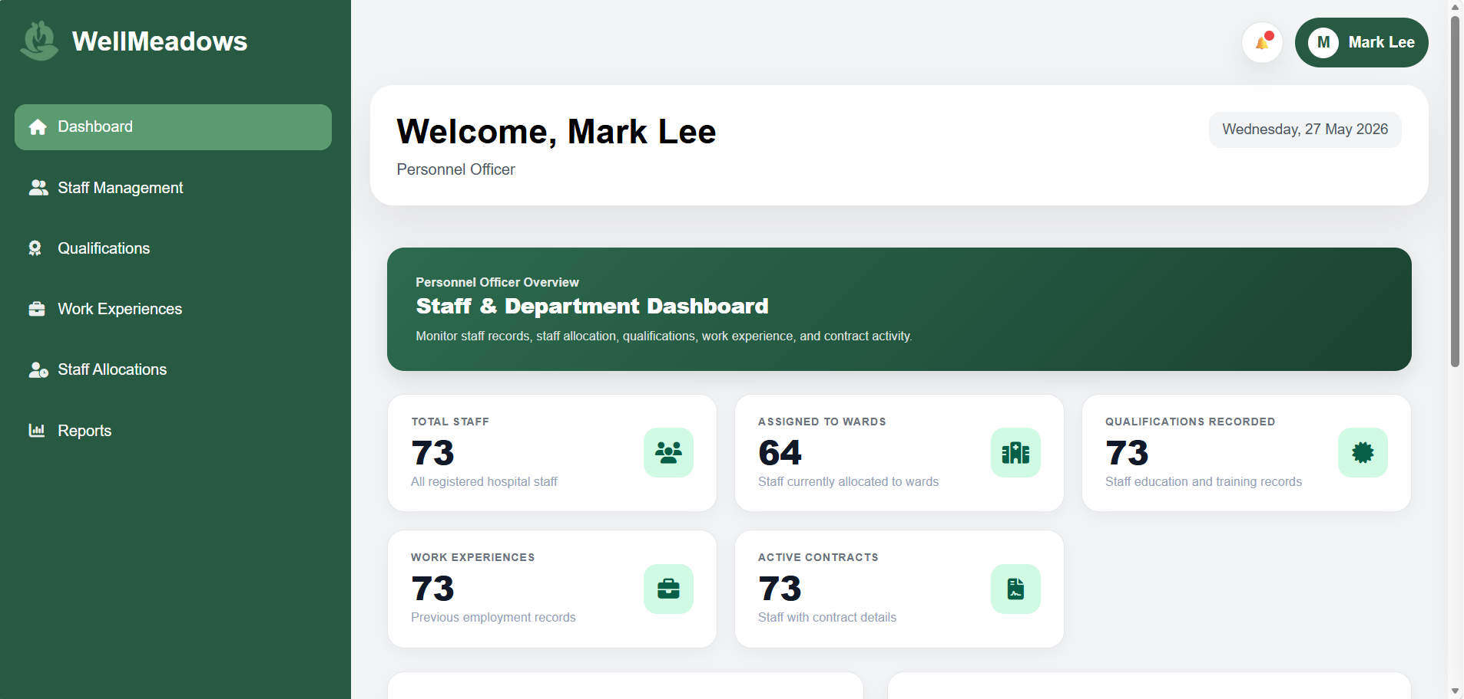
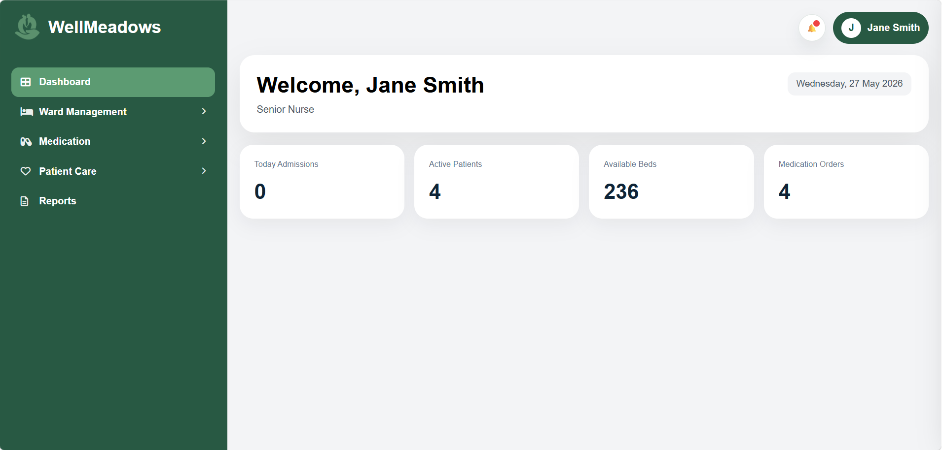
SYSTEM INTERFACE
Personnel officer Interface
Nurse Interface
IT2R6
SYSTEMS INTEGRATION AND ARCHITECTURE

Slide 10
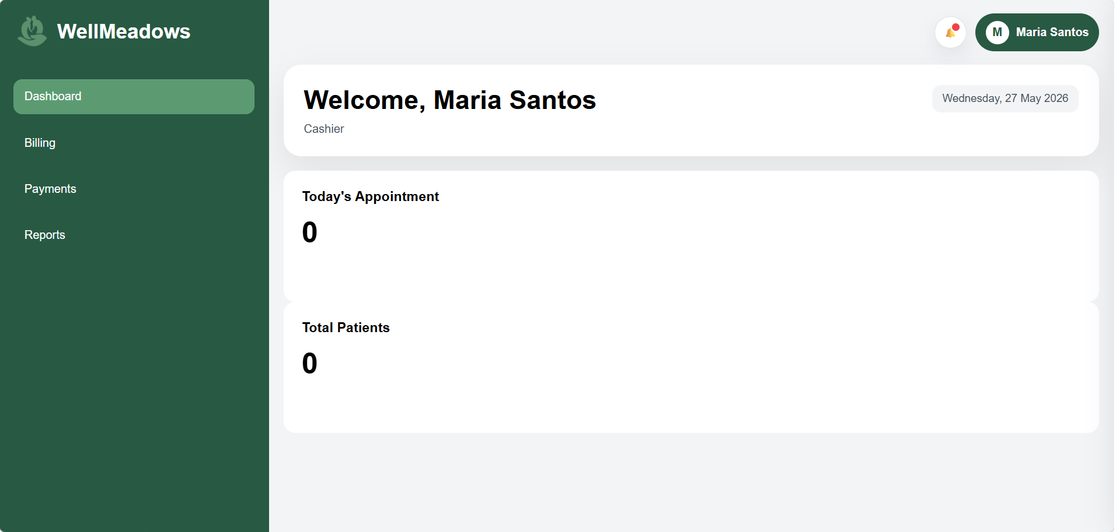
SYSTEM INTERFACE
Cashier Interface
IT2R6
SYSTEMS INTEGRATION AND ARCHITECTURE

Slide 11
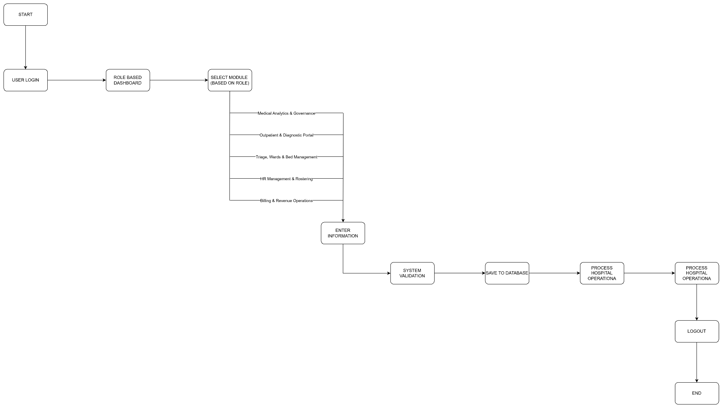
SYSTEM WORKFLOW
IT2R6
SYSTEMS INTEGRATION AND ARCHITECTURE

Slide 12
CONCLUSION
The Wellmeadows Hospital Management System provides a centralized and efficient solution for managing hospital operations. By automating key processes such as patient records, staff management, ward allocation, and billing, the system reduces data redundancy and improves overall hospital efficiency.
With its role-based interfaces and modern tech stack, the system ensures that each user can perform their responsibilities accurately and effectively — ultimately contributing to better and more organized healthcare service delivery.
IT2R6
SYSTEMS INTEGRATION AND ARCHITECTURE

Slide 13

Thank You

