Slide 1
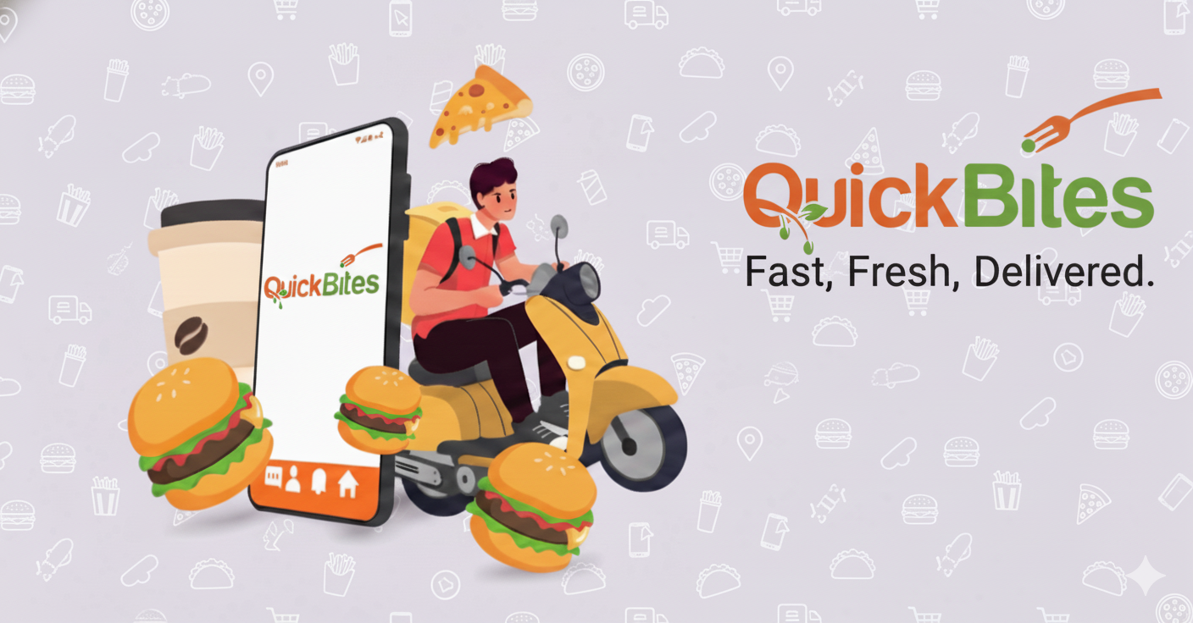
Crisis Recovery Insights for an
Online Food Delivery Startup

Slide 2

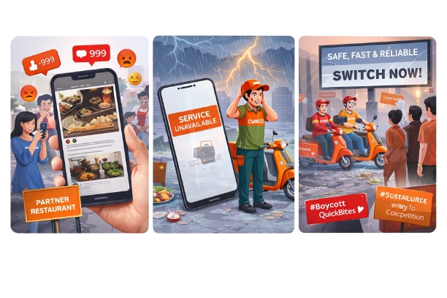
About QuickBite
QuickBite Express is a Bengaluru-based food-tech startup, founded in 2020, connecting customers with nearby restaurants and cloud kitchens.
In June 2025, QuickBite faced a major crisis. A viral social media incident involving food safety violations at partner restaurants, combined with a week-long delivery outage during the monsoon season, triggered massive customer backlash. Competitors capitalized with aggressive campaigns, worsening the situation.

Slide 3
Impact of the Crisis

Slide 4
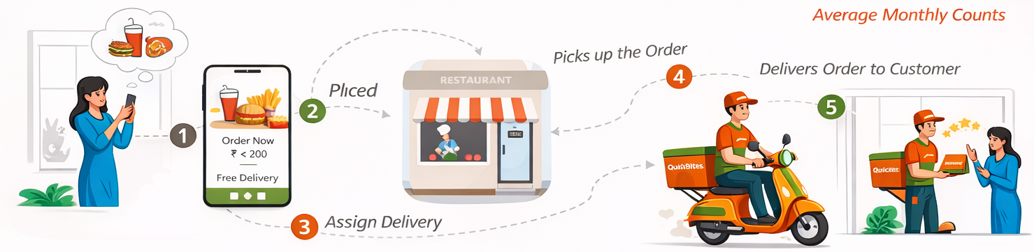
Food Delivery Space - INDIA
Customers
Restaurants
Delivery Partners
107K
18K
18K

