Slide 1



KONGU ENGINEERING COLLEGE
PERUNDURAI ERODE-638060
MSc SOFTWARE SYSTEMS
22ISP71- PROJECT WORK
Enhanced Emotion Classification via Multimodal Fusion of Physiological and Vocal Signals from Daily-Life Wearables
Presented by :
SHANDEEP S (22ISR046)
IV MSC (SS)
Guided by :
Mr. A. Vijay,
Assistant Professor,
Department of CT-PG,
Kongu Engineering College,
Perundurai.

Slide 2
INTRODUCTION
Traditional emotion recognition systems often rely on a single modality like speech or heart rate.
Single-modal systems struggle with accuracy in dynamic, real-life environments.
This results in inconsistent or less reliable emotion classification.
In real-world wearable applications, user emotions are complex and influenced by both physiological and vocal cues.
Existing models lack robustness and adaptability when modalities are incomplete or noisy.
The proposed project aims to enhance emotion recognition by fusing heart rate and speech signals using an efficient multimodal framework.

Slide 3
Objectives
To extract emotional features from heart rate and speech signals using lightweight deep learning models based on 1D CNN and LSTM.
To enhance emotion classification accuracy by applying score-based fusion on modality-specific outputs.
To improve model performance by incorporating attention mechanisms and dynamic feature alignment beyond the base architecture.
To ensure real-world applicability by designing a low-complexity system suitable for wearable devices and daily-life emotion tracking.

Slide 4
LITERATURE SURVEY
S.No | Title of the paper | Name of the Journal | Authors | Methodology proposed | Research Gap
1 | Multimodal Daily-Life Emotional Recognition Using Heart Rate and Speech Data From Wearables | IEEE Access, 2024 | E. Moon, S. Sagar, H. S. Kim | Score-based fusion of speech and HR using 1D CNN + LSTM | Lacked dynamic feature alignment and attention-based improvements
2 | Multimodal Emotion Recognition Based on Cascaded Multichannel and Hierarchical Fusion | Comput. Intell. Neurosci., 2023 | X. Liu, Z. Xu, K. Huang | Cascaded hierarchical fusion of multiple modalities | High complexity, lacks lightweight real-time suitability
3 | CSAT-FTCN: A Fuzzy-Oriented Model With Contextual Self-Attention | Cognitive Computation, 2023 | D. Jiang et al. | Contextual self-attention-based fuzzy fusion network | Not optimized for low-power or wearable settings

Slide 5
S.No | Title of the paper | Name of the Journal | Authors | Methodology proposed | Research Gap
4 | Emotion Recognition Using Random Convolutional Kernel on ECG | Biomed. Signal Process. Control, 2024 | A. Fang et al. | Random CNN kernels for ECG-based classification | Focused only on unimodal ECG, missing speech modality
5 | Speech Emotion Recognition Using CNN-BiLSTM with Multi-task Learning | Applied Acoustics, 2023 | Z. Liu et al. | CNN + attention-BiLSTM with multitasking | No integration with physiological features
6 | Multi-Label Multimodal Emotion Recognition with Transformer Fusion | IEEE Access, 2023 | H. Le et al. | Transformer-based multimodal fusion | Not optimized for wearable/low-memory devices

Slide 6
S.No | Title of the paper | Name of the Journal | Authors | Methodology proposed | Research Gap
7 | CNN-LSTM for Emotion Recognition Using Contactless PPG Signals | Biomed. Signal Process. Control, 2023 | W. Mellouk, W. Handouzi | CNN-LSTM on facial-based PPG signals | PPG signals less suitable for real-world wearable use
8 | Interpretable Multimodal Emotion Recognition Using Hybrid Fusion | Multimedia Tools Appl., 2024 | P. Kumar et al. | Speech + image fusion with hybrid attention layers | Does not address emotion detection in speech + ECG
9 | Emotion Recognition Using Audio-Text via Hybrid Attention Network | Biomed. Signal Process. Control, 2023 | S. Zhang et al. | Hybrid attention on audio and textual embeddings | Lacks physiological signals and real-time adaptability

Slide 7
S.No | Title of the paper | Name of the Journal | Authors | Methodology proposed | Research Gap
10 | Multimodal Emotion Detection via Attention-Based Facial and Speech Fusion | Sensors, 2023 | D. Mamieva et al. | Attention-based fusion of facial and vocal features | High computational overhead for wearables
11 | Real-Time Emotional Health Detection Using Transfer Learning | Neural Comput. Appl., 2023 | A. Sharma et al. | Fine-tuned transfer networks on audio-visual-text data | Misses real-time fusion from physiological data
12 | Emotion Recognition Using Spatio-Temporal CNNs | Biomed. Signal Process. Control, 2022 | M. Sharafi et al. | Spatio-temporal convolution across modalities | Model too deep for edge deployment on wearables

Slide 8
S.No | Title of the paper | Name of the Journal | Authors | Methodology proposed | Research Gap
13 | Behavior-Driven Emotion Recognition Using Mobile Sensors | IEEE Trans. Affect. Comput., 2023 | K. Yang et al. | Deep multimodal sensing from mobile behavioral data | Fusion did not include speech or heart rate directly
14 | Multicultural Speech Emotion Recognition with Language-Speaker Cues | Biomed. Signal Process. Control, 2023 | S. K. Pandey et al. | Incorporates multilingual and speaker-specific traits | Focused only on audio modality
15 | Multimodal Emotion Recognition Using Affective Biomarkers (MEMoR) | Image Vis. Comput., 2022 | Image Vis. Comput., 2022 | Predictive emotion health analytics using biomarkers | Misses lightweight models for wearable deployment

Slide 9
PROPOSED SYSTEM
Performing emotion recognition on physiological (heart rate) and vocal (speech) signals using lightweight deep learning models (1D CNN and LSTM,BILSTM).
Features from both modalities are extracted independently and combined using a score-based fusion method, enhanced with attention mechanisms and dynamic alignment.
The system is designed for real-time deployment on wearable devices, and performance is evaluated using output parameters like accuracy, F1-score, confusion matrix, and inference time.

Slide 10
System Flow Diagram
Speech + ECG Dataset
Data Preprocessing
Noise Removal (Speech)
Signal Filtering (ECG)
Normalization / Scaling
Evaluation Metrics
Accuracy
F1-Score
Precision
Recall
Feature Extraction
MFCC, Chroma, Spectral (Speech)
HER / ECG Features
Statistical Features
Model Training
Early Stopping
Optimization
Fusion Model
Speech Branch (Dense / CNN)
HER Branch (Dense / BiLSTM)
Concatenate & Dense Layers
Feature Storage (CSV files)

Slide 11
Module Identification
SER Model
Data Preprocessing
Audio feature extraction (e.g., MFCCs or spectrograms)
Label Encoding of emotion classes
Train–Test split
Data Augmentation
Handling class imbalance (e.g., oversampling)
Feature Extraction
Sequential audio features
Temporal patterns in speech
Model Development (LSTM)
LSTM(128, return_sequences=True)
LSTM(64)
Dense(64, ReLU)
Output: Dense(Softmax, multi-class)
Evaluation Metrics
Accuracy, Precision, Recall, F1-score

Slide 12
Module Identification
HER Model
Data Preprocessing
Physiological feature cleaning
Label Encoding for binary classification
Data Augmentation
Class Imbalance Handling
Feature Extraction
Local features via Conv1D
Sequential dependencies via BiLSTM
Model Development (CNN + BiLSTM)
Conv1D(16, kernel=5, ReLU)
BiLSTM(32, return_sequences=True)
Dense(64, ReLU)
Output: Dense(2, Softmax → Binary Emotion Recognition)
Evaluation Metrics
Accuracy, Precision, Recall, F1-score

Slide 13
Module Identification
Fusion Model (SER + HER Combined)
Data Preprocessing
Input 1: Speech features (from SER)
Input 2: HER features
Synchronization & normalization
Feature Extraction
Speech Dense layers: 128 → 64
HER Dense layers: 128 → 64
Model Development (Fusion Network)
Concatenation of speech + HER features
Dense(128, ReLU)
Output: Dense(Softmax, multi-class emotion classification)
Evaluation Metrics
Accuracy, Precision, Recall, F1-score
Confusion Matrix

Slide 14
DATASET DESCRIPTION
Attributes:
ECG Dataset: patient_id, age, signal (ECG time-series), emotion_label, valence, arousal
Speech Dataset: speaker_id, audio_path, emotion_label, valence, arousal, pitch, energy, MFCCs
Fusion Dataset: emotion_label, ecg_features, speech_features (post feature extraction and alignment)
Number of Records:
ECG Data: 3,000 ECG signal samples labeled with emotional/physiological states
Speech Data: 7,000 audio samples from multiple public datasets

Slide 15
DATASET DESCRIPTION
Format:
ECG: Time-series arrays (CSV/NumPy format)
Speech: WAV audio files and extracted features (CSV or NumPy arrays)
Link:
ECG Dataset: https://www.Zenodo.com/datasets/evilspirit05/ecg-analysis
Speech Dataset: https://www.kaggle.com/datasets/ejlok1/cremad

Slide 16
PREPROCESSING TECHNIQUES
Signal Filtering: Applied bandpass filtering (0.5–40 Hz) to remove baseline noise and high-frequency artifacts from ECG signals.
Feature Extraction: Extracted temporal (HRV) and frequency-domain features from ECG, extracted MFCC, pitch, ZCR, and energy features from speech
Label Mapping: Standardized emotion labels from both datasets into four emotional quadrants (HVHA, HVLA, LVHA, LVLA) based on valence-arousal model
Fusion Preparation: Aligned and grouped ECG and speech samples under the same emotion label to generate fusion dataset entries.

Slide 17
Tools and Technologies
Programming Language: Python
Libraries: TensorFlow, NumPy, SciPy, Librosa, Scikit-learn, Pandas, Matplotlib, Seaborn
Platform: Google Colab / Jupyter Notebook
Visualization: Confusion Matrix, Accuracy Graphs, F1-Score Heatmaps, ROC Curve
Dataset:
ECG Dataset: Zenodo – ECG Analysis Dataset
Speech Dataset: Kaggle – CREMA-D Emotional Speech Dataset

Slide 18
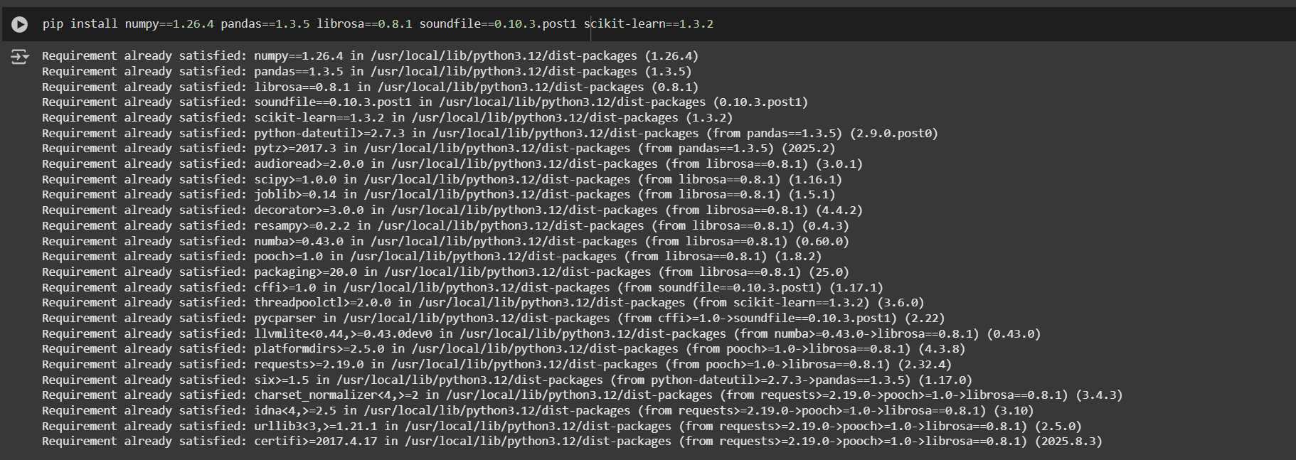
Screenshots
Installing packages

Slide 19
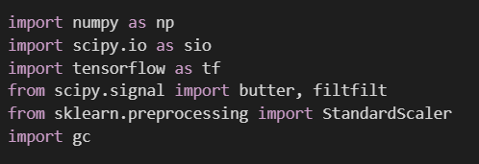
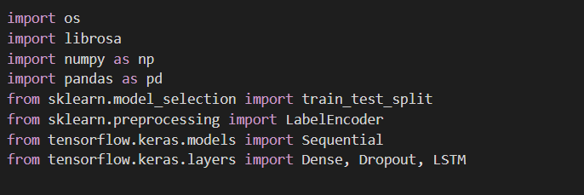
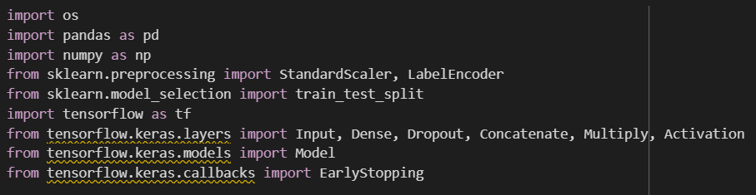
Screenshots
Importing the necessary modules
HER Model
SER Model
Fusion Model

Slide 20
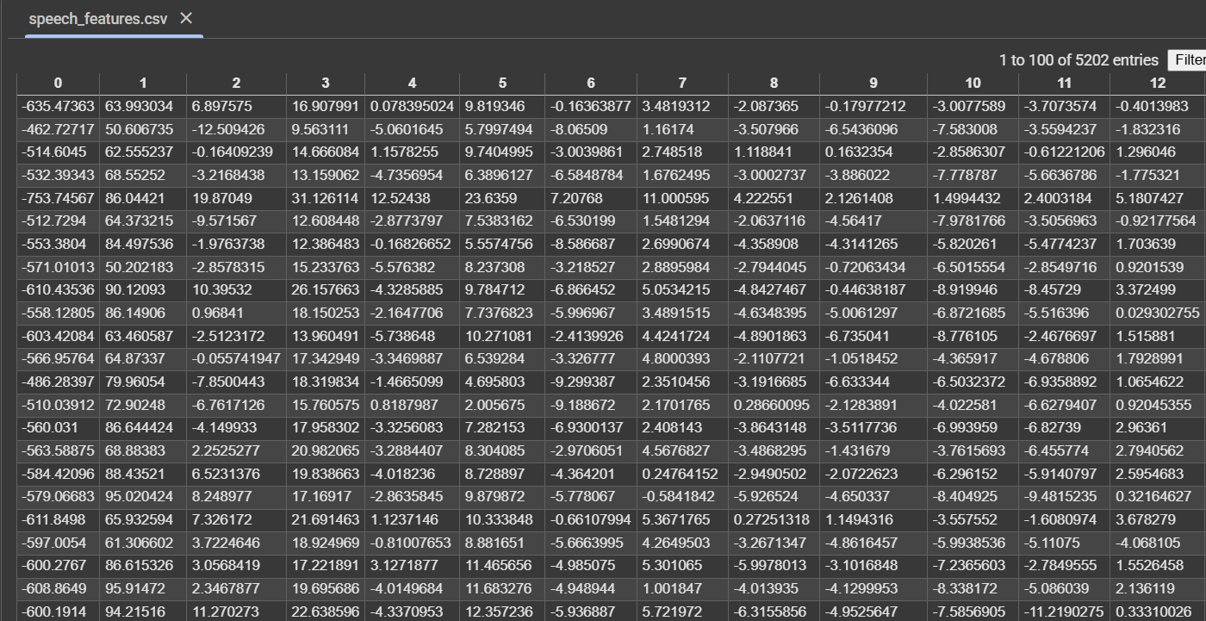
Screenshots
Speech Dataset

Slide 21
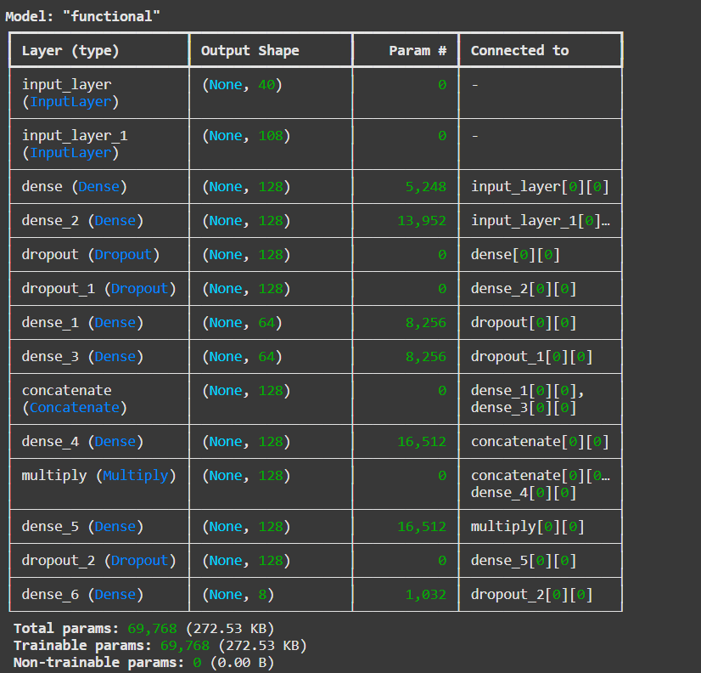
Screenshots
Build Fusion Model

Slide 22
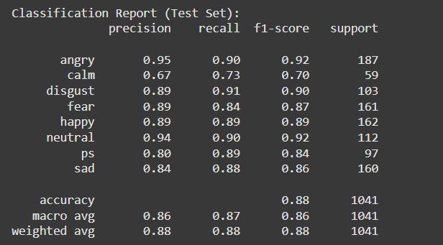
Screenshots
Final result

Slide 23
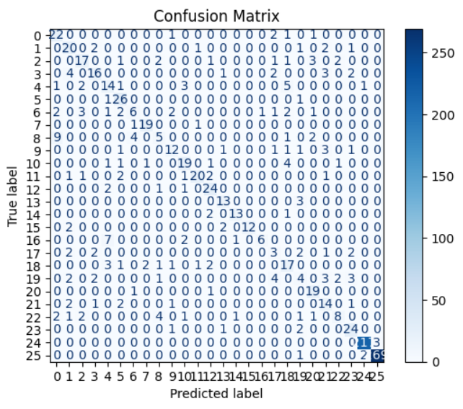
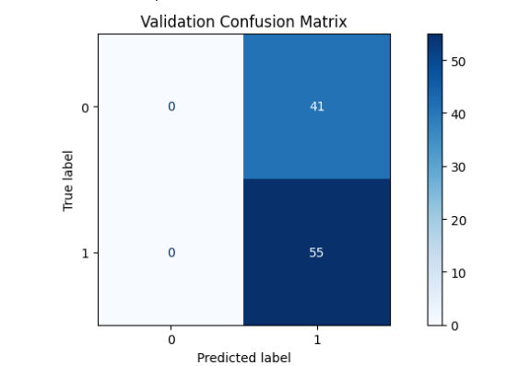
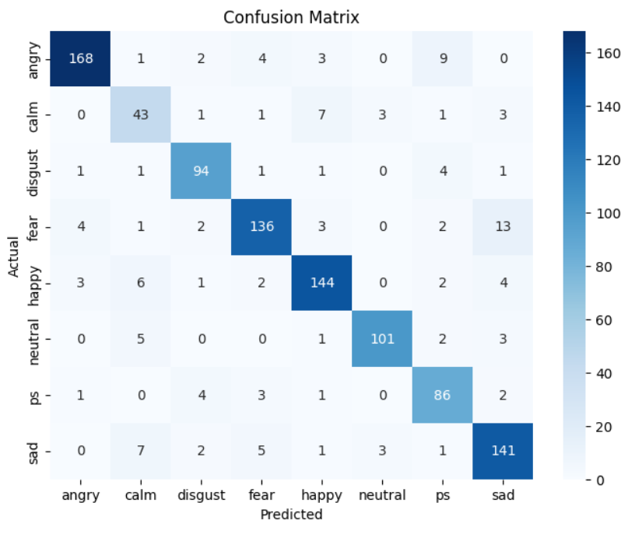
Screenshots
SER Model
HER Model
Fusion Model

Slide 24
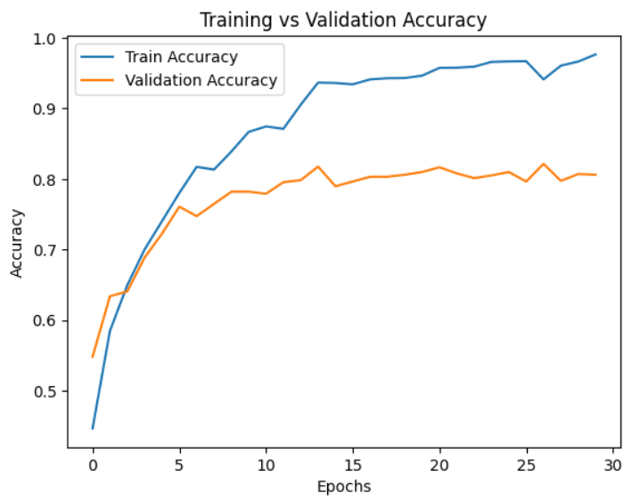
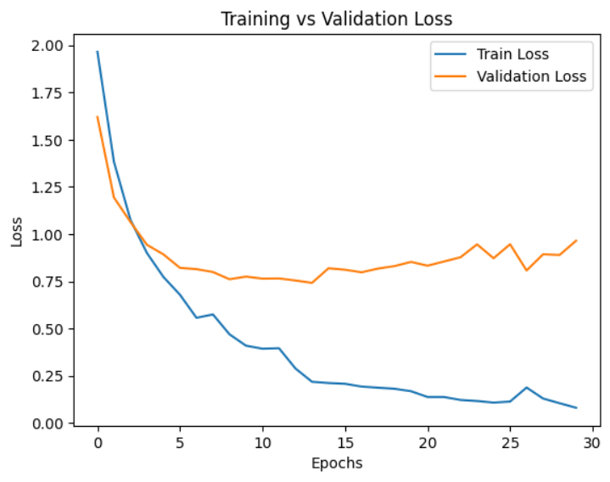
Screenshots
SER Model

Slide 25
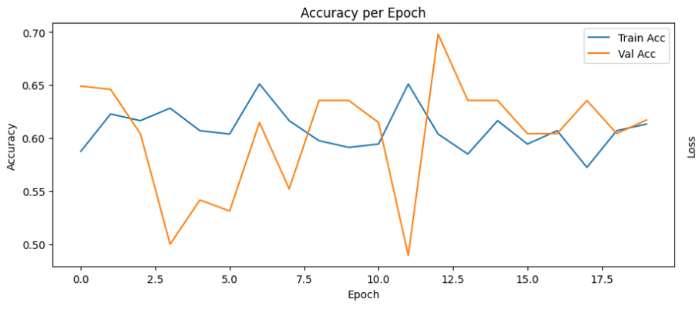
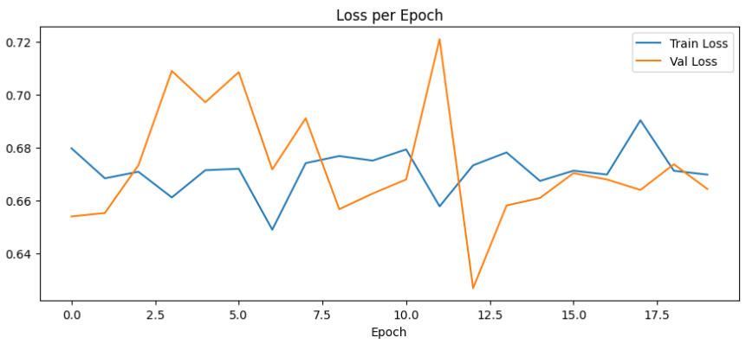
Screenshots
HER Model

Slide 26
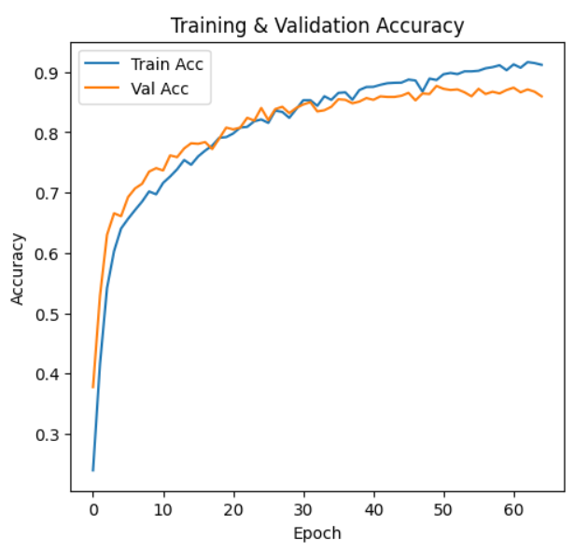
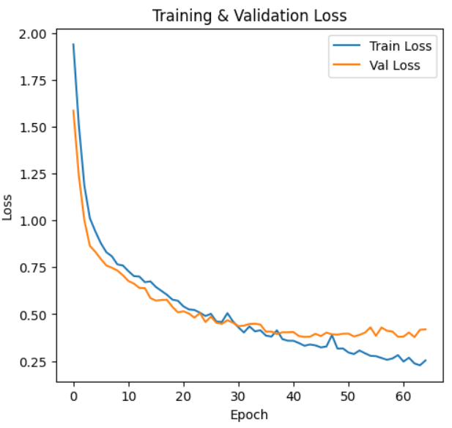
Screenshots
Fusion Model

Slide 27
Performance Analysis
Model | Train Accuracy | Test Accuracy | Train F1-score | Test F1-score
SER (LSTM) | 98.39% | 89.24% | 98.39% | 89.29%
HER (CNN + BiLSTM) | 92% | 84% | 92% | 84%
Fusion (Concatenation) | 96% | 89% | 96% | 89%
Fusion + Attention | 94.11% | 87.70% | 94.16% | 87.80%

Slide 28
Conclusion
The project successfully built three deep learning models for emotion recognition: SER Model (LSTM) for speech signals, HER Model (CNN + BiLSTM) for heart-rate/physiological signals, Fusion Model that fused both modalities
A stronger Fusion model with Attention was used, with ~87.7% test accuracy and better generalization, being resistant to noisy or missing data.
Utilizing both speech and physiological features resulted in more balanced precision, recall, and F1-score outcomes, so the model won't tend to be biased towards a particular emotion class.
In summary, the project shows that deep learning–based multimodal fusion can successfully identify intricate emotional patterns and is thus well-suited for real-world wearable applications in healthcare, human–computer interaction, and monitoring of mental well-being.

Slide 29
Future Enhancement
Investigate newer architectures like Transformers and Graph Neural Networks (GNNs) to enable richer emotion representation.
Implement real-time, light-weight, and interpretable emotion recognition systems for mobile and IoT platform deployment.
Expand multimodal fusion by incorporating facial expressions or body movements to improve accuracy.

Slide 30
Thank You !!

