Slide 1
JUSTBILLING
I have selected the “just billing” https://justbilling.in/ for this SEO project
ABOUT JUST BILLING:
Just Billing software is a solution designed to streamline and simplify the billing and invoicing processes for businesses.
It typically offers features that assist in managing invoices, expenses, and financial transactions, helping users maintain accurate financial records and improve operational efficiency.

Slide 2
Services of Just Billing Software
Invoicing-Customizable Templates, Automated Invoicing, Multi-Currency Support
Billing Management-Expense Tracking, Payment Integration, Billing Reports
Accounting Integration-Sync with Accounting Software, Tax Calculation
Client Management-Client Database, Client Portal
Customization and Branding-Branding Options, Personalized Messaging
Reporting and Analytics-Financial Reports, Analytics Dashboard
Security and Compliance-Data Security, Compliance

Slide 3
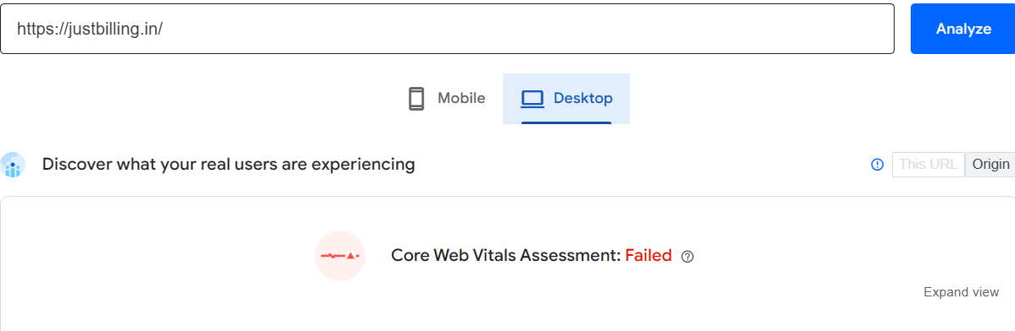
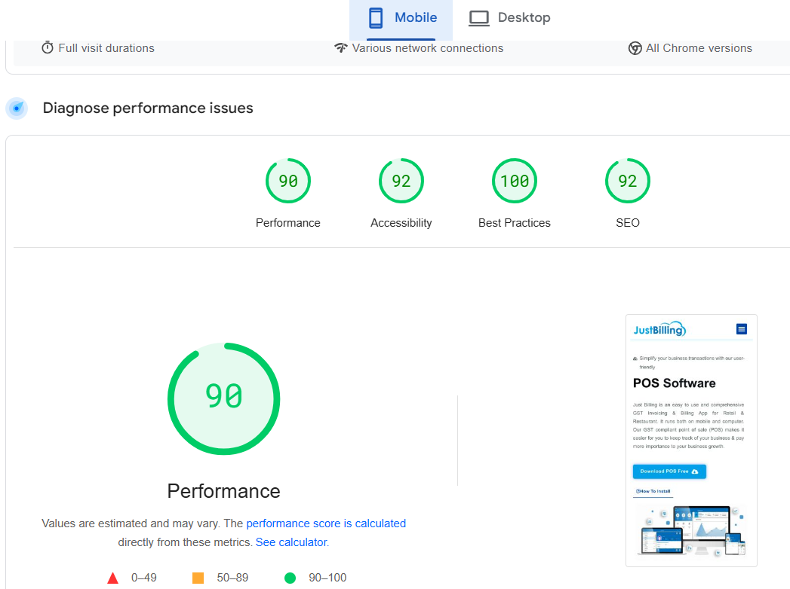

Task-1-Initial Audit
Current performance:
This website is not optimize properly as core web
vitals assessment failed.
The performance of this page is high in both mobile
and desktop
STRENGTHS:
Just billing site is using HTTPS for secure communication
The website is clean and user friendly
Images related to keywords are added
There is no any broken link, used https://brokenlinkcheck.com/ for analysing.

Slide 4
Weakness
Missing of friendly URL in the organic page
Improve internal linking to support navigation and distribute authority.

Slide 5
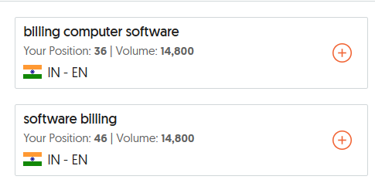
TASK-2-Keyword research
Targeted keyword:
Primary Keywords:
Invoicing, Billing, GST , Accounting , Purchases ,and expenses.
Secondary Keywords:
Inventory management , Customer Management , POS of service
Longtail Keywords:
Multi store retail management, digital payment to GST Invoicing
Retail billing software.
Example: Ubersuggest
The search volume for just billing is high and Ranking position is 36

Slide 6
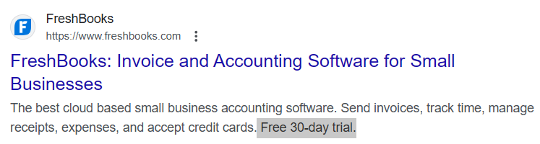
Competitive analysis:
For example-Fresh books
In the description their have mentioned the 30-day trial that will interact their clients.

Slide 7
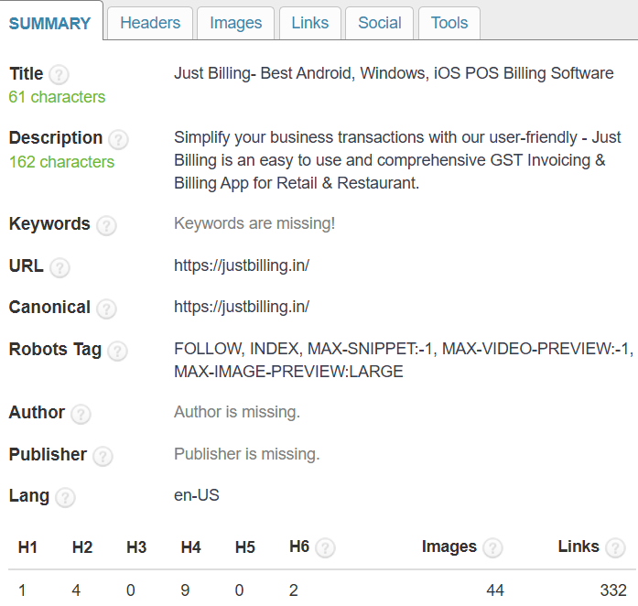
TASK-3-On page SEO optimization audit
Selected page - https://justbilling.in/android-billing-app/
Strength:
Meta description- Is optimized properly and 162 characters are present
URL-Navigation to next page is mentioned, Links are internally structured.
Content-Given lot of content related to Mobile billing app and point of sale app
Title Tag- Title is more relevant to the keywords
Weakness:
Keywords are not optimized properly.
H3-Hierachy is not optimized properly.
Images are not optimized which is relevant to keywords

Slide 8
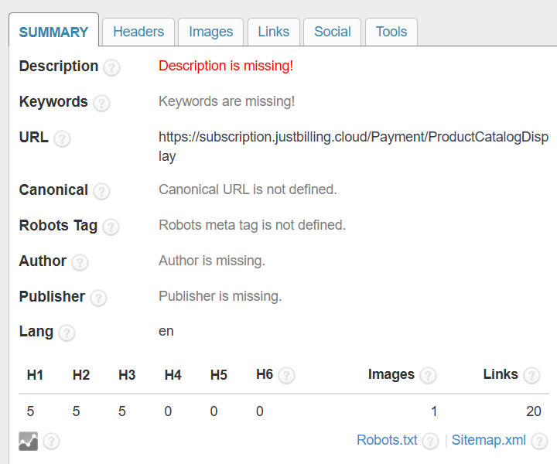
Selected page- https://subscription.justbilling.cloud/Payment/ProductCatalogDisplay
Strength:
URL-URL is completely optimized and permalink URL is mentioned
Title-Title is optimized properly
Headings-Heading tags are optimized with the relevant keyword(H1,H2,H3….)
Weakness:
Description-Description is not optimized here no description is mentioned
Keywords-Keyword is completely missing in this page
Images-Lack of images
Links are mentioned but its not relevant to the title
and keyword.

Slide 9
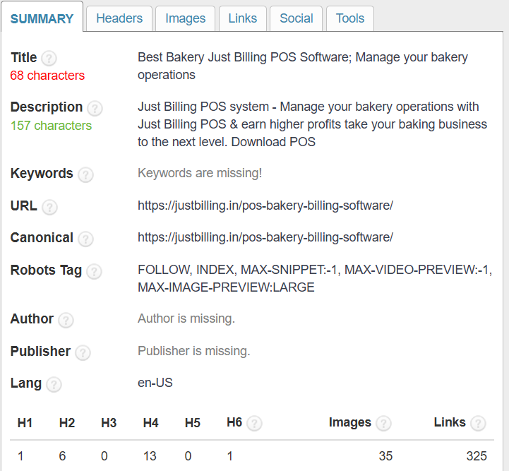
Selected page- https://justbilling.in/pos-bakery-billing-software/
Strength:
Description- The description is optimized properly 157 characters are mentioned
URL- URL is optimized and complete URL link is mentioned
Headings- Headings are more relevant to the keyword like bakery , Take away , easy menu etc..
Links- More internal structured links are given
Social media- This bakery billing service is advertised on Facebook media.
Weakness:
Title- the title tag is not crisp and simple it must be 50-60
character but here it is 68 characters mentioned.
Keywords-lack of keywords is missing.
Images- Images are not relevant to the keyword
and optimized without ALT.

Slide 10
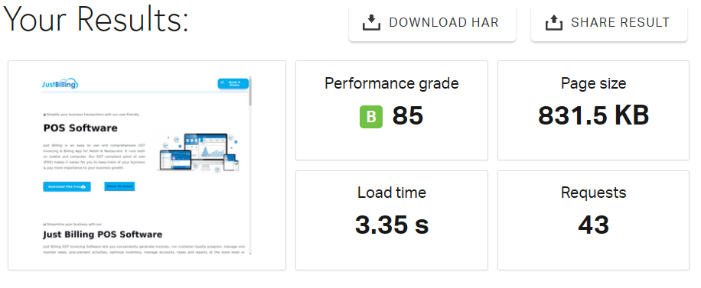
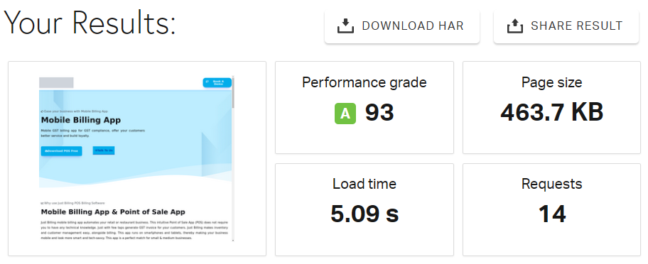
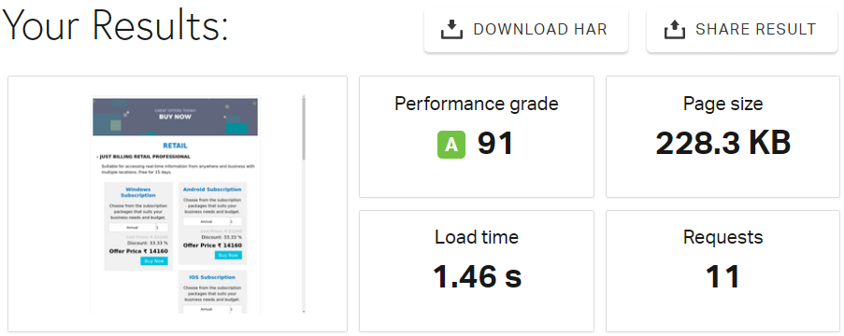
Task-4-Technical SEO
https://justbilling.in/
The speed of this website is optimized properly
why because the secs taken for this website
to load is 3.35 which is less than 5 secs
For this page https://justbilling.in/android-billing-app/
This page is not optimized properly as the secs
to load this page taken more than 5 secs
For this page https://subscription.justbilling.cloud/Payment/ProductCatalogDisplay
This page is optimized properly as the time taken
for this page to load is 1.46 secs

Slide 11
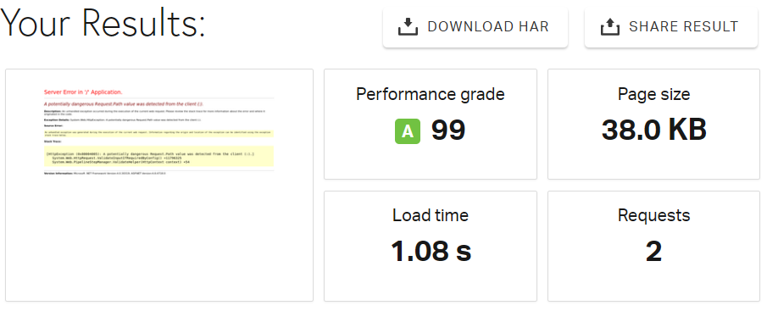
For this page - https://justbilling.in/pos-bakery-billing-software/
The speed for this page is optimized properly
and loadings secs is also low as it is below 5 secs
5 Best Practices to reduce website loading:
Minimize the use of HTML and unnecessary whiteboards, Comments and characters
Choose the right image format to optimize images (e.g.: JPEG for photos, PNG for graphics)
Utilization of CDN(Content delivery network)will reduce the website loading speed(e.g.: Cloudflare and Amazon CloudFront)
The usage of Gzip compression will reduce the size of the file or image sent over Network.
Regularly clean up and optimize your database to remove unnecessary data and improve performance.

Slide 12
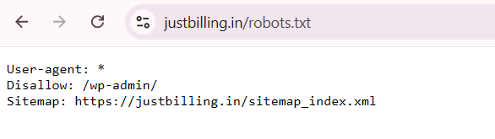
‘robots.txt’ is not configured properly and blocking important pages.
XML sitemap is present for this website up-to-date
Crawl error-There is no crawl error like(404 error) and fix broken links for this website.

Slide 13
TASK-5-CONTENT STRATEGY
Keyword Research and Optimization
Target Keywords: Inventory Management , Customer Management , POS of service
Planning
Create a list of all existing content
Including blog posts, articles, landing pages, product descriptions, etc.
Search Console to evaluate performance metrics such as page views, bounce rates, and average session duration.

Slide 14
TASK-6-OFF-PAGE SEO
Social Media Presence and Engagement
Ensure social media profiles are complete, consistent, and optimized with relevant keywords and links to your site.
Measure engagement metrics such as likes, shares and comments
Identify Competitors
Compare the quantity and quality of their backlinks with ours to identify opportunities for link building
Backlink Profile Analysis.
Quantity and Quality- Use tools like Ahrefs, SEMrush, or Moz to analyze your backlink profile.
Reviewing Anchor text distribution.
Identify and disavow toxic or low-quality backlinks

Slide 15
RECOMMENDATIONS
1.Technical Enhancements: Prioritize addressing site speed, mobile optimization, and fixing crawl errors to enhance overall site performance.
2.On-Page Optimization: Refine keyword usage, improve internal linking,
and ensure meta tags are fully optimized for target keywords.
3.Content Development: Create new content to fill gaps, update existing articles, and explore additional content formats to engage a broader audience.
4.Off-Page Strategies: Build high-quality backlinks, enhance local SEO efforts, and improve social media engagement to boost domain authority and online presence.
5.Ongoing Monitoring: Regularly track SEO performance, adjust strategies based on analytics, and stay updated with SEO best practices and algorithm changes.

Slide 16
CONCLUSIONS
The SEO audit for JustBilling reveals a comprehensive overview of the current state of your website's SEO performance, highlighting key strengths and areas for improvement. By implementing these recommendations, JustBilling can enhance its search engine visibility.

