Slide 1
D’MART
Nmae:Shandhini

Slide 2
TABLE OF CONTENT
Introduction
Porter’s 5 forces
SWOT
Six forces model
GAP
3 P’s
STP
Marketing mix model
Profitability Framework
3 C’s Framework
Product life cycle
MECE
Conclusion

Slide 3
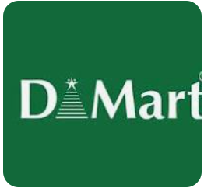
INTRODUCTION
D-Mart is one of India’s largest and most successful retail chains, known for offering a wide range of consumer goods at competitive prices. It operates primarily in the hypermarket and supermarket formats, providing a one-stop shopping destination for customers seeking groceries, home essentials, personal care products, apparel, and more. D-Mart was founded in 2002 by Radhakishan Damani, a prominent Indian investor, under the company Avenue Supermarts Limited (ASL). The first store was launched in Powai, Mumbai, and since then, it has rapidly expanded across India, especially in urban and semi-urban areas.

Slide 4
PORTER’S 5 FORCES
.
Competitive Rivalry (High)
price-sensitive and convenience-oriented segments
Big Bazaar, Reliance Retail, Spencer’s, HyperCity, and online retailers such as Amazon and Flipkart.
The competition extends to both organized (large retail chains) and unorganized (local kirana stores, small retailers) sectors.
Threat of New Entrants (Moderate)
High capital investment
prime real estate in densely populated urban areas, where D-Mart’s presence is already well-established.
Economies of scale
Bargaining Power of Suppliers (Low to Moderate)
D-Mart's large scale and high inventory turnover give it considerable negotiating power
FMCG sector, may have more bargaining power

Slide 5
.
Bargaining Power of Customers (Moderate to High)
D-Mart operates in, are price-sensitive and can easily switch to other retailers
The rise of e-commerce platforms like Amazon and Flipkart gives customers more alternatives, increasing their power to choose based on price and convenience.
Threat of Substitutes (High)
e-commerce platforms and local kirana stores,
Online grocery delivery (BigBasket, JioMart) is gaining traction, offering customers
Unorganized retail (local stores) remains a major substitute

Slide 6
SWOT ANALYSIS
.
STRENGTH
Low-Cost Leadership
Efficient Supply Chain
Wide Product Range
Strong Real Estate Strategy
Brand Trust and Customer Loyalty
WEAKNESS
Limited Geographic Presence
Minimal E-Commerce Focus
Dependence on Physical Stores
Low Product Differentiation
OPPORTUNITY
E-Commerce Expansion
Expansion into Untapped Markets
Rising Demand for Grocery Retail
Private Label Development
THREATS
Intense Competition
E-Commerce Disruption
Changing Consumer Preference
Economic Slowdowns

Slide 7
SIX FORCES MODEL
Competitive Rivalry: High – Intense competition from both organized retail
chains and e-commerce players.
Threat of New Entrants: Moderate to Low – High capital investment and economies of scale deter
new entrants, though online platforms pose a disruptive threat.
Bargaining Power of Suppliers: Low – D-Mart’s scale and purchasing power give it the
upper hand in negotiations with suppliers.
Bargaining Power of Customers: High – Customers have numerous options, and price
sensitivity in the Indian market makes retention a challenge.
Threat of Substitutes: High – E-commerce platforms and local kirana stores provide strong
alternatives in terms of convenience and pricing.
Influence of Government and Complementors: Moderate to High – Government regulations
can affect growth, while partnerships with telecom and digital payment companies can enhance customer experience

Slide 8
GAP
. Current State:
D-Mart has a limited online presence compared to major competitors like Amazon, Flipkart, and JioMart.
While D-Mart has physical stores, its e-commerce platform is not fully developed, and its reach in online grocery is limited.
Desired State:
D-Mart needs to expand its e-commerce operations and offer a fully integrated omnichannel experience, which allows customers to shop online, pick up in-store, or have products delivered to their homes.
GAP:
The absence of a robust e-commerce strategy and limited focus on digital transformation is a major gap as consumer preferences shift toward online shopping, especially after the COVID-19 pandemic.

Slide 9
3 P’s
Price
Everyday Low Pricing (EDLP)
Cost-Efficient Operations
Bulk Purchasing Power
.
PRODUCT
Wide Range of Essential Goods
Branded and Non-Branded Items
Category Focus
Place
Strategically Located Stores
Owned Store Properties
Limited Online Presence

Slide 10
STP
.
Segmentation
Income: Primarily targets middle-income and lower-income
D-Mart operates primarily in urban and semi-urban areas
affordable prices and convenience over luxury or premium products.
Targeting
Mass Market Targeting
Value Shoppers
Urban and Semi-Urban Consumers
affordability, low prices, and convenience
bulk buying to save costs in the long run.
Positioning
Value for Money
low-cost retail leader, offering products at affordable prices with its Everyday Low Pricing (EDLP) strategy
consistent pricing and no-frills shopping experience

Slide 11
MARKETING MIX MODEL
Product
fast-moving consumer goods (FMCG)
private label products
avoiding luxury or premium products
Price
Everyday Low Pricing (EDLP)
Bulk Purchasing Power
lean cost structure
.
Place (Distribution)
high foot traffic, ensuring convenience for customers.
D-Mart has a physical presence in several key regions
Promotion
Minimal Advertising
bulk discounts or combo offers
affordable pricing and value for money

Slide 12
PROFITABILITY FRAMEWORK
Revenue Drivers
Number of Customers (Foot Traffic)-D-Mart relies heavily on high foot traffic in its stores
Average Basket Size-D-Mart encourages bulk buying by offering discounts on large quantities, which increases the average ticket size per transaction.
Price per Unit-While D-Mart maintains lower prices compared to competitors
Store Expansion-D-Mart’s focus on increasing the number of stores
Cost Drivers
Cost of Goods Sold (COGS)-D-Mart has more control over sourcing, production, and margins.
Operating Expenses-reducing long-term rental costs.
Supply Chain Efficiency-distribution centers to manage inventory and streamline the supply process, reducing logistics costs.
Profitability Levers
Gross Margin-D-Mart’s ability to keep COGS low by purchasing in bulk
Operating Margin-D-Mart’s ownership of its store locations lowers long-term fixed costs like rent, allowing for better control over operating margins.
Net Profit Margin-minimizing fixed costs

Slide 13
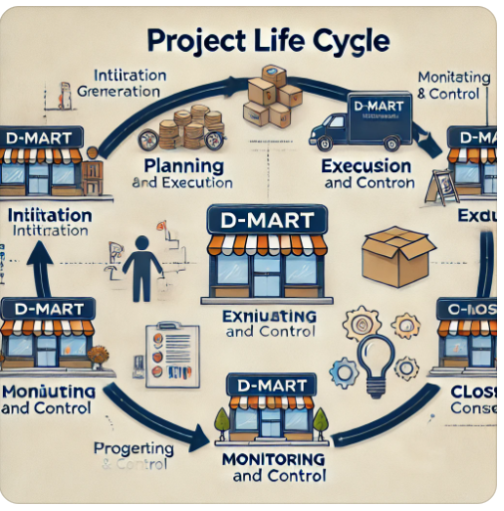
PRODUCT LIFE CYCLE

Slide 14
3 C’s FRAMEWORK
Customer
Target Segment
Customer Needs
Customer Behavior
Company
Core Competencies
Value Proposition
Challenges
Competitors
Direct Competitors
E-Commerce Competitors
Local Retailers

Slide 15
MECE
.
Geographic Expansion
Online Grocery Sales
In-store Promotions
Bulk Buying and Wholesale
Not exclusive
Not exhaustive
Geographic Expansion
Online Grocery Sales
In-store Promotions
Bulk Buying and Wholesale
Product Line Expansion
Mutually Exclusive
Collectively Exhaustive

Slide 16
RECOMMENDATION
Expand E-Commerce Capabilities
Leverage Technology and Data Analytics
Explore New Geographies
Focus on Product Diversification
Enhance In-Store Experience
CUSTOMER FEEDBACK:
Customers appreciate the Everyday Low Pricing (EDLP) strategy, where products are consistently sold at lower prices compared to competitors.
D-Mart stores are clean and organized
Sometimes, popular products run out of stock quickly due to high demand.
The absence of home delivery services in many areas adds to the dissatisfaction of tech-savvy consumers.

Slide 17
CONCLUSION
D-Mart has established itself as a leading player in India's organized retail sector, thanks to its focus on Everyday Low Pricing (EDLP), operational efficiency, and understanding of its target market—price-sensitive consumers. Its core strengths include cost control, bulk purchasing, and owning a significant number of its store locations, allowing for competitive pricing and long-term sustainability. D-Mart’s consistency in delivering essential products at low prices has earned it customer loyalty and strong market positioning.

