Slide 1
Titanic: Machine Learning from Disaster
-Deepti Shandilya

Slide 2
Look into your DATA !
Survived
Class 1
Passenger
Passenger
Class 2
Not Survived
Class 3
Class 1
Survived
Survived
Passenger
Passenger Age
Bins
Class 2
Not Survived
Not Survived
Class 3
Male
Survived
Passenger
Female
Not Survived
Yes/ No Survived
Passenger Survived
SibSp/ Parch
Yes/No
Not Survived

Slide 3
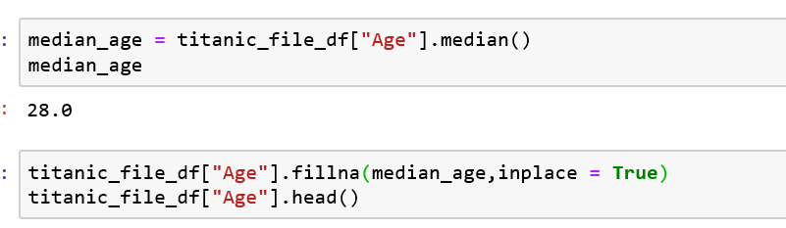
Data Clean UP…. for Machine Learning …
- Calculated Median Age . Filled Blank age column with calculated median age.
Gender Column conversion from Female / Male to 0 / 1.
Dropped columns - "Name", "Ticket", "Cabin", "Embarked", "Survived“ to make all the columns numerical.

Slide 4
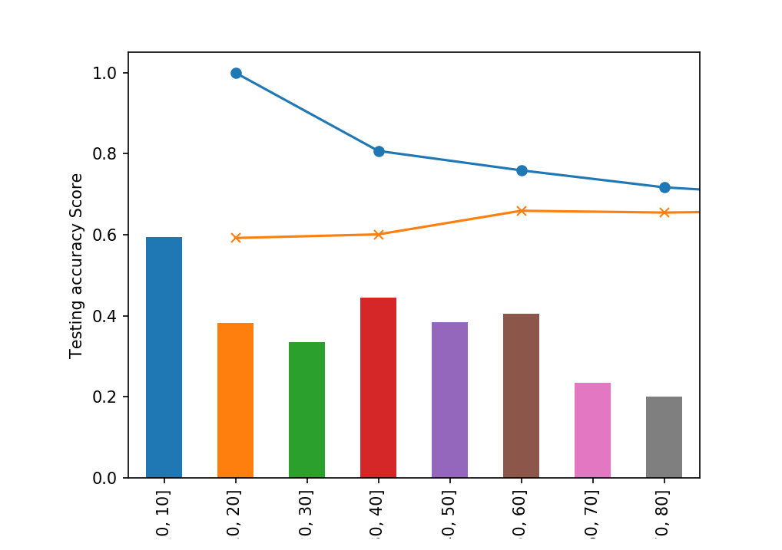
Age Binning - Survived

Slide 5
Tools used…
SVM
KNN -K Nearest Neighbor
Decision Tree
Random Forest
Logistic Regression Model

Slide 6
Splitting Data - ML
target = titanic_file_df["Survived"]
data=titanic_file_df.drop("Survived", axis=1)
from sklearn.model_selection import train_test_split
X_train, X_test, y_train, y_test = train_test_split(data, target, random_state=42)

Slide 7
Decision Tree
Decision Tree predicted 77 % - survival rate.

Slide 8
Random Forest
Accuracy = 82.06 %
Random Forests in sklearn calculated feature importance:
Array [0.2026064 0.0746949 0.25243783 0.17136965 0.04584669 0.03195638 0.22108815]
Sorting features by their importance:
[(0.2524378279263806, 'Name’),
(0.22108815145444752, 'Parch’),
(0.20260639994235496, 'PassengerId’),
(0.17136965406360136, 'Sex’),
(0.07469489995022431, 'Pclass’),
(0.04584668540345136, 'Age’),
(0.03195638125954031, 'SibSp')]

Slide 9
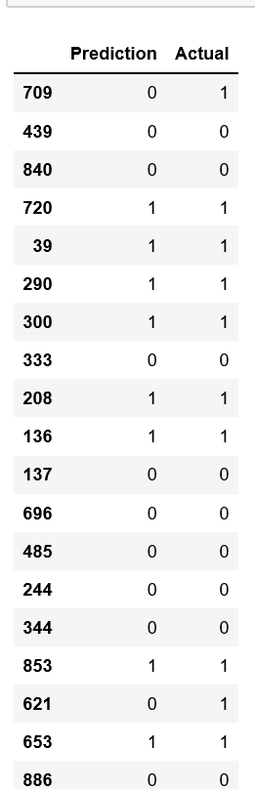
Logistic Regression Model
Training Data Score: 0.8023952095808383
Testing Data Score: 0.7982062780269058
Make predictions

Slide 10
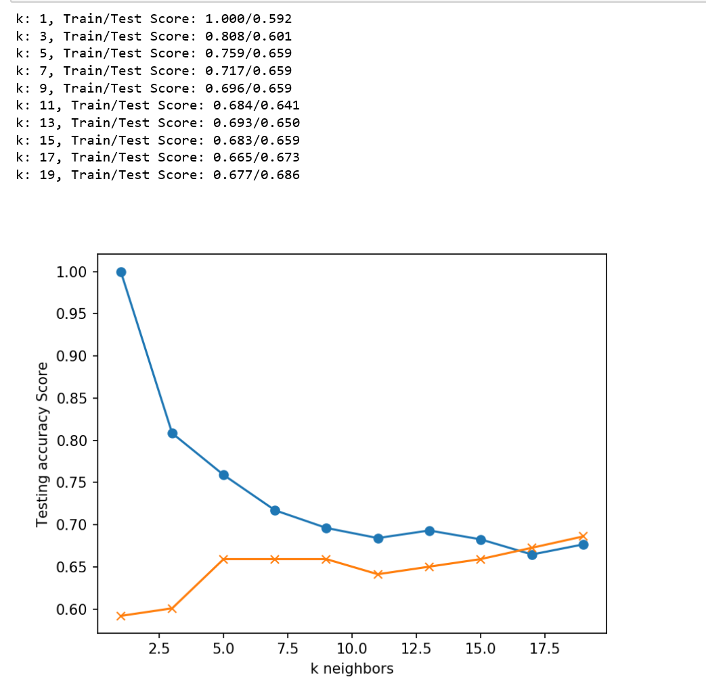
KNN-K Nearest Neighbor
k=13 Test
Accuracy: 65 %

Slide 11
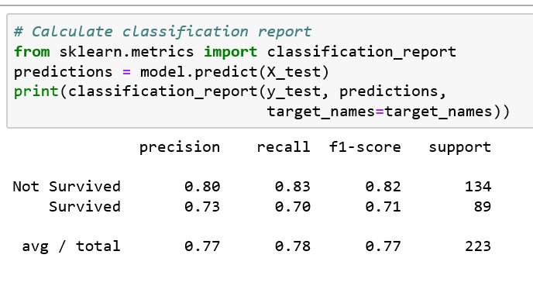
SVM-Support Vector Machine
Model Accuracy
78 %

Slide 12
Decision Making: Which one is better ?
Model | Accuracy
Decision Tree | 77 %
Random Forest | 82%
KNN | 65%
SVM | 78%
Logistic Regression Model | 80%

