Slide 1
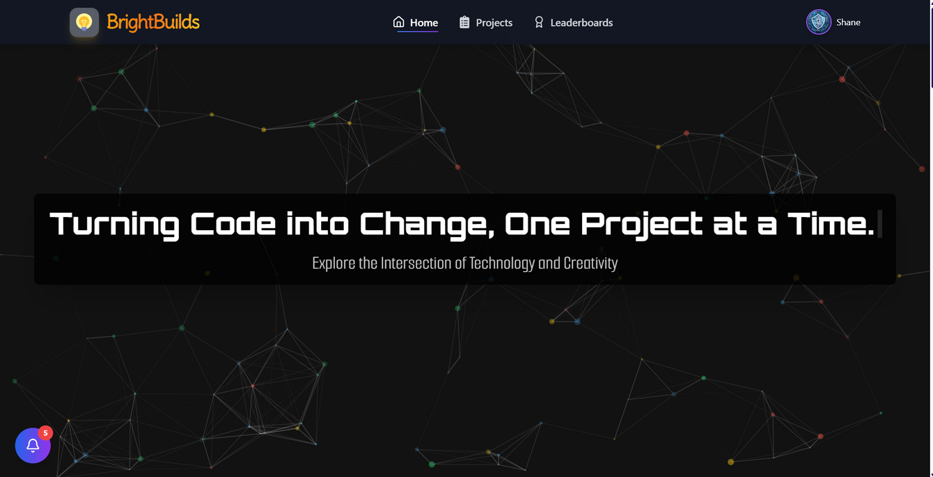
Welcome to brightbuilds
A web platform to showcase student projects from the "Creative Coding using Python" course, with SDG mapping, feedback, leaderboards, and role-based dashboards to promote creativity, collaboration, and sustainability.

Slide 2
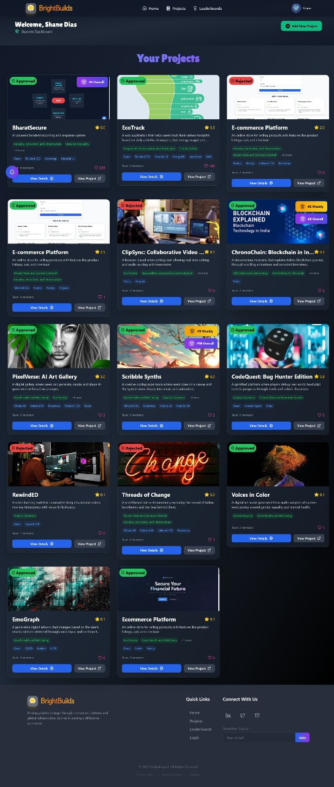
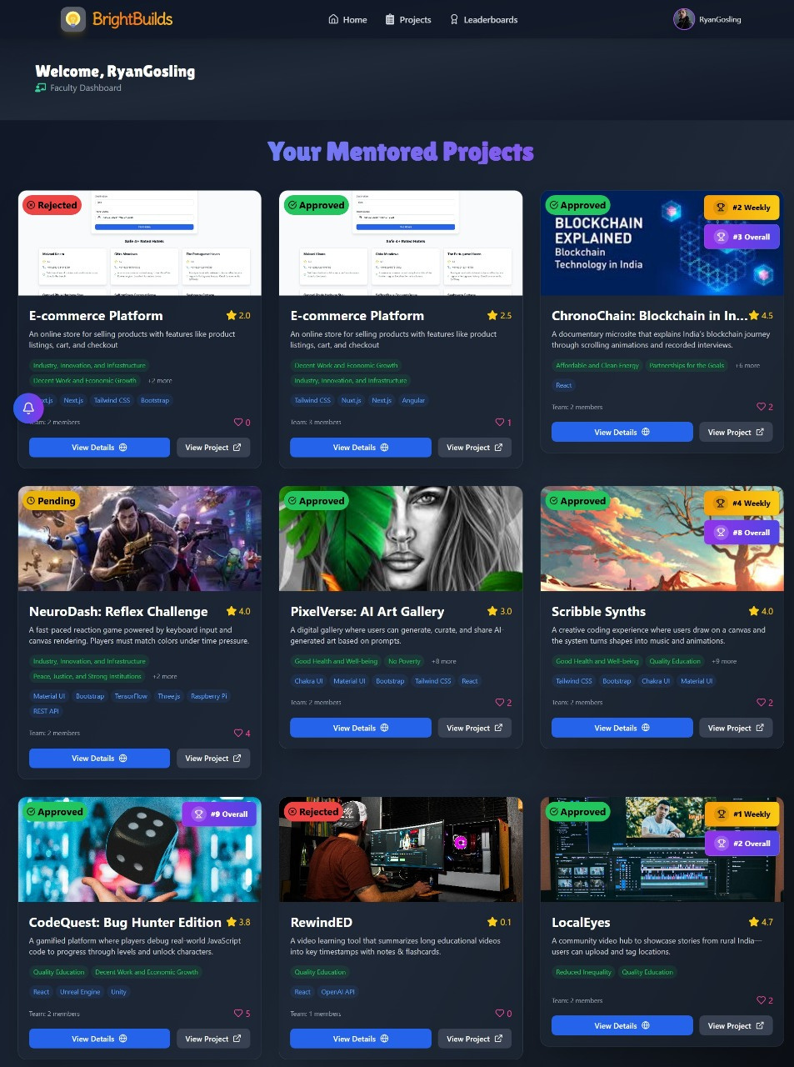
Faculty DashBoard
Here the Faculties Can see the projects that the have mentored and uploaded to the website. It also shows the status of the project, whether the project has been approved or not by the admin.
Student DashBoard
Here Students Can see the projects that the have created and
uploaded to the website. It also shows the status of the project, whether the project has been approved or not by the admin.

Slide 3
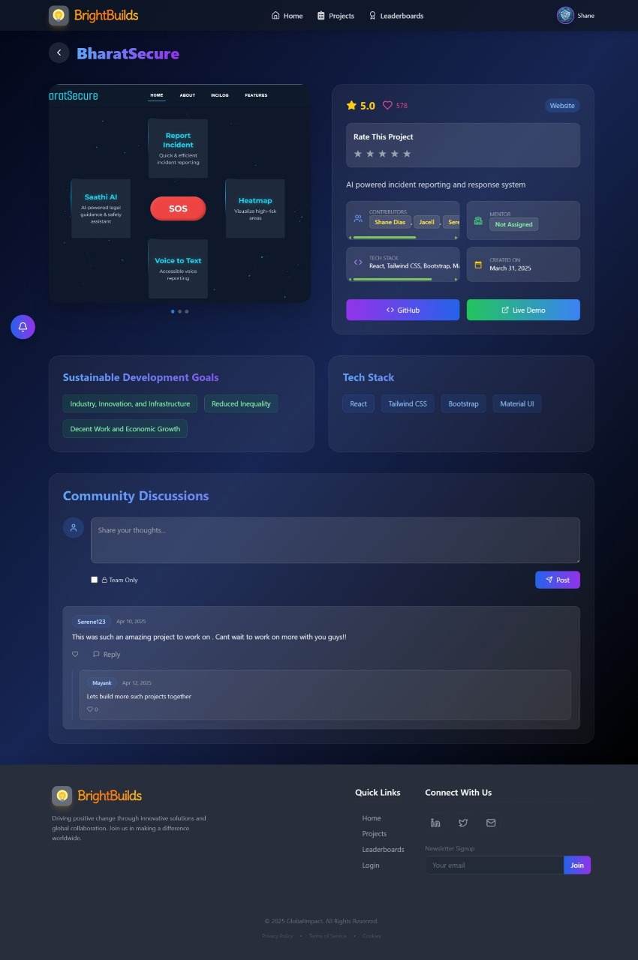
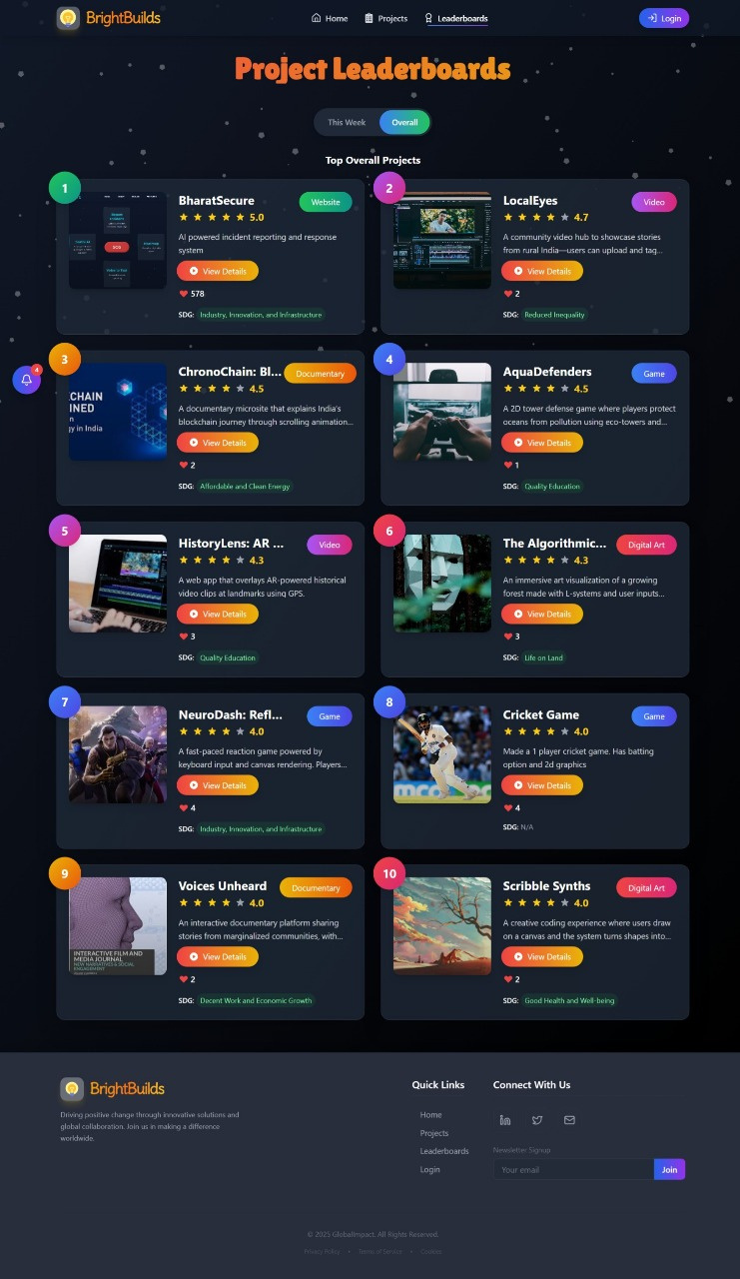
View project
Here Students Can see the projects that the have created and
uploaded to the website. It also shows the Github repo and the live demo of the project. The admin can add privte comments as well.
Leaderboard
This the leader board here the top 10 overall & weekly top 5 projects are displayed with the highest ratings and the hightest no. of likes

Slide 4
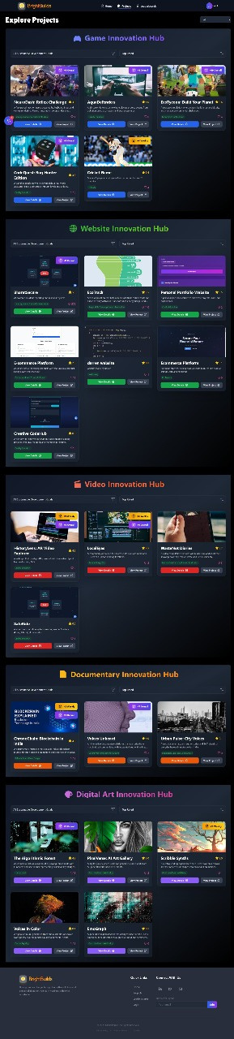
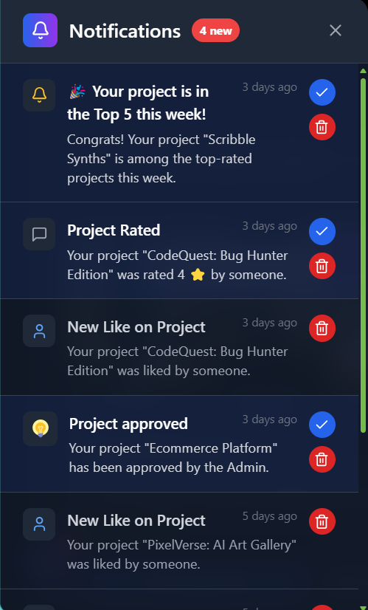
projects sections
Here all the projects are displayed. There are 5 categories.
notifications
Here the students get the notifications when thier project gets approved, rated, commented on and when it gets selecte for the top 10 or weekly rated project.

Slide 5
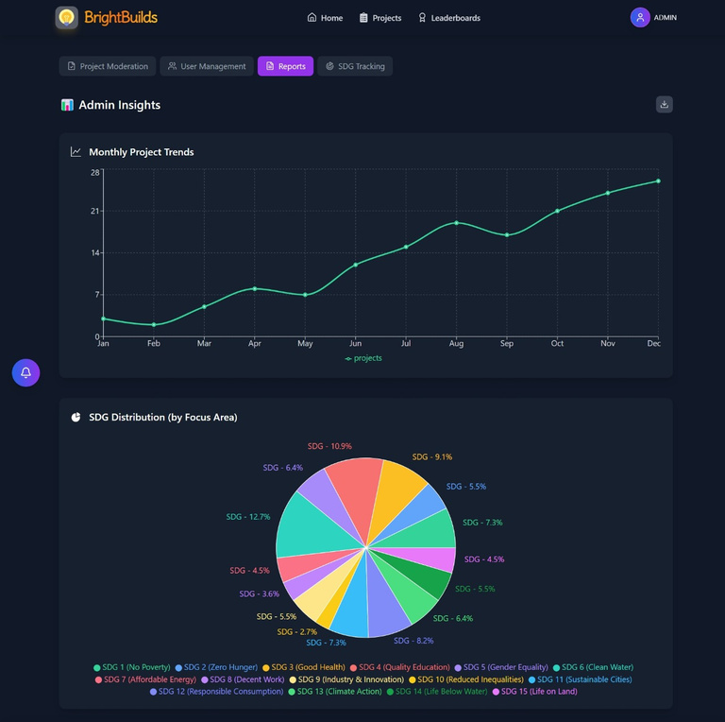
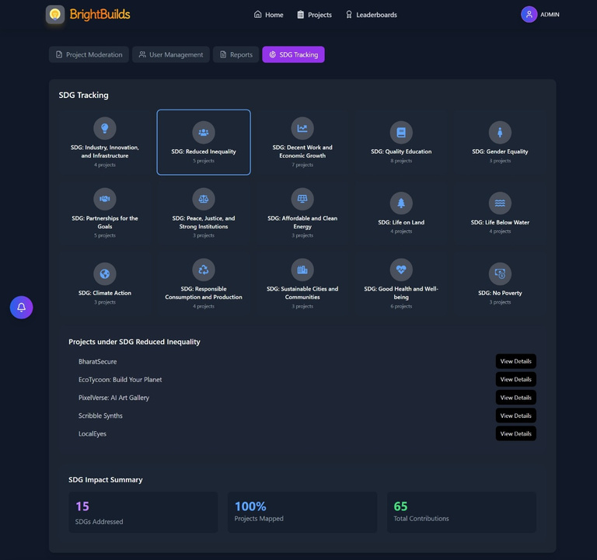
ADmin dashboard (reports section)
Here the admin can download reports of the projects. Can se the overall trends and analytics of the projects based on the sdg goals as well.
ADmin dashboard (SDG MAPPING section)
Here the admin can download reports of the projects. Can se the overall trends and analytics of the projects based on the sdg goals as well.

Slide 6
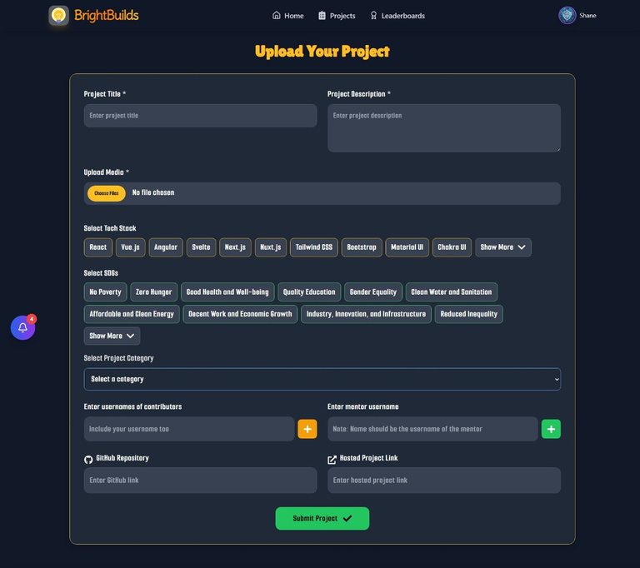
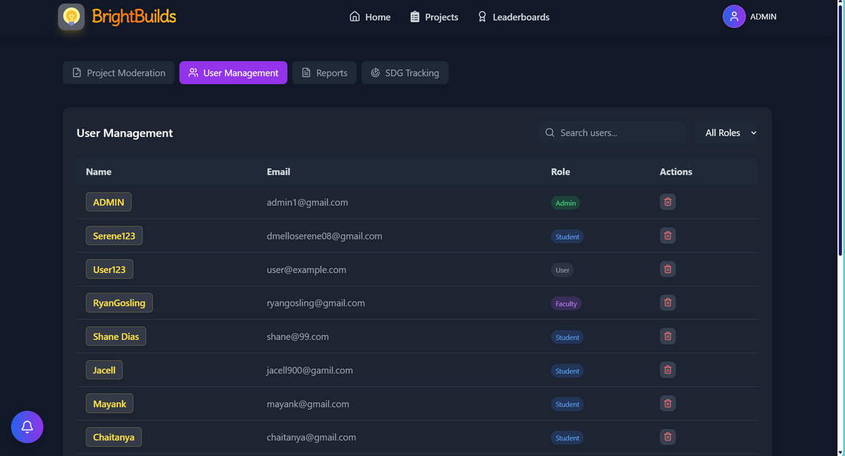
upload project
Here the user uploads the projects by providing the required details of the project.
ADmin dashboard (user management section)
Here the admin can view and delete users

Slide 7
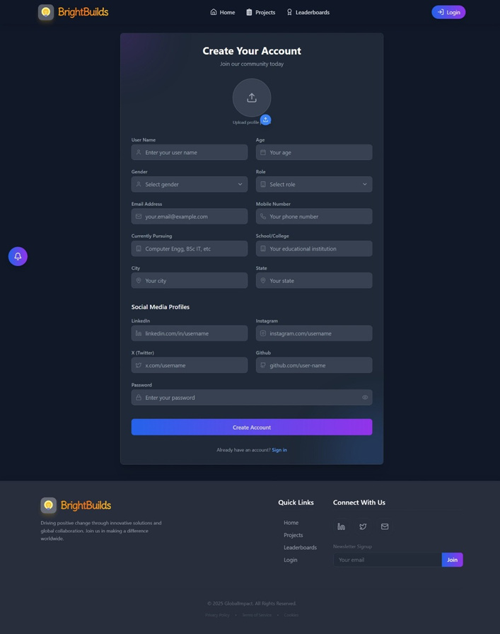
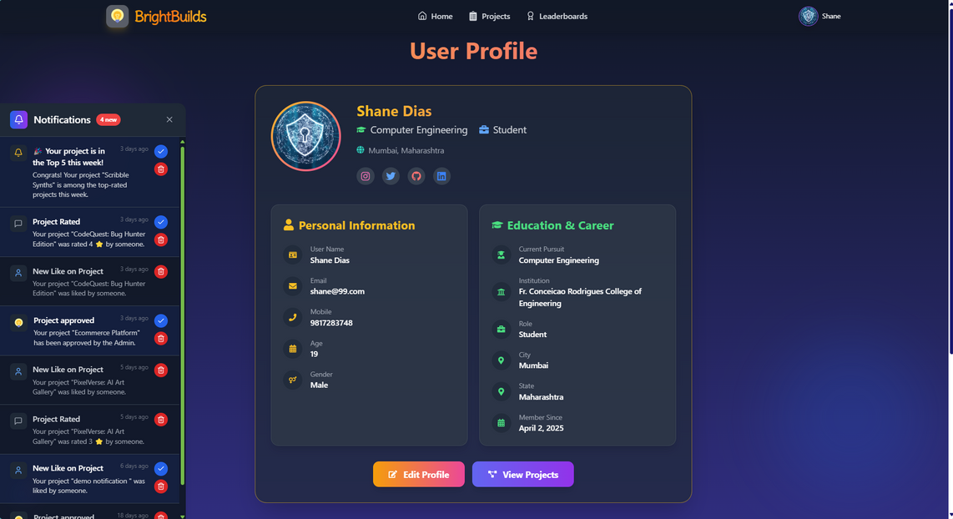
sign up page
Here the user signs up by providing the required creadentials
user profile
Here users can edit/can make changes to thier profile

