Slide 1

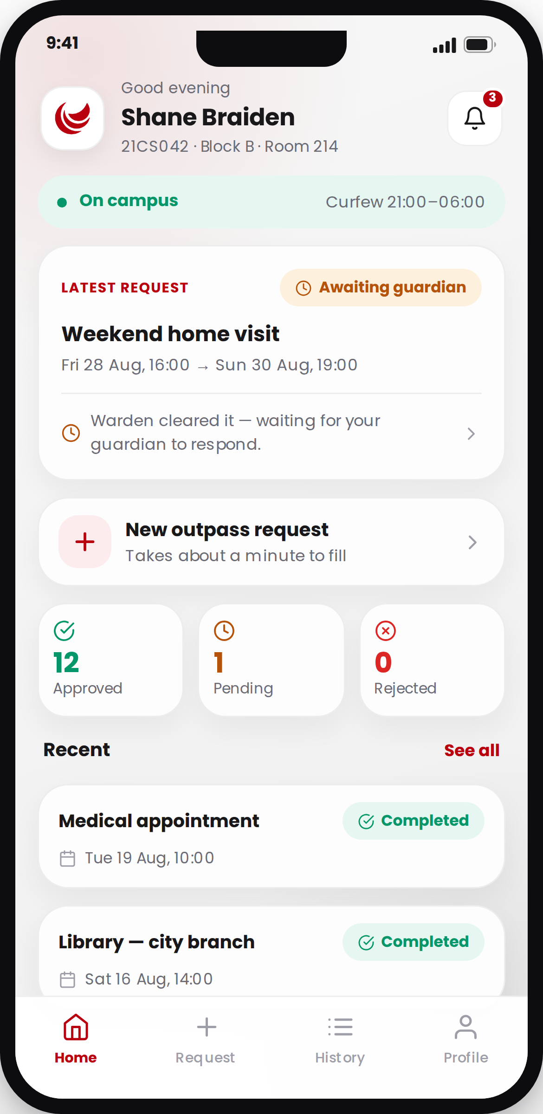

Iverto.ai
Hostel outpass, end to end.
One app for students, guardians and wardens — a pass requested, approved and closed with a record of every step.
Prepared for client review · August 2026
Notes:
Open here. Iverto.ai replaces the paper outpass slip with one app used by three different people: the student who asks, the guardian who approves, and the warden who clears and closes it. Everything you will see today is running software, not a concept.

Slide 2






THE SITUATION TODAY
A paper slip cannot answer the questions that matter
When a student leaves campus, four people need to agree and one office has to prove it happened.
The approval happens over the phone
A warden calls a parent, or takes the student’s word that the call was made. Nothing about it is written down.
The record is a book at the gate
Finding one entry from three weeks ago means reading pages. Producing a term’s figures means counting them by hand.
The parent finds out afterwards
A guardian learns their child left campus when the child tells them — or when something has already gone wrong.
Nobody owns the exception
A late return, an unreachable parent, a pass used twice — each is handled by whoever happens to notice.
Notes:
Four failures, and they are all the same failure: the process leaves no trace. Everything Iverto does follows from fixing that one thing.

Slide 3




THE ANSWER
One app. Three people. One record.
The same pass, seen from wherever you stand — and closed only when the student is back.
The student
The guardian
The warden
Raises the pass in about a minute, sees exactly where it is stuck and who it is waiting on.
Approves or refuses from their phone, and can see whether their child is on campus right now.
Clears the request, activates it at the gate and closes it on return. Every action is signed and timed.
Nobody chooses their role at sign-in.
Accounts are issued by the hostel office. The account’s own role decides which app opens — a student cannot reach a warden’s screen by picking a different option.
Notes:
Three roles, one shared record. And note the point at the bottom — role is a property of the account, set by the office. It is not something a user selects.

Slide 4





HOW A PASS MOVES
Five steps, and the app knows which one you are on
Fifteen tracked states sit behind these five. The student is only ever shown the one sentence that matters.
1
2
3
4
5
Requested
Warden clears it
Guardian decides
Out at the gate
Back and closed
›
›
›
›
The student fills the form. Category rules — how long, what proof — come from your campus, not from us.
Checked against curfew, late returns and the hostel’s own rules.
Approve, refuse, or ask to speak to the warden first. With a note either way.
The pass is activated and the exit scan is recorded against it.
The return is logged. A late return is written to the student’s record.
And when it does not go to plan:
A guardian who does not answer in time escalates to the warden. One who cannot be reached at all is marked as such. An unused pass expires on its own. None of these end as a blank.
Notes:
This is the spine of the product. Five steps the user sees; fifteen states underneath so that the awkward cases — no answer, unreachable, expired, cancelled — each have a name rather than being left ambiguous.

Slide 5
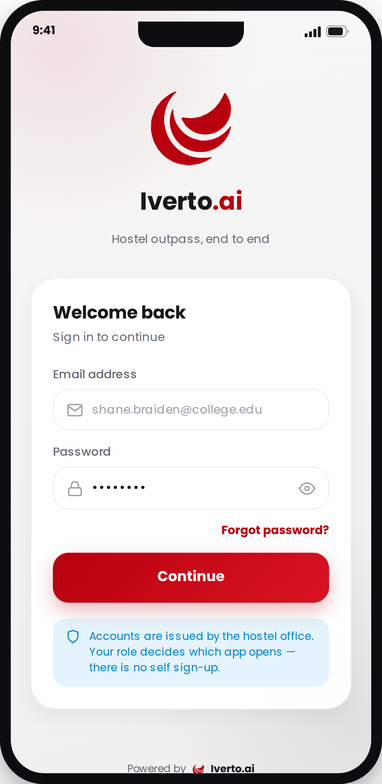


GETTING IN
Nobody signs themselves up
The hostel office provisions every account. That is the whole security model, and it is deliberately dull.
Issued by the office, not requested
A student, a guardian or a warden exists in the app because the campus record says so. There is no public sign-up to abuse.
The first password is temporary
An account still on its office-issued password is taken straight to a new-password screen before it can reach anything else.
A guardian’s number links every child
One phone number on record links all wards registered against it, in a single step. Siblings switch from the header.
You stay signed in
Sessions survive a restart and refresh quietly in the background — no guardian is asked to log in again mid-decision.
Notes:
Worth dwelling on the first point with a client: there is no self-registration, so the app can never contain a person your office did not put there.

Slide 6


FOR THE STUDENT
The first screen answers the only two questions
Am I allowed out right now, and what happened to the pass I asked for?
Tonight’s curfew, and where the gate last saw them
On campus or currently out, with the site’s own curfew window beside it. This is the one place either fact appears.
The live request, in plain language
Not a status code — a sentence. “Warden cleared it, waiting for your guardian to respond.” No student has to ask what a state means.
A term at a glance
Approved, pending and rejected counts come from the server, so they stay right past the first page of history.
A late return is surfaced, not buried
If one is on record, it says so here — with the note that the warden reads it when clearing the next pass.
Notes:
The design rule on this screen: the student should never have to interpret anything. Every status is written as a sentence about what happens next.

Slide 7
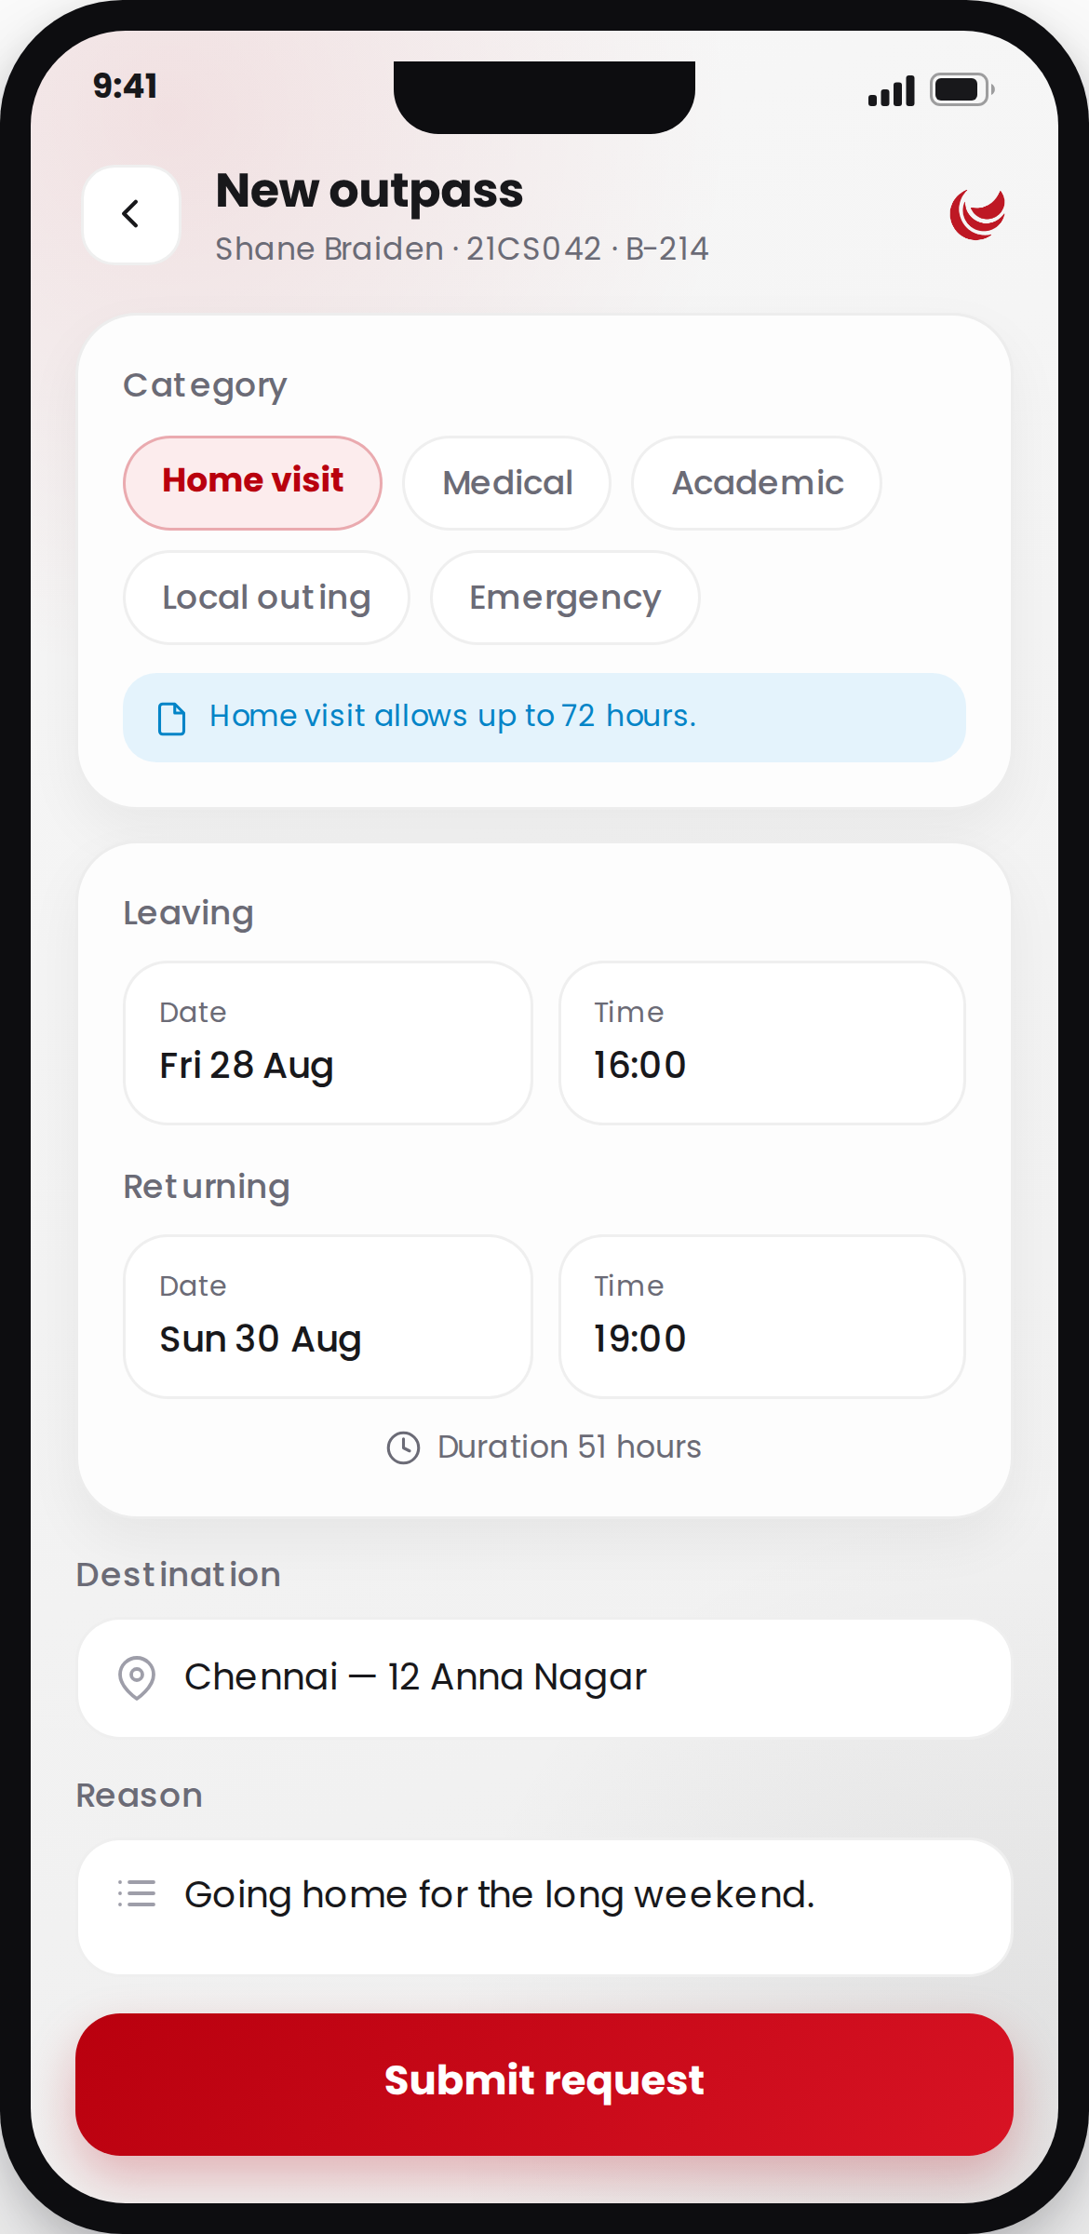




FOR THE STUDENT
A pass takes about a minute to raise
One screen, and the rules your campus set are enforced before the student can submit — not after.
The categories are yours, not ours
Home visit, medical, academic, local outing — each with its own maximum duration and whether proof is required. Your office sets the list.
Rules checked before the button unlocks
A trip longer than the category allows, or a missing document, is caught on the phone. The student never submits into a refusal.
Real dates, an emergency number, an attachment
Out and back times from proper pickers, a destination, a reason, a number they can be reached on, and a document where one is needed.
Cancellable while it is still open
A plan that changes is withdrawn by the student, rather than left in the queue for a warden to clear.
Notes:
The important commercial point here is the first one: categories and their rules are configuration, not code. A campus with different rules does not need a different build.

Slide 8
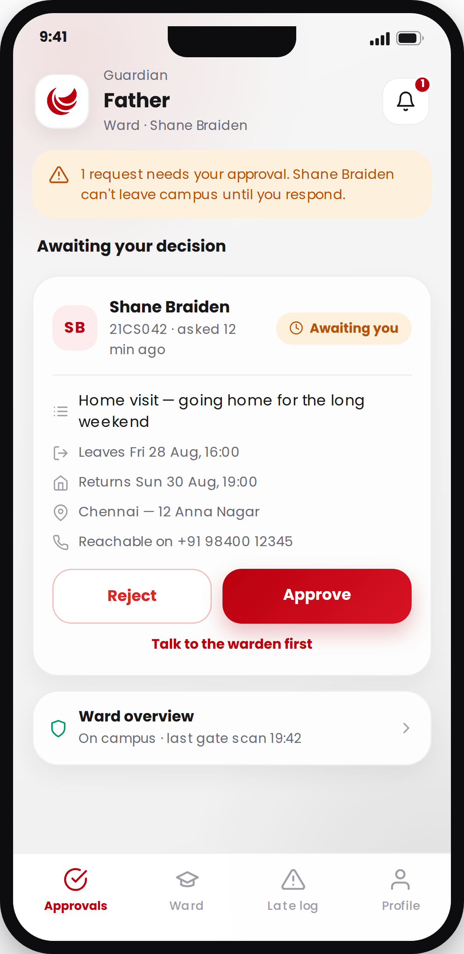


FOR THE GUARDIAN
The parent decides — and it is written down
The phone call becomes a tap, and the tap becomes a record that the student and the warden can both see.
Everything needed to decide, on one card
Who, why, leaving when, back when, going where, and the number they can be reached on. No opening a second screen.
Approve, refuse, or ask to speak to the warden
The third option matters: a parent who is unsure is not forced into a yes or a no. It routes the request to the warden with a note.
A refusal carries a reason
Written by the guardian, seen by the student and the warden. The student is never left guessing why.
Several children on one account
A guardian with more than one ward switches between them from the header; the queue re-filters underneath.
Notes:
Call out the "talk to the warden" button. In the paper process, an unsure parent means an unanswered phone. Here it becomes an explicit, tracked state.

Slide 9
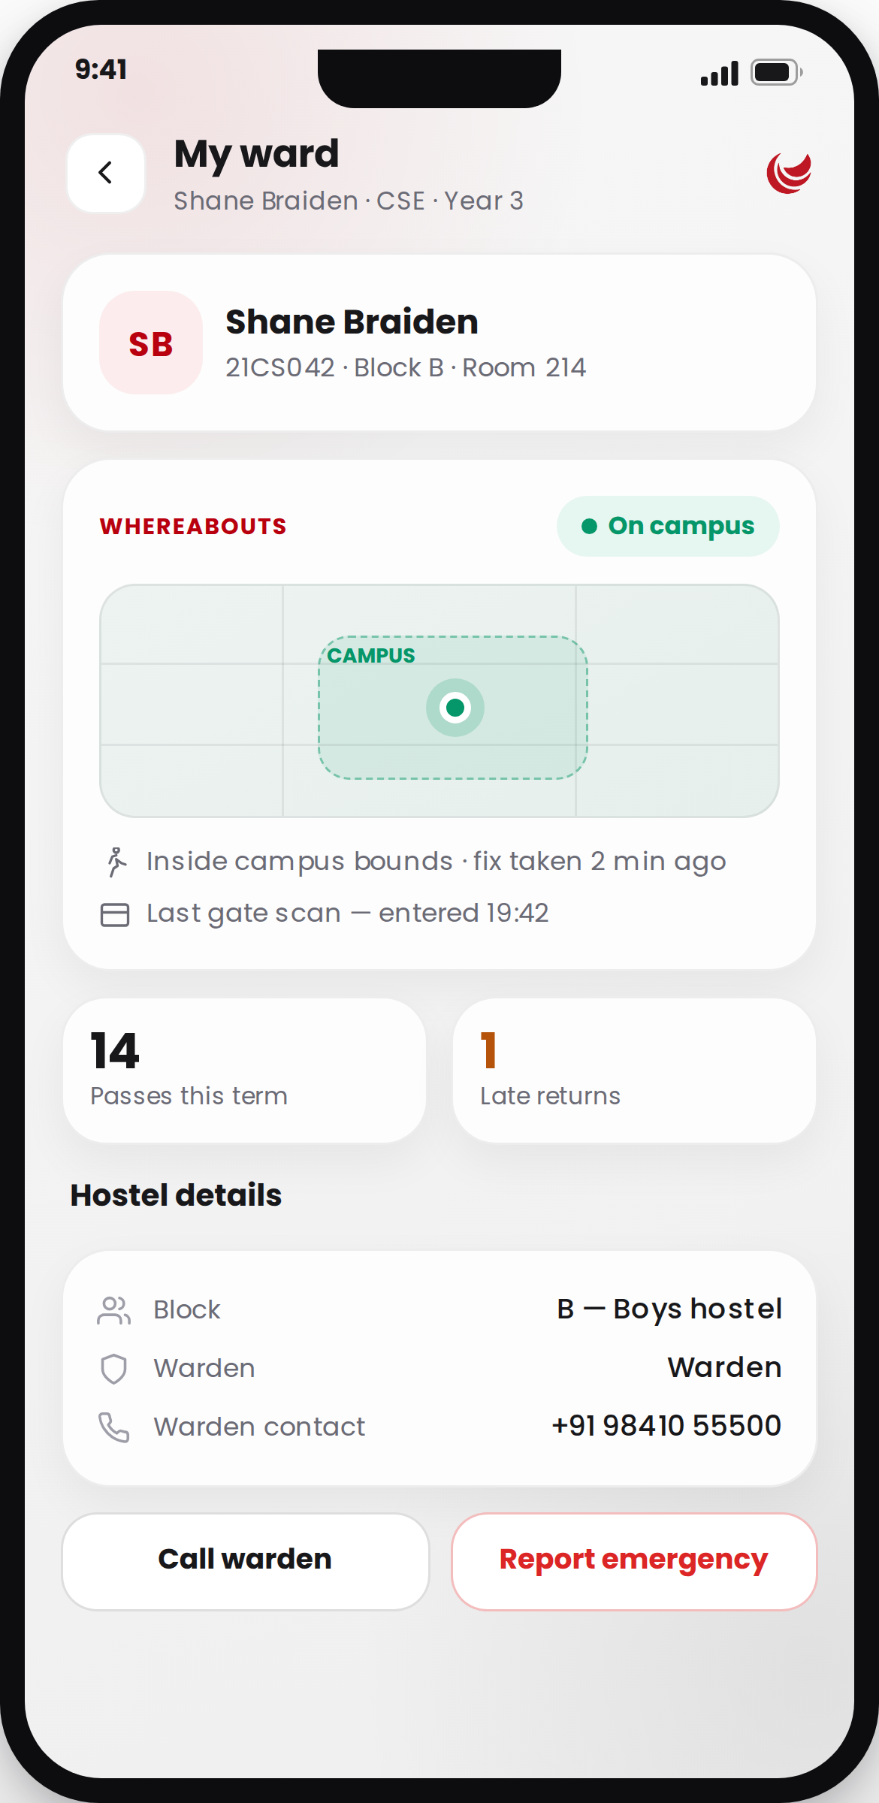


FOR THE GUARDIAN
“Where is my child right now?” — answered honestly
Two sources, gate scans and location, reconciled into one answer that admits when it is old.
The last gate scan, always available
In or out, and at what time. This comes from the hostel’s own gate record and needs nothing from the student’s phone.
Live location only if the student turns it on
Off by default. When on, fixes are taken only while the app is open, at most one a minute, and only after real movement.
A stale fix is labelled stale
The app will say the reading is old rather than show yesterday’s position as if it were current.
The warden’s number, and an emergency button
Medical, family, safety or other — raising one alerts every warden on that site immediately.
Notes:
This slide usually draws the privacy question, so answer it before it is asked: location is opt-in, foreground-only, and there is no background tracking in the app at all.

Slide 10
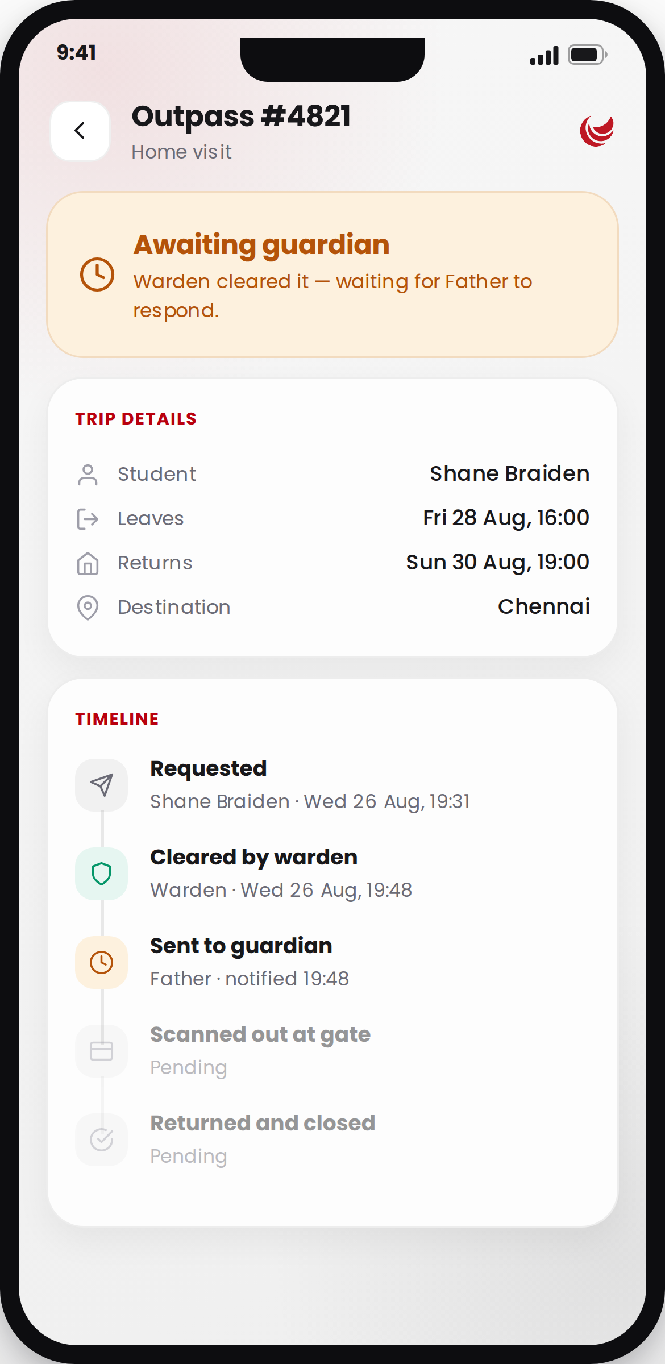


FOR EVERYONE
One pass, one timeline, four points of view
The same record opens for the student, the guardian and the warden — each seeing only the actions they actually hold.
The timeline is the audit trail
Who did what, and when — requested, cleared, sent to the guardian, scanned out, returned. It is built by the server, not the phone.
The action bar changes by role
A guardian sees approve and refuse. A warden sees activate and close. A student sees cancel. Nobody sees a button they cannot use.
Nothing is deleted
A cancelled or overridden pass stays in the record with the reason attached. The register only ever grows.
Exports for the office
Any filtered view of the register exports to a spreadsheet, straight into Drive, email or WhatsApp — up to 5,000 rows.
Notes:
This is the slide that answers the compliance question. If an incident is investigated six months later, the whole sequence is here with names and timestamps.

Slide 11
WHEN IT MATTERS MOST
The exceptions are the reason this exists
Ordinary passes are the easy case. What a campus is actually judged on is the night something goes wrong.
Emergency in two taps
Late returns, logged and seen
Medical, family, safety or other. Every warden on that site is alerted the moment it is raised, and the alert is acknowledged and resolved on the record.
A late entry is written against the student, shown to the guardian, and read by the warden when the next request is cleared.
Guardian unreachable has a name
Overrides are signed
No response in time escalates to the warden. Unreachable is recorded as unreachable, not left as pending.
A warden can act on a guardian’s behalf when there is a phone call to act on — and that override is written to the audit log with who did it.
Notes:
Reframe here: an outpass system is not really about outpasses. It is about being able to say, credibly, what was known and who was told.

Slide 12


KEEPING EVERYONE CURRENT
Nobody has to refresh, and nobody has to be told twice
Decisions travel to the people waiting on them, and the screen in front of you updates as they land.
Push, email and SMS — per person
What triggers a message
Each recipient chooses the channels they want. Turning push off does not lose the message; the in-app inbox still fills.
A request needs your approval
A guardian approved or refused
Live while the app is open
A warden cleared or rejected
A guardian approving on their phone updates the student’s screen as it happens, with no pull-to-refresh.
A student scanned out or in
An emergency was raised
An inbox that backs it up
A campus announcement
Every notification is kept, with an unread badge, and each one opens the exact pass or alert it refers to.
Notes:
The practical value of the live connection is that a parent and a child on the phone together see the same thing at the same moment.

Slide 13
PRACTICALITIES
It has to work on the phones your students actually own
Built as one Android app, small enough to download on hostel wi-fi, and already meeting Google Play’s newest requirements.
24 MB
Android 7+
21
Multi-site
Download size
Devices covered
Screens
Campuses
Smaller than most messaging apps. Installs over a weak connection.
Nine years of phones, including budget handsets.
Students, guardians and wardens, in one app.
Staff covering more than one site filter the whole app to one.
Current with Google Play — Built against Android 16 — the target every app on the Play Store must meet from 31 August 2026. Many campus apps have not made that move.
Fast under load — Lists stay smooth while searching, screens show shaped placeholders rather than spinners, and animation is dropped for anyone whose phone asks for less of it.
Your server, your data — Point the app at your own backend with a single setting. Nothing is hard-wired to us.
Notes:
The Play deadline is a genuine differentiator — a lot of campus apps in the market will stop receiving updates this year because they have not made this move.

Slide 14



PRIVACY BY DEFAULT
What the app deliberately does not do
A campus system that over-collects becomes a liability. These are choices, and we would rather explain them than hide them.
No background location
Location is read only while the student has the app open, at most once a minute, and only after they have actually moved. The app never asks for background tracking permission.
Location is opt-in
Off until the student turns it on from their own profile, and switchable off at any moment. Guardians still get gate scans either way.
Minimum permissions
Storage and overlay permissions were removed outright. Exports go through the phone’s own share sheet, which needs no permission at all.
Profile changes are reviewed
A student or guardian requests a change from a field list your campus controls. Nobody edits their own record directly.
Notes:
Lead with this rather than waiting to be asked. Parents raise it, and a clear answer here does more for adoption than any feature.

Slide 15
WHERE IT STANDS
Live today, and what comes next
Said plainly, because you will find it out in week one either way.
Live and in use today
Next, and why it waits
The full request → approval → gate → return cycle
A scannable QR gate pass
The gate runs on warden activation and scan records today. A code that proves itself needs proper signing and expiry — we will not draw one we cannot verify.
Guardian approvals, refusals and warden escalation
Emergencies, late-return logging and curfew
Push on iPhone
Android push is live. iOS needs its own notification certificate exchanged first; until then iPhones use the in-app inbox and live updates.
Gate scans, whereabouts and the shared timeline
Notifications, live updates and the in-app inbox
Per-hostel launcher icons
Blocks can already carry their own name and mark inside the app. Changing the icon on the home screen needs a separate build step.
Register search, filters and spreadsheet export
Notes:
Being upfront about the QR pass reads as engineering discipline rather than a gap — we would rather have no code than a code that can be screenshotted and reused.

Slide 16
GETTING STARTED
From this meeting to first pass in four steps
Nothing here needs new hardware at the gate or a change to how your office already works.
1
Point it at your campus
We connect the app to your backend and load your sites, hostels, blocks and staff. Categories and curfew windows are set to your rules.
2
Import the register
Students, rooms and guardian phone numbers come across from what your office already keeps. Accounts are created with office-issued passwords.
3
Pilot one block
One hostel, one warden, two weeks. Everyone else carries on as they are, so there is nothing to roll back.
4
Open it up
Hand out the app, brief the wardens for an hour, and retire the register book. Guardians need no training — they get a notification and two buttons.
Notes:
The pilot step is the one to emphasise. It de-risks the decision: one block, two weeks, nothing else changes.

Slide 17

Every pass accounted for.
The student knows where the request stands. The guardian decides from wherever they are. The office can prove what happened.
Pilot one block for two weeks
A working session with your hostel office
Questions, in any order
Thank you.
Notes:
Close on the ask: a two-week pilot in one block. Then open the floor.

