Slide 1

Weather Prediction
Fundamentals of Data Engineering
Team 16
23DEA3101R

Slide 2


Agenda
Abstract
Introduction
Literature Review
Dataset
Methodology
Findings
Tools & Technologies used
Result and Analysis
Conclusion

Slide 3

Abstract
This project focuses on building a scalable data pipeline for weather prediction. It involves collecting, cleaning, and storing weather data in a structured format for easy access and analysis. The pipeline ensures high-quality data is available for applications like machine learning models, dashboards, and public services. By providing reliable and timely weather information, this system supports decision-making in agriculture, disaster management, and urban planning. The project demonstrates the importance of efficient data pipelines, data quality, and scalability in weather forecasting systems.

Slide 4
Introduction
Weather conditions affect daily life, agriculture, transportation, and disaster management. Accurate weather prediction helps in preparing for extreme events and planning resources efficiently. However, weather data is often large, complex, and comes from multiple sources, which makes analysis challenging. Efficient data collection, storage, and processing are essential to handle this data effectively. This project aims to address these challenges by building a robust data pipeline that organizes and prepares weather data for forecasting and analytical applications.

Slide 5

Literature Review
Many studies tried forecasting weather directly.
Problem: They often faced data quality issues (missing, messy, unorganized data).
Most research focused only on prediction models, not on how to prepare and clean the data.
Our work: We focus on building a data pipeline that makes weather data clean, reliable, and ready for prediction.

Slide 6
Dataset
Source: weather.csv (static dataset)
Historical Climate Data – CSV files containing long-term weather trends (temperature, humidity, rainfall).
The dataset includes fields such as:
Temperature, humidity, rainfall, wind speed, pressure.
Location (city).
Timestamp (date, time).

Slide 7
Methodology
Data Ingestion – Collects real-time and batch data from APIs, IoT sensors, satellite feeds, and CSV files. Tools: Kafka, Flume, Python scripts.
Data Storage – Raw data stored in a data lake (Hadoop/S3); cleaned data stored in a data warehouse (Snowflake/BigQuery). Storage formats optimized (Parquet, ORC).
Data Transformation (ETL/ELT) – Cleaning, unit conversions, timestamp formatting, and missing-value handling. Automated workflows via Apache Spark, Airflow.
Data Modeling & Schema Design – Star schema with fact tables (temperature, rainfall, humidity, wind speed) and dimension tables (time, location, season).
Data Quality & Governance – Validation checks, logging, monitoring, and data lineage for consistency and compliance.
Visualization & Access – Dashboards (Power BI, Tableau) and APIs for stakeholders, ML teams, and public services.

Slide 8
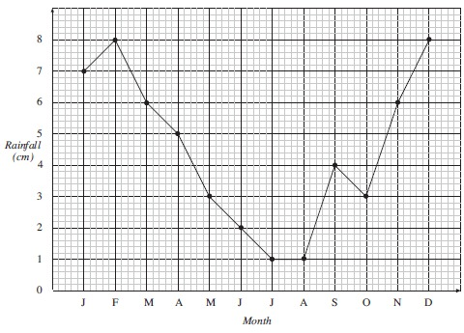

Findings Our dashboards show temperature, rainfall, and humidity trends. We can observe seasonal patterns (like summer heat, monsoon rains). We detected anomalies, such as sudden heavy rainfall or unusual weather changes.

Slide 9
Tools & Technology
Data Ingestion → Python (read CSV, maybe small API if available)
Storage → CSV files / SQLite / MySQL (simple, easy for class project)
Transformation (ETL) → Python (Pandas for cleaning, handling missing values, formatting timestamps)
Modeling → Simple relational tables (Temperature, Rainfall, Humidity linked with Time & Location)
Visualization → Matplotlib / Seaborn (graphs) or Power BI / Tableau (if you want dashboards)

Slide 10
Results & Analysis
The project delivers a scalable and automated weather data pipeline with:
Real-time dashboards showing temperature, humidity, and rainfall trends.
Automated ETL workflows that continuously clean and update datasets.
Optimized querying using fact-dimension schema design.
Insights such as:
Monthly and seasonal weather patterns.
Rainfall distribution across regions.
Detection of anomalies (extreme weather events).

Slide 11

Conclusion
This project demonstrates how data engineering forms the backbone of weather prediction systems by enabling seamless data flow from diverse sources to reliable, analysis-ready datasets. Through a scalable pipeline integrating real-time ingestion, ETL workflows, structured storage, and visualization, the system ensures high data quality, governance, and accessibility.

Slide 12

We are grateful for your time and attention THANK YOU
2320030280.
2320030093.
2320030406.

