Slide 1
CSE185 Introduction to Computer Vision Lab 11: Eigenfaces
Instructor: Prof. Ming-Hsuan Yang
TA: Tiantian Wang & Tsai-Shien Chen

Slide 2
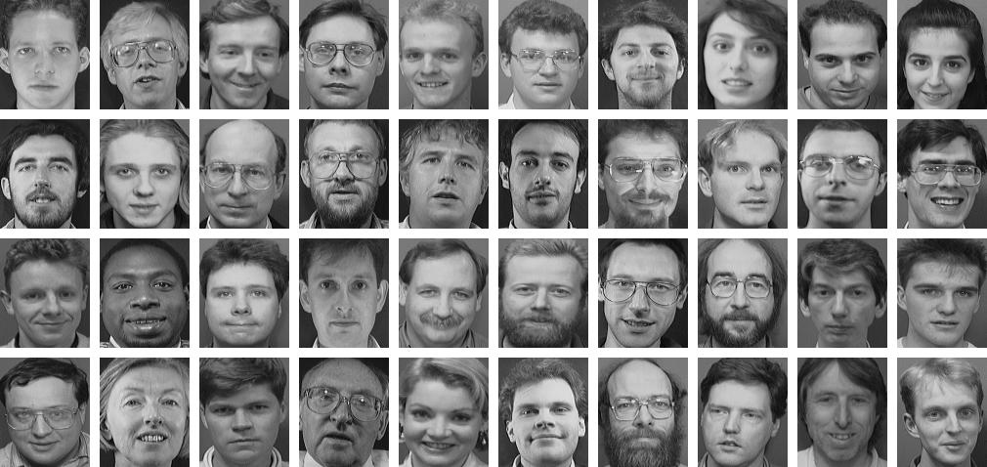
Eigenfaces
Eigenfaces are a set of representative faces from a given dataset
AT&T Face dataset: http://www.cl.cam.ac.uk/research/dtg/attarchive/facedatabase.html

Slide 3
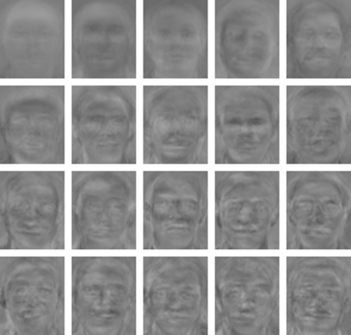
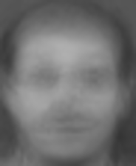
Eigenfaces
Eigenfaces are a set of representative faces from a given dataset
mean face
eigenfaces

Slide 4

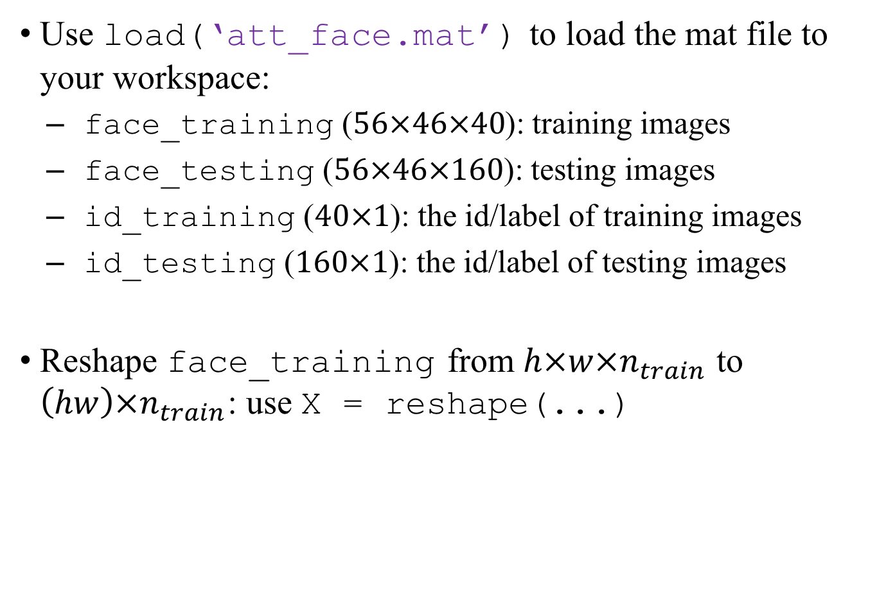



Step 1: Reshape Training Data
Use load(‘att_face.mat’) to load the mat file to your workspace:
face_training ($56×46×40$): training images
face_testing ($56×46×160$): testing images
id_training ($40×1$): the id/label of training images
id_testing ($160×1$): the id/label of testing images
Reshape face_training from $h×w×n_{train}$ to $\left(hw\right)×n_{train}$: use X = reshape(...)
each column is a feature vector
$$hw$$
$$X$$
h
$$n_{train}$$
w
$$n_{train}$$

Slide 5





Step 2: Mean Face
Compute a mean face from X
$\overline{x}$ is a $hw×1$ vector
Plot mean face by reshaping it back to $h×w$
$$hw$$
$$X$$
$$hw$$
$$\overline{x}$$
$$n_{train}$$
$$1$$
mean face

Slide 6











Step 3 : Covariance Matrix
Covariance matrix:
$$C=\sum_{i}{\left(x_{i}−\overline{x}\right){\left(x_{i}−\overline{x}\right)}^{T}}$$
3 methods to subtract $\overline{x}$ from each column of X
use for loop
Y = X – repmat(x_bar, 1, n_train);
Y = bsxfun(@minus, X, x_bar);
$x_{i}$ is a column of X
$$hw$$
$$X$$
$$−$$
$$hw$$
$$\overline{x}$$
$$⋯$$
$$\overline{x}$$
$$n_{train}$$
$$n_{train}$$

Slide 7











Step 3 : Covariance Matrix
Covariance matrix, let $y_{i}=x_{i}−\overline{x}$:
$C_{i}=y_{i}y_{i}^{T}$, $C=\sum_{i}{C_{i}}$
Use for loop to compute and accumulate $C_{i}$:
$$Y$$
$$×$$
$$Y^{T}$$
$$=$$
$$C_{1}$$
$$hw$$
$$n_{train}$$
$$hw$$
$$n_{train}$$
$$hw$$
$$hw$$

Slide 8



Step 3 : Covariance Matrix
Covariance matrix, let $y_{i}=x_{i}−\overline{x}$:
$C_{i}=y_{i}y_{i}^{T}$, $C=\sum_{i}{C_{i}}$
Use for loop to compute and accumulate $C_{i}$:
$$Y$$
$$×$$
$$Y^{T}$$
$$=$$
$$C_{2}$$
$$hw$$
$$n_{train}$$
$$hw$$
$$n_{train}$$
$$hw$$
$$hw$$

Slide 9

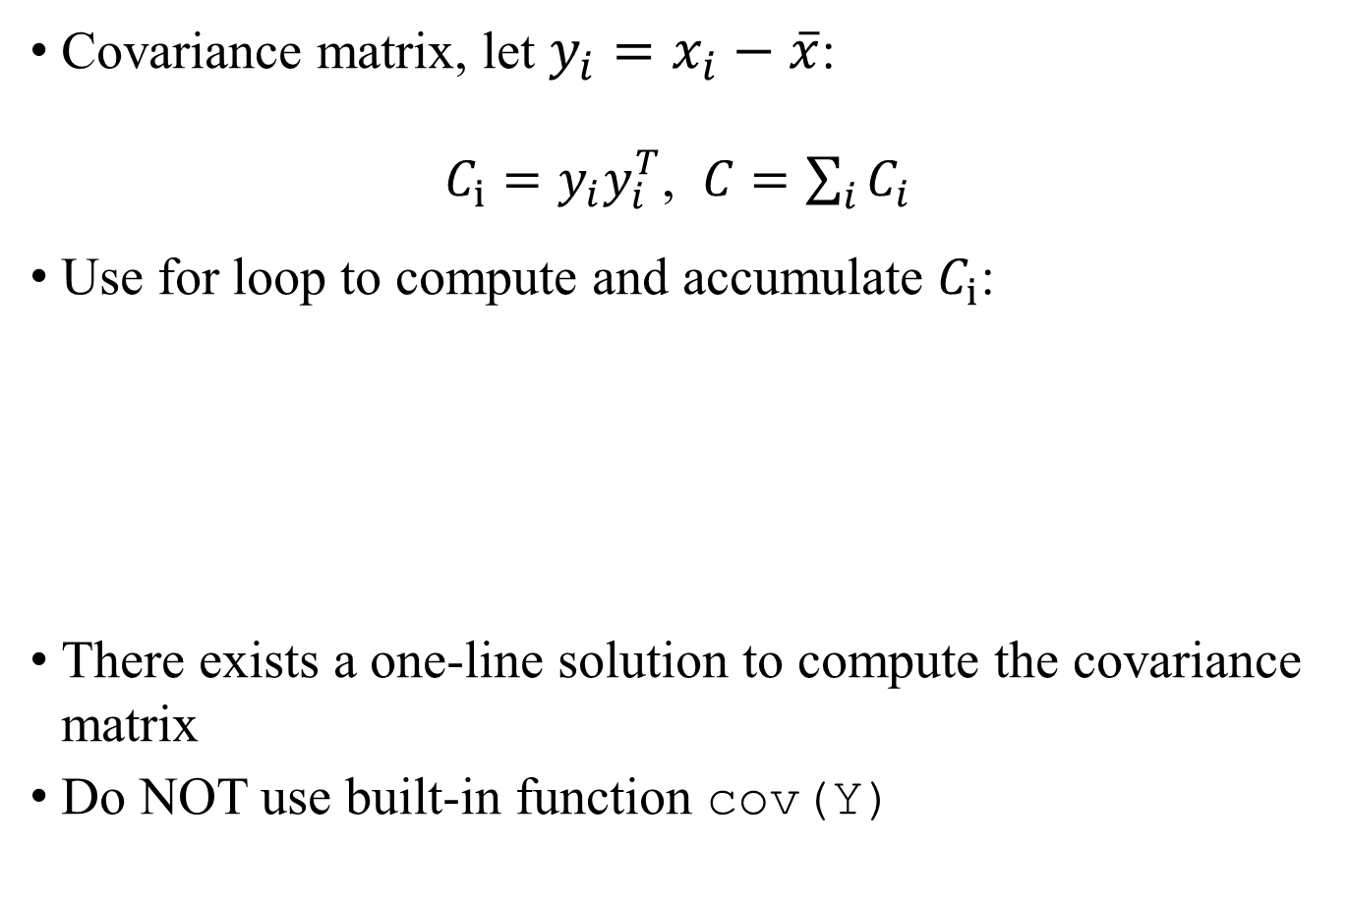

Step 3 : Covariance Matrix
Covariance matrix, let $y_{i}=x_{i}−\overline{x}$:
$C_{i}=y_{i}y_{i}^{T}$, $C=\sum_{i}{C_{i}}$
Use for loop to compute and accumulate $C_{i}$:
There exists a one-line solution to compute the covariance matrix
Do NOT use built-in function cov(Y)
$$Y$$
$$×$$
$$Y^{T}$$
$$=$$
$$C_{3}$$
$$hw$$
$$n_{train}$$
$$hw$$
$$n_{train}$$
$$hw$$
$$hw$$

Slide 10


Step 4: Singular Value Decomposition
Apply SVD to the covariance matrix:
[U, S, D] = svd(C);
columns in U are the eigen-vectors/eigenfaces
Select the first k columns of U as our eigenfaces
$$U$$
$$k$$

Slide 11

Visualize Eigenfaces
Reshape the column of U to $h×w$, and add 0.5 or $\overline{x}$ before imshow
eigenfaces

Slide 12


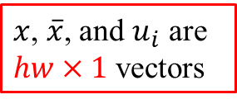
Represent Face in the Face Space
Represent each face image as coefficients of the eigenfaces
$${coef}_{i}=\left(x−\overline{x}\right)⋅u_{i}$$
Encode each face image as the coefficients
inner product
x = face_training(:, :, 1);
x = x(:);
% subtract mean
x = ?
% inner product with U
coef = ?
$x$, $\overline{x}$, and $u_{i}$ are $hw×1$ vectors
coef is a $k×1$ vector

Slide 13



Reconstruct Image from the Face Space
Given a coefficient vector $coef$ and mean face $\overline{x}$, we can reconstruct a face image by:
$$x_{rec}=\overline{x}+{coef}_{1}u_{1}+{coef}_{2}u_{2}+⋯+{coef}_{k}u_{k}$$
input image
reconstruct image
k = 10

Slide 14

Reconstruct Image from the Face Space
Given a coefficient vector $coef$ and mean face $\overline{x}$, we can reconstruct a face image by:
$$x_{rec}=\overline{x}+{coef}_{1}u_{1}+{coef}_{2}u_{2}+⋯+{coef}_{k}u_{k}$$
input image
reconstruct image
k = 20

Slide 15

Reconstruct Image from the Face Space
Given a coefficient vector $coef$ and mean face $\overline{x}$, we can reconstruct a face image by:
$$x_{rec}=\overline{x}+{coef}_{1}u_{1}+{coef}_{2}u_{2}+⋯+{coef}_{k}u_{k}$$
input image
reconstruct image
k = 30

Slide 16

Reconstruct Image from the Face Space
Given a coefficient vector $coef$ and mean face $\overline{x}$, we can reconstruct a face image by:
$$x_{rec}=\overline{x}+{coef}_{1}u_{1}+{coef}_{2}u_{2}+⋯+{coef}_{k}u_{k}$$
input image
reconstruct image
k = 40

Slide 17
Reconstruct Image from the Face Space
Given a coefficient vector $coef$ and mean face $\overline{x}$, we can reconstruct a face image by:
$$x_{rec}=\overline{x}+{coef}_{1}u_{1}+{coef}_{2}u_{2}+⋯+{coef}_{k}u_{k}$$
input image
reconstruct image
k = 50

Slide 18
Face Recognition with Eigenfaces
In Lab 06, we use Sobel features as feature vectors
In this lab, we will use the coefficients of eigenfaces as feature vectors
coef_train = zeros(k, n_train);
% TODO: compute coef_train
id_predict = zeros(size(id_testing));
for i = 1:n_test
img_test = face_testing(:, :, i);
coef_test = ? % TODO: replace this line
error = zeros(n_train, 1);
for j = 1:n_train
diff = coef_train(:, j) - coef_test;
error(j) = sum( diff .^2 );
end

Slide 19
Face Recognition with Eigenfaces
Fill in the table with different k
%---------------------------------------%
%---------- Fill in this table ---------%
%---------------------------------------%
% k | Accuracy
%---------------------------------------%
% 10 |
%---------------------------------------%
% 20 |
%---------------------------------------%
% 30 |
%---------------------------------------%
% 40 |
%---------------------------------------%
% 50 |
%---------------------------------------%

Slide 20
Lab Assignment 11
Complete lab11.m
Fill in the table at the bottom of lab11.m
Upload lab11.m and 5 reconstructed images separately by using k = 10, 20, 30, 40, 50
You have 2 weeks to finish this lab

