Slide 1
How To Keep Your Apache® Project's Independence
Shane Curcuru
VP, Brand Management
The Apache Software Foundation

Slide 2
Introduction
Shane Curcuru - VP, Brand Management, The Apache Software Foundation
Volunteer, appointed by Apache Board of Directors
Define and implement trademark & brand policy for all 200+ Apache project communities
Provide trademark support for projects
Involved at Apache since 1999
Not a lawyer
Questions? <trademarks@apache.org>

Slide 3
Topics
Apache Project Independence
Trademark concepts brief overview
  Adjectives, nominative use, consumer confusion, and registration
PMC Branding Responsibilities
  Policing Third Party Brand Use
  Granting Third Party Permissions
When To Work With trademarks@
Resources / Q&A

Slide 4
Apache Project Independence

Slide 5
PMCs: Be independent
Apache projects are governed independently
  Treat all participants / contributors fairly
Apache software products are also independent
  Clearly branded, eg, Apache Foo
  Independence = Apache Foo software performs useful functions, without additional (proprietary) software
http://community.apache.org/projectIndependence
This is required of all Apache projects

Slide 6
PMCs: Be inclusive
An inclusive community relies on independence from commercial influence (a requirement for Apache projects)
Committer & PMC member diversity is the best way to maintain long-term independent project governance
Actively seek out new contributions with “low hanging” bugs; review patches quickly and thoughtfully
Encourage positive contributions; mentor new contributors to become committers and PMC members
Promote real-world stories of how project software helps end users

Slide 7
Trademark Concepts in 30 Seconds

Slide 8
What are trademarks?
A trademark is the legal instantiation of your brand
Your trademark is the specific name or logo a consumer (user of your software) associates with a downloadable software program
Trademarks are about preventing consumer confusion as to the source of goods within a specific field of commerce
Trademarks protect consumers by ensuring expectations of quality, functionality, etc. available from a specific vendor
Trademark vs Brand:
A brand includes many elements – names, logos, look and feel – parts of which are specific trademarks that signify your product or service

Slide 9
Trademarks are adjectives
Trademarks legally are used to describe the actual goods: I buy Kleenex® brand tissues
We run Apache CouchDB™ software and Apache Hadoop® software
  … but in common usage we just write: we're running Python
Use as an adjective and marking with TM and (R) is important on your homepage & download page
  … not as important in other places
Your project name is not necessarily a trademark, although it may be a service mark

Slide 10
Registered trademarks
In most countries, common law rights accrue from actual use of a name™ or logo™ to identify goods – without any registration
Trademarks may also be registered® with the USPTO, the EU/Community Trade Mark, and other individual country governments – improves our rights
Every country has different registration laws
    Some are “first to file” like China, Korea; most are “first to use”
Apache PMCs may request registration – now recommended
    Email tm-registrations@apache.org to request registration

Slide 11
Nominative use is OK
Nominative use for trademarks ~= fair use for copyright
Other people may use the trademark to describe your goods
Personal blogs, newspaper articles, technical mailing list discussions are almost always nominative use
Nominative use even allows people/companies to post bad reviews of your software product
Not OK:
Infringement is when a third party uses your marks in a way that may mislead consumers as to the true source of goods, or confuse users as to which company provides a software product

Slide 12
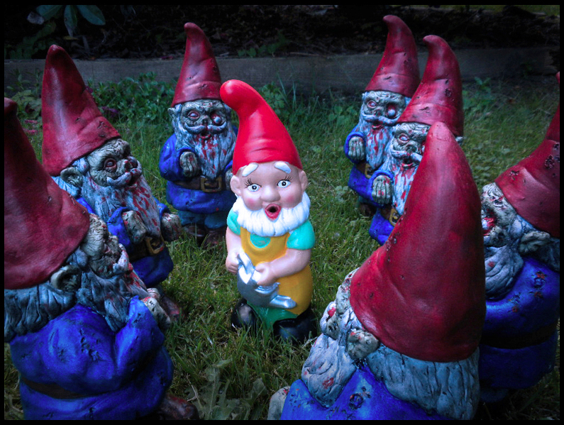
Nominative use is OK
GNOME ALERT!
Nominative use for trademarks ~= fair use for copyright
Other people may use the trademark to describe your goods
Personal blogs, newspaper articles, technical mailing list discussions are almost always nominative use
Nominative use even allows people/companies to post bad reviews of your software product
Not OK:
Infringement is when a third party uses your marks in a way that may mislead consumers as to the true source of goods, or confuse users as to which company provides a software product

Slide 13
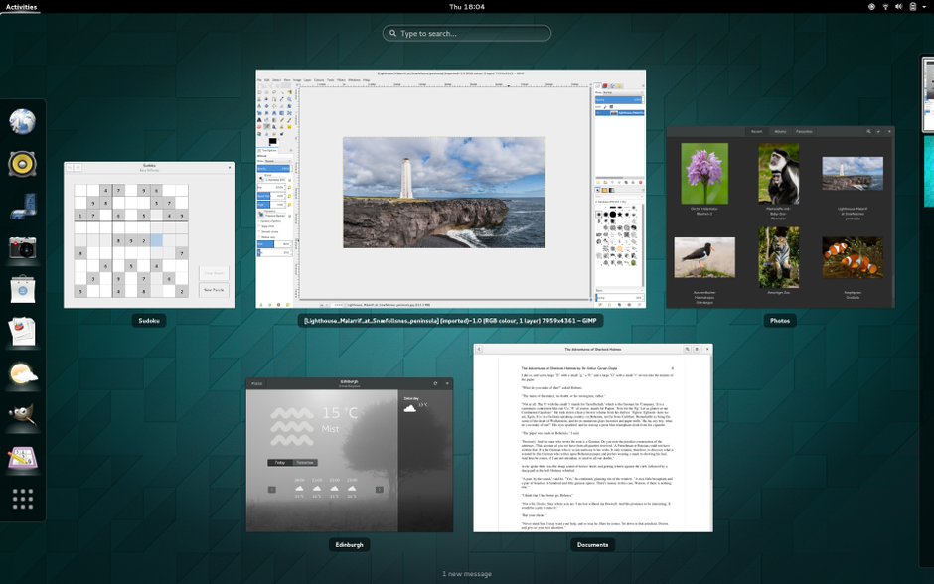

Brands really matter
Notes:
Which GNOME is which?
See the recent Groupon Versus Gnome trademark controversy, luckily now solved:
https://www.gnome.org/groupon/
GNOME is a registered trademark of the GNOME Foundation. Groupon is a registered trademark of Groupon, Inc.

Slide 14
PMCs: Branding Responsibilities

Slide 15
PMCs: Be responsible
PMCs are responsible for their own brand:
Have a consistent brand and use it
Be aware of how your brand is used in the marketplace
Be respectful of other brands and the Apache brand
http://www.apache.org/foundation/marks/responsibility

Slide 16
PMCs: Be consistent
Your use of your Apache Foo™ brand is the reference implementation
Annotate your own trademarks (both words and logos) with ™ or ® to make their status clear to others
Ensure consistency in your website
    In your documentation, first and most prominent uses
    On your download page: download Apache Foo™ software
    In publicly visible parts of your product UI
Trademark law is not a compiler: the general consumer perception is what counts, and that is what you can actively manage

Slide 17
PMCs: Be aware
Be aware of how other companies use your project brand
Situations that require your action to protect your brand/trademark:
    Inappropriate third party use of your brand may cause confusion as to the source of software products
    It is important for the PMC to review and respond here
    Fairness to all users is critical – both with outsiders and with companies who are contributing to your project
    http://www.apache.org/foundation/marks/reporting
Unlikely to be a problem: personal blogs, press articles, software reviews, benchmark reports, forum discussions, emails on dev@...

Slide 18
PMCs: Be respectful
Treat other organizations’ trademarks respectfully
Charitable or community-based projects have no business infringing on others’ trademarks
Be liberal in attribution and giving credit to other communities or companies
Respond calmly and professionally if a third party asks for/demands changes; always cc: trademarks@

Slide 19
PMCs: Register your mark
Recommended policy is to register your software product name
The ASF will register most Apache product names for software goods in the US, if requested by the PMC
If your project is very popular, you can can request additional registrations in other jurisdictions like the EU/CTM
http://www.apache.org/foundation/marks/register

Slide 20
PMCs: Policing Use Of Your Project Brand

Slide 21
Police brand use privately
When a third party is improperly using your project's brand, the PMC needs to take action and ask for corrections!
Assume ignorance rather than malice
Use reporting guidelines to determine if the use is (or is not!) a problem
    http://www.apache.org/foundation/marks/reporting
Always contact third parties privately (but be sure to cc: trademarks@)
    Private, direct contact allows all parties to save face
    Public confrontations often escalate, potentially damaging everyone's reputation

Slide 22
Be professional and polite
Whenever contacting anyone about improper brand use:
  Be professional – you are talking to managers/marketers
  Be polite – many cases are resolved through simple discussion
  Be firm – state the ASF's clear ownership of the marks
  Be specific – quote specific uses that we request to be changed
Most potential infringements cases are resolved through discussion between private@, trademarks@, and the other party
  Be patient – discussions take time to resolve
Legal threats are never the first step

Slide 23
Get legal advice
The ASF has pro bono corporate counsel from DLAPiper
Send any legal questions, especially any from outside the ASF, to:
  trademarks@ for anything brand-related (private archive)
  legal-internal@ for any specific legal question the PMC has on behalf of the project (private archive)
  legal-discuss@ for any general legal questions that can be discussed publicly (public archive)
Never grant exception to brand policy without trademarks@ approval
Never give legal advice (unless you actually are an ASF counsel)
Never respond to an outside lawyer without asking ASF counsel

Slide 24
PMCs: Granting Third Party Permissions
New Policy!

Slide 25
Granting third party permissions
PMCs may directly grant certain third party permissions for specific uses (events, domains, swag / merchandise) of their project marks
Best practices / improved how-to guides being rolled out
  Respond promptly: acknowledge the question even if the answer is not ready yet
  Respond professionally: many requesters are marketers or lawyers, not coders
  Respond privately: keep on private@ unless OP used dev@

Slide 26
Responding to third party requests
Only grant specific permissions as noted in policy
  Events; domain names; services; merchandise
Do not grant exceptions dealing with software product names
  But: you can allow “Powered By” names/icons (For..., Plugin...)
Be consistent and fair when granting permissions
Does a use of your project's brand by a third party / other company:
  Maintain clarity about the source of Apache software?
  Help the image, impact, or reach of your project community?
Ask trademarks@ for help anytime you have a question!

Slide 27
When To Work With Trademarks@

Slide 28
Trademarks@ sets policy
The ASF owns all Apache trademarks on behalf of the projects
PMCs are required to comply with trademark policy; PMCs otherwise define and promote their own brand
Project brand design, like technical direction, is completely up to PMCs
trademarks@, like press@, operations@, infra@, etc. are here to serve the needs of all Apache projects

Slide 29
Dealing with difficult parties
Any time a third party responds negatively, or when another company lawyer is involved – ask trademarks@ to help craft your reply
Any difficult negotiations should be done by VP, Brand Management, with appropriate legal counsel
Most corporations respond to official titles
Patience is required: trademark issues are rarely time critical
Legal threats are never the second step

Slide 30
Trademark enforcement & legal action
A Cease & Desist (C&D) is considered a last resort, when all other approaches have failed
  Trademark litigation is expensive and risky
  Consider the public image of “attacking” a third party
Most issues can be resolved with polite, firm, and private discussion with the right parties
A very few serious issues end up being resolved with more visible actions: making a public case; restricting PMC or commit access; or the board unilaterally restructuring a project

Slide 31
Thank You & Resources

Slide 32
Thank You!
Thanks to all Apache Members
Thanks to all Apache committers and PMCs
Thanks to members of Apache Trademarks Committe
Thanks to DLAPiper counsel: Mark Radcliffe, Dash McLean, Nikkya Williams, Carol Anne Bashir
Thank you to companies who respect Apache brands

Slide 33
Trademark Resources - External
Formal policy for third party use
  http://www.apache.org/foundation/marks/
Third party requesting permission for events
  http://www.apache.org/foundation/marks/events
Third party requesting permission for domains
  http://www.apache.org/foundation/marks/domains
All other questions
  http://www.apache.org/foundation/marks/contact

Slide 34
Trademark Resources – For PMCs
Policy for PMC websites
  http://www.apache.org/foundation/marks/pmcs
Linking to third party sites/products/services
  http://www.apache.org/foundation/marks/linking
Project Independence is required for PMCs
  http://community.apache.org/projectIndependence
Questions? <trademarks@apache.org> and relevant
<private@project.apache.org>

Slide 35
Questions?
Please feel free to find Shane with any
questions this week!
Or, Look for the Ask Me! Buttons, and just ask!
@ShaneCurcuru
http://communityovercode.com/

Slide 36
Shane Curcuru, VP, Brand Management
@shanecurcuru trademarks@apache.org

Slide 37
But it's open source!
Apache License, v2.0
6. Trademarks. This License does not grant permission to use the trade names, trademarks, service marks, or product names of the Licensor, except as required for reasonable and customary use in describing the origin of the Work and reproducing the content of the NOTICE file.

