Slide 1
Policing Apache® Project Brand Use By Third Parties
@ShaneCurcuru
VP, Brand Management
The Apache Software Foundation
Apache License, 2.0
V 2.0b
Notes:
When outside companies want to use Apache project brands in different ways, they often ask permission. PMCs may now start granting permissions for their own project brand directly. (this is a recent policy change)

Slide 2
Introduction
Shane Curcuru
  VP, Brand Management, The Apache Software Foundation (ASF)
Volunteer, appointed by Apache Board of Directors
Define and implement trademark & brand policy for all 180+ Apache project communities
Provide trademark support for projects
Involved at Apache since 1999
Not a lawyer
Questions? <trademarks@apache.org>

Slide 3
Topics
Trademark concepts brief overview
  Adjectives, nominative use, consumer confusion, and registration
PMC Branding Responsibilities
Policing Third Party Brand Use
Granting Third Party Permissions
When To Work With trademarks@
Resources

Slide 4
Trademark Concepts
In 30 Seconds
Notes:
Reminder: this is not legal advice – if you have a legal question for an Apache project, ask on trademarks@ or legal-internal@ for a specific answer.

Slide 5
What are trademarks?
A trademark is the legal instantiation of your brand
Trademarks are about preventing consumer confusion as to the source of goods within a specific field of commerce
The specific name and logo an informed consumer (user of your software) associates with a specific downloadable software program or service
Trademarks protect consumers by ensuring expectations of quality, functionality, etc. available from a specific vendor
A brand includes many elements – names, logos, look and feel – parts of which are specific trademarks that signify a software product or service
Your project name is not necessarily a trademark, although it may be a service mark
Notes:
Details matter – trademarks are defined by law in very specific ways, some of which are not necessarily obvious for the layperson.

Slide 6
Trademarks are adjectives
Trademarks legally are used to describe the actual goods
I buy Kleenex® brand tissues
We run Apache CouchDB™ software and Apache Hadoop® software
… but in common usage we just write: we're running Python
Use as an adjective is important on your homepage & download page
… not as important in other places
Notes:
Yes, this seems picky, but it's important!

Slide 7
Nominative use is OK
Nominative use for trademarks ~= fair use for copyright
Other people may use the trademark to describe your goods
Nominative use even allows people/companies to post bad reviews of your software product
Personal blogs, newspaper articles, technical mailing list discussions are almost always nominative use
Infringement is when a third party uses your marks in a way that may mislead consumers as to the true source of goods, or confuse users as to which company provides a specific software product
Notes:
Don't panic! Most uses are not infringing, and most/many uses are not even worth asking to change – even if it's a bad review, it's still not a problem as far as trademarks are concerned.
It's only the “consumer confusion” about actual products that really matters (from a legal perspective, that is – there are cases where socially/PR wise, some uses might not be good)

Slide 8
Registered trademarks
In most countries, common law rights accrue from actual use of a mark to identify goods – without any registration
Trademarks may also be registered with the USPTO, the EU/Community Trade Mark, and other individual country governments – improves our rights
Every country has different registration laws
  Some are “first to file” like China, Korea; most are “first to use”
Apache PMCs may request their name be registered
  Email tm-registrations@apache.org to request

Slide 9
But it's open source!
Apache License, v2.0
6. Trademarks. This License does not grant permission to use the trade names, trademarks, service marks, or product names of the Licensor, except as required for reasonable and customary use in describing the origin of the Work and reproducing the content of the NOTICE file.

Slide 10
PMC Branding Responsibilities

Slide 11
PMCs: Be responsible
PMCs are responsible for their own brand
http://www.apache.org/foundation/marks/responsibility
Have a consistent brand and use it
Be aware of how your brand is used in the marketplace
Be respectful of other brands and the Apache brand
Present an independent face to project governance

Slide 12
PMCs: Be consistent
Your use of your Apache Foo brand is the reference implementation
Attribute your own trademarks with ™ or ® to make their status clear to others – both words and logos
Ensure consistency in your website
  In your documentation, first and most prominent uses
  On your download page: download Apache Foo software
  In publicly visible parts of your product UI
Trademark law is not a compiler: the general consumer perception is what counts

Slide 13
PMCs: Be aware
Be aware of how other companies use your project brand
Third party uses that may confuse consumers as to the source of software products are important to review and respond to
Other uses probably don't need to be addressed formally
Personal blogs, press articles, software reviews, benchmark reports, forum discussions, emails on dev@... are all places that are unlikely to be infringing uses
Fairness to all users is critical – both with outsiders and with companies who are contributing to your project

Slide 14
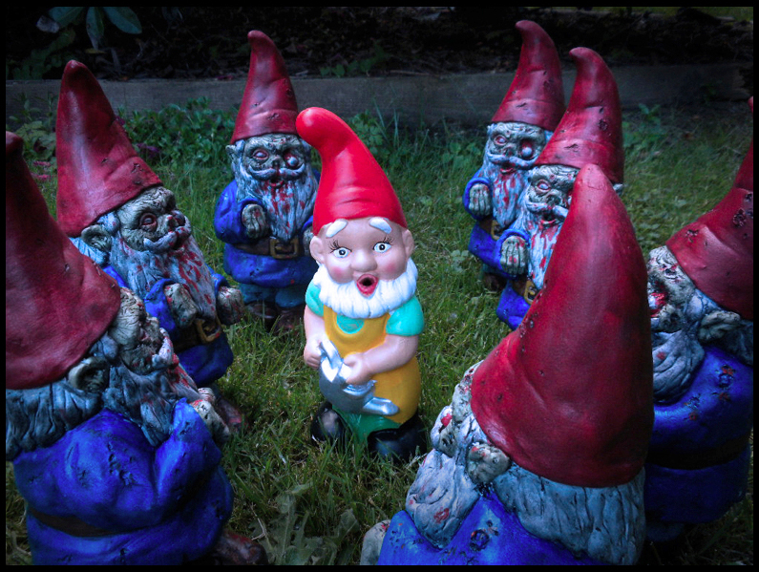
GNOME Alert!
Notes:
Source:
http://www.zombiewagon.com/2011/07/attack-of-the-zombie-garden-gnomes.html
CC-BY-NC 2.0
I gave this talk immediately after lunch, so chose the strangest looking garden gnome picture I could find – including the 1990's style scrolling text – to ensure people would stay awake!

Slide 15
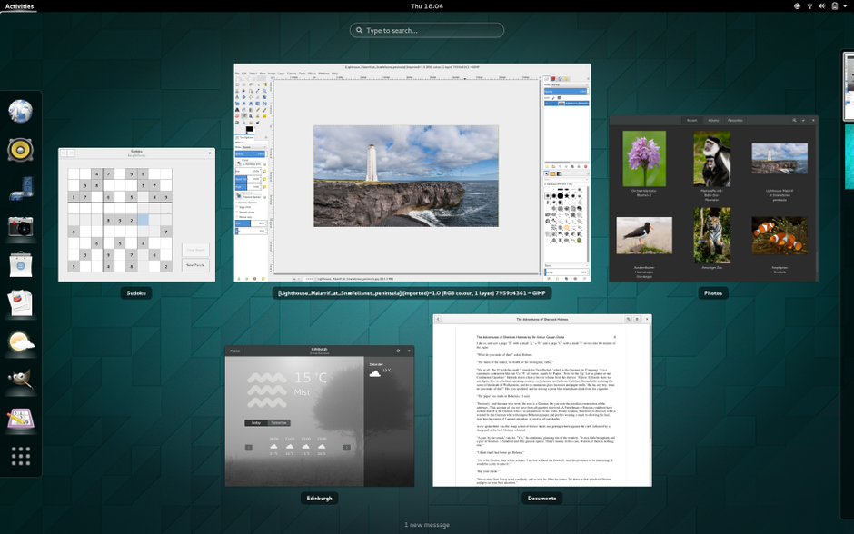
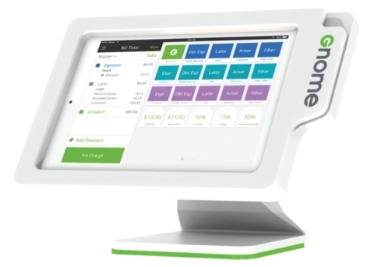
Brands really matter
Notes:
Which GNOME is which?
See the recent Groupon Versus Gnome trademark controversy, luckily now solved:
https://www.gnome.org/groupon/
GNOME is a registered trademark of the GNOME Foundation. Groupon is a registered trademark of Groupon, Inc.

Slide 16
PMCs: Be respectful
Ensure you treat other organization's trademarks respectfully
Charitable or community-based projects have no business infringing on other's trademarks
Be liberal in attribution and giving credit to other communities or companies
Respond calmly and professionally if a third party asks/demands for changes; always cc: trademarks@

Slide 17
PMCs: Be independent
Apache projects are governed independently
http://community.apache.org/projectIndependence
Software products are clearly branded Apache Foo
Treat all participants / contributors fairly
Independence from undue commercial influence is a requirement for Apache projects
Independence means Apache Foo software performs useful functions, without additional (proprietary) software

Slide 18
Policing Use Of
Apache Project Brands
Notes:
Part of a PMC's job in managing their project's brand is ensuring that any third party – other company – use of your project brand is not infringing on our marks.

Slide 19
Police brand use privately
When a third party is improperly using your project's brand, the PMC needs to take action and ask for corrections!
Always contact third parties privately
  Private, direct contact allows all parties to save face
  Public confrontations often escalate, potentially damaging everyone's reputation
Assume ignorance rather than malice
Use reporting guidelines to determine if the use is (or is not!) a problem
  http://www.apache.org/foundation/marks/reporting
Notes:
Never make the first contact in public – always privately. Almost every trademark infringement the ASF or any of our projects has pursued has been resolved privately.
Many cases result from ignorance by the other party; once the issue is clearly explained (we hold this trademark, here's the appropriate way to use it), the issue is fixed with a “oops, we're sorry!” from them.

Slide 20
Be professional and polite
Whenever contacting anyone about improper brand use:
  Be professional – make them understand the project is serious
  Be polite – many cases are resolved through simple discussion
  Be firm – state the ASF's clear ownership of the marks
  Be specific – quote specific uses that we request to be changed
Most potential infringements cases are resolved through discussion between private@, trademarks@, and the other party
  Be patient – discussions take time to resolve
Legal threats are never the first step
Notes:
Remember: most of the time, the people you need to contact here are marketing people and lawyers – not coders or other typical project contributors. Our requests to make changes in other company marketing materials often get bounced around to find the right corporate decision maker to make the fix.

Slide 21
Get legal advice
The ASF has pro bono corporate counsel from DLAPiper
Send any legal questions, especially any from outside the ASF, to:
  trademarks@ for anything brand-related (private archive)
  legal-internal@ for any specific legal question the PMC has on behalf of the project (private archive)
  legal-discuss@ for any general legal questions that can be discussed publicly (public archive)
Never grant exceptions to brand policy without trademarks@ approval
Never give legal advice (unless you actually are an ASF counsel)
Never respond to an outside lawyer without asking ASF counsel

Slide 22
Granting Third Party
Brand Permissions
New Policy!

Slide 23
Responding to third party requests
NEW POLICY CHANGE: PMCs may now directly grant certain third party permissions for specific uses (events, domains, swag / merchandise) of their project marks
Best practices / how-to guides being rolled out
  Respond promptly: acknowledge the question even if the answer is not ready yet
  Respond professionally: many requesters are marketers or lawyers, not coders
  Respond privately: keep on private@ unless OP used dev@
Ask trademarks@ for help anytime you have a question!

Slide 24
Granting third party permissions
Only grant specific permissions as noted in policy
  Events; domain names; services; merchandise
Do not grant exceptions dealing with software product names
  But: you can use allow Powered By phrases (For..., Plugin...)
Be consistent and fair when granting permissions
Does a use of your project's brand by a third party / other company:
  Not confuse consumers about the source of Apache software?
  Help the image, impact, or reach of your project community?

Slide 25
When To Work
With trademarks@

Slide 26
Trademarks@ sets policy
The ASF owns all Apache trademarks on behalf of the projects
PMCs are required to comply with core use policy
PMCs otherwise define and promote their own brand
Project brand design, like technical direction, is completely up to PMCs to define for themselves
trademarks@, like press@, infra@, etc. are here to serve the needs of all Apache projects

Slide 27
Deal with difficult third parties
Any time a third party responds negatively, or when another company lawyer is involved – ask trademarks@ to help craft your reply
Any difficult negotiations should be done by VP, Brand Management, with appropriate legal counsel
Most corporations respond to official titles
Patience is required: trademark issues are rarely time critical
Legal threats are never the second step

Slide 28
Trademark enforcement & legal action
A Cease & Desist (C&D) is never the right place to start
Consider the public image of “attacking” a third party
Trademark litigation is expensive and risky
Most issues can be resolved with polite, firm, and private discussion with the right parties
A very few serious issues end up being resolved with other actions: making a public case; restricting PMC or commit access; or the board unilaterally restructuring a project

Slide 29
Thank You &
Resources

Slide 30
Thank You!
Thanks to all Apache Members
Thanks to all Apache committers and PMCs
Thanks to members of Apache Trademarks Committee, with special thanks to David Nalley
Thanks to DLAPiper counsel: Mark Radcliffe, Dash McLean, Nikkya Williams, Carol Anne Bashir
Thank you to companies who respect Apache brands
Notes:
Also: Community over Code. It's important, as is giving the thanks to the community members who have built everything the ASF and it's projects are about.
Members have built the Foundation.
Committers/PMC members have built our projects.
Members and the trademarks committee have assisted in forming and documenting our policies, as well as assisting our various projects in applying them and defending their brands.
Our pro bono law firms have helped with review and strategy. In the past we have also used other firms, including SFLC, however DLAPiper is our primary brand-related pro bono firm.

Slide 31
Trademark Resources - External
Formal policy for third party use
  http://www.apache.org/foundation/marks/
Third party requesting permission for events
  http://www.apache.org/foundation/marks/events
Third party requesting permission for domains
  http://www.apache.org/foundation/marks/domains
All other questions
  http://www.apache.org/foundation/marks/contact

Slide 32
Trademark Resources – for PMCs
Policy for PMC websites
  http://www.apache.org/foundation/marks/pmcs
Linking to third party sites/products/services
  http://www.apache.org/foundation/marks/linking
Project Independence is required for PMCs
  http://community.apache.org/projectIndependence
Questions? <trademarks@apache.org> and relevant
<private@project.apache.org>

Slide 33
Questions?
Please feel free to find Shane with any
questions this week!
Or, Look for the Ask Me! Buttons, and just ask!
@ShaneCurcuru
http://communityovercode.com/

