Slide 1
Supporting Apache® Brands While Making A Profit
@ShaneCurcuru
VP, Brand Management
The Apache Software Foundation
Apache License, 2.0
V 2.0b

Slide 2
Introduction
Shane Curcuru
  V.P. Brand Management, The Apache Software Foundation (ASF)
Volunteer, appointed by Apache Board of Directors
Define and implement trademark & brand policy for all 180+ Apache project communities
Involved at Apache since 1999
Not a lawyer
Questions? <trademarks@apache.org>
Notes:
Welcome, and thank you for coming!
My name is Shane Curcuru, and I serve...

Slide 3
Topics
What is Apache?
What is the Apache brand?
How you can use Apache brands
Apache brand enforcement
Q&A and Resources
Notes:
To understand how to use Apache brands, we need to first understand what the Apache Software Foundation is, what the Apache brand is, and how all 154 Apache project brands work.
As an open source organization, we allow broad re-use of Apache project brands in a variety of ways that I'll describe here – often being much more lenient than normal software vendors, although we do want our project communities to get the credit they deserve.
We'll wrap up with a brief discussion on how the ASF and Apache projects enforce use of our brands, and have some time for questions.

Slide 4
What Is The Apache Software Foundation?

Slide 5
Apache structure
US 501(c)(3) membership corporation and public charity (tax exempt)
9 member Board of Directors
  Elected from/by individual members (non-corporate)
Corporate Sponsorship program + individual donors = 100% funding
$750K+ annual budget:
  Sysadmin contractors & Hardware/Bandwidth
    Publicity; Events; Brand; other
ASF provides services to all it's projects
http://www.apache.org/foundation/sponsorship
Notes:
The Apache Software Foundation is the legal corporation which governs all 154 Apache projects. We have a formal board, elected from the existing Membership, that appoints various officers and PMCs, or project management committees.
As a non-profit, we rely on donations – both individual and recurring corporate sponsorships – for all of our funding. By far, our largest expense is for system administrators and the hardware that our source control and websites live on.
Note that all Apache project work is done by volunteers: our budget is only used for core infrastructure, not coding.

Slide 6
Apache governance
Board appoints executive/corporate officers
  Set Apache-wide policy: legal, brand, infra, press, etc.
Board creates VPs & PMCs to manage projects
  PMCs are run independently by merit-based volunteers
154+ Apache projects + 32 Incubator podlings
  PMCs determine technical direction
All governance positions are volunteers
http://www.apache.org/foundation/governance/
Notes:
Just like any other corporation, the board appoints officers to set policy, and appoints officers and PMCs or Project Management Committees to run each separate Apache project.
Understanding the independence of the ASF as a whole and all Apache projects is critical to understanding the Apache brand. Governance decisions – including technical ones within our projects – is made by volunteers, and is for the benefit of all project users. Commercial ownership, influence, or affiliation is not considered in governance decisions.

Slide 7
We have different goals
Apache is a non-profit, public charity
Our Mission: provide software for the public good
Our Method: provide stable, independent home for like-minded diverse project development communities
Our Goal: Ensure Foundation exists for next 50 years
Notes:
Not to belabor the point but: the ASF is a non-profit, public charity. Our purpose is to provide a public good. We're happy to have various for-profit companies use our software and work in our communities, as long as you remember what the true purpose of our mission is.

Slide 8
What Is The Apache Brand?

Slide 9
The Apache® brand
APACHE is our house brand for community built software
  Pragmatic and permissive Apache license
  Always free to download
  Participation in projects based on merit
  Openly developed software
  Independent project governance
APACHE brand and feather are special to the ASF
APACHE is a registered trademark of the ASF
http://community.apache.org/projectIndependence
Notes:
Much of the Apache brand comes from our structure, and from our non-profit mission for the public good.
Please remember that the APACHE name and our feather logo are special both to all projects and to the foundation itself. These are our symbols of independence and vendor neutrality.

Slide 10
Apache project brands
“Apache Foo” is required of all projects
Every PMC defines own “Foo” brand independently
All share common Apache Way, but:
  Actual Apache project brands may differ in style
Foundation owns all trademarks on behalf of projects
Treat all Apache project/product names as trademarks
HADOOP, LUCENE, OPENOFFICE and some other project names are registered trademarks in the US, EU, and/or other countries
Notes:
Every project uses the APACHE name in it's brand, and projects are required to follow independent governance policies set by the Foundation.
But beyond that, every project defines it's own brand. We are also allowing PMCs and project Vice Presidents broad authority to manage their own specific project brand, as well as to directly grand permissions for use in events, domains, and the like.
The fact that the ASF owns all trademarks on behalf of our projects ensure project independence: even if one vendor happens to overload a PMC, trademark ownership is still with the Foundation as a whole, and the board can step in to keep the project running appropriately.

Slide 11
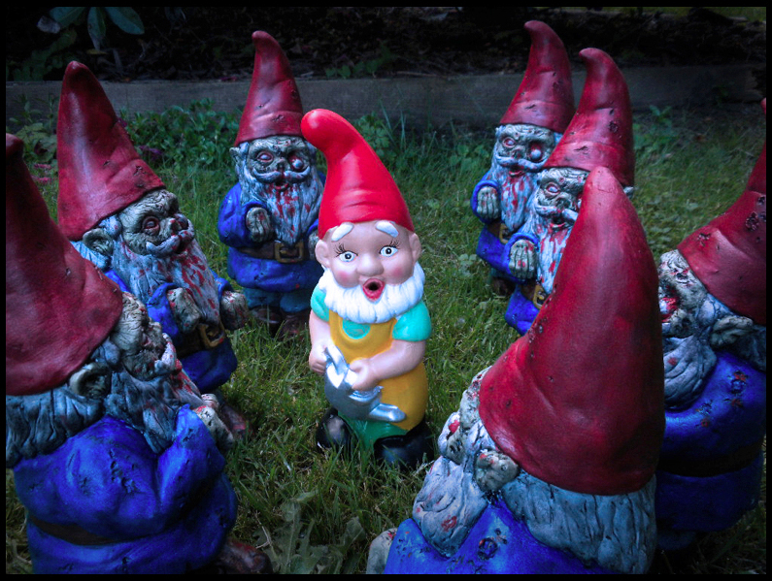
GNOME Alert!
Notes:
Source:
http://www.zombiewagon.com/2011/07/attack-of-the-zombie-garden-gnomes.html
CC-BY-NC 2.0
I gave this talk immediately after lunch, so chose the strangest looking garden gnome picture I could find – including the 1990's style scrolling text – to ensure people would stay awake!

Slide 12
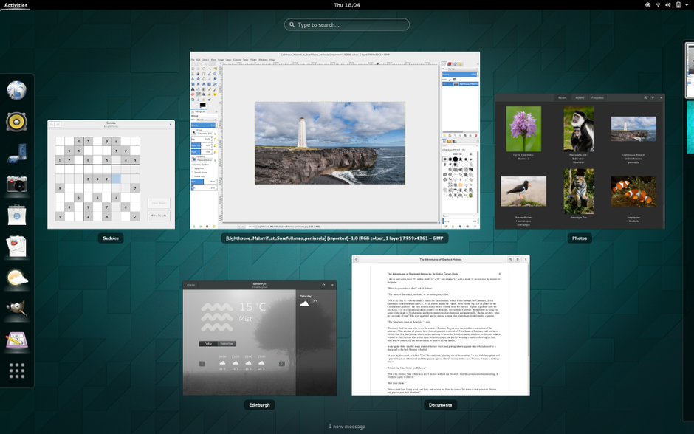
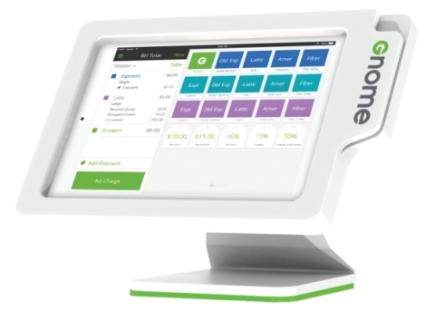
Brands really matter
Notes:
Which GNOME is which?
See the recent Groupon Versus Gnome trademark controversy, luckily now solved:
https://www.gnome.org/groupon/
GNOME is a registered trademark of the GNOME Foundation. Groupon is a registered trademark of Groupon, Inc.

Slide 13
Apache trademark use policy
Purpose: maintain our ability to defend all Apache project brands such that we can attract new project contributors
Primary Apache goods are software products
Secondary Apache goods are software services: basic support
Mix of registered and common law marks
Within policy, individual projects make own decisions
http://www.apache.org/foundation/marks

Slide 14
A friendly reminder
It's not your brand
It's Apache's brand
Our projects welcome participation from anyone and welcome re-use by everyone
Notes:
I'm sure that most people attending this talk at ApacheCon understand this, but I find that some corporations still need to be reminded.
Even if your corporation donated a specific project to the Apache Incubator, once the project graduates to top level status, the brand belongs to the ASF. Donating project technology or brands does not grant the original donor any special abilities or privledges.

Slide 15
So, what can you do?
So, Shane, what are we allowed to do with Apache marks?

Slide 16
How To Use Apache Brands

Slide 17
Software products
Primary brand must be your own
Must use full “Apache Foo” form of name
  Ono-Sendai Console, Powered By Apache Steve
  Yoyodyne Accelerator For Apache CloudStack
May not use official Apache project logos as part of brand
May use Powered By Apache banded logos in conjunction with (but not part of) your brand
No other exceptions
http://www.apache.org/foundation/marks/faq/#products
Notes:
The primary purpose of the ASF is to provide software products for the public good. Therefore, our trademark use policies around software products are stricter than other uses.
We have a variety of Powered By phrases and logos: while these are related to the original Apache project logos, they are distinct designs, and are usable in a broader variety of places than the official project logos.
In every case, the primary software product brand may be your own – and displays the Apache project brand as a distinct and separate product.

Slide 18
Software services & hosting
Primary brand must be your own
Must use full “Apache Foo” form of name
Must not imply exclusivity or affiliation
  Support
  Training
  Consulting
  Hosting
  Customizations
Apache project logo used only in reference to Apache product
Notes:
As a non-profit, the ASF and most projects only offer a limited amount of free support for project users and contributors. So here is a great place where companies can step in to provide other useful services or software or data hosting, that are closely based on or work with Apache software products.
Again, the primary brand for the service should be your own,but in general you may more closely integrate the branding from the Apache software product into your service than you would be able to from, say, another commercial vendor's product.
From the Apache project's point of view, services, training, and the like that helps more users be able to find and use our Apache software products is a net gain for the ASF.

Slide 19
Most importantly
Give credit to the project community
Ensure users understand every Apache project is independently governed
Notes:
This is the most important concept about how to properly use Apache brands. Many uses of Apache brands in third party marketing or the like – that in a commercial context might seem infringing – may be allowable for Apache brands – as long as our project communities get the credit they deserve for producing Apache software.
We love it when companies use or promote our software – we just want the credit, and we want users to understand that they can always find our software directly at apache.org

Slide 20
Events & Swag
Event primary brand may use “Foo”, but not official Apache logo
  Must have an “About Apache Foo” link on website
Include educational content
Allow PMC members on selection committee
PMCs empowered to give permissions for events
We are Improving policy for giveaways supporting projects: PMCs may allow broad merchandise, giveaway use
http://www.apache.org/foundation/marks/events
Notes:
Events are another great place where corporations may have the resources to teach more users about Apache software, while making profit for themselves and their services.
We're working on having every individual Apache PMC issue approvals for use in events. Please be sure your event branding plan complies with our policy posted here before requesting permission.
Similarly, companies wanting to do giveaways of swag – shirts, stickers, stuffed animals and the like – are generally welcome to do so as long as the image of independent Apache brands is maintained.

Slide 21
Appropriate marketing
Don't imply ownership or control
No superlatives
No corporate affiliation
Frown on “employ the most PMC members”
Apache is vendor-neutral
Apache projects must be viewed as independent
Notes:
In marketing and trademarks, asking “is this use acceptable”, the answer is usually “It depends”.
The most important thing to remember is that Apache project brands stand for independently developed software projects. While we are happy when companies use or promote our software, you need to do it in a way that doesn't compromise our vendor neutrality and independence.
We welcome everyone's participation, and want to ensure that everyone is comfortable joining one of our projects – your company, independent developers or consultants, or even your competitors in the marketplace.
Think of Apache as the Switzerland of software.

Slide 22
Other ways you can show support
Donate code / engineers
Support non-coders on projects
Send speakers to events
Sponsor and organize events
Sponsor the ASF
Notes:
Often people ask how else they can contribute to Apache projects. There is no one way – other than jumping in and getting involved in each individual project.
If you're a manager, then there are still ways you can get involved – by ensuring your company and your employees are supported in contributing to projects. Don't overlook things like allowing editors or doc writers to spend time on open source projects, and especially support your staff when they want to speak or attend open source events. Running your own events about Apache projects is another great way to give back: be sure to involve the project in how the vent is managed.
And we always love new corporate sponsors!
Key point: way to influence Apache projects is to be involved in doing the work of the project.

Slide 23
Apache Brand Enforcement

Slide 24
Apache brand enforcement
Private requests, from the PMC or trademarks@
Social pressure & press
Removal from PMC & project(s)
Legal action
  DLAPiper, global IP law firm as pro bono counsel
Don't let it get there! Ask us first
http://www.apache.org/foundation/marks/contact
Notes:
So what happens when Apache brands are abused? This is where I come in, and work with Apache projects to enforce their brand usage.
Many cases are a result of misunderstandings, and these are usually cleared up with some careful discussion. Our goal is to ensure proper use of our brand for the long term.
But, when it is necessary, the ASF has excellent pro bono representation, and for infringing companies who are involved in our projects, we can remove their participation in project governance if needed.
The big message is: keep communication open -and if you're wondering if something is a good idea – then ASK FIRST!

Slide 25
Thank You & Resources

Slide 26
Thank you
Thank you to companies who respect Apache brands
Thanks to all Apache Members
Thanks to all Apache committers and PMCs
Thanks to members of Apache Trademarks Committee, with special thanks to David Nalley
Thanks to DLAPiper counsel: Mark Radcliffe, Dash McLean, Nikkya Williams, Carol Anne Bashir

Slide 27
Apache Trademark Resources
Formal policy for third party use
  http://www.apache.org/foundation/marks/
Third party requesting permission for events
  http://www.apache.org/foundation/marks/events
Third party requesting permission for domains
  http://www.apache.org/foundation/marks/domains
Other questions
  http://www.apache.org/foundation/marks/contact

Slide 28
Questions
Please feel free to find Shane or any of the other directors or executive officers with your strategic questions this week
Look for the Ask Me! Buttons, and just ask!
@ShaneCurcuru
http://communityovercode.com/

Slide 29
But it's open source!
Apache License, v2.0
6. Trademarks. This License does not grant permission to use the trade names, trademarks, service marks, or product names of the Licensor, except as required for reasonable and customary use in describing the origin of the Work and reproducing the content of the NOTICE file.
Notes:
Backup slide: There are some companies and individuals who see “open source” as an invitation to take everything the project provides and use it freely. Most open source licenses actually have explicit provisions preventing trademark re-use.
We are happy to have anyone fork Apache project code – just please don't attempt to fork our brand or our communities.
For many open source groups, the brand for the project as whole (usually the same name as the software product itself) is both the most important part of the project, as well as the main point of control for the community. Competition is welcome on technical merits even with forked code – as long as the forker creates their own separate brand.

