Slide 1
Trademarks In Open Source
Shane Curcuru
Vice President, Brand Management
The Apache Software Foundation
Pamela Chestek
Chestek Legal
Presented at PLI: Open Source Software 2017 - From Compliance to Cooperation
December 20, 2017

Slide 2

Agenda
Shane: The Open Source Ethos Is Sharing
How open source works differently.
Pamela: Trademarks In Open Source Practice
What that means for your clients.

Slide 3
Open Source Is Sharing
Open Source Ethos = Culture Of Sharing
Open Source Clients Are Different
Use Cases For Open Source Brands
Notes:
The ways that open source software products are built - technology-wise, people-wise, process-wise, and even business-wise - are different than traditional software vendors. Understanding how clients in open source industries are structured, how they work differently, and how they have subtly different goals than traditional corporate clients is important to be able to give the best advice.

Slide 4
The Sharing Ethos
Open source organizations want and need to share their work - and to a degree, their brands.

Slide 5
Industry-wide adoption of open source
Open source use is the norm
100% of companies run part or all of their operations on open source software
When you use a computer, you are using open source
Notes:
In case it’s not obvious: 100% of enterprises and companies that use computers are using open source in some part of their work. While much of this open source software may not be visible - hidden in your operating system, your networks, your databases, and inside your smartphones - it’s still there, and it’s still changing how

Slide 6
Industry-wide contributions to open source
Open source contribution is mainstream
65% of companies are contributing to open source software*
Smart companies want to work and partner with open source groups and foundations
* Black Duck / North Bridge 2016 Future Of Open Source Software report
Notes:
Active contributions to open source continue to grow - and continue to be recognized. While your company’s developers have been contributing (somehow) to open source for years, businesses are now recognizing that contribution, and changing corporate structures to recognize that, and better capture the value and improve results by actively working with open source projects in other companies.

Slide 7
Open Source Organizations Make Sharing Explicit
Free Software Foundation and the GPL: designed to enforce sharing
Apache Software Foundation mission: to provide software for the public good
Open Source Initiative (OSI) “protects and promotes open source software... and prevents abuse of the ideals and ethos inherent to the open source movement.”
Notes:
The FSF, ASF, and many other open source non-profit foundations and independent projects make sharing their work explicit parts of their goals. The people driving many of these organizations and the popular open source programs used for businesses around the world have an expectation of sharing when talking about anything “open source”. Along with other similar open source foundations, these non-traditional corporations provide the underpinnings of the majority of most software products today.
While not all open source companies are so ideologically driven, they are all driven by the business value that an open source development model can bring to many software industries.

Slide 8
"We recognize that we are beholden to open source communities for our success... we are responsible for contributing as much code as we can back to those communities because everyone gets better when we do that."
— Thomas Cameron, Red Hat
https://opensource.com/article/16/12/why-red-hat-takes-upstream-first-approach
Notes:
More and more companies recognize the importance of working with open source projects.
While this quote is from Red Hat - long an open organization - we can find dozens of other similar quotes from both technical and business leaders in various industries. This is not idealism, it’s a good business decision for the development benefits of sharing this kind of code.

Slide 9
“Open Source” Or Truly Open Development?
“Open source” means it has been provided publicly under an OSI-approved license (Apache, GPL*, MIT, etc.)
Being “open source” while ignoring the community will backfire
Open development - allowing the community some input and collaboration - is the expected behavior and where the value is
Notes:
What, specifically, does “open source” mean?
Merely using an OSI approved license means you could call your product open source - but it will backfire. Only once you allow open development - where the community can participate and help build the product - is there a benefit to doing so.
The open source community is very sensitive to “openwashing” - which is applying an open source license, but ignoring the community. If you never respond to other parties trying to improve the software you’ve open sourced, it will lead to a fork - something you can’t control and won’t gain value from.
So what’s the business value in sharing at least some work with open source?

Slide 10
The Business Value In Sharing
Submitting fixes upstream reduces development and maintenance costs
Providing open source API programming models draws in contributors that help build a strong ecosystem
Employees want open source experience
34% of companies have >50% of their developers contributing to open source
https://www.blackducksoftware.com/2016-future-of-open-source
Notes:
(SLIDE TO BE HIDDEN IN PLI SESSION - NOT ON TOPIC, NOT ENOUGH TIME)
The business value of adopting open source processes for appropriate parts of your software are well known and proven.
As open source becomes the norm for more and more parts of industry, employees are expecting this kind of experience as well.

Slide 11
“Open source’s value in reducing development costs, in freeing internal developers to work on higher-order tasks, and in accelerating time to market is undeniable.
Simply put, open source is the way applications are developed today.”
— Lou Shipley, Black Duck Software
https://www.blackducksoftware.com/2016-future-of-open-source
Notes:
The business value of adopting open source processes for appropriate parts of your software are well known and proven. Not only are there good development and maintenance savings, and a lot of opportunity to capture mindshare by partnering appropriately with open source communities, but more and more employees are expecting to be able to work in open source for part of their job. The next big change will be how open source experience changes the talent game for companies.
This quote is from the 10th annual Black Duck survey on the Future of Open Source. This is a single quote that distills years of practical business and technical learning, including various studies and the fact that many new business markets are opening because of, and around, major open source technology. A great example: Apache Hadoop and Apache Spark are 100% open source, and is the defining core of the big data software stack.

Slide 12
Open Source Clients
Open source organizational structures, actions, people, and culture are different than traditional clients.
Notes:
The most important thing to take away from today’s seminar is this: when you are working with open source clients, understand that they tend to have different goals and motivations than traditional software vendor clients do. Whether you’re working with an open source client, or you’re sitting across the table from one, understanding their motivations helps you give the best advice to your client.

Slide 13
Open Source Projects Versus Products
Open source projects are communities of people from various employers, countries, backgrounds
Open source products are most often eponymous with the project community
Community often lacks legal experience, and won’t understand subtle issues around trademarks
Notes:
To an open source company, their brand is their identity. To the community - and to your client’s developers - “Node.JS” is the brand. That encompasses the software product(s) being developed, the name of the entity behind the product, and the community as a whole.
While trademarks may legally only be the product identifier, for the participants in this technology, the different aspects - company, product, community - are often thought of as the same thing.

Slide 14
Open Source People Are Different
The people leading open source projects support sharing and contributions
Often have a personal connection to the project brand
Careers are measured across projects
Communication speed, style, organization can be chaotic and very technical
Notes:
The people behind most major open source software are driven differently. They understand the business and community value of sharing parts of the technology, engaging with multiple companies to drive the project, and building the larger open source ecosystem.
In particular, many open source participants are very passionate about their project brand - far more so than in traditional companies. When you combine this passion for their project’s identity with their distributed and non-hierarchical model, their reactions to branding issues may be surprising - and may often be expressed very strongly, and might not be to you directly, but rather in public.

Slide 15
Open Source Projects Have Governance
Types of governance
Benevolent Dictator (individual)
Benevolent Company (corporation)
Multi-Corporate Board (501C6 foundation)
Individual Meritocracy (Apache, 501C3)
Many open source projects have policy for IP submission (CLA or DCO)
Documented community voting on releases
Notes:
Even apparently unorganized open source groups often have some governance structures; open source at major foundations (Apache, Eclipse, SPI, FSF) will have documented governance covering IP submissions, formal project maintainers, committee voting process to build, test, and produce public releases. While the organization may be distributed and include community members from various employers, their actions in the context of the project community follow documented processes and are for the benefit of the community as a whole - not directly their employers.
Governance varies widely, but virtually all popular open source projects have a well-running structure here. Decisions often happen more slowly than in a traditional software vendor context, but they are just as rigorous and expert.

Slide 16
Open Source Organizations Are Different
Open source groups are often non-profits
Participants are distributed geographically, work for different vendors
Decision making and communication are non-hierarchical
Goals are mindshare and credit - not profit
Lack paid staff, greatly under-represented by counsel
Notes:
The organizations that build and drive many important open source projects are non-profit foundations, either 501C3 or 501C6 in the US, or the equivalent in Europe. Many groups use a consensus model for making decisions, with a very flat and non-hierarchical decision making process.
From the perspective of an open source project, the goal is often mindshare and credit for their work - not profit. Most open source projects aren’t trying to compete directly with a vendor, they’re just trying to build a better tool that they can control.
Importantly, most open source projects don’t have much legal support, and when they do it’s hard to coordinate. So don’t be surprised when they react in a business way that might not strictly make legal sense.

Slide 17
Open Source Brands
Open source brands work differently - when building your own, or using others’.

Slide 18
Open Source Projects Encourage Sharing
Open source trademark policies often allow additional uses of their brands
Vendor marketing including an open source brand helps build ecosystem, brings additional contributors to the project
Source of origin still important to the project and the community
Notes:
Many open source groups allow broader use of their brand by vendors in the hopes that vendor marketing (often better funded and organized than community marketing) will bring more contributors to the open source project itself. So while ensuring the brand still stands for a single source of the open source product itself, most groups welcome vendors talking about their community brand and featuring it at events, in materials, and in the vendor’s own products and services. This should be a combination - “SuperProduct uses OpenSource to run faster” - a recognition of the source of some of the software your client is selling (but not all of it).

Slide 19
Using An Open Source Brand
Projects may allow outside use of their brands - shows support of their ecosystem, and helps grow their community
But still need to respect policy; not a blanket license or permission
Often freely permit brand use on stickers, apparel, some kinds of services
Give credit to the project’s community
Notes:
Just because an open source project doesn’t mark their trademarks or have a policy, they will get upset if you misuse their good name. Open source wants vendors to talk about their project, but to keep it clear that it’s the community project the vendor is building something on top of.
Note that many projects are much more permissive when it comes to non-software goods. When your marketing team gives out Lucene® stickers at an event, that helps drive awareness of the open source project - as well as perhaps your client’s hosting or consulting services.

Slide 20
Creating Your Own Open Source Brand
When building open source brands, understand that others will want to integrate the brand into their own work
Carefully consider what goes into the open source brand (vs. proprietary brand)
Publish a clear policy defining and encouraging community engagement
Notes:
The biggest question when a client decides to “open source” something is deciding what, exactly, is going in the open source part - and what will stay proprietary. Ensure clients have a clean separation between the two halves of the product - and a separation between the two brands.
Publishing a specific trademark policy for any open source brands is important to help set expectations for the ecosystem. To be taken seriously with an open source product, your client needs to clearly define what and how they are sharing the project direction with the community - or not.
Remember: the open source community can drive a lot of innovation back to your client - but they lack the legal experience to know up front how they can or should use the brand you’re promoting as “open source”. Don’t be surprised by what the community does.

Slide 21
Conflicts With Open Source Brands
Open source groups react differently when you misuse their brand
Enforcement likely to be social and technical, not legal
Do not underestimate how important an open source brand is to its community
Notes:
If your client is accused of misusing an open source brand, stop and discuss with the client’s technology leaders first before making contact. Overzealous marketing departments regularly go too far when trying to capitalize on someone else’s open source brand - and communities and brand owners often react very passionately. There will be cases where a client has the legal right to use the brand some way, but exercising that right will cause business harm to your client from the bad publicity and backlash from the larger ecosystem.
Open source groups often don’t have sufficient legal counsel to write complaints - so don’t ignore complaints from non-counsel project members.

Slide 22
Trademarks In Open Source Practice
Basic concepts
Trademark rights in open source software
Enforcement

Slide 23
Trademark Basics
The rules are the same

Slide 24
Trademark basics
A trademark is a symbolic representation of the sum of information about a product or service (in marketing terms, the "brand")
It points to a unique single source, but it can signal many types of relationships
The law only prohibits a situation where there is confusion about the relationship being signaled
(It is not the same thing as "attribution" contemplated in open source licenses)

Slide 25
Trademarks and Community
Community engagement drives different behavior

Slide 26
Trademarks and the Community
The trademark is the project’s most valuable (and perhaps only) asset
It carries a heavy load --
The name of the project
The name of the community
The individual contributors’ sense of belonging and ownership
Notes:
No copyright to enforce, patents are the plague.

Slide 27
“I … do not want to have ‘Linux’ as a name associated with unacceptable … behaviour, and it’s important that ‘Linux’ doesn't get a name of being associated with scams, cybersquatting, etc etc.”
—Linus Torvalds, Jan. 19, 2000

Slide 28
Trademarks and the Community
No open source license in use grants a trademark license
BUT
The ethos of sharing carries through to how the project manages its trademarks
All while the open source project has the same challenges as a commercial company
Notes:
The license to modify the code does not imply any right to use the trademark
It’s exactly the same law as trademarks used by proprietary companies, the difference is the community’s desire to encourage a sense of belonging and share
Meanwhile, they also have infringement and cybersquatting

Slide 29
Trademark Ownership
Who owns the open source trademark, i.e., who can register it?
Individual
A recognized type of legal entity but not formally formed, e.g., partnership
Non-profit foundation
Corporation or benevolent custodian
Fiscal sponsorship
Notes:
Foundation, e.g., GNOME, OpenStack (charitable or trade) Corporate owner, e.g., Fedora, Ubuntu Fiscal sponsor, e.g., SPI, Software Freedom Conservancy Founder, e.g. Linus Torvalds Unincorporated association

Slide 30
Trademark Ownership
Quality control
There is a canonical (i.e., “single”) source, just like any product developed in more traditional ways
The quality of the product is highly controlled
Notes:
Shane explained the various ways that the open source project software is developed, even though it is a decentralized development model there is clearly quality control going on, generally quite easily shown

Slide 31
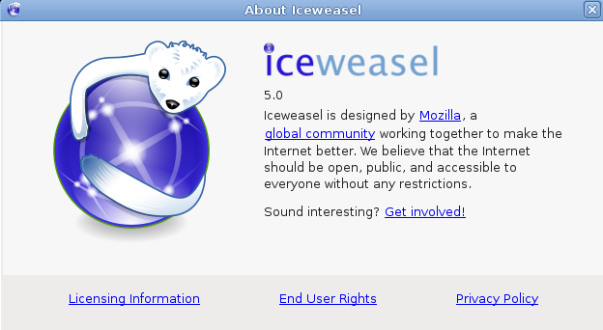
...getting FireFox on Debian Linux

Slide 32
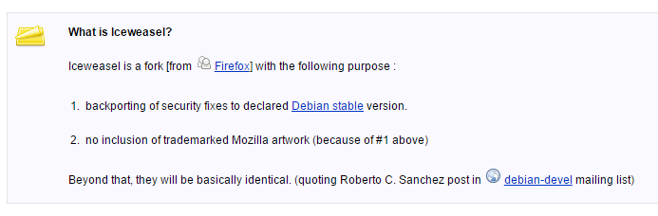
https://wiki.debian.org/Iceweasel#How_to_install_iceweasel_.28Firefox.29

Slide 33
Trademark Enforcement
When to enforce is malleable, and requires a delicate touch

Slide 34
Trademark Guidelines
Open source project guidelines will often grant licenses, especially for promotional goods
It will also describe lawful use for clarity
Referential use
Resale
Notes:
Enforcement often starts with guidelines
The project itself will follow the guidelines
Trademark guidelines for proprietary companies are just what you can’t do
Trademark guidelines for open source projects may actively grant permission

Slide 35
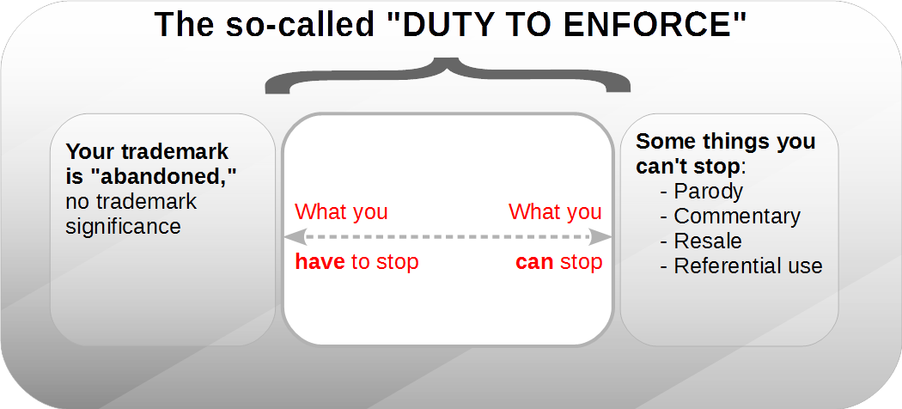
Notes:
When do you really need to enforce?

Slide 36
Trademark Enforcement
The community is often highly engaged in enforcement
While there is a named owner, the community members are equal stakeholders
Because of the sharing culture, enforcement has to be approached delicately

Slide 37
Resources
Learning about the open source perspective.

Slide 38
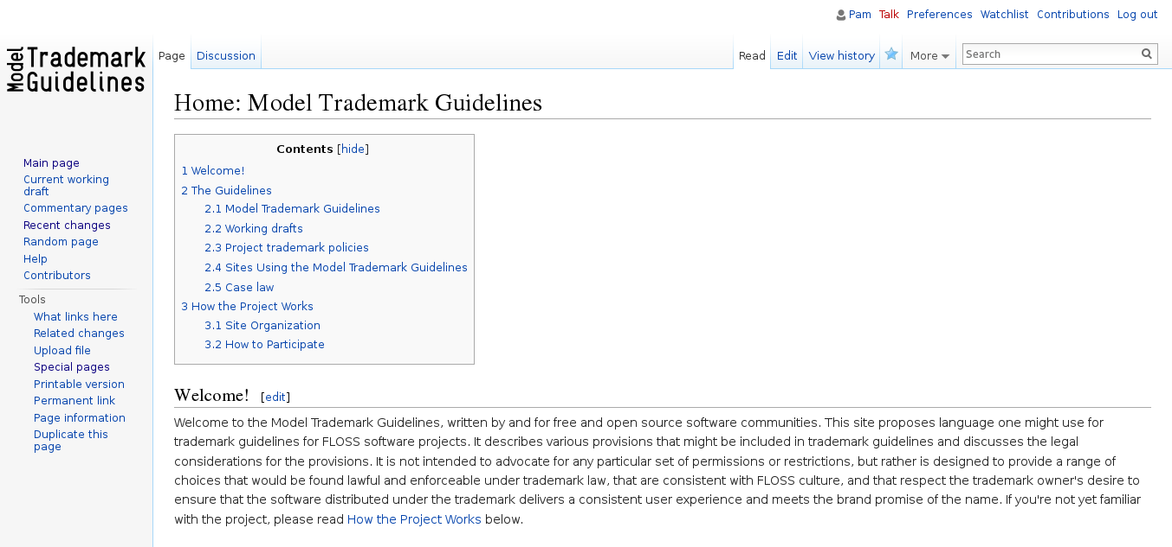
http://modeltrademarkguidelines.org/

Slide 39
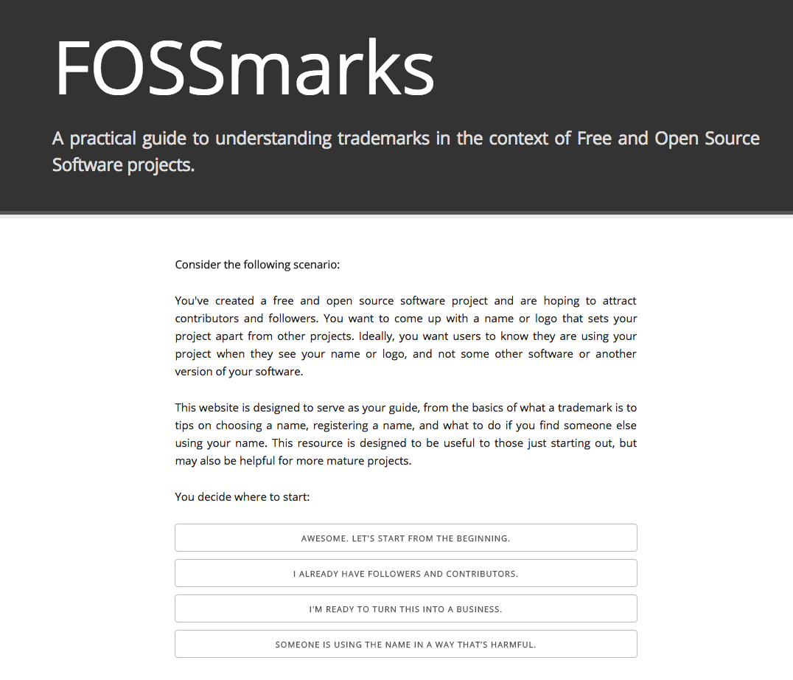
http://fossmarks.org/

Slide 40
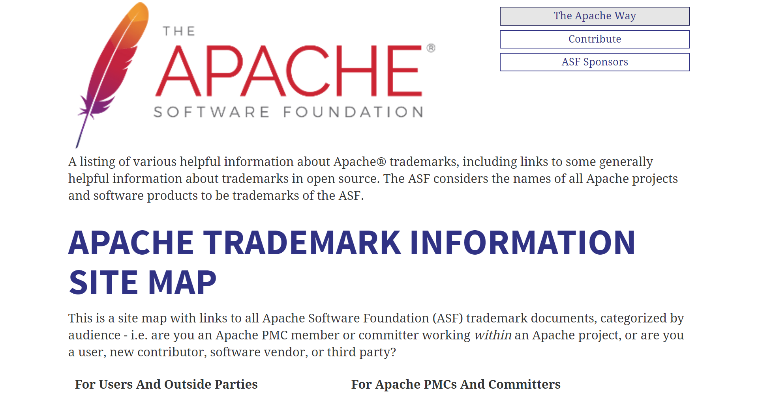
https://www.apache.org/foundation/marks/resources

Slide 41
Credits / License
Shane Curcuru - first half slides (Apache-2.0)
Pamela Chestek - second half slides (CC-BY)
Presentation template by SlidesCarnival (CC-BY)
Presented at PLI: Open Source Software 2017 - From Compliance to Cooperation
December 20, 2017

Slide 42
Thanks!
Any questions?
You can find us at:
@ShaneCurcuru
@PChestek
🐱

