Slide 1
Trademarks In Open Source
Shane Curcuru
Vice Chairman
The Apache Software Foundation
Pamela Chestek
Principal
Chestek Legal
Presented at PLI: Open Source Software 2018 - From Compliance to Cooperation
November 28, 2018
Notes:
Shane: Even apparently unorganized open source groups often have some governance structures; open source at major foundations (Apache, Eclipse, SPI, FSF) will have documented governance for their corporate affairs, project governance, and more.
Most organizations have detailed processes covering IP submissions - whether a CLA or a DCO or some other agreement. In terms of product development, they have well-defined project maintainers, and committee voting process to build, test, and produce releases of the software product that are just as rigorous as traditional vendors.
Governance varies widely, but virtually all popular open source projects have a well-running structure here. Decisions may happen more slowly than in a traditional software vendor context, but they are just as rigorous and expert.
Merely using an Open Source Initiative approved license means you could call your product open source - but it will backfire. The open source community is very sensitive to “openwashing” - which is applying an open source license, but ignoring the community or otherwise attempting to play games with your licenses. There is immense business value outside of the licensing model, but in the process model by which we build software or related services.
So what’s the business value in sharing at least some work with open source?

Slide 2

Agenda
Shane: How open source works differently.
Pam: How that applies in practice.
Notes:
Shared

Slide 3
Open Source Is Sharing
Open Source Ethos = Culture Of Sharing
Open Source Clients Are Different
Use Cases For Open Source Brands
Notes:
Shane: The ways that open source are built - technically, people-wise, process-wise - are different than traditional software vendors. Understanding how clients in open source industries are structured, how they work differently, and how they have subtly different goals than traditional corporate clients is important to be able to give the best advice.

Slide 4
Trademark Basics
The rules are the same but the application might be very different
Notes:
Pam

Slide 5
Trademark Basics
A trademark is a symbolic representation of the sum of information about a product or service (in marketing terms, the "brand")
It points to a unique single source, but it can signal many types of relationships
The law only prohibits a situation where there is confusion about the relationship being signaled
(It is not the same thing as "attribution" contemplated in open source licenses)
Notes:
Pam: A level set, a very brief background on trademark law

Slide 6
Trademarks and the Community
The trademark may be the project’s only asset
The community generally understands what it represents and its high value
Notes:
Pam: No copyright to enforce, patents are the plague.
Red Hat acquired CentOS, which was a Red Hat clone – what exactly did they get? The name, which wasn’t even registered, and people

Slide 7
“I … do not want to have ‘Linux’ as a name associated with unacceptable … behaviour, and it’s important that ‘Linux’ doesn't get a name of being associated with scams, cybersquatting, etc etc.”
—Linus Torvalds, Jan. 19, 2000
Notes:
Pam

Slide 8
Trademarks and the Community
It can mean different things depending on the context
The name of the software
The name of the community
The individual contributors’ sense of belonging and ownership
Notes:
Pam

Slide 9
The Sharing Ethos
Open source organizations want and need to share their work - and to a degree, their brands.
Notes:
Shane: If the client you’re working for considers themselves an “open source organization”, they’ll likely have a different attitude about sharing their work and their brands than most clients. Sharing your work has tremendous value in open source, and it fundamentally changes how groups of all kinds in this space work when thinking about all kinds of IP.

Slide 10
Industry-wide adoption of open source
Open source use is the norm
78% of companies run part or all of their operations on open source software
Notes:
This morning, Luis and Eileen talked about the prevalence of open source use and contribution across the industry. But we should correct one bullet point on their slides...

Slide 11
Industry-wide adoption of open source
Open source use is the norm
100% of companies run part or all of their operations on open source software
When you use a computer, you are using open source
Notes:
Virtually every US company uses open source to run their business. If you use a smartphone, laptop, or server just about anywhere in the world, you’re using open source software - even if you don’t realize it. Open source is truly the norm. Most major proprietary software product you can think of includes some bits of open source inside it today.

Slide 12
Open Source Organizations Make Sharing Explicit
Free Software Foundation and the GPL: designed to enforce sharing
Apache Software Foundation mission: to provide software for the public good
Open Source Initiative (OSI) “protects and promotes open source software... and prevents abuse of the ideals and ethos inherent to the open source movement.”
Notes:
Shane: Many of the non-profit foundations and open source projects make sharing their work explicit parts of their goals.
The GPL is designed to enforce sharing. The ASF’s mission is for the public good at large. And the Open Source Initiative is here to serve as the steward of what open source itself as a term means, and the ethos of sharing that is a fundamental part of their model, and is a big part of the success of open source in general.
The people driving these organizations and the popular open source programs they provide for businesses around the world have an expectation of sharing when talking about anything “open source”. This ethos is changing how most software in the world today is being built, and that affects how the brands around these projects are perceived.

Slide 13
"We recognize that we are beholden to open source communities for our success... we are responsible for contributing as much code as we can back to those communities because everyone gets better when we do that."
— Thomas Cameron, Red Hat
https://opensource.com/article/16/12/why-red-hat-takes-upstream-first-approach
Notes:
Shane: More and more companies recognize the importance of working with open source projects and foundations.
While this quote is from Red Hat - long an open organization - we can find dozens of other similar quotes from both technical and business leaders in various industries. This is not idealism, it’s a good business decision for the development benefits of sharing this kind of code, and is a very different model than traditional vendors.

Slide 14
“Open Source” Or Truly Open Development?
“Open source” means it has been provided publicly under an OSI-approved license (Apache, GPL*, MIT, etc.)
Being “open source” while ignoring the community will backfire
Open development - allowing the community some input and collaboration - is the expected behavior - and where the value is
Notes:
Shane: But what, specifically, does “open source” mean? The minimal definition is source code that’s provided under an Open Source Initiative approved license, which ensure that users of the software have a limited set of restrictions. These limited restrictions are defined by the Open Source Definition that the OSI serves as a steward of.
Merely using an Open Source Initiative approved license means you could call your product open source - but it will backfire. The open source community is very sensitive to “openwashing” - which is applying an open source license, but ignoring the community or otherwise attempting to play games with your licenses. There is immense business value outside of the licensing model, but in the process model by which we build software or related services.
So what’s the business value in sharing at least some work with open source?

Slide 15
The Business Value In Sharing
Submitting fixes upstream reduces development and maintenance costs
Providing open source API programming models draws in contributors that help build a strong ecosystem
Employees want open source experience
34% of companies have >50% of their developers contributing to open source
https://www.blackducksoftware.com/2016-future-of-open-source
Notes:
Shane: The business value of adopting open source processes for appropriate parts of your software products are well known and proven like sharing maintenance costs by working with upstream products and pushing your fixes or improvements. Then there’s increased innovation in conjunction with the broader ecosystem using common software APIs. These innovation benefits come with stacks of software, not just individual products, and these software stacks span multiple brands and trademarks, often from different vendors.
And - as open source becomes the norm for more and more parts of industry, your client’s employees expect to be able to work on open source easily. Having strong open source participation and usage policies is a growing issue for technical talent retention.
The business value of working with open source in the right parts of product development far outweigh the traditional legal risks that you might have advised clients on in the past.

Slide 16
“Open source’s value in reducing development costs, in freeing internal developers to work on higher-order tasks, and in accelerating time to market is undeniable.
Simply put, open source is the way applications are developed today.”
— Lou Shipley, Black Duck Software
https://www.blackducksoftware.com/2016-future-of-open-source
Notes:
Shane: The business value of adopting open source processes for appropriate parts of your software are well known and proven. Not only are there good development and maintenance savings, and a lot of opportunity to capture mindshare by partnering appropriately with open source communities, but more and more employees are expecting to be able to work in open source for part of their job. The next big change will be how open source experience changes the talent game for companies.
This quote is from the 10th annual Black Duck survey on the Future of Open Source. This is a single quote that distills years of practical business and technical learning, including various studies and the fact that many new business markets are opening because of, and around, major open source technology. One great example: Apache Hadoop is 100% open source, and is the defining core of the big data software stack.

Slide 17
Trademarks and the Community
The rules are the same
No open source license in use grants a trademark license
The community’s application may be different
The ethos of sharing carries through to how the project manages its trademarks
Meanwhile, they have the same legal issues as commercial companies
Notes:
Pam: The license to modify the code does not imply any right to use the trademark
It’s exactly the same law as trademarks used by proprietary companies, the difference is the community’s desire to encourage a sense of belonging and share
Meanwhile, they also have infringement and cybersquatting

Slide 18
Open Source Clients
Open source organizational structures, actions, people, and culture are different than traditional clients.
Notes:
Shane: The most important thing to take away from today’s seminar is this: when you are working with an open source client, understand that they tend to have different goals and motivations than traditional software vendor clients do. Whether you’re working with an open source client, or you’re sitting across the table from one, understanding their motivations helps you give the best advice to your client.

Slide 19
Open Source Projects Versus Products
Open source projects are communities of people from various employers, countries, backgrounds
Open source products are most often eponymous with the project identity
The community often lacks legal support and members may act unilaterally
Notes:
Shane: While trademarks may legally only be the product source identifier, for the people working in open source, all the different aspects - company, software product, the open source community - are often thought of as the same thing under the same name, brand and trademark.
To an open source company or foundation, their brand is their identity. To the community - and to your client’s developers - Node.JS *is* the brand. That encompasses the software product(s) being developed, the name of the entity behind the product, and the community as a whole. While we may all understand the subtleties of what specific goods the trademarked name applies to, for the business and community perception, it doesn’t matter: they’re all one.
This sense of shared ownership can also lead to independent action by a variety of individuals who feel a sense of belonging to the project - immaterial of their actual legal ownership of any branding.

Slide 20
Open Source People Are Different
The people leading open source projects support sharing and contributions
Often have a personal connection to the project brand
Careers are measured across projects
Communication speed, style, organization can be chaotic and very technical
Notes:
Shane: The people behind most major open source software are driven differently. They understand the business and community value of sharing parts of the technology, engaging with multiple companies to improve specific parts of the technology, and building the larger open source ecosystem. Depending on the specific technology, mindshare is often more important than profit or capturing IP, and in some cases, you explicitly want the code and the brand to be shared.
In particular, many open source participants are very passionate about their project brand - far more so than in traditional companies. Open source is a field where individuals can truly follow a work product across their career and across multiple employers. This can lead to very personal connections to specific open source brands from very passionate individuals across the whole community, and many of these individuals may appear to be speaking for the project as a whole.
While this may not seem like a legal organization running a project, there actually is a structure here.

Slide 21
Open Source Projects Have Governance
Types of governance
Benevolent Dictator (individual)
Benevolent Company (corporation)
Multi-Corporate Board (501C6 foundation)
Individual Meritocracy (Apache, 501C3)
Many open source projects have policy for IP submission (CLA or DCO)
Documented community voting on releases
Notes:
Shane: Even apparently unorganized open source groups often have some governance structures; open source at major foundations (Apache, Eclipse, SPI, FSF) will have documented governance covering IP submissions, formal project maintainers, committee voting process to build, test, and produce public releases. While the organization may be distributed and include community members from various employers, their actions in the context of the project community follow documented processes and are for the benefit of the community as a whole - not directly their employers.
Governance varies widely, but virtually all popular open source projects have a well-running structure here. Decisions often happen more slowly than in a traditional software vendor context, but they are just as rigorous and expert.

Slide 22
Open Source Organizations Are Different
Open source groups are often non-profits
Participants are distributed geographically, work for different vendors
Decision making and communication are non-hierarchical
Goals are mindshare and credit - not profit
Lack paid staff, greatly under-represented by counsel
Notes:
Shane: That’s because the organizations that build and drive the most important open source projects are non-profit foundations, either 501C3 or 501C6 organizations. These non-profits serve as a governance nexus to help coordinate the work of individuals from many different companies on their open source work.
open source organization are distributed and include community members from various employers, and the contributors actions in the context of the project community follow documented processes and are for the benefit of the community as a whole - not directly their employers.
From the perspective of an open source project, the goal is mindshare and credit for their work - not profit. For many projects, their success is in having their product and programming model be used - by everyone. They just want credit for the specific parts of a software stack they’ve built.
Importantly, most open source projects don’t have much legal support, and when they do it’s often not as coordinated as a traditional company legal department. So don’t be surprised when open source groups - or individuals from them- react in a business way that might not strictly make legal sense.

Slide 23
Trademark Ownership
Who owns the open source trademark, i.e., who can register it?
Individual
A recognized type of legal entity but not formally formed, e.g., partnership
Non-profit foundation
Corporation or benevolent custodian
Fiscal sponsorship
Notes:
Pam: Foundation, e.g., GNOME, OpenStack (charitable or trade) Corporate owner, e.g., Fedora, Ubuntu Fiscal sponsor, e.g., SPI, Software Freedom Conservancy Founder, e.g. Linus Torvalds Unincorporated association

Slide 24
Trademark Ownership
Quality control
There is a canonical (i.e., “single”) source, just like any product developed in more traditional ways
The quality of the product is highly controlled
Notes:
Pam: Shane explained the various ways that the open source project software is developed, even though it is a decentralized development model there is clearly quality control going on, generally quite easily shown

Slide 25
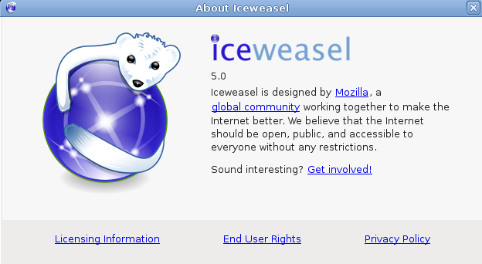
...getting FireFox on Debian Linux
Notes:
Pam: Where Firefox objected to a change that the Debian project made, Debian used the same software with minor changes by gave it a different name

Slide 26
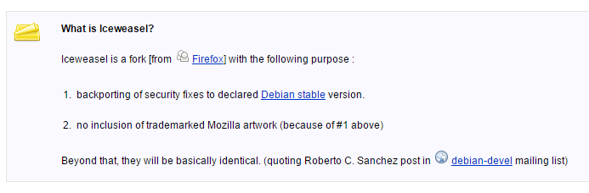
https://wiki.debian.org/Iceweasel#How_to_install_iceweasel_.28Firefox.29
Notes:
Pam

Slide 27
Open Source Brands
Open source brands work differently - when building your own, or using others
Notes:
Shane - “Open Source” has strong associations in the industry with both technology itself and the brands around it, and it’s important to understand how that shapes business goals and perceptions of both business and technical leaders around trademarks.

Slide 28
Open Source Projects Encourage Sharing
Vendor marketing including an open source brand helps build ecosystem, brings additional contributors to the project
Project as origin still important to the community
Notes:
Shane: Many open source groups allow broader use of their brands and trademarks by vendors in the hopes that vendor marketing (often better funded and organized than community marketing) will bring more contributors to the open source project itself.
So while ensuring the brand of the underlying product still stands for a single source of the open source product itself, most groups welcome vendors talking about their community brand and featuring it at events, in materials, and in the vendor’s own products and services.
This may be a combination name for a product - “SuperProduct uses OpenSource to run faster” - a recognition of the source of some of the underlying software your client is selling within their own product.

Slide 29
Using An Open Source Brand
Projects will allow outside use of their brands - shows support of their ecosystem, and helps grow their community
But still need to respect policy; not a blanket license or permission
Often freely permit brand use on stickers, apparel, some kinds of services
Give credit to the project’s community
Notes:
Shane: Importantly, Just because an open source project doesn’t mark their trademarks or have an obvious policy, they will get upset if you misuse their good name. Open source wants vendors to talk about their project, but to keep it clear that it’s the community project the vendor is building something on top of or using as a plugin.
Note that many projects are much more permissive when it comes to non-software goods. When your marketing team gives out Apache Lucene® stickers at an event, that helps drive awareness of the open source project itself, separately from your client’s products - as well as perhaps your client’s hosting or consulting services that are built around the underlying software. In many cases, the open source groups will welcome this - as long as they’re getting the credit for the specific products they built.

Slide 30
Trademark Guidelines Are an Important Tool
Open source project guidelines will often grant licenses, especially for promotional goods
It will also describe lawful use for clarity
Referential use
Resale
The project itself is expected to follow the guidelines too
Notes:
Pam: Enforcement often starts with guidelines
Trademark guidelines for open source projects may actively grant permission
The project itself will follow the guidelines
Trademark guidelines for proprietary companies are just what you can’t do

Slide 31
Creating Your Own Open Source Brand
When building open source brands, understand that others will want to integrate the brand into their own work
Carefully consider what goes into the open source brand (vs. proprietary brand)
Publish a clear policy defining and encouraging community engagement
Notes:
Shane: The biggest question when a client decides to “open source” one of their own products is deciding what, exactly, is going in the open source part - and what will stay proprietary. Ensure clients have a clean separation between the two halves of the product - and a separation between the two brands.
Publishing a specific trademark policy for any open source brands is important to help set expectations for the ecosystem. To be taken seriously with an open source product, your client needs to clearly define what and how they are sharing the project direction with the community - or not.
Remember: the open source community can drive a lot of innovation back to your client - but open source participants lack the legal experience to know up front how they can or should use the brand you’re promoting as “open source”. Don’t be surprised by what the community does.

Slide 32
Enforcing Your Open Source Brand
The community is often highly engaged in enforcement
While there is a nominal owner, the community members are equal stakeholders and may be involved in decisionmaking
Because of the sharing culture, enforcement has to be approached delicately
Notes:
Pam

Slide 33
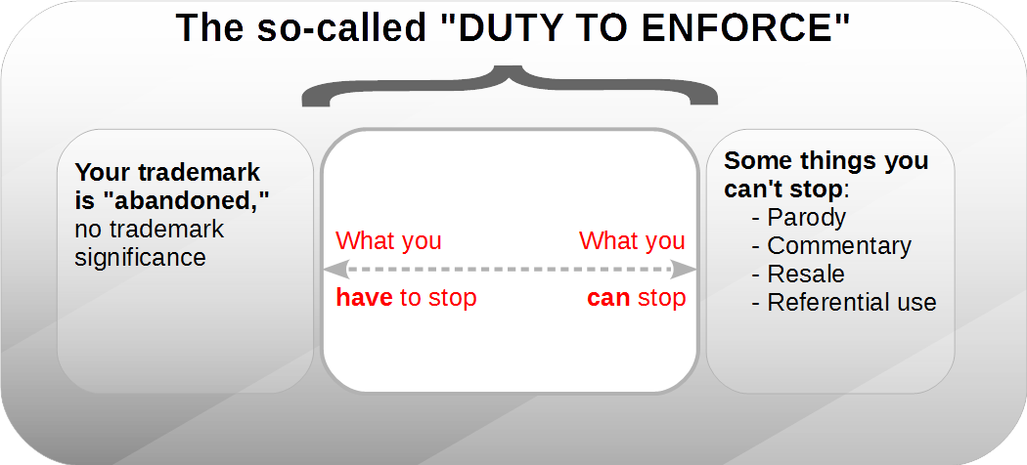
Notes:
Pam: When do you really need to enforce?

Slide 34
Conflicts With Open Source Brands
Open source groups react differently when you misuse their brand
Enforcement likely to be social and technical, not legal
Do not underestimate how important an open source brand is to its community
Notes:
Shane: If your client is accused of misusing an open source brand, stop and discuss with the client’s technology leaders first before making contact. The deeper business factors around major open source groups may be more important than the legal details of trademark law.
Overzealous marketing departments regularly go too far when trying to capitalize on someone else’s open source brand - and communities and brand owners often react very passionately. There will be cases where your client might have the legal right to use an open source brand in some way, but exercising that right will cause business harm to your client from the bad publicity and backlash from the larger ecosystem.
Open source groups often don’t have sufficient legal counsel to write complaints - so don’t ignore complaints from other project members or officers who might not be lawyers themselves.

Slide 35
Conflicts With Open Source Brands
Be prepared for adverse publicity
Be prepared for negotiating with a collective
Be prepared for a strongly absolute position
It’s unlikely a settlement will be confidential
Notes:
Pam: point 1 clear
Point 3: The other party can’t buy their way out of the problem; too many stakeholders to consider. The project won’t force any community member to take on the burden
Point 4: culture of sharing and transparency means openness in every way

Slide 36
Resources
Learning about the open source perspective.

Slide 37
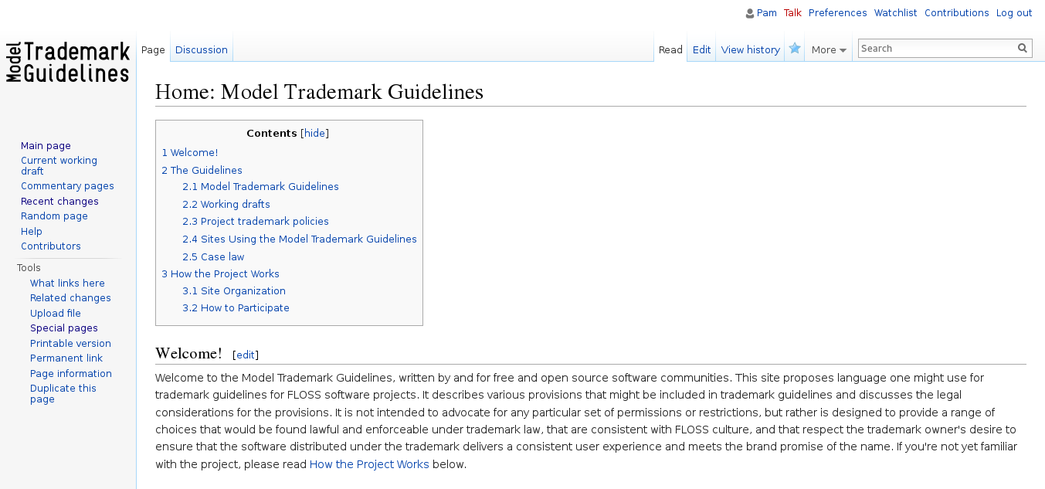
http://modeltrademarkguidelines.org/

Slide 38
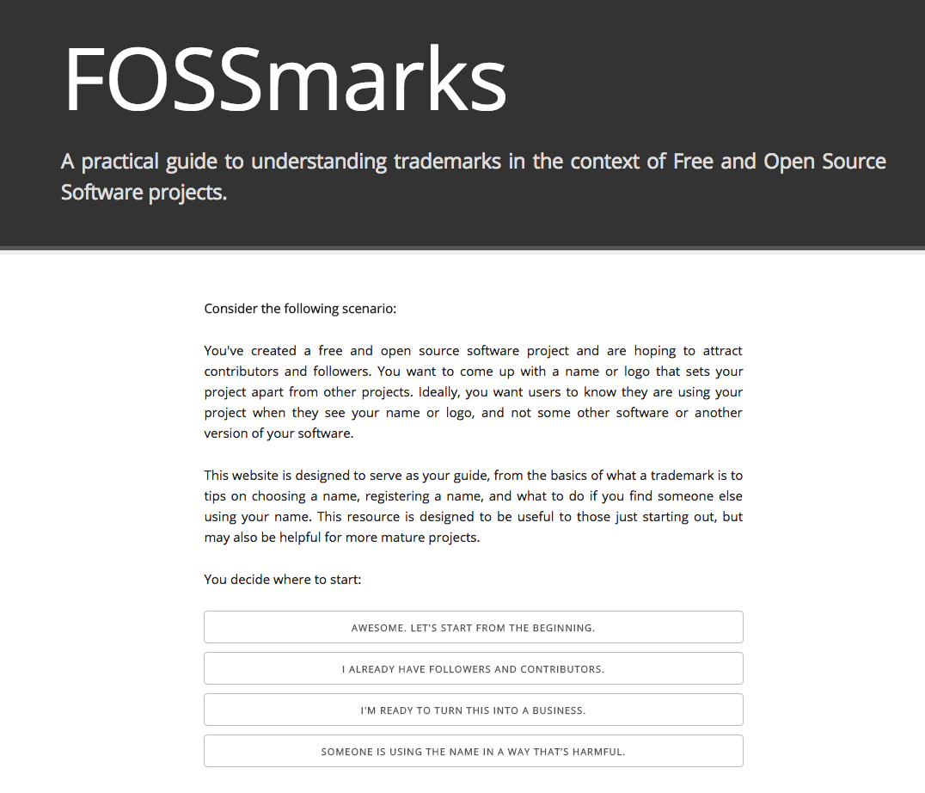
http://fossmarks.org/

Slide 39
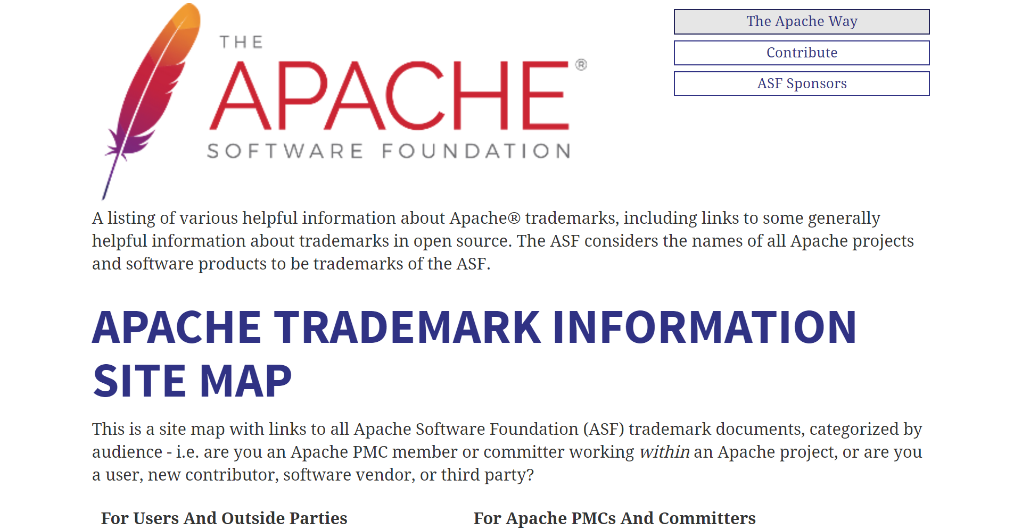
https://www.apache.org/foundation/marks/resources

Slide 40
Credits / License
Slides Apache-2.0
Presentation template by SlidesCarnival (CC-BY)
Presented at PLI: Open Source Software 2018 - From Compliance to Cooperation
November 28, 2018

Slide 41
Thanks!
Any questions?
You can find us at:
@ShaneCurcuru
@PChestek
🐱

